Slide 1
GEO and GEOSS status 10th SDCG Osamu Ochiai GEO Secretariat 7 September 2016 Reading, UK

Slide 2
Unique Time in GEO’s History
Transition to next decade 2016-2025
Recognition of GEO’s convening power – Members, POs, Development Banks, Foundations, emerging Private Sector
Evolution & Recognition of Policy Mandates
New Strategic Plan with new programmatic mechanisms – community activities, foundational tasks, initiatives and flagships

Slide 3
Governance
The GEO Plenary
103 Member Countries, 103 Participating Organizations, 12 Observers
The GEO Executive Committee
Africa: Egypt, Senegal, South Africa
Americas: Colombia, Mexico, United States
CIS: Armenia, Russia
Asia/Oceania: Australia, China, Japan, Korea
Europe: EC, Finland, France, Germany
Observers from Program Board: CEOS, GOOS, WMO
The GEO Programme Board
Oversees the establishment of the multi-year GEO Work Programmes
42 members from GEO Members and Participating Organizations
The GEO Secretariat

Slide 4
Societal Benefit Areas

Slide 5
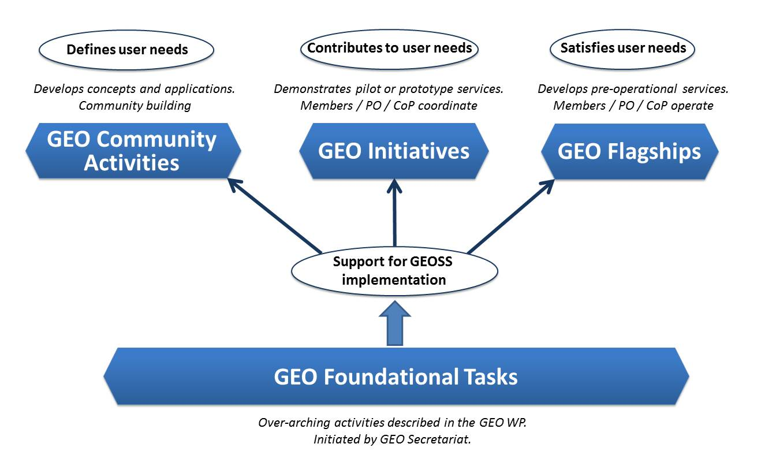
Four Types of GEO Activities

Slide 6
SBAs, Community Activities and Initiatives
SBA | GEO Initiatives |  | Community Activities
 | GI-02 | GEOBON-Global Biodiversity Observation (GEO BON) | CA-29 | Using Geospatial Data to Identify and Monitor Ecosystem Service and Track in a Natural Capital – Ecosystems Accounts Framework
 | GI-03 | GFOI Global Forest Observation Initiative | CA-30 | Harmful Algal Bloom (HAB) Early Warning System
 | GI-14 | GECO: the GEO Global Ecosystem Initiative | CA-31 | For Global Mangrove Monitoring
 | GI-15 | GEO-GNOME Initiative: GEO Global Network for Observation and information in Mountain Environments
 | GI-08 | GEO Geohazard Supersites and Natural Laboratories (GSNL) | CA-23 | Space and Security
 | GI-09 | Global Wildfire Information System | CA-26 | Towards Chinese tsunami mitigation system under GEO framework
 | GI-16 | GEO-DARMA = Data Access for Risk Management (to support the implementation of Sendai framework). | CA-27 | Foster Utilization of Earth Observation Remote Sensing and In Situ Data for All Phases of Disaster Risk Management (new-CEOS)
 |  |  | CA-28 | Global Flood Risk Monitoring
 | GI-10 | EO data and renewable energies | CA-06 | EO data and mineral resources (Includes Impact Monitoring System for Geo-Resource Exploration and Exploitation)
 |  |  | CA-25 | Africa Global-scale Geochemical Baselines for mineral resource and environmental management: Capacity-building phase

Slide 7
SBAs, Community Activities and Initiatives
SBA | GEO Initiatives |  | Community Activities
 | GI-01 | GEOGLAM-Global Agricultural Monitoring and Early Warning
 | GI-04 | Global Observing System for Mercury and Persistent Pollutants | CA-07 | Integrated Water-cycle Products and Services - Overall coordination
 | GI-12 | Integrated Information Systems for Health (Cholera, Heat waves) | CA-14 | GEO Water Quality
 | GI-13 | Integration of Methods for Air Quality and Health Data, Remote Sensed and In-Situ with Disease Estimate Techniques | CA-18 | Water Cycle Integrator (WCI)
 |  |  | CA-19 | E2E Water Indicators
 |  |  | CA-22 | Linking water tasks with wider societal benefit areas and the post-2015 global development framework
 | GI-17 | Global Urban Observation and Information | CA-24 | Earth Observation in Cultural Heritage documentation
 | GI-21 | Human Planet Initiative

Slide 8
SBAs, Community Activities and Initiatives
SBA | GEO Initiatives |  | Community Activities
 | GI-11 | Information Services for Cold Regions | CA-07 | Integrated Water-cycle Products and Services - Overall coordination
 | GI-20 | GEO Global Water Security (GEOGLOWS) | CA-08 | Water Vapor and Clouds (Aerosol & Precipitation)
 |  |  | CA-09 | Precipitation
 |  |  | CA-10 | Evapotranspiration (and Evaporation)
 |  |  | CA-11 | Soil Moisture
 |  |  | CA-12 | River Discharge
 |  |  | CA-13 | Groundwater
 |  |  | CA-14 | GEO Water Quality
 |  |  | CA-15 | Water Cycle Capacity Building
 |  |  | CA-16 | Global Drought Information System (GDIS)
 |  |  | CA-17 | GEO Great Lakes Activity
 |  |  | CA-18 | Water Cycle Integrator (WCI)
 |  |  | CA-19 | E2E Water Indicators
 |  |  | CA-20 | EartH2Observe
 |  |  | CA-21 | Total Water Prediction: Observations Infrastructure
 |  |  | CA-22 | Linking water tasks with wider societal benefit areas and the post-2015 global development framework

Slide 9
GEO Initiatives not associated with one SBA
GI-05 | Global Carbon Observation and Analysis System | Climate
GI-06 | Reinforcing engagement at regional level: AfriGEOSS for Africa | Regional coordination
GI-19 | AmeriGEOSS (new)
GI-22 | Asia-Oceania GEOSS –Asia-Oceania regional comprehensive earth observation application system
GI-07 | Ocean and society - Blue Planet
GI-18 | GEO and SDGs. EOs role in providing support to countries in achieving SDGs and in defining and monitoring the associated indicators.

Slide 10
Community Activities not associated with one SBA
CA-01 | Global Land Cover
CA-02 | Land Cover for Africa
CA-03 | Access to model data in GEOSS | Climate
CA-04 | Strengthen collaboration between GEO and GFCS
CA-05 | TIGGE (Thorpex Interactive Grand global Ensemble) evolution into a Global Interactive Forecast System (GIFS)
CA-32 | Research Data Science Summer Schools | Capacity Building
CA-33 | Building capacity for Forest Biodiversity in Asia and the Pacific Region
CA-34 | Multi-source Synergized Remote Sensing Products and Services | Support to GEOSS

Slide 11
Foundational Tasks – Current List
GD | GEOSS Development and GCI Operations
GD-01 | Advancing GEOSS Data Sharing principles
GD-02 | GCI Operations (including access to Knowledge)
GD-03 | Global Observing and Information Systems (new) (includes systems like WIGOS. GCOS; …. And reference datasets)
GD-04 | GEONETCast Development and Operations
GD-05 | GEOSS satellite Earth Observation Resources (includes advocacy for continuity)
GD-06 | GEOSS in situ Earth Observation Resources (includes inclusion of citizens’ observatories) (includes advocacy for continuity)
GD-07 | GCI Development (includes development of Data Management guidelines)
GD-08 | SBAs processes: Systematic determination of user needs / observational gaps
GD-09 | Knowledge Base development
GD-10 | Radio-frequency protection
GD-11 | Utilization of Communication Networks
CD | Community Development
CD-01 | Capacity Building coordination
CD-02 | Reinforcing engagement at national and regional level
CD-03 | Assess the benefits from EOs and of their socio-economic value
SO | Secretariat Operations
SO-01 | Management and Support
SO-02 | Communication and Engagement
SO-03 | Monitoring and Evaluation
SO-04 | Resources Mobilization

Slide 12
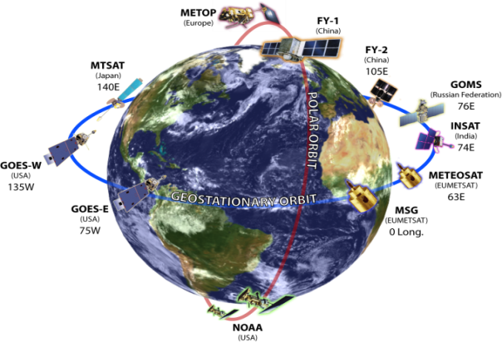
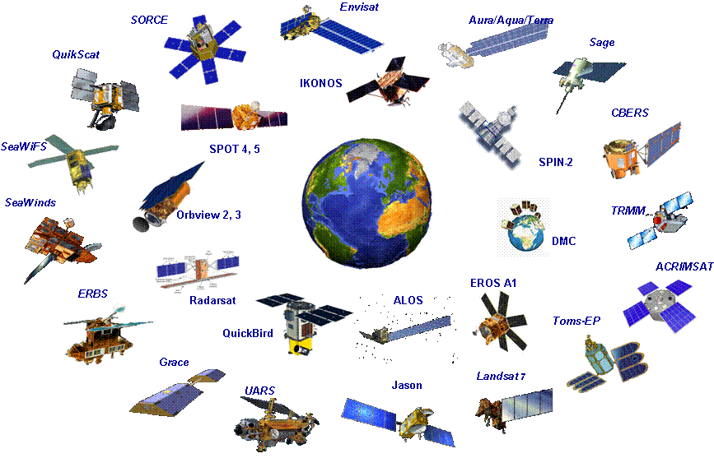
Strengtheninig Space-based Coordination
Climate Change
GEO & 2030 Agenda

Slide 13
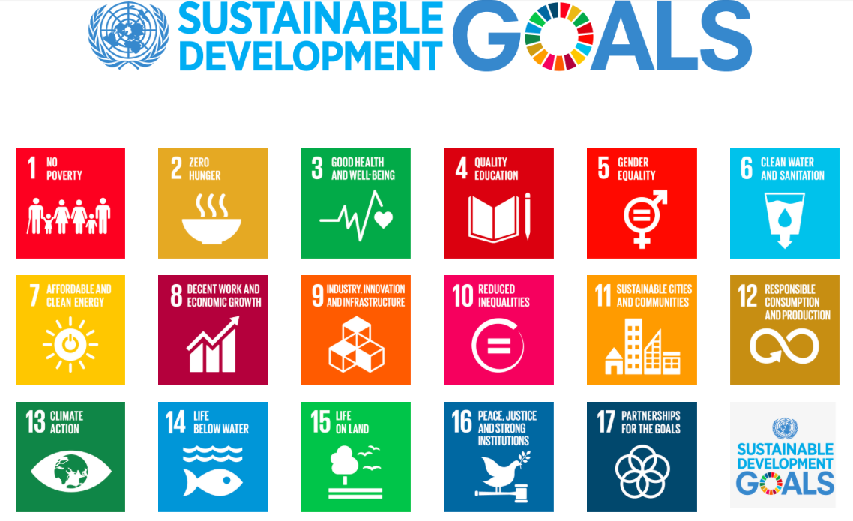
Transforming Our World: The 2030 Plan for Global Action - Article 76: “We will promote transparent and accountable scaling-up of appropriate public-private cooperation to exploit the contribution to be made by a wide range of data, including Earth observation and geo-spatial information, while ensuring national ownership in supporting and tracking progress.”

Slide 14
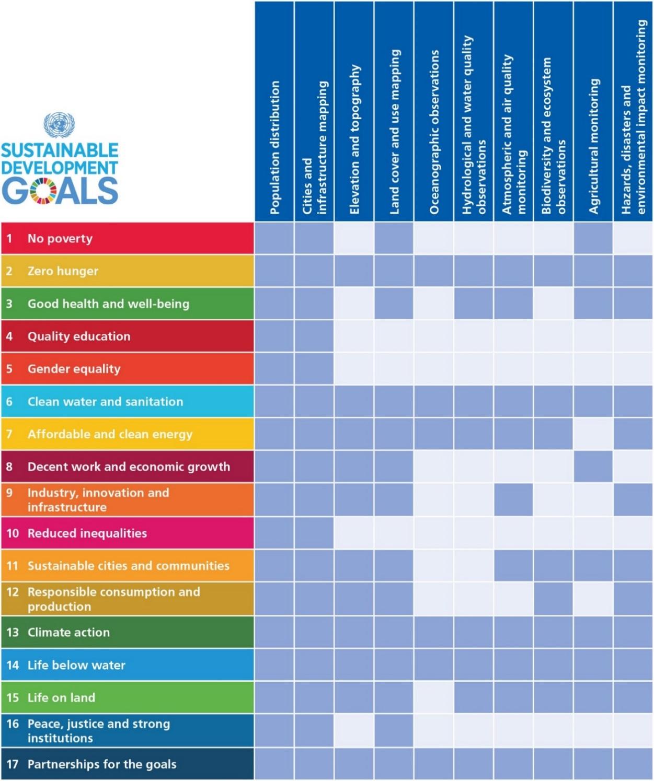
Earth Observations and
Geospatial Information
Support to SDGs
Direct measures of some Indicators and indirect support to others.
Contribute to progress on the Targets, which will show up in the Indicators.

Slide 15
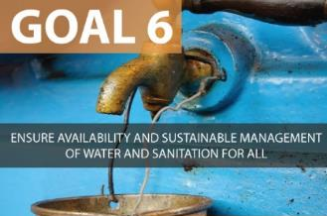
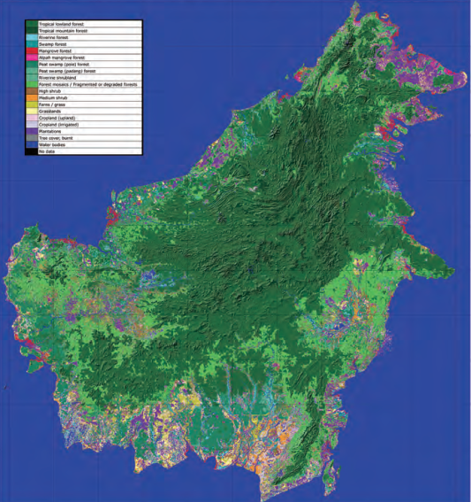
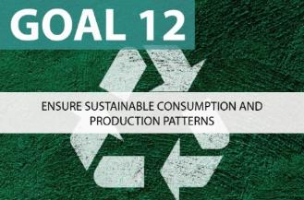
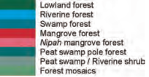
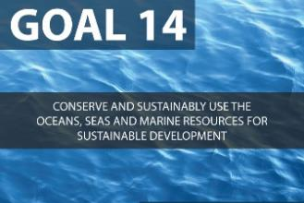
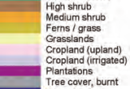
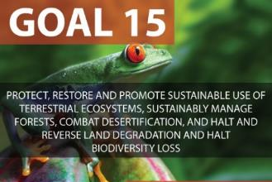
Land Use and Land Cover Mapping
Borneo Island
Forest and land cover map featuring 18 classes
Source: JAXA EORC; CEOS EO Handbook. ALOS PALSAR image, 2007; Sarvision (NL)
Notes:
Images for slide provided by JAXA EORC (Japan Aerospace Exploration Agency, Earth Observation Research Center)
Image acquired from ALOS PALSAR (Phased Array type L-band Synthetic Aperture Radar); acquired in 2007
Map available through CEOS Earth Observations Handbook produced by CEOS and ESA.
http://www.eohandbook.com/eohb2014/case_studies_global_forest_observations_for_carbon_tracking.html
and
http://www.eohandbook.com/eohb2014/images/part_2_images/5.3_image_05_large.jpg

Slide 16
UNFCCC COP21 Subsidiary Body for Scientific and Technological Advice (SBSTA)
30. The SBSTA recognises the importance of: GEO, including its implementation plan for GEOSS; collaboration between GEO and GCOS; and of capacity building on systematic observation, inter alia, to enable developing countries to apply climate observations for impact assessment and preparation for adaptation. The new GEO Strategic Plan 2016-2025 establishes three Strategic Objectives – Advocate, Engage, Deliver – and emphasizes climate change and its impacts as a cross-cutting area, and strengthens the societal benefit areas making them more focused on the needs of society to support processes under the UNFCCC, the UN Sendai Framework for Disaster Risk Reduction, the SDGs and other UN agencies.

Slide 17
G20 Meeting of Agricultural Ministers Action Plan on Food Price Volatility and Agriculture Paris, France, June 2011
32. In order to improve crop production projections and weather forecasting, with the use of modern tools, in particular remote sensing tools, we decide to launch, via the Group on Earth Observation, an international voluntary network of agricultural production monitoring based on geoinformation. This “Global Agricultural Geo-Monitoring Initiative” will be a useful input for AMIS concerning the provision of more accurate crop forecasts data.

Slide 18
G7 Science Ministers
“Fundamental to the progress of open science is the continued investment by governments and others, such as the Group on Earth Observations’ Global Earth Observation System of Systems (GEOSS), in suitable infrastructures and services for data collection, analysis, preservation and dissemination.”
Communiqué
Meeting of the G7
Ministers of Science and Technology
Tsukuba, 13-14 May 2016

Slide 19
GEOSS Implementation requires: Data Sharing Principles
Full and Open Exchange of Data
Data and Products at Minimum Time delay and Minimum Cost
Free of Charge or Cost of Reproduction
Notes:
See slide text

Slide 20
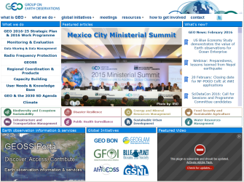
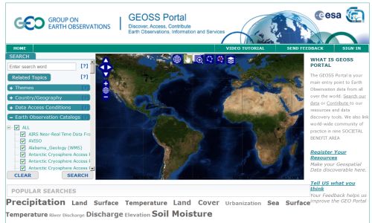
Climate/Weather
Cryosphere
GEO
Website
International Providers
Biodiversity
Disasters
GEO
Website
Energy
Geology/Soil
GEOSS
Portal
Environment
Health
Ocean
Satellites
Discovery and
Access Broker (DAB)
Water
Regional & National Providers
Australia
Brazil
Canada
Chile
China
France
Germany
Japan
Italy
New Zealand
Norway
Private sector providers
Switzerland
USA
Russia
South Africa
Spain
…
… more than 100 public providers…

Slide 21
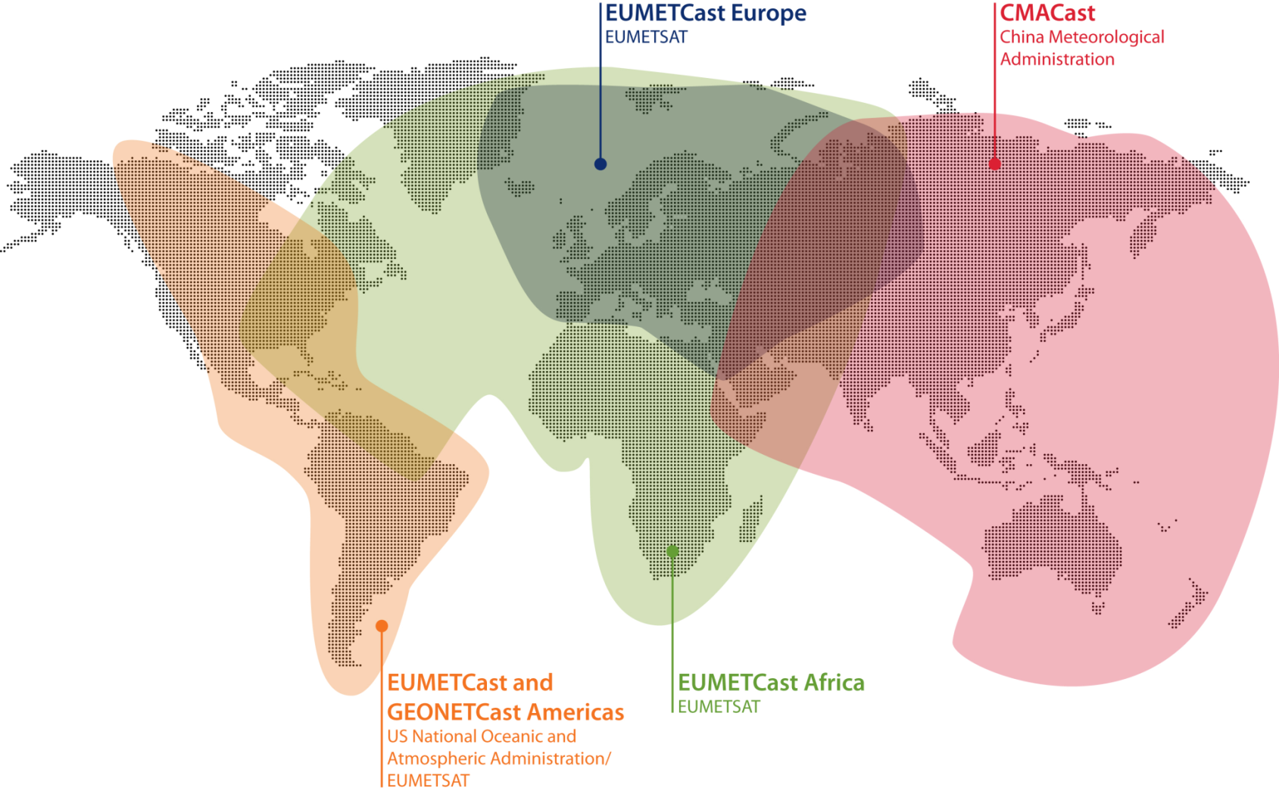
GEONETCast
3009 users
2680 users
238 users
97 users
Notes:
Changed CMACast to 2680 based upon last GNC telecon
How many stations does EUMETCast Americas have ?
I will add what I have for GNC-A stations to your total.

Slide 22
Expectations to SDCG
Enhance the SDCG success story to CEOS overall satellite coordination mechanism
Potential linkage to other GEO Tasks
GFOI datasets to other tasks
Share knowledge
Link SDCG Element 3 (Data Supply) to the GCI and GEONETCast
GCI – register SDCG datasets
GEONETCast – possibility to use the satellite based data dissemination to developing countries (maybe through GEO regional initiatives)

Slide 23
GEO-XIII Plenary
St. Petersburg, Russia
9-10 November 2016
http://www.earthobservations.org
Twitter: @geosec2025 @barbararyangeo
Facebook: Group on Earth Observations

