Slide 1
SESSION 4: GFOI Space Data Strategy
SDCG-10: Reading, 7-9 September, 2016

Slide 2
Space Data component heritage
The CEOS Space Data Coordination Group for GFOI has worked with the world’s largest providers of Earth observation data to ensure that all countries have access to the satellite data required for national forest monitoring and annual reporting of greenhouse gas emissions and forest carbon stocks to the UNFCCC under the provisions of REDD+ and consistent with IPCC guidelines
Notes:
I would second what Steve has said. We need to encourage large implementation supporters like GIZ to consider seeing GFOI as an approach whose MGD and supporting data can ensure fidelity and acceptance of their investment in national MRV systems. Its an insurance policy to guarantee the results of the investment in a policy context. If they were to require consideration of GFOI as part of their aid project process it would be ideal. I guess you will not be so explicit but you should show the path…?
For me, the important issue for us is to maximise the different paths for delivery of services to the final users. This can be done by FAO, by Silvacarbon, through Australia/ClInton but I would like to be less dependent on, especially, FAO hence my attempts to get UK and Germany involved. Ideally we would have the infrastructure of GFOI - data, MGD, CapB and R&D - helping to support a range of delivery mechanisms, as broad as possible, with no extra effort in principle. Hence what we would really like is for GFZ to support in-country activities and service delivery using the GFOI data/MGD, and as part of the overall GFOI partnership. I hope UK will also do so.

Slide 3
CEOS Space Data Strategy for GFOI - 3 Elements:
Implementation of Baseline Global Data Acquisition Strategy
Space Data Services Available
Data Supply in Support of GFOI R&D Activities
Publicly open (“core”) satellite data, phased implementation - full global coverage by 2016.
A coordinated strategy for national data acquisitions accommodating countries’ specific technical requirements, heritage, and experience.
Covers a wider range of satellite data sources, including commercial.
Includes support for science studies assisting the development and evolution of the MGD for GFOI and addressing specific country needs.
Assuring the availability of consistent time-series of optical and radar (SAR) satellite data over global forest cover.
At least one annual national cloud-free optical coverage over each country.

Slide 4
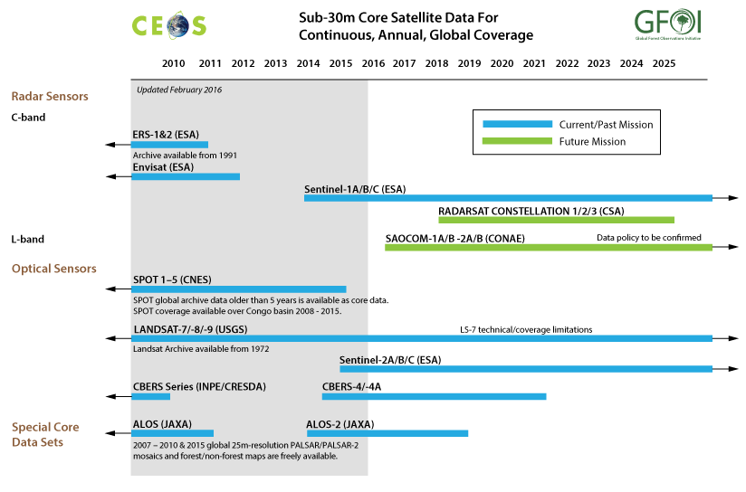
SDCG Data Streams – Core free and open

Slide 6
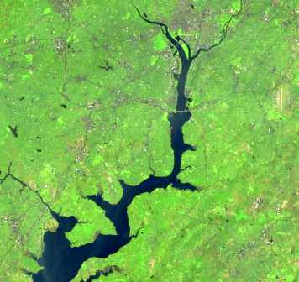
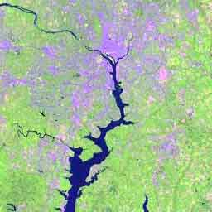
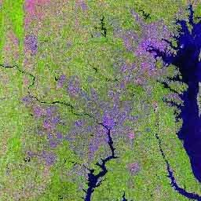
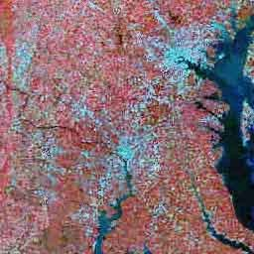
U.S. Landsat Archive Overview (February 1, 2016)
OLI-TIRS: Landsat 8: 660,847 scenes
~ 2,285 TB Raw and L0Ra Data
average scene size 1813 MB
ETM+: Landsat 7: 2,057,361 scenes
~ 1,911 TB Raw and L0Ra Data
average scene size 487 MB
TM: Landsat 4 & Landsat 5: 2,196,703 scenes
~ 1,101 TB Raw and L0Ra Data
average scene size 263 MB
MSS: Landsat 1 through 5: 1,300,419 scenes
~ 79 TB Raw and L0Ra Data
average scene size 32 MB
Total: 6,215,330 scenes
~ 5,376 TB Raw and L0Ra Data

Slide 7
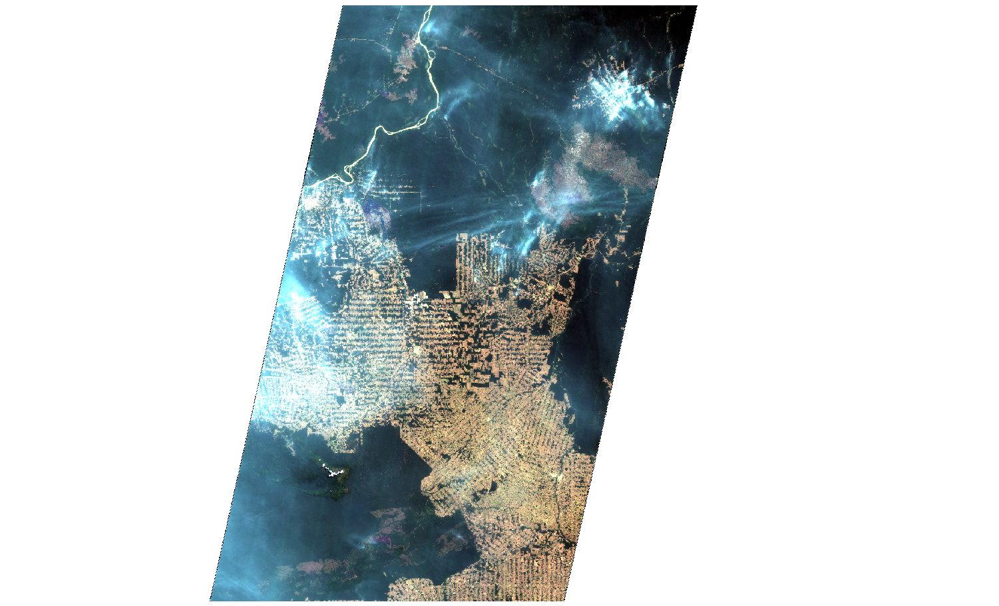
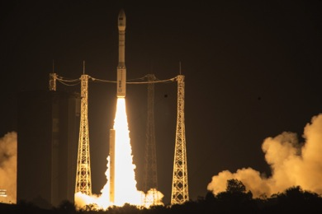
New Core Data: Sentinel-2
Sentinel-2A launched on 23 June 2015
Data available publicly online
➔ https://sentinel.esa.int/
⬅ 290 km ➔
Notes:
Example over Amazon forest in Brazil ➔ zoom to full resolution

Slide 8
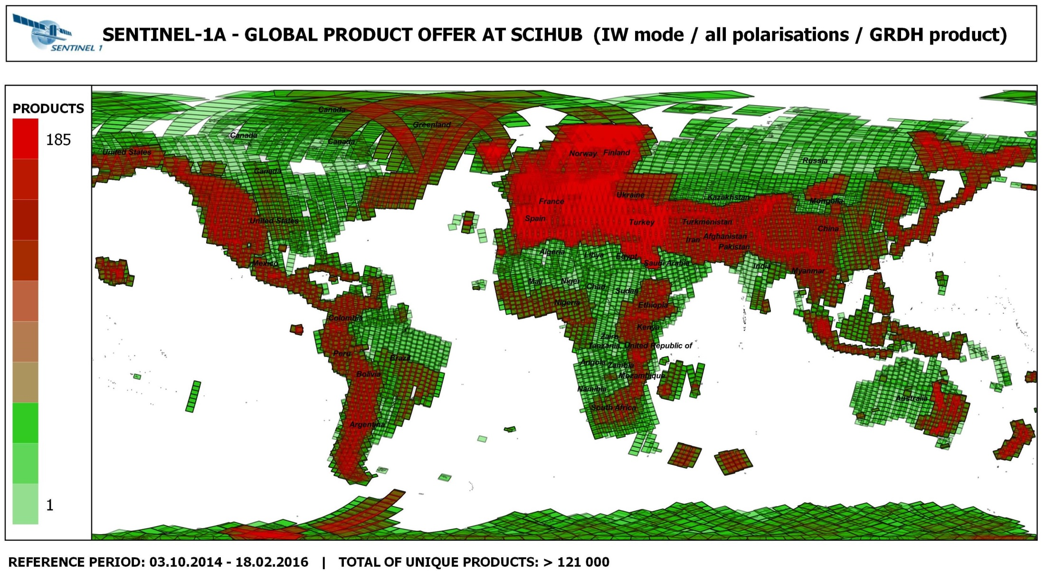

Slide 9
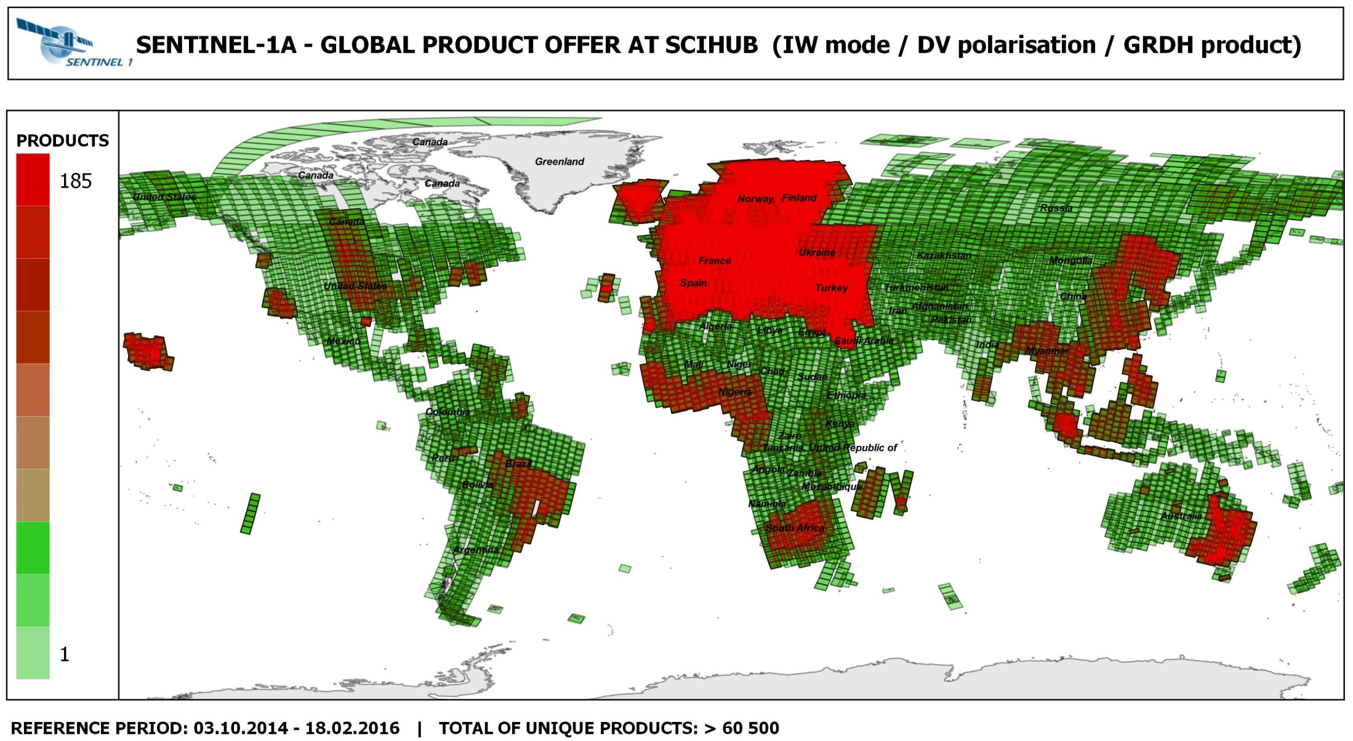

Slide 10
Space Data Support to GFOI R&D (Element-3)
Complement to the Global Baseline Data Acquisition Strategy (Element-1) and National Space Data Services Strategy (Element-2)
R&D focus provides a mechanism also for space agencies and data providers with commercial satellite missions to support GFOI aims
Developed to support the GFOI R&D Component needs for satellite data which are not available through the “core” missions:
Very High Resolution (optical and radar)
Radar (L-, C-, X-band SAR) data
Research undertaken by international team of experts managed by the GFOI R&D component (details in separate presentation)
Ultimate aim to help progress high priority applications – which are not yet included in the MGD – to operational status.

Slide 11
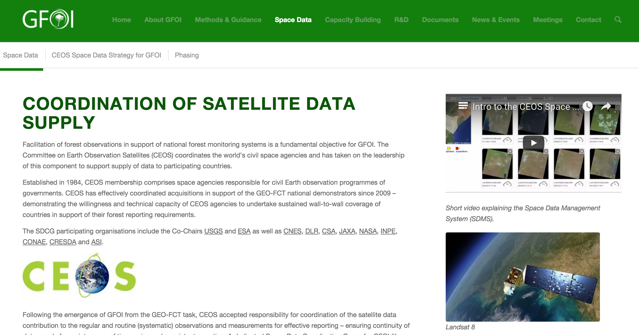
Thanks
http://www.gfoi.org/space-data/

Slide 12
SESSION 4: UK Session – Moderated Discussion Points
SDCG-10: Reading, 7-9 September, 2016

Slide 13
Session 4 Discussion Points
Are there UK projects underway or planned that might benefit and/or benefit from a linkage to GFOI?
Relevant to any of the components: space data, MGD, R&D, capacity building.
How do we make the connections to realise those benefits?
Is there technical work underway within UK community that might benefit and/or benefit from a linkage to GFOI
Relevant to any of the components: space data, MGD, R&D, capacity building.
How do we make those connections?

