Slide 1
Partnering to Measure Forest Carbon
September 2016

Slide 2
SILVACARBON PARTNERS
U.S. Agency for International Development
U.S. State Department
U.S. Geological Survey
U.S. Forest Service
NASA
U.S. Environmental Protection Agency
NOAA
Smithsonian Institution
As well as U.S. universities, NGOs, donors and industry

Slide 3
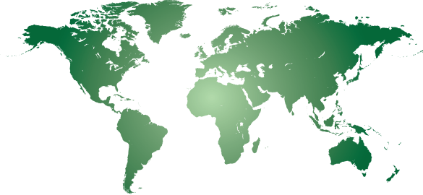
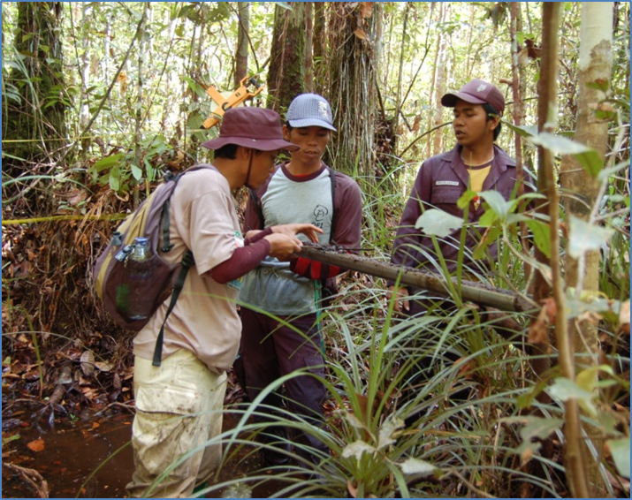
PARTNER COUNTRIES
Americas
Belize
Brazil
Colombia
Costa Rica
Ecuador
El Salvador
Guatemala
Honduras
Mexico
Nicaragua
Panama
Peru
Asia
Bangladesh
Cambodia
Indonesia
Lao PDR
Nepal
Philippines
Thailand
Vietnam
z
z
z
z
z
z
z
z
z
z
z
z
z
z
z
z
Africa
Cameroon
DR of Congo
Gabon
R of Congo
Zambia
z
z
z
z
z
z
z
z
z
Engagement through bilateral and regional activities, research, and in-country technical advisors

Slide 4
What are the specific needs of REDD+ countries in terms of forest monitoring and MRV
Needs assessment varies among countries, the person asked in the country, and the program conducting the assessment
Governance (legal frameworks, mandates and institutionalization of REDD+ processes)
Capacity to set reference levels, and monitoring safeguards
Technical, financial and administrative support
Need to implement National Forest Monitoring Systems for other purposes beyond REDD+
REDD projects in states and provinces for some regions (SE Asia)
Emerging technologies

Slide 5
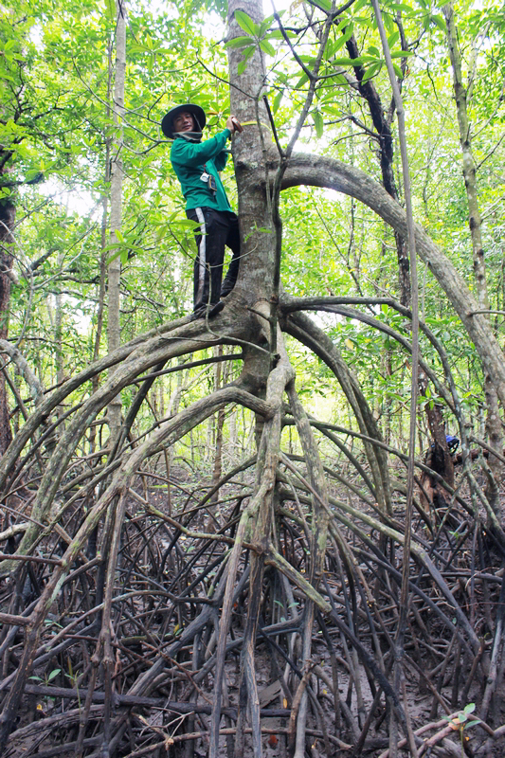
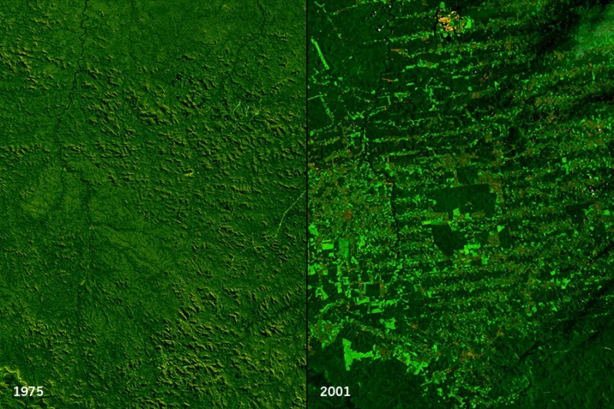
How is SilvaCarbon helping to meet country needs
Improved Forest Inventories
Improved remote sensing
Integration of remotely sensed and in situ data
GHG inventory and reporting (ALU tool)
2011
Goddard Space Flight Center Scientific Visualization Studio/NASA
Rondoña, Brazil – Human deforestation impact

Slide 6
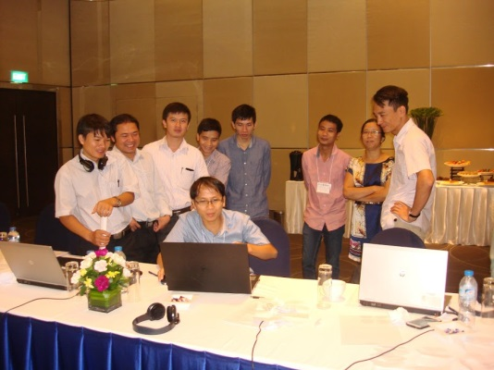
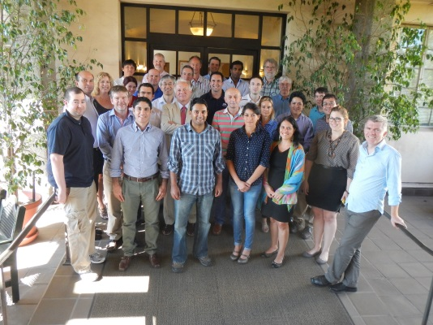
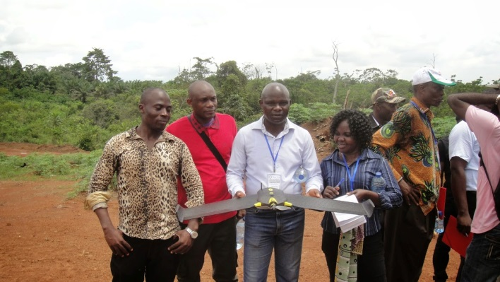
REMOTE SENSING
Does not developed tools, but support the development and testing of tools.
Present all GFOI capacity building efforts supporting forest cover mapping for reporting to REDD+
Support countries establish partnerships and implementing remote sensing methodologies
Promote research around EO for forest monitoring

Slide 7
REMOTE SENSING
Does not developed tools, but support the development and testing of tools.
Present all GFOI capacity building efforts supporting forest cover mapping for reporting to REDD+
Support countries establish partnerships and implementing remote sensing methodologies
Promote research around EO for forest monitoring

Slide 8
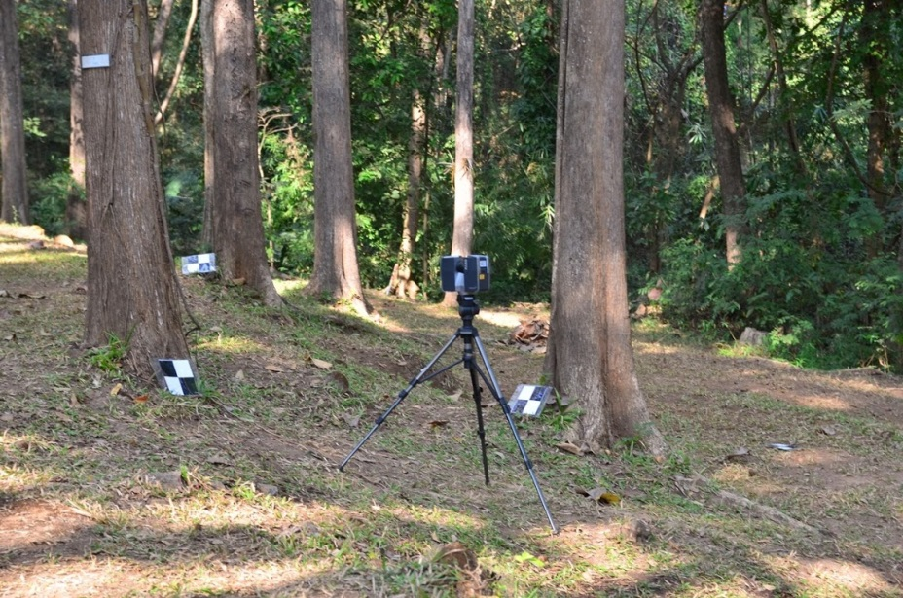
REMOTE SENSING
Regional GFOI Workshops
14 in Latin-America
https://sites.google.com/site/talleresgeofct/
5 in SE Asia
https://sites.google.com/site/gfoiseasiacapacitybuilding/
2 in Central Africa
https://sites.google.com/site/gfoiafricacapacitybuilding/home/first-gfoi-forest-monitoring-workshop
Objectives
Showcase operational methodologies for different aspects of forest monitoring
Provide and space for discuss new cutting edge research methodologies
Provide an space for testing and demonstration of field methods using new technologies

Slide 9
REMOTE SENSING
Does not developed tools, but support the development and testing of tools.
Present all GFOI capacity building efforts supporting forest cover mapping for reporting to REDD+
Support countries establish partnerships and implementing remote sensing methodologies
Promote research around EO for forest monitoring

Slide 10
REMOTE SENSING
Does not developed tools, but support the development and testing of tools.
Present all GFOI capacity building efforts supporting forest cover mapping for reporting to REDD+
Support countries establish partnerships and implementing remote sensing methodologies
Promote research around EO for forest monitoring

Slide 11
How SilvaCarbon benefit from engagement with GFOI
Open collaboration with others not only US. In the case of SE Asia and Africa, these synergies are key
Avoid duplication among partners in same developing countries and create a greater impact
Access to R&D community, use of collective training materials (REDD+ Compass), and access to data providers.
A bigger umbrella to operate

Slide 12
LOOKING FORWARD
FY17-19 strategy
Geographic priorities
Increase bilateral engagement
Enhance synergies with existing multilateral programs (ie, ISFL, FCPF, REDD Early Movers)
Key technical support areas
Support Nationally Determined Contributions (NDCs)
Development of baselines for REDD+ reference levels and NDCs
Expanding beyond forests/REDD+ to the landscape scale
Integration of subnational activities with national strategies

Slide 13
Sylvia Wilson – USGS
snwilson@usgs.gov
More information available at
www.SilvaCarbon.org

