Slide 1
ESA/CNES Spot5Take5 access to R&D Support strategy (Element 3) – Status update
Frank Martin Seifert, ESA
SDCG-10 Session #4

Slide 2
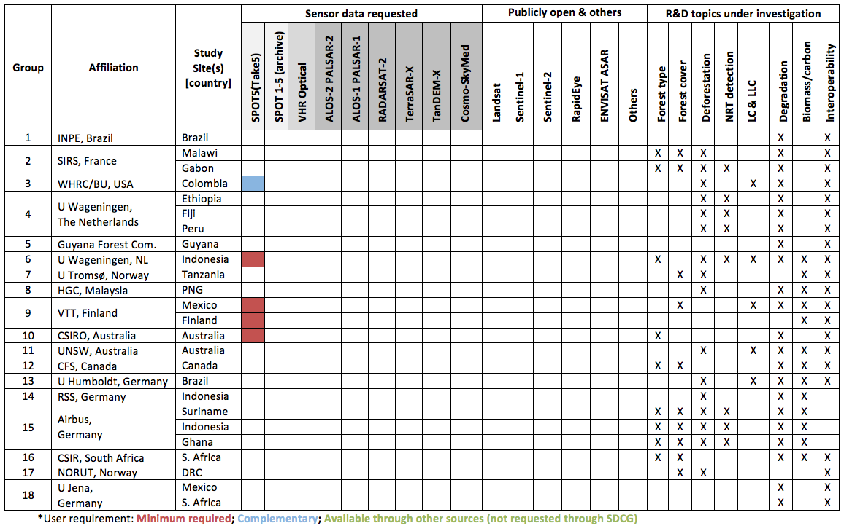
ESA/CNES – Spot5Take5

Slide 3
ESA/CNES – Spot5Take5
Background
From April to September 2015 SPOT-5 was placed in a 5 days cycle orbit to acquires data over 150 selected sites every 5 days under constant angles.
These Sentinel-2 type time series are made available by ESA and CNES to the scientific community to support the development of time series analysis in preparation for the exploitation of the Sentinel-2 mission.
Data provision procedures
Spot5Take5 data are distributed with a free and open policy via the joint ESA-CNES webportal https://spot-take5.org
For R&D purpose non-commercial use

Slide 4
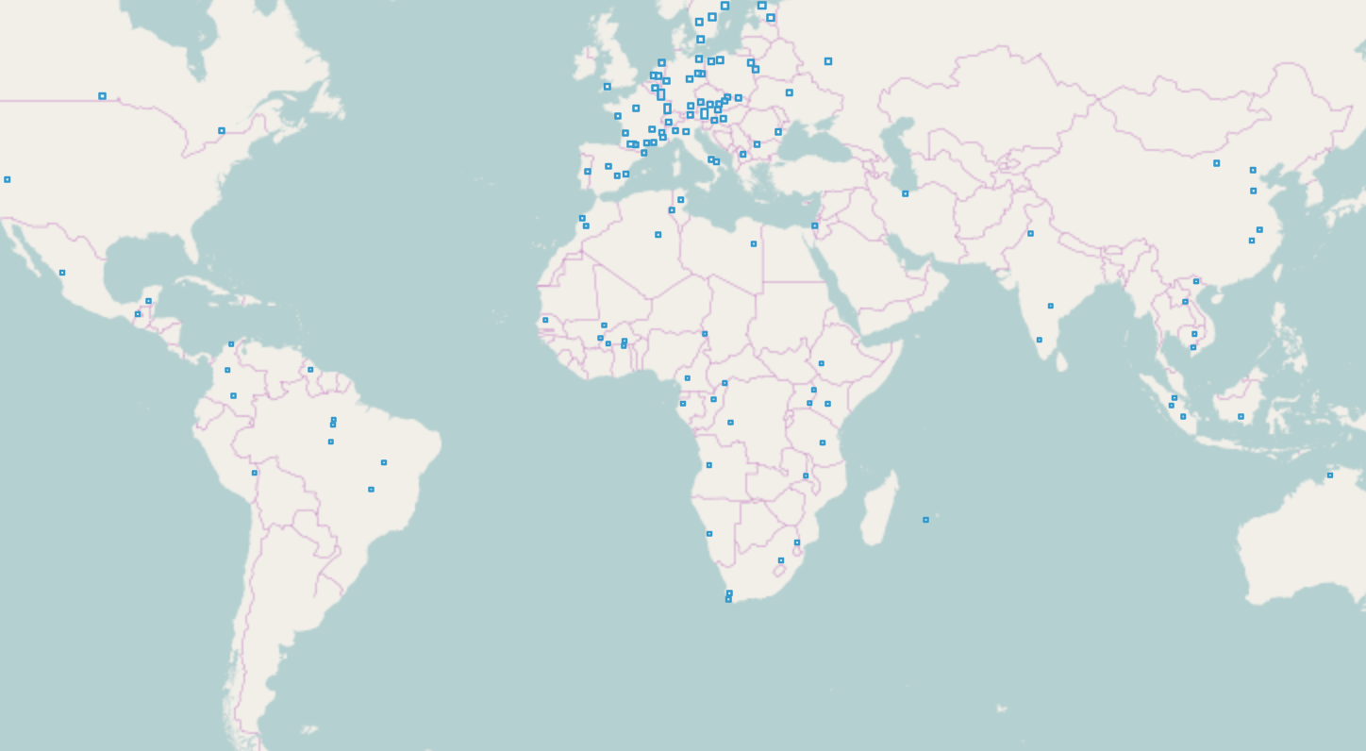
ESA/CNES – Spot5Take5
150 sites globally

