Slide 1
CNES contributions to R&D Support strategy (Element 3) – Status update
Delphine Fontannaz, Cécile Vignolles, Steven Hosford
SDCG-10 Session #4

Slide 2
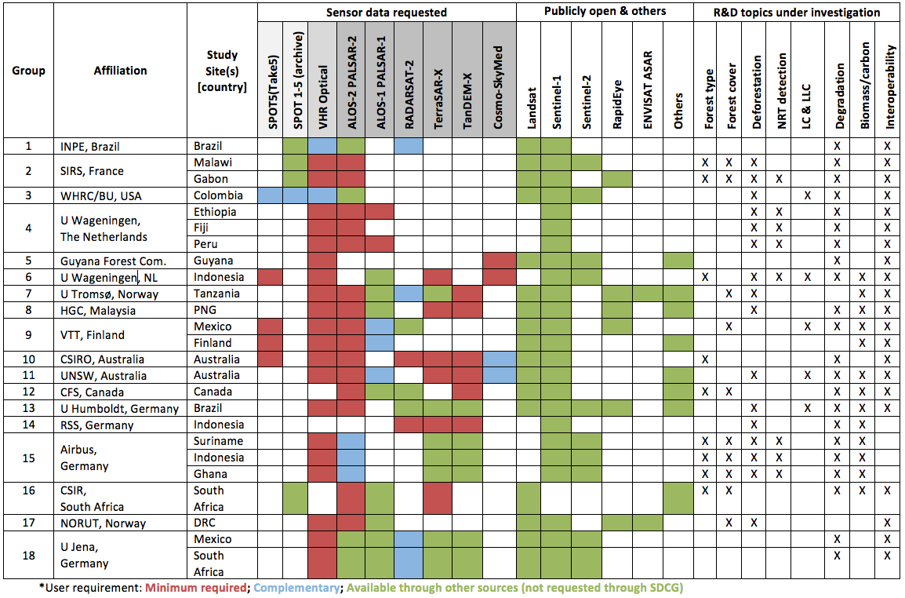
CNES Pléiades
GFOI R&D group satellite data requirements (El-3 v2.1)

Slide 3
CNES Pléiades
Approved support
Group 1 Brazil Mato Grosso 4200km2
Group 2 Private company Not possible
Group 3 Colombia La Victoria COL-7_VHR.kml 100km2 in 2016 and 2017. Also for archive data back to Pléiades launch (1 coverage/an).
Group 4 Ethiopia/Fiji/Peru total 3000km2 for 2016
Group 5 Guyana 3000km2 total for 2016
Group 6 Indonesia 2 sites BOR-3 VHR and SUM-2 VHR until March 2017
Group 7 Tanzania Liwale - Issue with AOI. OK for 3000km2 in 2016 ; Amani 200km2 in August and September 2016 200km2 in January and February.
Group 8 Clarify status of “Horizon consulting”
*
*
*
*
*

Slide 4
CNES Pléiades
Approved support
Group 9 Clarify status of “ VTT”
Group 10 No ROI provided for VHR (noted as TBD)
Group 11 Australia Issue with “site footprint” (240km2). AOI provided covers 4200km2. OK for site footprint in 2016
Group 12 NO VHR optical requested
Group 13 Brazil 3000 km2 in 2016
Group 14 No VHR optical requested
Group 15 ADS/ Private
Group 16 No VHR optical requested
Group 17 DR Congo Mai Ndombe province too large for VHR data (128 000 km2!!)
Group 18 Mexico 2 sites OK 2015-2017 for Mex-6_VHR Hidalgo.kmz , Mex-4_VHR Kulic.kmz, SA-1B_VHR.kmz
Group 19 Indonesia/Malaysia - No ROI
*
*

Slide 5
CNES Pléiades
Approved support
Pléiades tasking activated for 2 request (5, 18), 2 being processed (13)
7 requests awaiting clarification feedback from science teams (1, 3, 4, 6, 7, 11, 17)
2 requests have not provided an ROI (10, 19)
2 private companies (Group 2 and Group 15). Awaiting feedback from Airbus
2 clarifications of user status needed (8, 9)
3 requests contain no VHR (12, 14, 16)
Thanks to Ake for interfacing with the science teams!
*

Slide 6
CNES
Data provision procedures
Currently data provision will be handled “manually” by CNES
Plan for image database for “self-service” provision
Area limitations managed per request for each group
Data sharing is possible among groups
All datasets will be accessible to all science teams (also among projects – GFOI/GEOGLAM/Disasters etc.) once labs have signed “Specific Agreement” with CNES

Slide 7
CNES
Other information and points of relevance
Focus on Pléiades - priority lower on SPOT 1-5 archive imagery for the moment
SPOT 6/7 access in discussion with Airbus

Slide 8
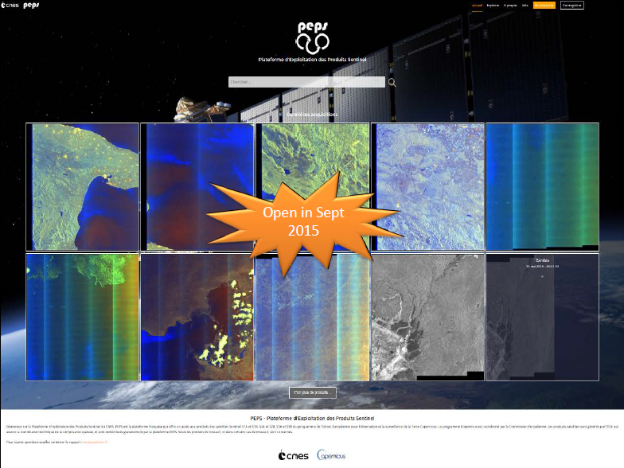

Slide 10
1000 registered users

Slide 11
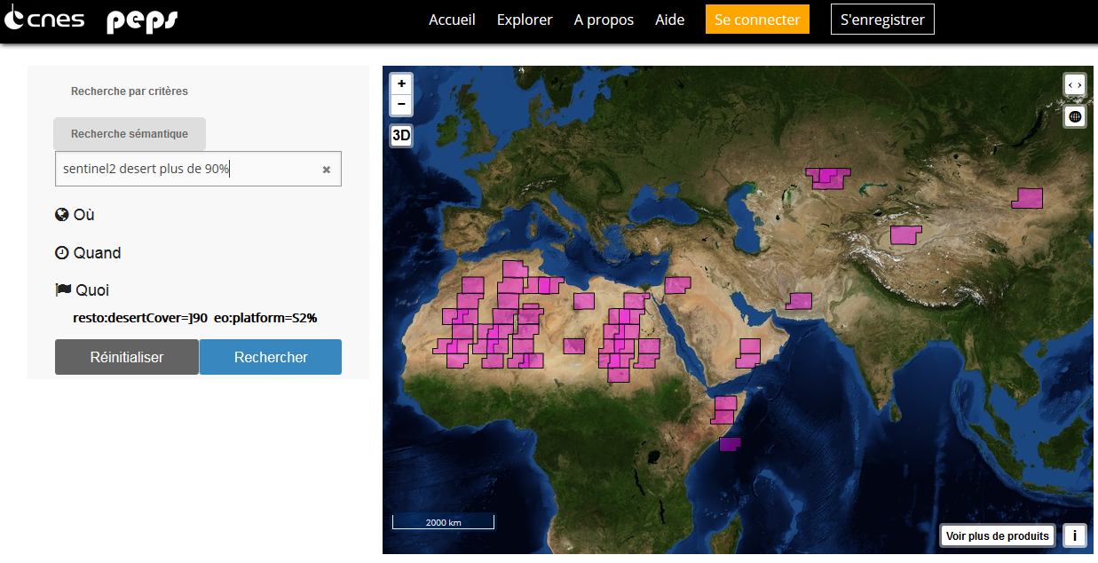
Semantic search (also in english)

Slide 12
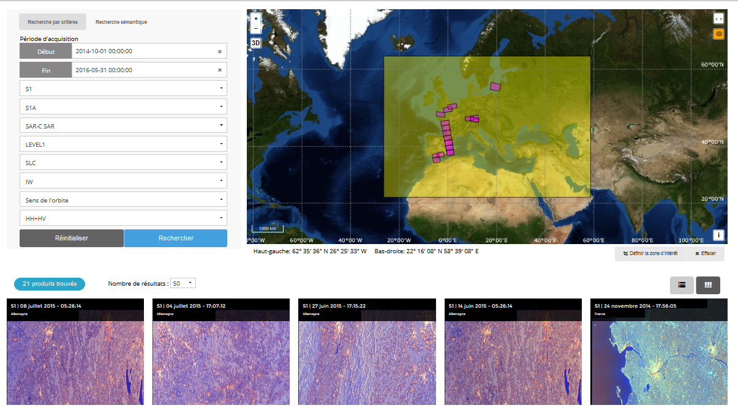
Standard search

Slide 13
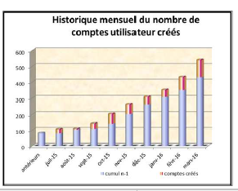
PEPS - some figures
End 2015 : 5 000 downloads (8 Tb) from 200 000 products published
723 User accounts in June 2016 (1000 in September)
Des utilisateurs issus de 43 pays différents
dont 74 % parlent français
65 % sont français
Principalement des pays européens (Italie, Allemagne, Belgique,…), USA, Canada Mais aussi Gabon, Chine, Viet Nam, Maroc, Russie, Suisse, Algérie…
52% (seulement) à des fins de recherche

