Slide 1
Towards an Enhanced Coordinated Data Response in Support of R&D Topics for GFOI Part 2
Y. Crevier
Sept 2016

Slide 2
SDCG 3-Year Work Plan Outcomes for 2015 – 2017 – R&D Component

Slide 3
Proposed Next Steps
Get an SDCG consensus to explore ways of enhancing our contribution to the GFOI R&D - DONE
Work on a simple and sustained procedure to enhance our engagement, collective contribution and facilitate reporting (development of SoP) – TO BE DEV.
Bridging the current framework into the new framework and continue to work hand-in-hand with the GFOI R&D team in order to avoid any disruptions in the R&D plan – ON GOING
Develop a multi-year support strategy based on a coordinated and agreed upon analysis of the Priority Research & Development Topics and other related documents - TO BE DEV.
Continued reporting back to SDCG Exec. and GFOI R&D – ON GOING

Slide 4
GFOI R&D session Extracts from the Discussion
Adding value to the coordination by leveraging interactions between the teams and by that add value to individual actions
Bringing the teams together – ensure convergence on R&D activities
Encouraging the creation of research synthesis
How do you determine which subject is going to be supported?
Adopting an R&D priority-based approach
R&D should reflects the needs from Countries
What is your plan – a plan should better inform funding agencies
Providing feedback to the funding agencies
No funding for projects – difficult to influence and focus the science activities

Slide 5
1. Encourage Horizontal Collaboration
Adding value to the coordination by leveraging interactions between the teams and by that add value to individual actions
Bringing the teams together – ensure convergence on R&D activities
Encouraging the creation of research synthesis
How do you determine which subject is going to be supported?
Adopting an R&D priority-based approach
R&D should reflects the needs from Countries
What is your plan – a plan should better inform funding agencies
Providing feedback to the funding agencies
No funding for projects – difficult to influence and focus the science activities

Slide 6
2. Fast-Tracking Priorities
Adding value to the coordination by leveraging interactions between the teams and by that add value to individual actions
Bringing the teams together – ensure convergence on R&D activities
Encouraging the creation of research synthesis
How do you determine which subject is going to be supported?
Adopting an R&D priority-based approach
R&D should reflects the needs from Countries
What is your plan – a plan should better inform funding agencies
Providing feedback to the funding agencies
No funding for projects – difficult to influence and focus the science activities

Slide 7
3. Enhance Accountability
Adding value to the coordination by leveraging interactions between the teams and by that add value to individual actions
Bringing the teams together – ensure convergence on R&D activities
Encouraging the creation of research synthesis
How do you determine which subject is going to be supported?
Adopting an R&D priority-based approach
R&D should reflects the needs from Countries
What is your plan – a plan should better inform funding agencies
Providing feedback to the funding agencies
No funding for projects – difficult to influence and focus the science activities

Slide 8
1. Encourage Horizontal Collaboration
Objectives:
Ensure fluid dialogue between the SDCG Element 3 and the GFOI R&D
Encourage and “compel” exchanges and interactions across projects addressing similar thematic issues / using similar datasets
Provide interaction platforms (virtual or physical) for EL-3 stakeholders
Allow for a better horizontal coordination on R&D issues that require data interoperability, data complementarity and high frequency of revisit
Questions:
Do we have the appropriate modus operandi?
How can we improve our way of doing things?
How do we entertain and nurture a dialogue?
How do we get feedback?
Other questions?

Slide 9
2. Fast-Tracking Priorities
Objectives:
Provide a coordinated framework with clear science objectives to be addressed within a finite horizon
Questions:
Can we be more proactive in identify low hanging fruits and invite data providers to select a set of R&D themes that would focus our collective efforts and provide a structure result-based framework?
How do we reconcile data provider’s priorities (national priority, application maturity, technological fit, etc.) with science and stakeholder’s priorities?
How do we select projects?
Should we be more involved (with the GFOI R&D) in R&D activities through out the value chain (prioritize themes, agree on science activities, provide data, stimulate exchanges of results, stimulate publications, ensures migration to MGD…)?
Other questions?

Slide 10
3. Enhance Accountability
Objectives:
Define new rules and an accountability framework for data requirements response (space agencies) and scientific community reporting
Better engage public agencies, and hybrid and commercial data providers through the precise definition of the R&D activities
Formalize SDCG response and related outcomes to GFOI R&D plan
Provide a framework to a) address, b) focus and c) fast track key science questions
Questions:
What are the advantages, rewards, difficulties and pitfalls of the current approach?
Thinking beyond just contributing data for science activities, is the R&D activity a sole GFOI responsibility?
What are the space agencies expectations?
What are the science teams expectations – do we know them?
How can we structure the process to better engage the private sector data providers – what are there expectations?
How do we communicate and receive feedback on programmatic elements?
Do you believe an enhanced programmatic framework would be more attractive for Funding Agencies?

Slide 11
Support slides

Slide 12
SDCG 3-Year Work Plan Outcomes for 2015 – 2017 – R&D Component How it can help meeting the WP Outcomes

Slide 13
Reference Framework
GFOI Concept Phase report and Implementation Plan
Review of Priority Research & Development Topics
GFOI R&D Plan 2015 +
Archive Data acquired over GFOI R&D Study Sites 2009-2011
GFOI Methods and Guidance Document
Satellite Data in Support of GFOI R&D - Element 3
Global Baseline Data Acquisition Strategy
Etc.

Slide 14
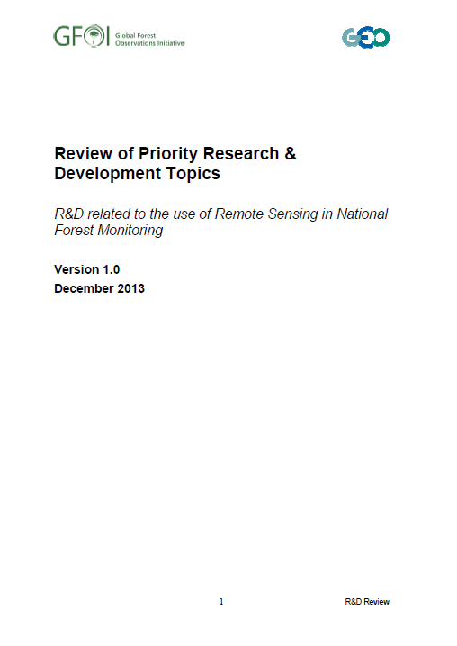
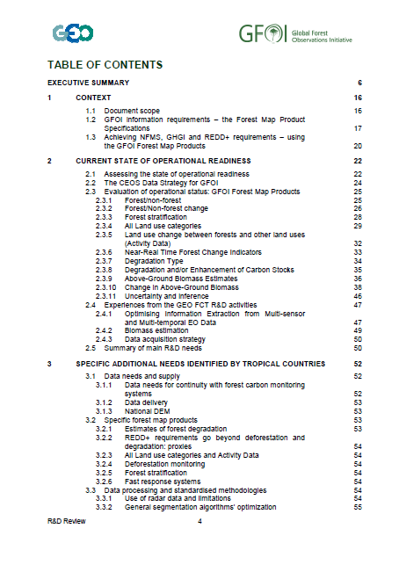
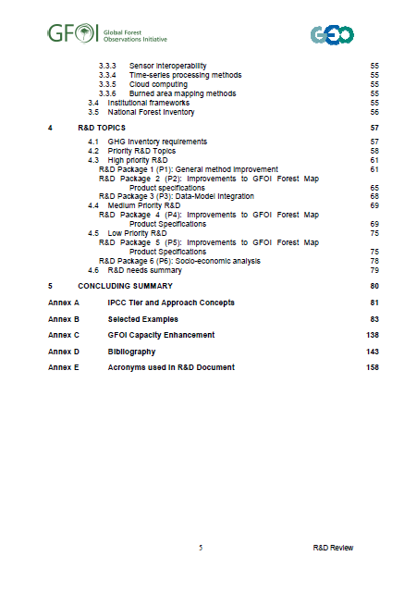
Key Document
GFOI (2013): Review of Priority Research & Development Topics: R&D related to the use of Remote Sensing in National Forest Monitoring. Pub. GEO, Switzerland, 2013 ISBN 978-92-990047-5-3.

