Slide 1
SESSION 8: Business Wrap-up & Review
SDCG-10: Reading, 7-9 September, 2016

Slide 2
Contents
Check consensus on major outcomes for each session
Check implications and next steps for each WP thread
BREAK
Next ‘stage’ for SDCG (capacity, meetings…)
Reports to CEOS (Oxford, Brisbane)

Slide 3
SDCG-10 Review
Stephen Ward, SDCG EXEC for Australia
SDCG-10: Reading, 7-9 September, 2016

Slide 4
Baseline strategy
Ongoing coverage from L-7,-8 and S-1,-2 (1B commissioning)
S-2 GRI completion late 2017… Landsat data will be processed
Good pre-interoperability collaboration
L-9 essentially an L-8 clone
SDCG should input to the L-10 consultation process
German and French Copernicus data access points
Importance of L-band data stressed and resolve to write to JAXA to ensure continuity
Global Data Flows will be reported to CEOS SIT next week

Slide 5
UK session
GNU commited $5Bn in finance 2015-2021
UK interested to explore closer GFOI engagement
inclusion of NovaSAR S-band data in the GFOI R&D programme, to help advance its application for forest applications;
specifically inclusion of NovaSAR data in the CEOS Data Cube to show its utility alongside better known data;
exchanging notes on the GFOI Capacity Building efforts with space data in countries
a number of detailed technical collaborations that popped up in discussions

Slide 6
R&D
El-3 strategy will be updated for SIT-32 information
Refinement of GFOI R&D team data requirements (next slide)
Agency reports on data provision
ASI and CNES: Supporting all groups without commercial provider requests; established contacts with the R&D groups
CSA: Will work to support groups with RADARDSAT-2 requests
DLR and JAXA: Support all groups that requested data; data distribution still to be commenced
ESA: Data available at Spot5Take5.org
ALOS-2 data approved for GFOI R&D

Slide 7
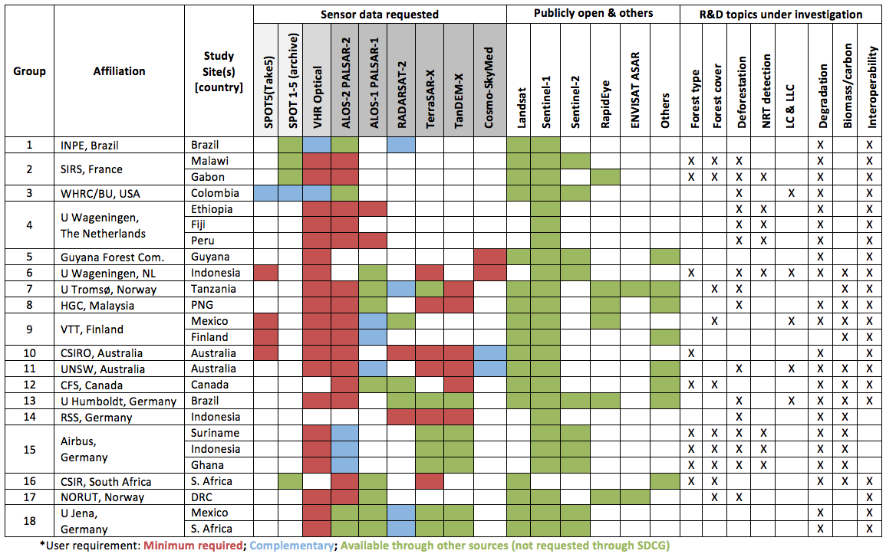
Refinement of data requests from GFOI R&D Teams

Slide 8
Space Data Services
Latest news on SDCG tools, pilots and prototypes
Colombia moving apace, Kenya not
Way forward on SEO-FAO collaboration…?
Data Cube Work Plan should go to CEOS for information
Discussed way forward in 2017/18 for the CDC and ARD activities – with a possible GFOI application emphasis
Heard latest on F-TEP from ESA
And from FAO on SEPAL 2.0

Slide 9
GFOI end-to-end demo: Colombia
Delayed dialogue... potential of REDDCompass Workshop in Colombia to be used to explore insertion points for GFOI MGD in country? Leads/Office need to pick up the end-to-end demo
Re-establish dialogue with Edersson
Opportunity as CEOS Data Cube demo in 2017-18?
Matt Hansen

Slide 10
Misc
TBA

Slide 11
Updates to 3 Year Work Plan
George Dyke, SDCG EXEC for Australia
SDCG-10: Reading, 7-9 September, 2016

Slide 12
2016 Work Plan Outcomes
Status Going Into to SDCG-10
* Full outcome text in 3yWP and SDCG-10 agenda
On Track / Complete | 5/17
Progressing | 8/17
Not Progressing / Unknown | 4/17
REMINDER!
 | Outcome* | Status |  | Outcome* | Status
Baseline | #1: Global Coverage | In Progress | Service (Cont’d) | #10: Cloud Computing Pilots | Colombia yes, Kenya no
 | #2 Data Flows | Final Draft for Review |  | #11: National Model | Colombia considered
 | #3: Info. Products | Progress in ‘ARD’ | R&D | #12: E3 Strategy | Complete
Services | #4: MGD Integration | Integration with MGD 2.0? |  | #13: Data for R&D | In progress – ASI, CNES
 | #5: CB Meetings | SilvaCarbon support drifting |  | #14: Broker Commercial | Next steps?
 | #6: Ensured coverage (CDS) | For LS+S2A | Component Coord’n | #15: Customer Experience | Not yet
 | #7: Interop. Discovery Tools | Any progress? |  | #16: Priority Country Service | Kenya only
 | #8: Core Data Assembly | Data Flow Study, ‘ARD’ |  | #17: Country I/F Management | Not yet
 | #9: MGD 2.0 Integration | Has integration been achieved?

Slide 13
Brief Discussion
Is the SDCG 3-Year Work Plan still relevant and on target?

Slide 14
Major Changes to Reflect
Global Data Flows moves from study to implementation
GFOI Component Coordination and Country Engagement contingent on GFOI Office continuity
Changes in services and Kenyan activities?
Add SEO support agenda with FAO?
Others?

Slide 15
2017-2019 WP Update Plan
SDCG-10 Action: SDCG Work Plan thread leads to provide revised outcomes for the 2017-2019 Work Plan by 30 September.
SDCG-10 Action: SDCG SEC to finalise updated 2017-2019 SDCG Work Plan by 31 November.
Anticipating revisions to be relatively light

Slide 16
SDCG Future Activities
Stephen Ward, SDCG EXEC for Australia
SDCG-10: Reading, 7-9 September, 2016

Slide 17
SDCG Future Activities
Where are we?
What has been achieved?
And still to be achieved?
What changes ahead in SDCG EXEC capacity?
What impact?
What meetings are likely and needed?
What course of action do we conclude, if any?

Slide 18
SDCG History
2011 CEOS Data Strategy for FCT/GFOI
SDCG formed at 2011 CEOS Plenary
Continuity of EO data supply for maintenance of time series and consistent reporting
Three element strategy has served us well:
A baseline, coordinated global data acquisition strategy involving a number of ‘core data streams’ that can be used free-of-charge for GFOI purposes
A coordinated strategy for national data acquisitions
Data supply in support of the FCT activities (evolved as ‘R&D’)

Slide 19
2012-2016
Element 1
Defined and implemented global baseline
Successful launches, tweaks to strategies catalysed by GFOI
2014 was the global target, 2016 the reality
All countries should now have access to the EO satellite data required for annual reporting as needed
Element 1 should look after itself? Some new core data streams (S-2B, SAOCOM-1A, RCM) for new opportunities
Global Data Flows study
Element 1 is internal business and within our sphere of influence

Slide 20
2012-2016
Element 2
Ad-hoc delivery of data on media by USGS/SC/some SEO
Space Data Services support to countries attending SDCG via SC
Regional workshops – Impartial assessments
Historical coverage reports – Ensured ongoing coverage
Data discovery, assembly, delivery – Cloud storage, processing, analysis
Pilot activities to stimulate demos of data uptake, application
Some collaboration with FAO on country tools (SEPAL, SDMS)
Closer collaboration between SC and FAO on the CB component
MGD recently mature with online tools
Office established – for how long?

Slide 21
2012-2016
Element 3
Support from ESA has helped in 2015-16
New strategy document endorsed by CEOS
ESA funding ends March 2017 – exploring Horizon €€
Pursued engagement of commercial data providers and support from CEOS PPP progarmmes

Slide 22
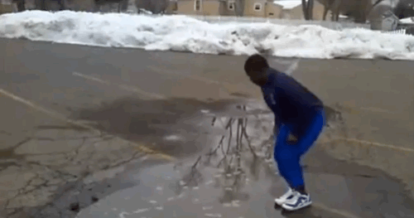
What are the targets for 2017-19?
In detail… see the Work Plan
Big picture….
Global coverage need not be a priority?
GFOI has yet to achieve substantial country engagement – and SDCG dependent on GFOI for the connections
Closer component coordination essential – SDCG to be proactive with both CB and MGD in engaging, supporting and supplying countries (joint WP?)
Mainstreaming of GFOI in REDD+, FCPF is cited in the SDCG WP
The pilot activities we are pioneering are the future, and should be prioritised and highlighted (what about the big data aspects?)
SDCG proposed an end-to-end GFOI demo – Colombia: leads supportive
Element-3... When can we demonstrate some ROI?

Slide 23
SDCG Operations
Australian support for SDCG SEC has allowed ~80+hrs pcm on average of capacity, plus 2 pax to SDCG, GFOI mtgs, plus SIT, CEOS
Substantial % of SDCG Exec capacity & SDCG Management
Ends Nov 2016 – no prospect of renewal
Fallback support (short-, maybe medium-term)
JAXA CEOS Lead support allows ~ 10hrs pcm (GFOI-specific)
1 pax to SDCG, GFOI mtgs plus general CEOS meetings
NASA SEO offered further ~ 10hrs pcm, plus poss. travel
Limited to meetings, telcons, key materials

Slide 24
SDCG Operations 2017
Meeting commitments:
GFOI Plenary – March 2017, SE Asia (inc SDCG-11)
SIT report – April 2017, Paris
SIT TW report – Sep 2017, Germany (?)
SDCG-12 (?)
CEOS strategy ultimately is for LSI-VC to integrate coordination efforts on forests, agriculture… but that will take time and the VC is newly re-formulated
Any GEOGLAM interaction needed?

Slide 25
Reporting to CEOS
SIT TW Oxford next week
CEOS Plenary Brisbane, early Nov
Propose to focus on Global Data Flows
What else should we include? GFOI Review if available.
Suggest to notify about SDCG EXEC capacity/status change?

Slide 26
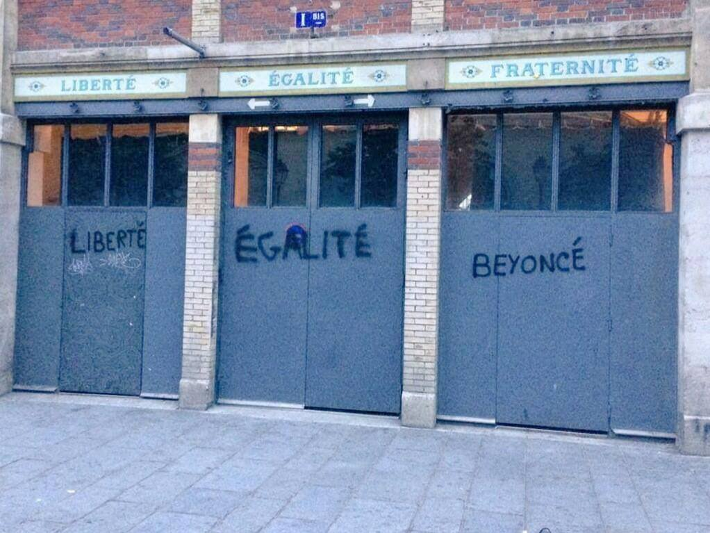
Reporting to CEOS

