Slide 1
Landsat Status Summary
10 January 2017
Brian Killough
for Gene Fosnight
USGS EROS
fosnight@usgs.gov

Slide 2
Agenda
Landsat 7 Status
Landsat 8 Status
Archive and LGAC Status

Slide 3
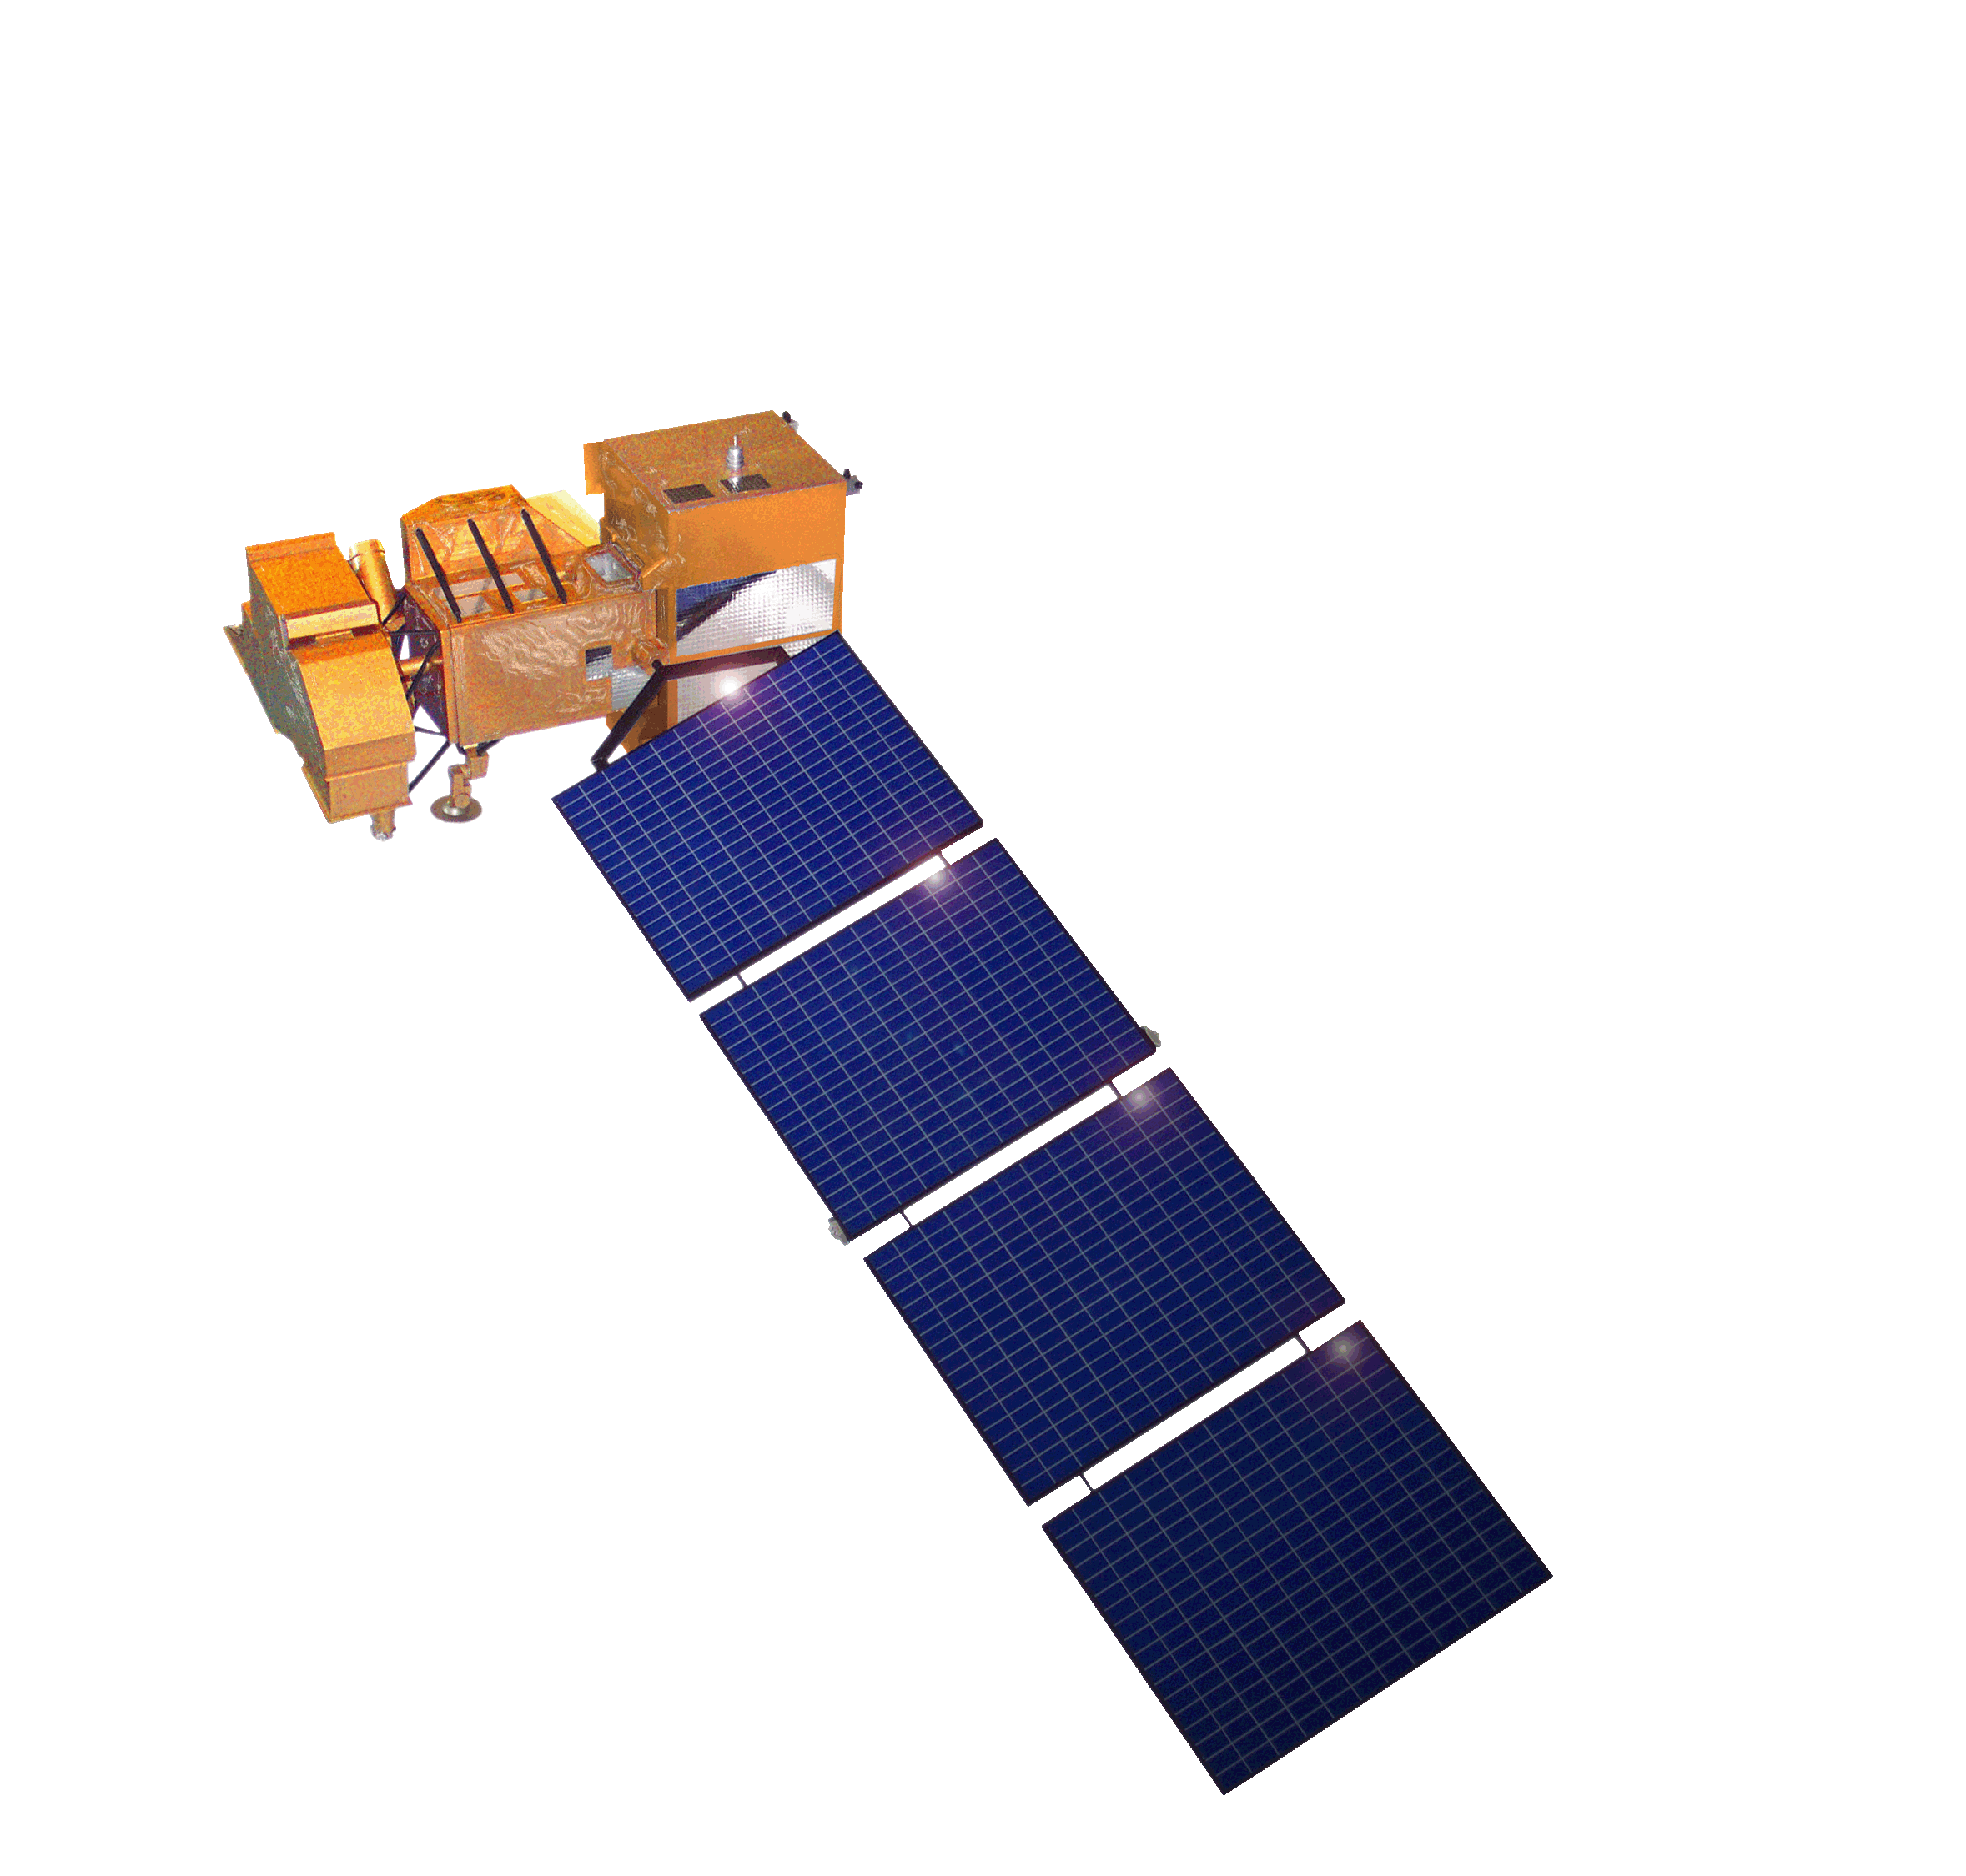
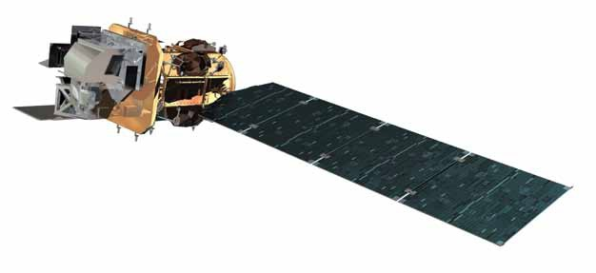
Landsat Mission Status
Landsat 7
  Acquiring at a rate of ~430 scenes per day with continental acquisition strategy
    105% duty cycle operations for ETM+ performing smoothly
  On-orbit performance of Landsat 7 observatory continues to be outstanding
    No spacecraft or instrument anomalies since October 2014
  Finalized end of mission planning – intent to overlap with Landsat 9 launch readiness
  Extended mission life potential to as late as July 2021
  Landsat 7 error free flight operations for over 4 years and counting
Landsat 8
  Acquiring at a rate of ~740 scenes per day
  On-orbit performance of Landsat 8 observatory continues to be outstanding;
    No spacecraft or instrument anomalies since September 2015
    Mission data management highly effective - on-board recorder averaging 70% margin
  TIRS Scene Select Mirror (SSM) Encoder Circuit B-side alternative operations concept performing very well
  Currently 5 LGN stations and 16 certified IC stations
    LGS (USGS), GLC (NOAA), NSN (DLR), ASN (GA), and SGS (KSAT)
Notes:
Final

Slide 4
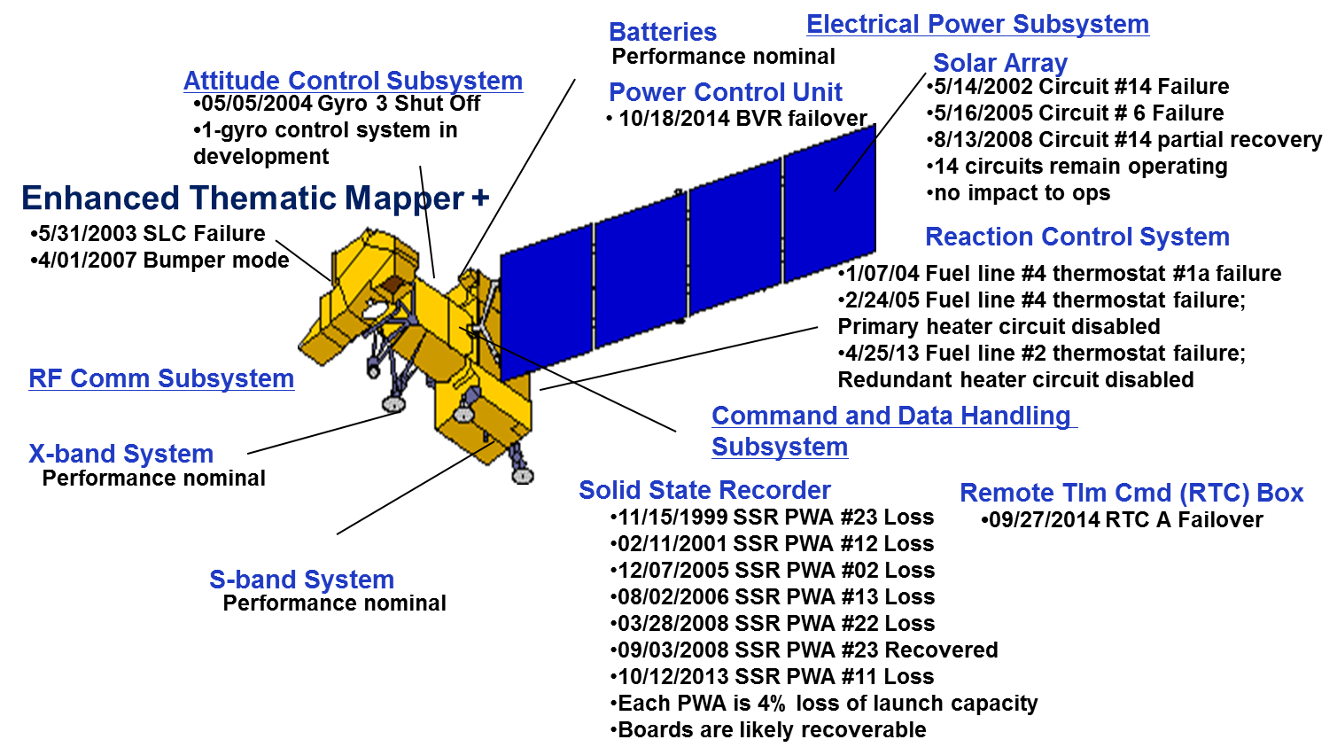
Landsat 7 Observatory Status – No Change
Almost 18 years of on-orbit operations
15 Nov 1999 - SSR PWA #23 failure
26 Apr 2000 - GXA - ETM+ interaction discovered
11 Feb 2001 - SSR PWA #12 failure
14 May 2002 - EPS Circuit #14 failure
31 Jul 2002 - Gyro 3 motor current spikes
24 Oct 2002 - ETM+ Scan Mirror stops during imaging
31 May 2003 - ETM+ SLC malfunction*
04 Sep 2003 - PDF - FSW timing conflict
05 May 2004 - Gyro 3 Shut down
24 Feb 2005 - RCS Primary heater circuit disabled
16 May 2005 - EPS Circuit #6 failure*
15 Jun 2005 - First of several reduced gyro FSW loads
07 Dec 2005 - SSR PWA #2 failure
01 Feb 2006 - Reduced gyro phase IIa complete
01 Apr 2007 - Switched to ETM+ Bumper mode
28 Mar 2008 - SSR PWA #22 failure
13 Aug 2008 - EPS Circuit #14 recovery
03 Sep 2008 - SSR PWA #23 recovery
25 Apr 2013 - RCS Redundant heater circuit disabled
12 Oct 2013 - SSR PWA #11 failure
27 Sep 2014 - RTC A to RTC B autonomous switchover
18 Oct 2014 - CLOCKGEN prime to redundant autonomous switchover
* Represents a permanent loss of redundancy and/or capability

Slide 5
Landsat 7 Decommissioning Criteria
The primary objective regarding Landsat 7 end of mission planning is to operate Landsat 7 as long as the science mission is viable
  Specifically, maximize the 8-day repeat imaging between Landsat 7 and Landsat 8 operations leading up to initiation of Landsat 9 operations
  Historic science mission requirement for Mean Local Time (MLT) along the equatorial plane is 10:00 AM plus or minus 15 minutes
Landsat 7 Operational mission will be declared over at the discretion of USGS, and may be triggered by any of the following reasons
  Insufficient fuel to maintain inclination required for science mission operations
    The orbital Mean Local Time (MLT) drops below 9:15 AM
    Note: Drag Make-Up (DMU) and Risk Mitigation Maneuvers (RMM) activities use minimal amounts of fuel (fractions of a kilogram)
  Observatory becomes unable, for any reason, to produce useable science data
    Due to mission ending failures within either the spacecraft or ETM+
  Key observatory subsystems demonstrate signs of imminent failure which could result in loss of mission
    Attitude control, propulsion, command & data handling

Slide 6
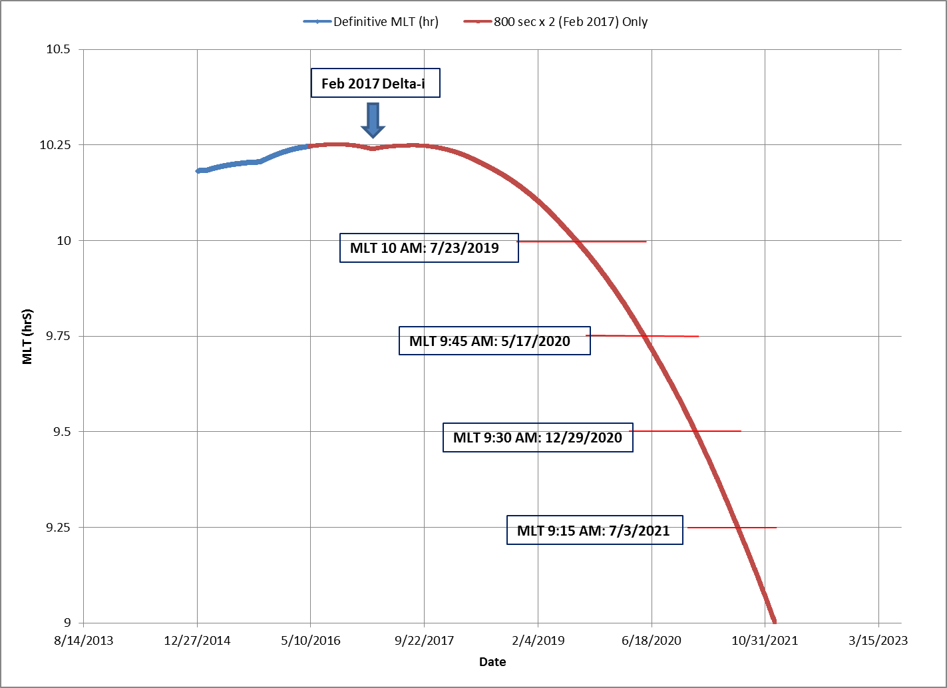
Approach
Align with L9: Extend Landsat 7 science mission operations as close to Landsat 9 launch as possible
Determine optimized, safe disposal orbit
  Assessment indicates 8km drop to disposal orbit of 697km
  Fuel reserve allows for perigee burn to maximize orbital drag and decay
Conduct one additional inclination maneuver (Delta-I) in February 2017
  9:45 AM MLT May 2020
  9:30 AM MLT December 2020
  9:15 AM MLT July 2021
Lower 8km following crossing of 9:15 AM MLT
  Or proximity to Landsat 9 launch
  Approximately 4.27kg of fuel margin projected

Slide 7
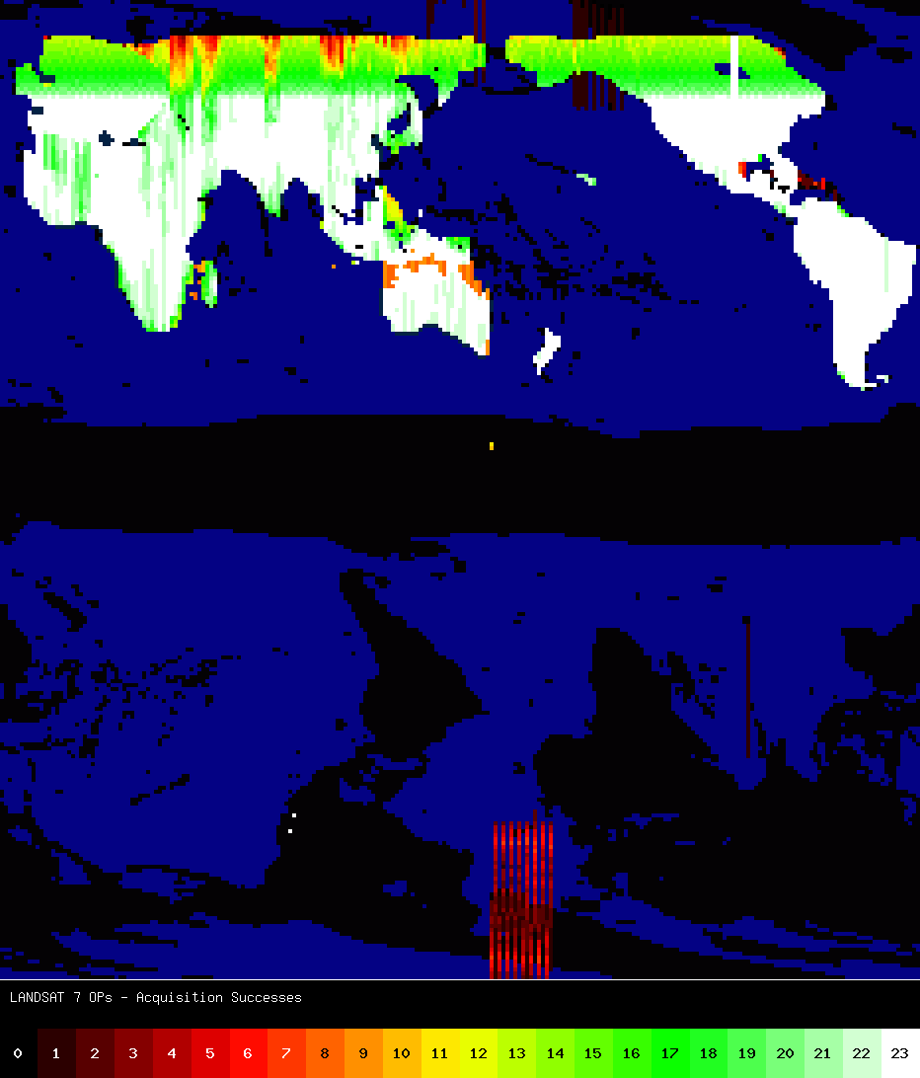
Landsat 7 Acquisitions
Map to the right shows the scheduled acquisitions from the past year
Upper half is descending; Lower half is ascending
  White = Scheduled for all possible acquisitions (23 times)
  Black = Wasn’t scheduled
Increased duty cycle has enabled acquisition of about 430 scenes / day
Data not acquired is lost forever!
– Eugene Fosnight

Slide 8
Landsat 8 Observatory Status – No Change
~3 years of on-orbit operations
RF Communications
Operational Land Imager
S-band System
X-band System
Thermal Control System
Propulsion Subsystem
Attitude Control System
Electrical Power System
Batteries
Solar array
Thermal Infrared Sensor
October 2014 - Side-A SSM Encoder
September 2015 – Encoder Side-B current fluctuations
January 2016 – Alternative Operations Concept B-Side
Command & Data Handling System
Solid State Recorder – File Delete (ghost file) errors
- Successfully corrected in September 2015

Slide 9
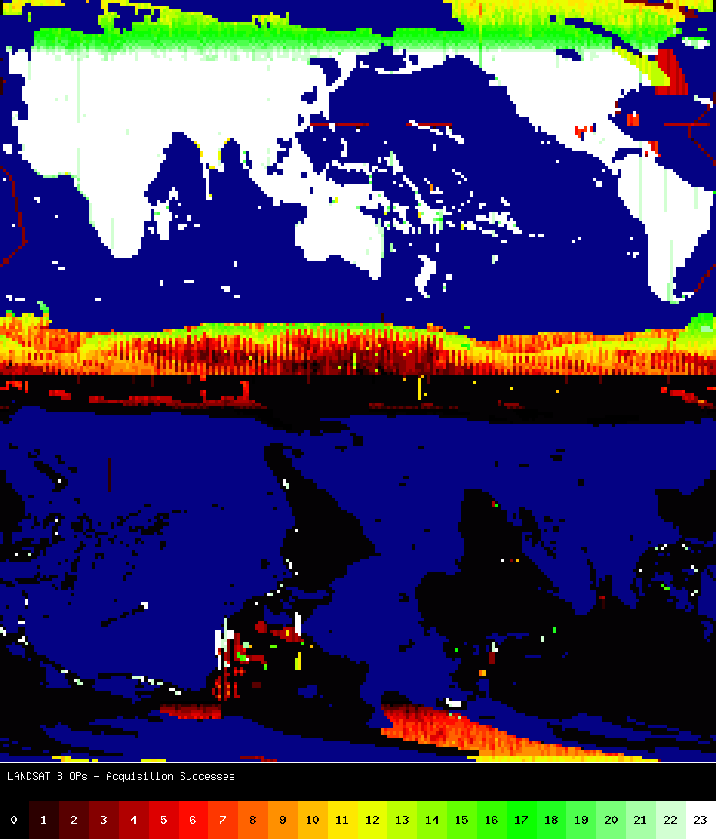
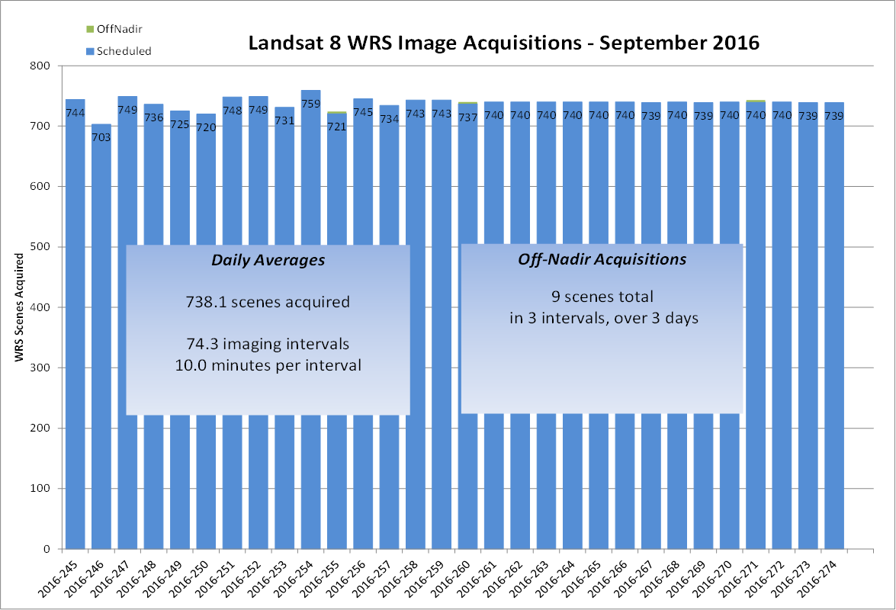
Landsat 8 Acquisitions
Landsat 8 is tracking close to its 740 scene per day maximum. Includes special requests and night imaging
User requests for off-nadir imaging remains limited

Slide 10

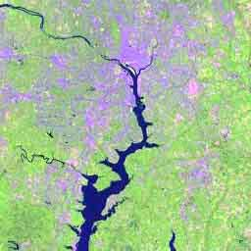


U.S. Landsat Archive Overview
(1 November 2016)
OLI-TIRS: Landsat 8
  855,921 scenes
ETM+: Landsat 7
  2,218,700 scenes
TM: Landsat 4 & Landsat 5
  2,337,132 scenes
MSS: Landsat 1 through 5
  1,300,274 scenes
Total:
  6,712,027 scenes

Slide 11
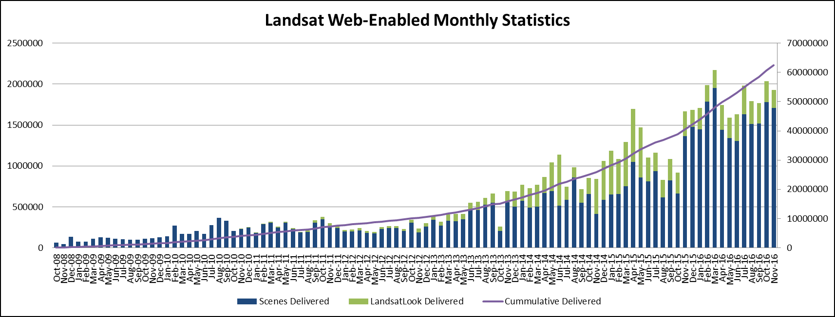
Monthly Downloads
Notes:
Final – circled month is reporting date used for LTWG #23 (April)
Date of LTWG #23 presentations was 9 June 2014

Slide 12
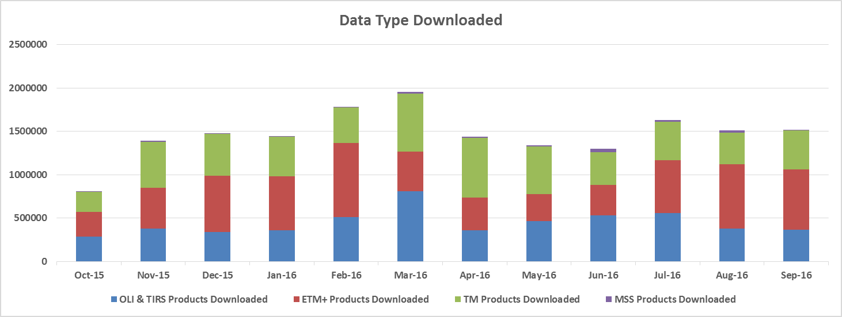
Monthly Downloads by Type

Slide 13
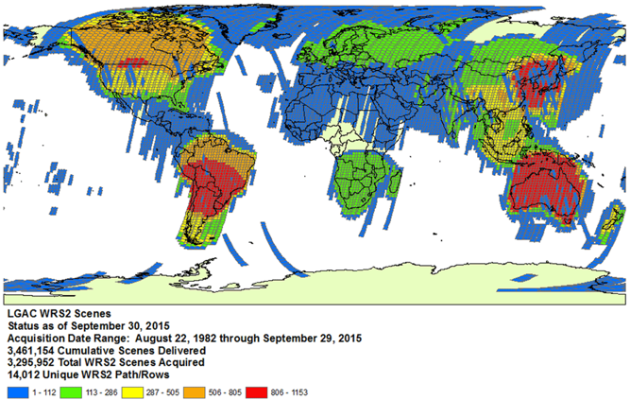
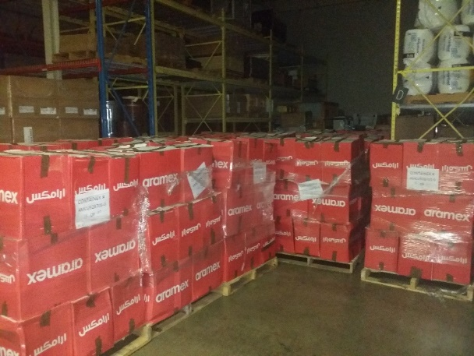
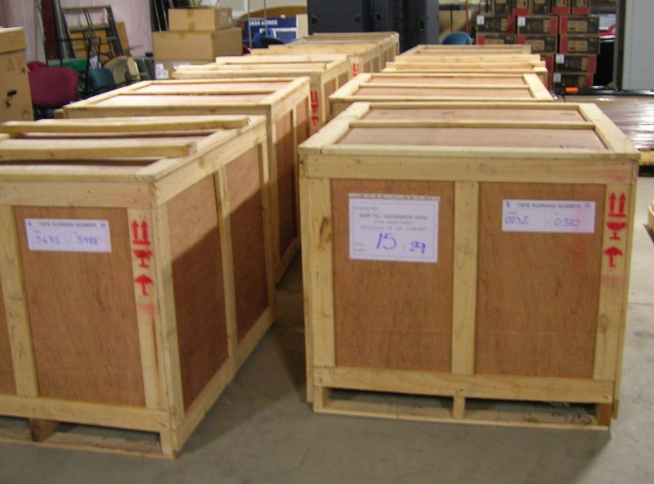
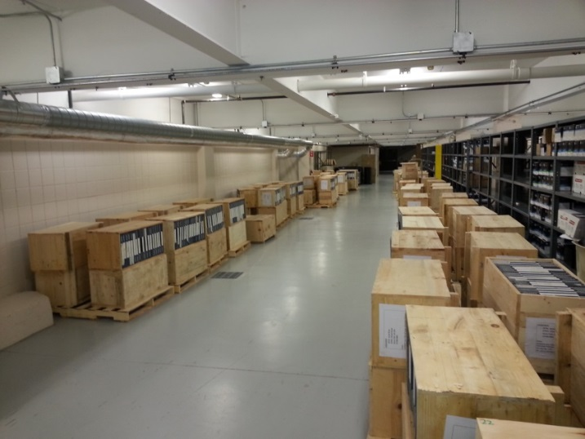
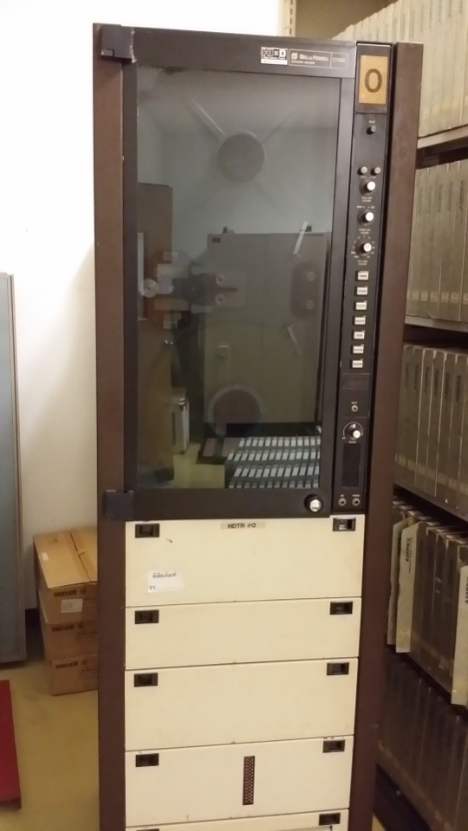
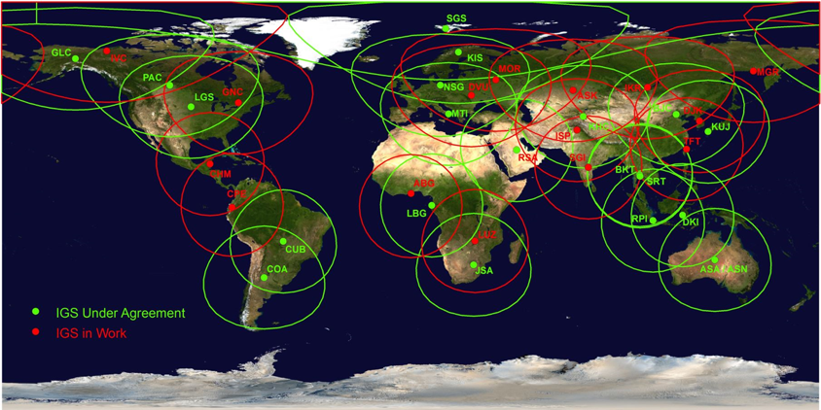
Landsat Global Archive Consolidation Status

Slide 14
Cumulative LGAC Status
Previous Science Team Meeting
Woodcock Metric: 4,069,571 scenes (October 2016)
Previous Metric: 3,745,686 scenes (April 2016)

Slide 15
LGAC Status
Country (Organization) | Ground Station | % LGAC Delivered | % LGAC Ingested
Argentina (CONAE) | COA | TM | TM
 |  | ETM+ | ETM+
Australia (GA-NEO) | ASA | MSS | MSS
 |  | TM | TM
 |  | ETM+ | ETM+
Australia (GA-NEO) | HOA | TM | TM
 |  | ETM+ | ETM+
Brazil (INPE) | CUB | MSS | MSS
 |  | TM | TM
 |  | ETM+ | ETM+
Canada (CCMEO) | GNC | MSS | MSS
 |  | TM | TM
 |  | ETM+ | ETM+
Canada (CCMEO) | PAC | MSS | MSS
 |  | TM | TM
 |  | ETM+ | ETM+
Argentina – LTOs
  TM and ETM+ data delivery continues
Brazil – HDDTs
  USGS to investigate setting up Wideband Video Drive to read tapes
    ~875 tapes to be sent by Brazil upon sample tape success
    Primarily consist of MSS data, with very small number of TM intervals also included

Slide 16
LGAC Status
Country (Organization) | Ground Station | % LGAC Delivered | % LGAC Ingested
China (RADI) | BJC | TM | TM
 |  | ETM+ | ETM+
China (RADI) | KHC | TM | TM
Ecuador (IEE) | CPE | TM | TM
Europe (ESA) | FUI | MSS | MSS
 |  | TM | TM
 |  | ETM+ | ETM+
Europe (ESA) | KIS | MSS | MSS
 |  | TM | TM
 |  | ETM+ | ETM+
Europe (ESA) | MTI | TM | TM
 |  | ETM+ | ETM+
Europe (ESA) | MPS | MSS | MSS
 |  | TM | TM
 |  | ETM+ | ETM+
Europe (ESA) | NSG | ETM+ | ETM+
China – Electronic data delivery
  Significantly accelerated electronic data delivery in past 6 months
Ecuador – All data has been received
  Addressing several problematic tapes
Europe – NAS HDs
  Transferring data with 30 TB hard drive
  USGS working with ESA to obtain updated metadata lists and aid in data reconciliation efforts
  USGS upgrading LPGS software by end of 2017 to handle ~500,000 TM scenes with missing PCD (Ron Morfitt will discuss on Thurs)
  MSS data delivery pending

Slide 17
LGAC Status
Country (Organization) | Ground Station | % LGAC Delivered | % LGAC Ingested
India (ISRO) | SGI | MSS | MSS
 |  | TM | TM
 |  | ETM+ | ETM+
Indonesia (LAPAN) | DKI | TM | TM
 |  | ETM+ | ETM+
Japan (HIT/HEEIC) | HIJ | ETM+ | ETM+
Japan (JAXA/RESTEC) | HAJ | MSS | MSS
 |  | TM | TM
 |  | ETM+ | ETM+
Kyrgyzstan (DLR) | BIK | TM | TM
Mongolia (DLR) | ULM | TM | TM
Pakistan (SUPARCO) | ISP | MSS | MSS
 |  | TM | TM
Russia (ScanEx) | IKR | TM | TM
Russia (ScanEx) | MGR | TM | TM
Russia (ScanEx) | MOR | TM | TM
India – Electronic data delivery
  MSS data was only available in partially processed Level 1 format
    USGS to assess options for data archival and distribution
  Newly acquired ETM+ 2016 data delivery pending
Indonesia – All data has been received
  DCRSi drive parts needed for remaining tapes
Pakistan – All HDDTs have been received
  HDDT reading completed
  Delivery of additional TM data on LTOs pending
Russia – All data has been received
  Outstanding TM scenes have been received, ingested, and archived (over 50,000 TM scenes)

Slide 18
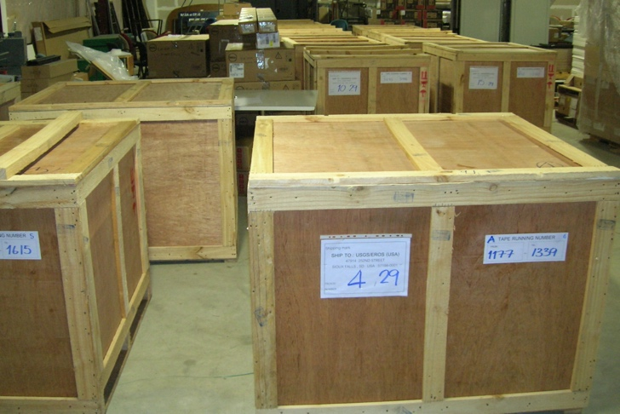
LGAC Status
Country (Organization) | Ground Station | % LGAC Delivered | % LGAC Ingested
Saudi Arabia (KACST) | RSA | MSS | MSS
 |  | TM | TM
South Africa (SANSA) | JSA | MSS | MSS
 |  | TM | TM
 |  | ETM+ | ETM+
Taiwan (CSRSR-NCU) | CLT | TM | TM
Thailand (GISTDA) | BKT | MSS | MSS
 |  | TM | TM
 |  | ETM+ | ETM+
US (U of Puerto Rico) | UPR | ETM+ | ETM+
Saudi Arabia – All HDDTs and DLTs have been delivered
  MSS and TM data
  Data from multiple sensors identified on media
    Approval has been received for reading the non-Landsat data
South Africa – Electronic data delivery
  Delivery of MSS data pending
Thailand – All data has been delivered
  HDDT tape baking, cleaning, reading, and ingest currently in progress
  687 of 1,897 tapes (36%) completed
  ~100 tapes set aside for further analysis

Slide 19
LGAC Status Summary
GSID | Country | Location | Scenes Ingested Since Sept. 2010
 |  |  | MSS |  |  |  |  | TM |  |  |  |  | ETM+
 |  |  | Actual | Estimated | % Comp | Unique | % Unique | Actual | Estimated | % Comp | Unique | % Unique | Actual | Estimated | % Comp | Unique | % Unique
ASA | Australia | Alice Springs | 237,583 | 237,000 | 100% | 167,213 | 70% | 186,021 | 186,000 | 100% | 181,883 | 98% | 226,030 | 226,000 | 100% | 128,469 | 57%
BIK | Kyrgyzstan | Bishkek |  |  |  |  |  | 2,340 | 2,000 | 100% | 1,749 | 75%
BJC | China | Beijing |  |  |  |  |  | 376,326 | 560,000 | 67% | 363,958 | 97% | 116 | 47,000 | 0% | 17 | 15%
BKT | Thailand | Bangkok | 0 | 25,000 | 0% | 0 | 0% | 214,836 | 230,000 | 93% | 194,847 | 91% | 18,704 | 18,700 | 100% | 8,268 | 44%
CLT | Taiwan | Chung Li |  |  |  |  |  | 11,586 | 11,600 | 100% | 11,297 | 98%
COA | Argentina | Cordoba |  |  |  |  |  | 103,643 | 190,000 | 55% | 96,185 | 93% | 137,192 | 200,000 | 69% | 59,735 | 44%
CPE | Ecuador | Cotapaxi |  |  |  |  |  | 25,246 | 50,000 | 50% | 12,304 | 49%
CUB | Brazil | Cuiaba | 0 | 76,000 | 0% | 0 | 0% | 306,704 | 307,000 | 100% | 263,745 | 86% | 103,648 | 103,500 | 100% | 60,157 | 58%
DKI | Indonesia | Parepare |  |  |  |  |  | 17,017 | 32,000 | 53% | 16,686 | 98% | 59,643 | 59,500 | 100% | 26,482 | 44%
FUI | Italy | Fucino | 0 | 2,000 | 0% | 0 | 0% | 48 | 567,000 | 0% | 48 | 100% | 20,832 | 51,000 | 41% | 11,496 | 55%
GNC | Canada | Gatineau |  |  |  |  |  | 53,019 | 53,000 | 100% | 14,681 | 28% | 37,955 | 38,000 | 100% | 9,988 | 26%
HAJ | Japan | Hatoyama | 166,531 | 166,500 | 100% | 95,712 | 57% | 131,556 | 131,500 | 100% | 127,107 | 97% | 20,556 | 20,500 | 100% | 10,667 | 52%
HIJ | Japan | Hiroshima |  |  |  |  |  |  |  |  |  |  | 39,365 | 39,300 | 100% | 15,316 | 39%
HOA | Australia | Hobart |  |  |  |  |  | 5,812 | 5,800 | 100% | 5,767 | 99% | 13,110 | 13,100 | 100% | 5,255 | 40%
IKR | Russia | Irkutsk |  |  |  |  |  | 23,431 | 23,400 | 100% | 23,363 | 100%
ISP | Pakistan | Islamabad | 504 | 500 | 100% | 413 | 82% | 63,564 | 66,000 | 96% | 61,842 | 97%
JSA | South Africa | Hartebeesthoek | 0 | 18,000 | 0% | 0 | 0% | 97,946 | 119,000 | 82% | 84,879 | 87% | 32,157 | 40,000 | 80% | 9,113 | 28%
KHC | China | KaShi |  |  |  |  |  | 30,681 | 30,600 | 100% | 29,240 | 95%
KIS | Sweden | Kiruna | 0 | 432,000 | 0% | 0 | 0% | 183,508 | 300,000 | 61% | 180,755 | 98% | 28,592 | 43,000 | 66% | 17,764 | 62%
MGR | Magadan | Russia |  |  |  |  |  | 2,970 | 2,970 | 100% | 2,440 | 82%
MOR | Moscow | Russia |  |  |  |  |  | 27,344 | 27,300 | 100% | 26,613 | 97%
MPS | Spain | Maspalomas | 0 | 154,000 | 0% | 0 | 0% | 16,329 | 50,000 | 33% | 16,329 | 100% | 7,480 | 32,000 | 23% | 4,099 | 55%
MTI | Italy | Matera |  |  |  |  |  | 2,962 | 234,000 | 1% | 2,941 | 99% | 12,401 | 48,000 | 26% | 6,385 | 51%
NSG | Germany | Neustrelitz | 5,160 | 5,000 | 100% | 5,130 | 99% |  |  |  |  |  | 70,009 | 94,000 | 74% | 42,200 | 60%
PAC | Canada | Prince Albert | 427,579 | 428,000 | 100% | 201,808 | 47% | 369,790 | 370,000 | 100% | 193,020 | 52% | 100,374 | 100,000 | 100% | 28,671 | 29%
RSA | Saudi Arabia | Riyahd | 0 | 5,000 | 0% | 0 | 0% | 1,608 | 250,000 | 1% | 860 | 53%
SGI | India | Shadnagar | 0 | 12,000 | 0% | 0 | 0% | 38,404 | 38,400 | 100% | 38,054 | 99% | 10,479 | 17,000 | 62% | 7,432 | 71%
ULM | Mongolia | Ulan Bator |  |  |  |  |  | 565 | 565 | 100% | 554 | 98%
UPR | Puerto Rico | Mayaguez |  |  |  |  |  |  |  |  |  |  | 315 | 315 | 100% | 118 | 37%
Totals |  |  | 837,357 | 1,561,000 | 54% | 470,276 | 56% | 2,293,256 | 3,838,135 | 60% | 1,951,147 | 85% | 938,958 | 1,190,915 | 79% | 451,632 | 48%
4.07 million scenes ingested!
Approximately 62% complete
Approximately 71% of scenes are new to the archive!
Includes partial scenes
Green = Completed
Notes:
3,500,000 complete or 55%
6,350,000 estimated
2,400,000 unique or 69%

Slide 20
LGAC Notional Timeline – TM

Slide 21
Questions???
Following slides include additional download statistics and additional mission status details
  Doesn’t include Collection 1 Distribution Statistics

