Slide 1
DLR contributions to R&D Support strategy (Element 3) – Status update
Michael Bock, Helmut Staudenrausch
SDCG-11 Session 3

Slide 2
TerraSAR/TanDEM-X Mission Status
Satellite lifetimes
The TerraSAR-X and TanDEM-X satellites were launched in 2007 and 2010, respectively. Both satellites show an excellent health status:
■ the radar instrument is working nominal
■ the battery status is much better than specified
■ consumption of consumables (hydrazine) is well below initial predictions
■ For both satellites a further lifetime beyond 2020-22 is expected
■ This allows operations at least until the next-generation SAR mission is operational.
■ in May 2017 is the Mission Definition Review of the follow-on mission (“HRWS”) with a launch for 2022. Phase A to start soon.

Slide 3
TerraSAR/TanDEM-X Mission Status
TerraSAR-X Mission
■ The TerraSAR-X Mission is performed by TerraSAR-X and TanDEM-X spacecrafts, each contributing a part of their imaging resources.
■ In the case of the unavailability of one of the two satellites, the second system will ensure continuity of the TerraSAR-X Mission.
TanDEM-X Mission
■ The TanDEM-X Mission is performed by TerraSAR-X and TanDEM-X in close formation flight, each contributing a part of their resources.
■ The close formation flight of both satellites is continued at least until September 2017.
■ DLR proposal for acquisition planning beyond Sept 2017 currently under discussion internally and with partners

Slide 4
TerraSAR/TanDEM-X Mission
Approved support
By E3 doc 11 R&D groups have requested data from TSX/TDX mission(s) as per Element-3 doc v2.1 but only very limited feedback available besides German R&D groups
TSX Background started mid 2015 mission for GFOI will be stopped soon for most sides due to missing feedback (e.g. to KMLs provided, no information if TSX/TDX proposals were handed in, marginal respond to E-Mails )
DLR will still support R&D groups with TSX/TDX data (new acquisitions and/or from archive) using Standard AO procedures

Slide 5
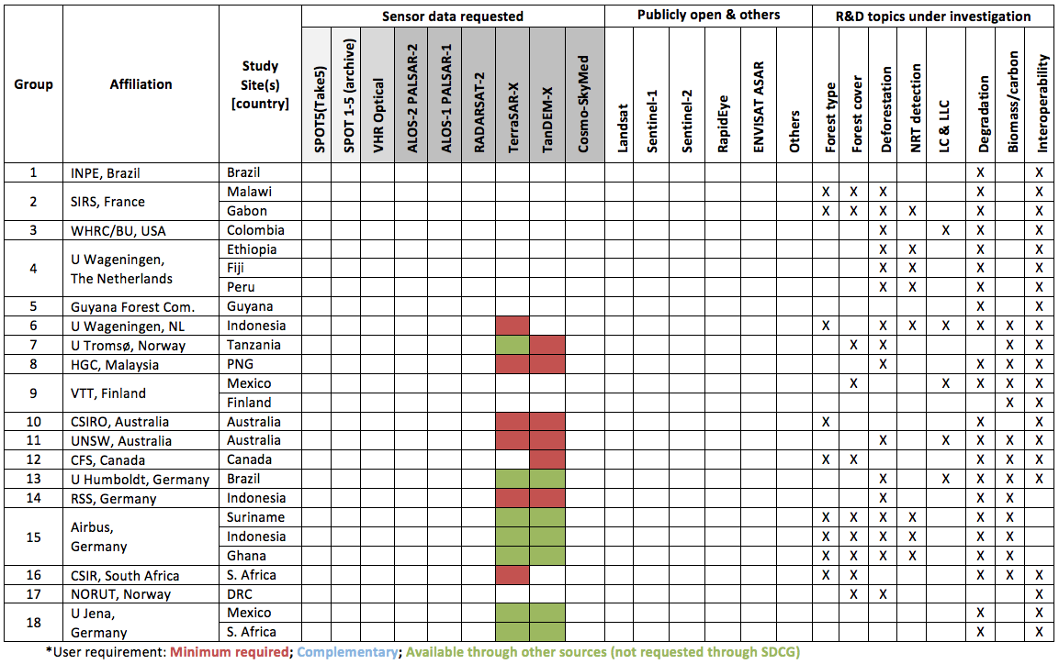
DLR: same slide as SDGC-10 Marginal or no feedback from R&D groups
No data request known yet ! Use TSX-General or Archiv AO
Background misson ongoing
TanDEM-X
Use
Final-DEM-AO
Data access
by AO ongoing
Data access
by AO ongoing

Slide 6
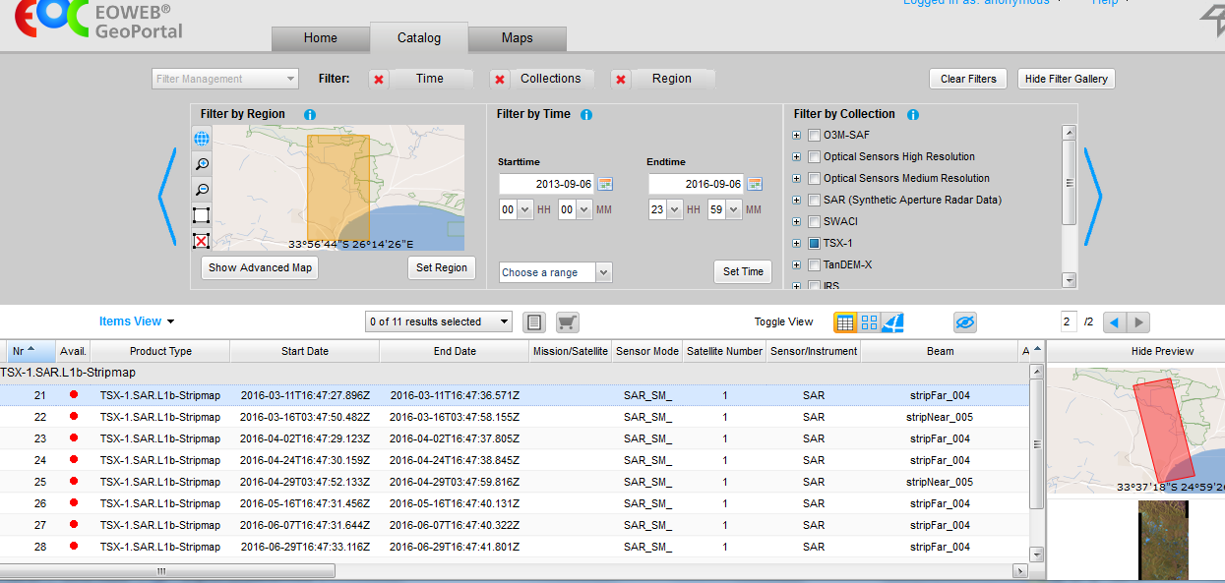
TerraSAR Background Mission
Example Group 16 CSIRS South Africa
28 TSX stripmaps, asc/dec mode, at least monthly July 15 –Sept. 16.

Slide 7
TerraSAR/TanDEM-X Mission
Data provision procedures
TSX-Data Archiv data: TerraSAR Archive AO (no costs, open unlimited)
TSX-Data New acquisitions: TerraSAR General AO
TDX-X DEM: General AO (TDX-Final-DEM AO closed)
General AO Costs for GFOI R&D group can be waived if DLR Agency is contacted before AO-proposal submission
New TanDEM-X acquisitions e.g. for forest monitoring: please contact us for current and future acquisition planning (see next slides)
Global 90m DEM: SatDSiG approval still pending, but release expected soon
Notes:
We are also discussing a better (maybe 30 m) global DEM product for relevant UN and global programmes. There is interest at our Partner Airbus to work on an affordable license model that could be offered to a development cooperation donor with realistic chances for funding. However, Data security law and other challenges exist.

Slide 8
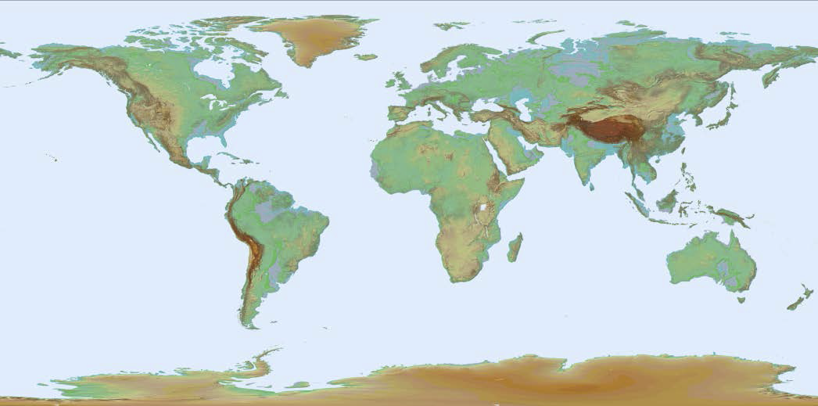
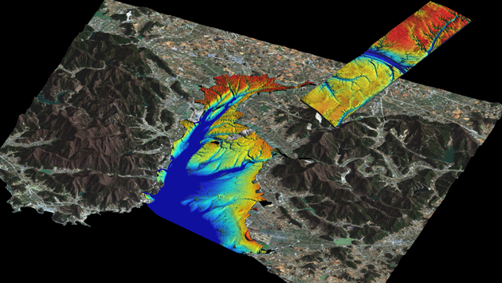
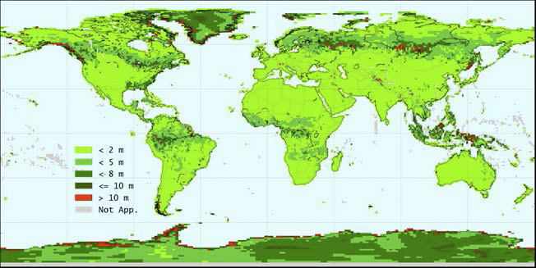
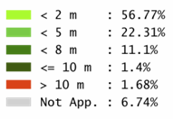
TanDEM-X DEM AO
Number of AO proposals: 757
Number: Forest DEM-Tiles: 466 (4.36 %)
Absolute Height Error per DEM Tile.

Slide 9
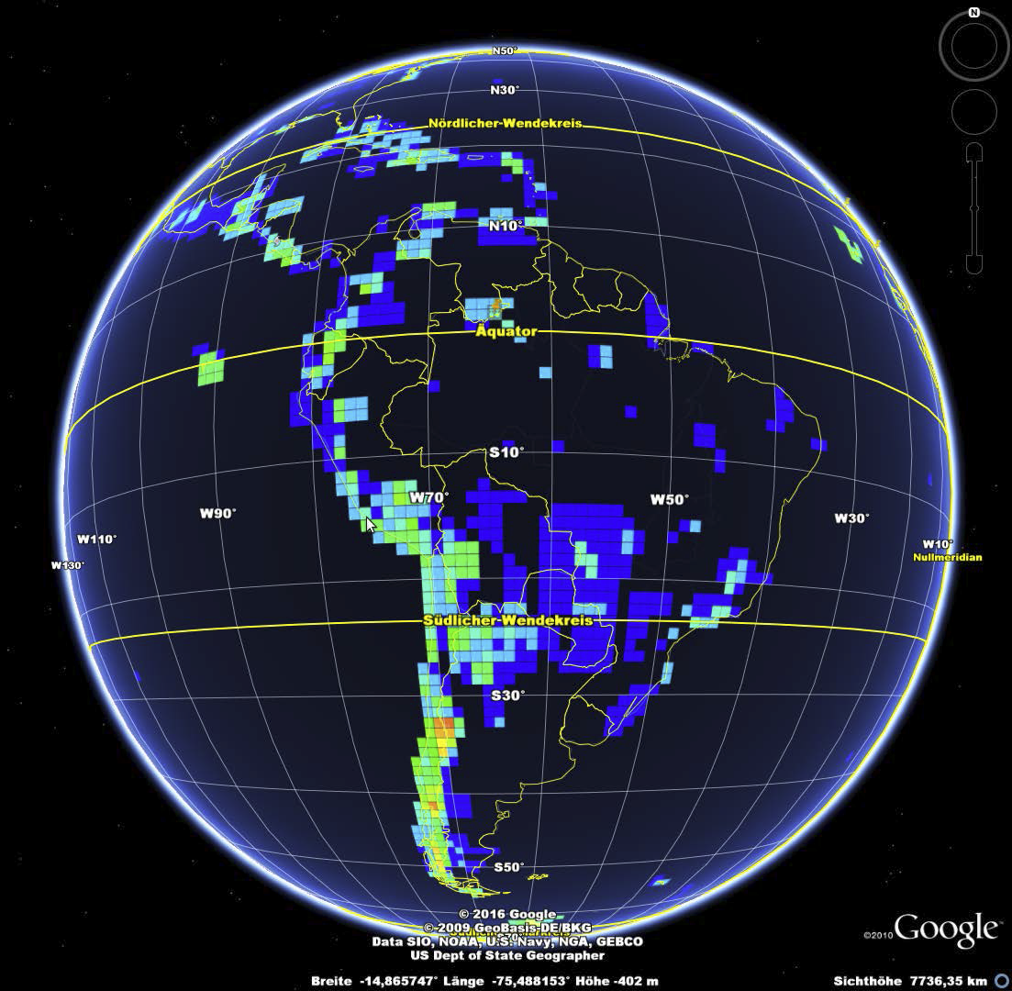
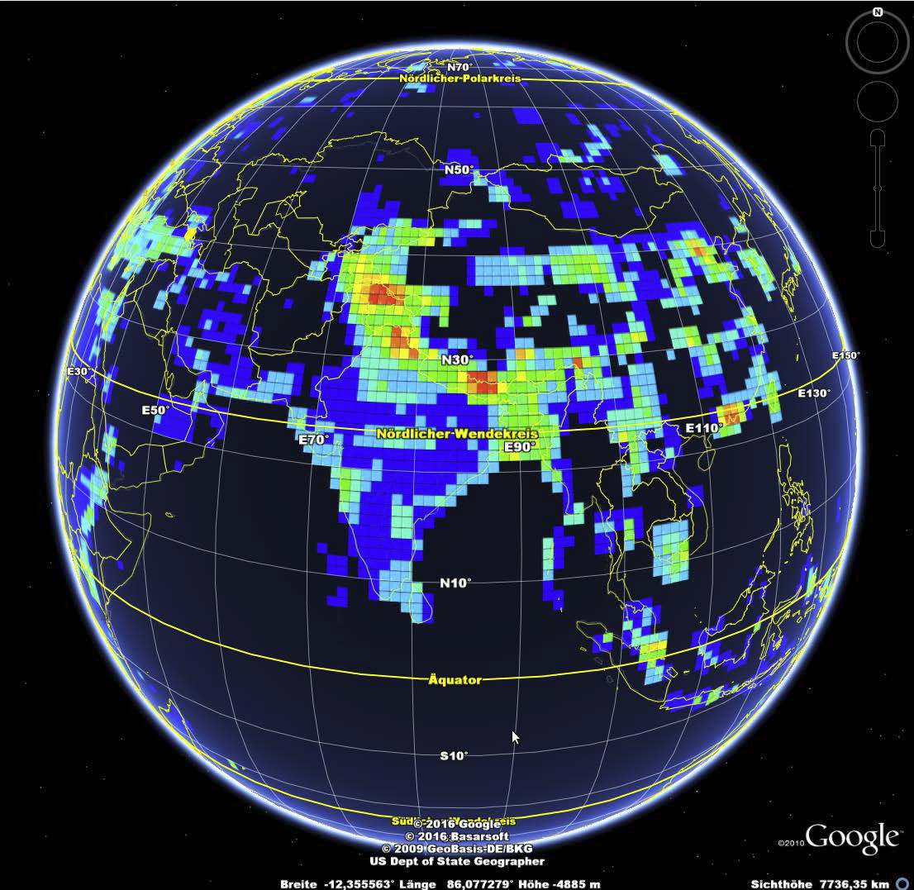
TanDEM-X DEM Heat maps
DEM Product Heatmap: South America
DEM Product Heatmap: Asia

Slide 10
TanDEM-X Current and Future Obseravtion scenario
Sept 2016 – Sept. 2017: focus on areas with high dynamics and local height changes:
Permafrost Boreal, Arctic & Antarctic
Global Volcanos / Sahara
(Sub-) Tropical Forests
Oct 2017 – Oct 2020 (initial discussions - not approved)
One additional global acquisition (2017-2020): DEM 2.0
Change layer
Acquisition with a second baseline for tropical forest
Notes:
If there was a clear message from GFOI to cover certain areas until Sept this year, this should be forwarded to DLR as soon as possible. There might still be a chance to integrate that into the acquisition plan for the coming months.
GFOI is also invited to make proposals for the coming phase from oct 2017 onwards. We are happy to consider them in the planning.
Michael Bock is the PoC for both short and medium term proposals.

Slide 11
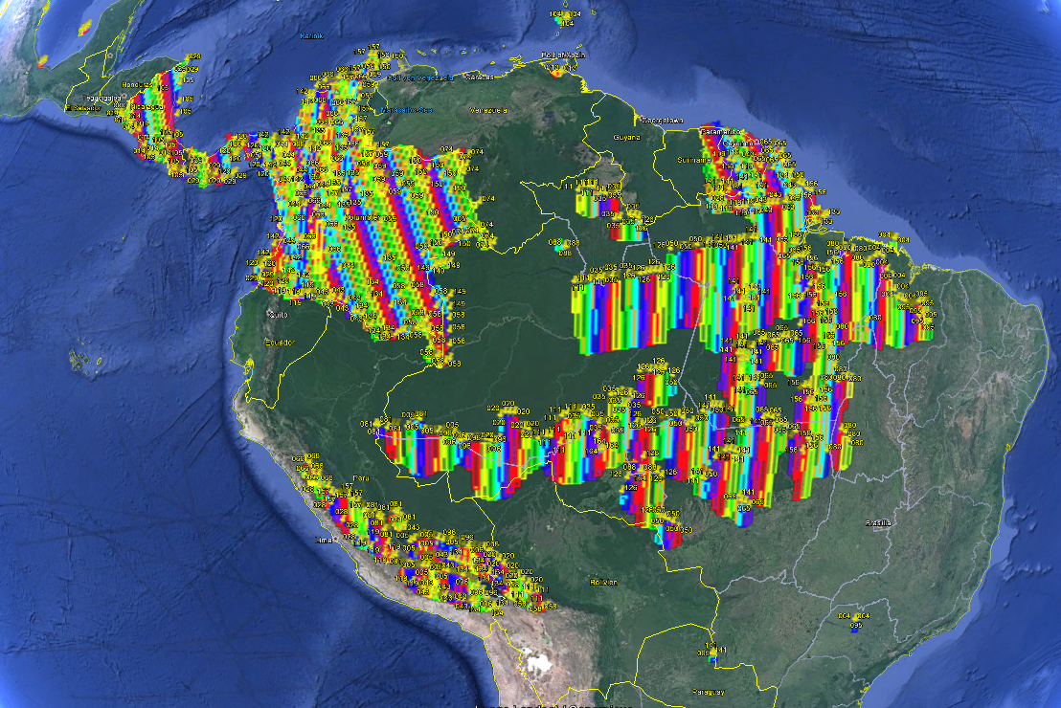
TanDEM-X: South America 9.2016 - 9.2017
Nicaragua
Costa Rica
Panama
Colombia
Peru
Brazil
French- Guayana

Slide 12
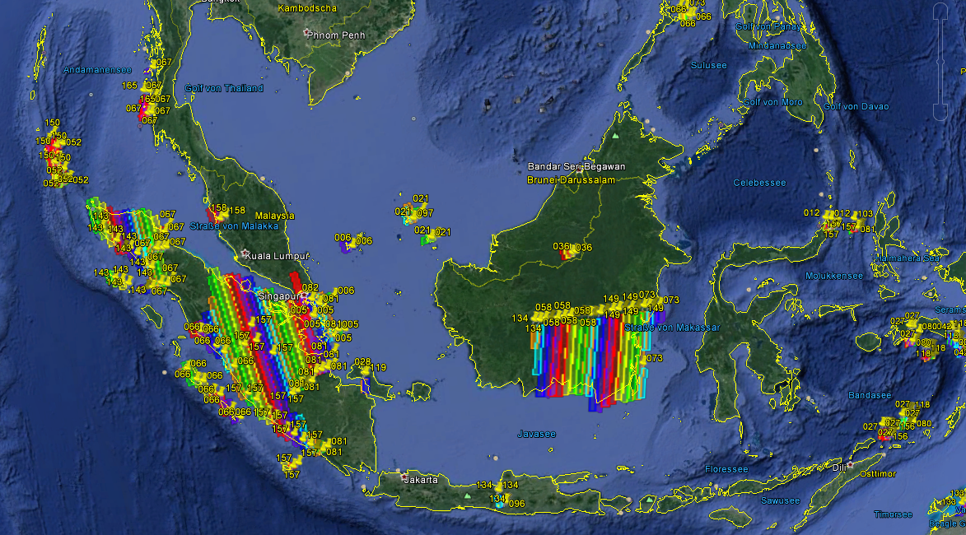
TanDEM-X: South-ASIA 9.2016 - 9.2017
Sumatra
Borneo

Slide 13
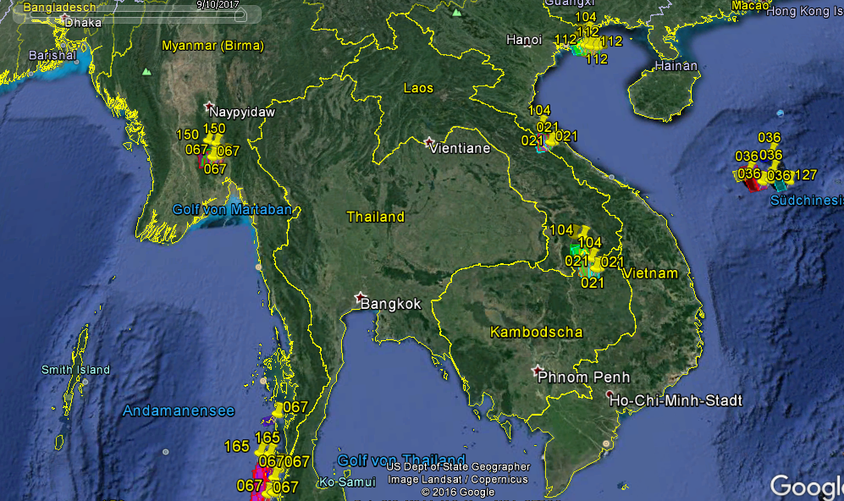
TanDEM-X: South-ASIA 9.2016 - 9.2017

Slide 14
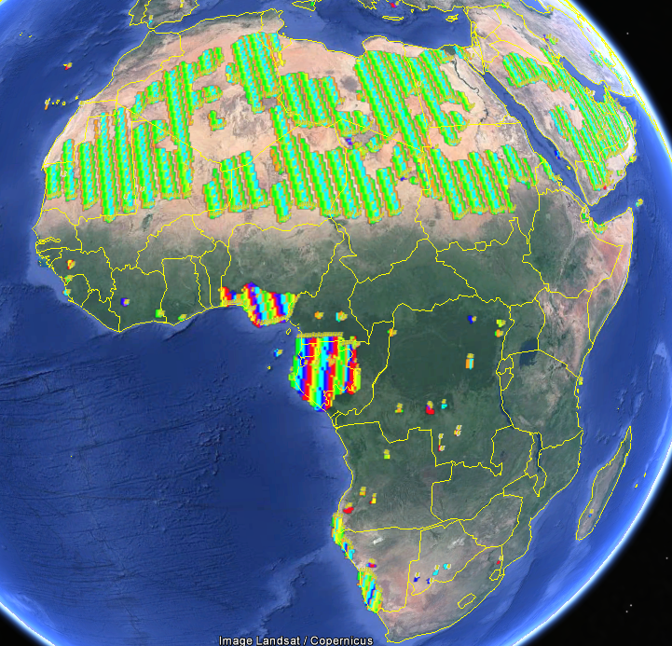
TanDEM-X: Africa 9.2016 - 9.2017
Gabun
Nigeria

Slide 15
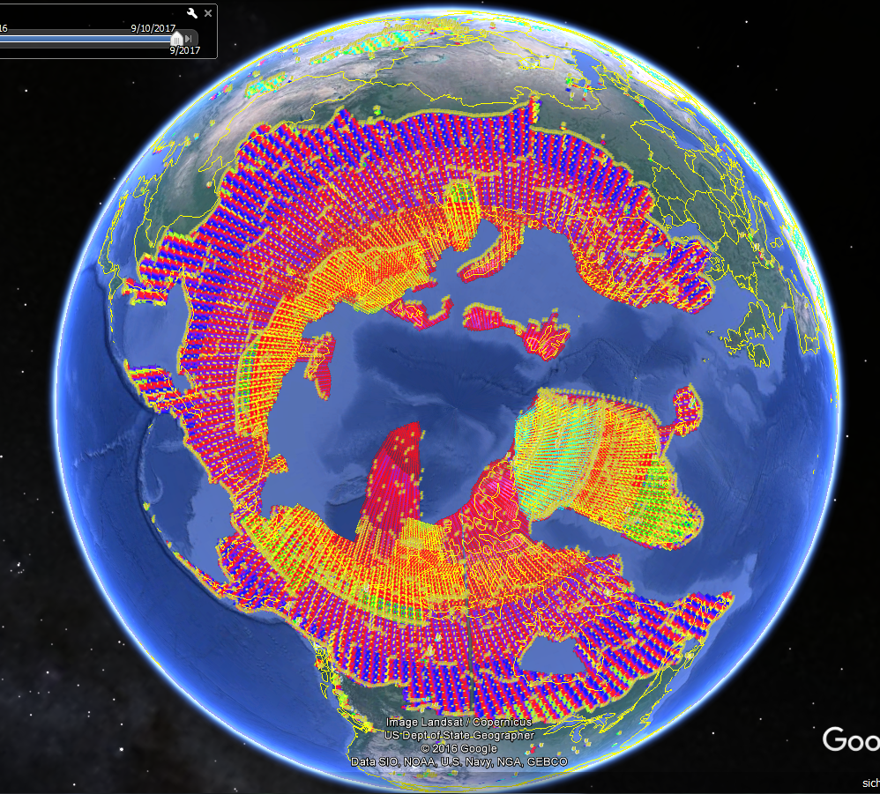
TanDEM-X: Boreal & Arctic 2017

Slide 16
DLR R&D grants to GFOI R&D teams
Support to research GFOI R&D groups
R&D Team | Nr. | Scientific Focus | Sensors used | Region
HU & FU Berlin (P. Hostert, B. Waske) |  | SENSE CARBON: Improved mapping of REDD+ using deep and dense time-series and large area compositing approaches | Landsat, Rapid Eye, ASAR, TSX, Sentinel-1 /-2 | Brazil Mato Grosso
FSU Jena, (C. Thiel) |  | SEN4REDD: Development of integrated multi-temporal Processing chain for Sentinel-1 und 2 data to REDD support | Sentinel-1 Sentinel-2 | Mexiko, South Africa
Support to SME & industry GFOI R&D groups:
R&D Team | Nr. | Scientific Focus | Sensors used | Regions
Airbus DS / Univ. Hamburg |  | Development of a cost efficient REDD+ Monitoring -concept by use of TSX/TDX and Sentinel-2 | TSX/TDX Sentinel-2 | SurinameIndonesia Ghana
RSS (Florian Siegert) |  | Estimation of forest height and biomass using multipass X-and C-Band POL-INSAR data (CSA parallel support to AUG Signals) | TSX/TDX Radarsat-2 Sentinel-1 | Indonesia
Project Factsheets: http://www.dlr.de/rd/desktopdefault.aspx/tabid-4285/6899_read-45464/

Slide 17
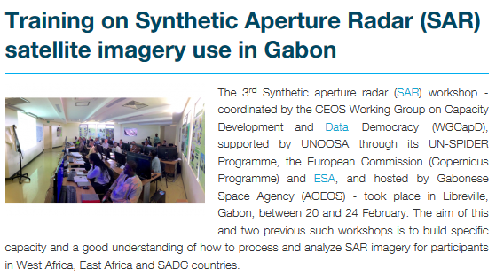
CEOS WG CAPD SAR Capacity Building
DLR & SAREDU support CEOS WG CAP-D Regional Africa Workshops including forest and biomass topics
Zambia, Lusaka Oct. 2016
Gabon, Libreville Feb. 2017.
South Africa, Pretoria May 2017 ISRSE SAR Summer school includes a specific REDD session .

Slide 18
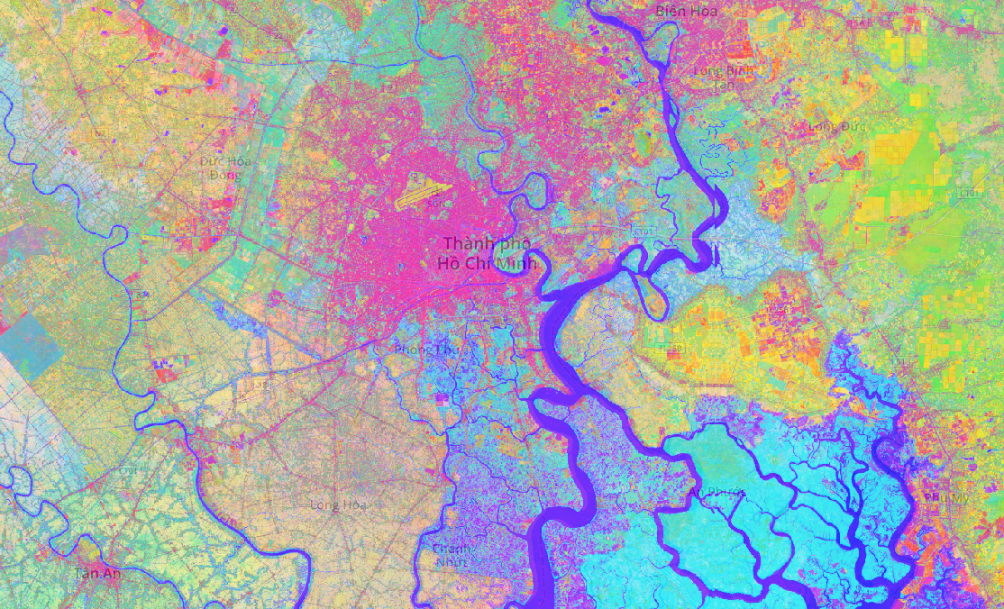
Questions ?
Any suggestions for additional country coverages ?
DLR TIMESCAN Landsat 2013 – 2015
Ho Chi Minh Vietnam
https://urban-tep.eo.esa.int/geobrowser/?id=timescan
Or soon also on http:www.code-de.org

