Slide 1
SESSION 2: 2017-2019 Work Plan Outcomes Status
SDCG-12: ESRIN, 4-7 September, 2017

Slide 2
SDCG-11 Actions Status
17 total actions
10 actions COMPLETE or CLOSED
3 On Hold
3 to be addressed at SDCG-12
1 On Going

Slide 3
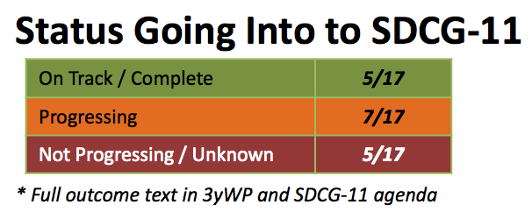
2017 Work Plan Outcomes
Status Going Into to SDCG-12
* Full outcome text in 3yWP and SDCG-12 agenda
On Track / Complete | 5/17
Progressing | 6/17 (-2)
Not Progressing / Unknown | 6/17 (+2)
 | Outcome* | Status |  | Outcome* | Status
Baseline | #1: Global Coverage | In Progress | Service (Cont’d) | #10: Cloud Computing Pilots | Colombia on track, new pilots yes
 | #2 Data Flows | Implementation steps? |  | #11: National Model | No Colombia progress
 | #3: Info. Products | Progressing in ‘ARD’ via LSI-VC | R&D | #12: E3 Strategy | Updated for SIT-32
Services | #4: MGD/SilvaCarbon Integration | Complete? |  | #13: Data for R&D | All agencies contributing
 | #5: CB Meetings | SilvaCarbon support drifting? |  | #14: Broker Commercial | No recent discussion
 | #6: Ensured coverage (CDS) | For LS+S2A | Component Coord’n | #15: Customer Experience | Not yet – DUAG?
 | #7: Interop. Discovery Tools | Progress? |  | #16: Priority Country Service | DUAG?
 | #8: Core Data Assembly | Could be addressed by data cube? |  | #17: Country I/F Management | Not yet – DUAG?
 | #9: MGD 2.0 Integration | MDG 2.0 finalised, integration?

Slide 4
Questions?
How to progress 2018 – 2020 update?
What’s needed to reflect GFOI Phase 2?

