Slide 1
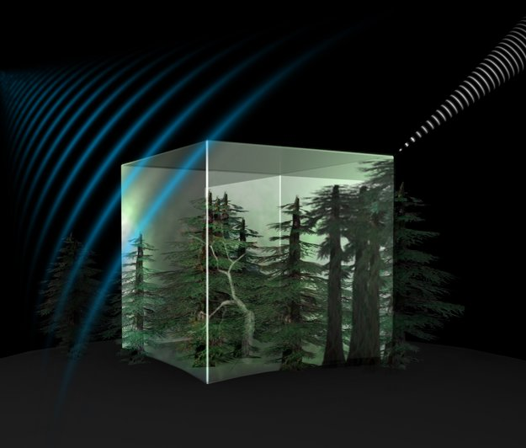
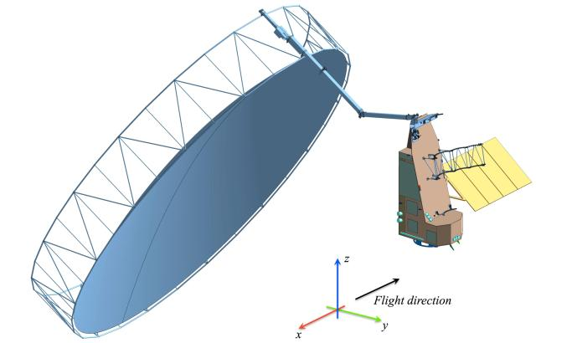
Earth Explorer BIOMASS
BIOMASS will be the 7th Earth Explorer
Selected by ESA’s Earth Observation Programme Board
Biomass based on global interferometric and polarimetric P-Band Radar observations
Essential to understand the Earth’s carbon cycle
To be launched in July 2021
EE7 BIOMASS products
Above ground forest biomass
Upper canopy height
Areas of forest clearing
Notes:
AGB and canopy height with 200 m res, forest clearing with 50 m
Design drivers: Large deployable antenna of 12 m diameter and Vega launcher compatibility

Slide 2
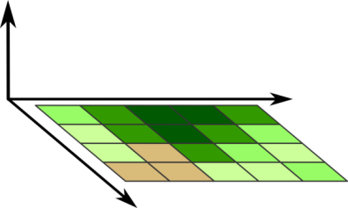
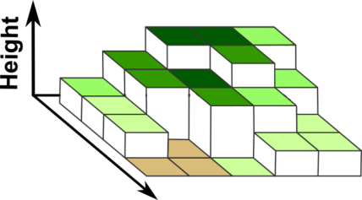
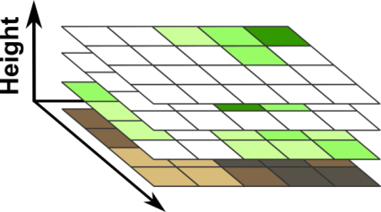
Biomass: 3 independent types of information
PolSAR
(SAR Polarimetry)
PolInSAR
(Polarimetric SAR Interferometry)
TomoSAR
(SAR Tomography)
z
z
z
x
x
x
o
o
o
y
y
y

Slide 3
Preparatory Science Activities
Airborne campaigns to support the mission: AfriScat in Ghana, AfriSAR in Gabon, BorealScat, AfriLidar ➔ http://www.esa.int/Our_Activities/Observing_the_Earth/The_Living_Planet_Programme/Campaigns
International Forest Biomass Network (IFBN) ➔ http://www.forest-observation-system.net/
Biomass Retrieval Intercomparison Exercise (BRIX) to run from July 2017 to February 2018 with 12 teams ➔ https://earth.esa.int/web/sppa/meetings-workshops/hosted-and-co-sponsored- meetings/brix
GlobBiomass User meeting at FAO, 11-13 September 2017
Workshop on “Measuring Forest Structure Parameters using Space-Based Observing Systems” is organised at ISSI in Bern on 6-10 November 2017
Notes:
AGB and canopy height with 200 m res, forest clearing with 50 m
Design drivers: Large deployable antenna of 12 m diameter and Vega launcher compatibility

