Slide 1
Overview of NovaSAR

Slide 2
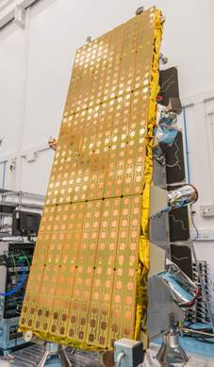
NovaSAR programme overview
Demonstration Synthetic Aperture Radar (SAR) mission
  Designed for lower cost missions
  S-band (3.1 – 3.3 GHz)
  Medium resolution with wide coverage
  Multiple modes and multi-polarisation (non-coherent)
First satellite launching November 2017
  Polar Orbit, SSO LTAN
Data becoming available around April 2018
UK Government involvement
  Grant to support development
  Will receive 15% of the data
    Data freely available for R&D
    Will be a UK user group
  UK Space Applications Catapult
    Handling user requests for imagery
    Storing and archiving data
    Making data available on portal

Slide 3
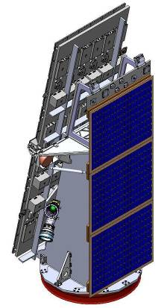
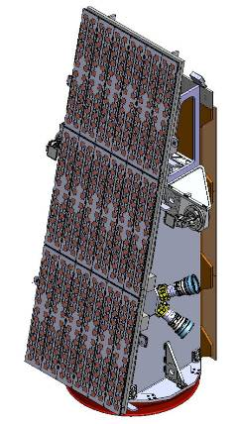
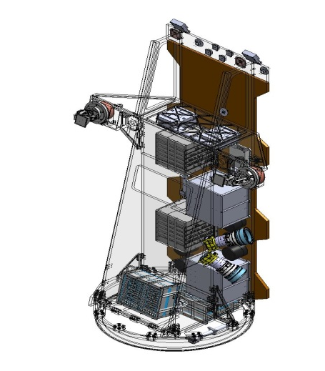
Mission
Design lifetime 7 years
Multiple imaging modes
  From high resolution to wide area coverage
Multi-polarisations
  HH, VV, VH, HV possible
  Single, dual, tri and quad polar imaging available BUT with some compromise in resolution or swath
Payload duty cycle
  Payload orbital duty cycle of >120 s
  Multiple images or single image >800 km long
Imagery products
  Expected outputs: L1, L2, L2+
  L2 include GEC (Geo-coded Ellipsoid Corrected) and Ortho-rectified products

Slide 4


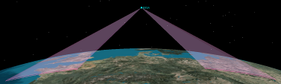

Baseline operating modes
Based on 580 km orbit
Modes | Typical swath width | Spatial resolution | Incidence angle | Number of looks
ScanSAR | 100 km | 20 m | 16 - 30 deg | 4
Maritime Surveillance | > 400 km | 6 m x 13.7 m | 34.5 - 57.3 deg | 1
Stripmap | 15 - 20 km | 6 m | 16 - 31 deg | 4
ScanSAR (wide) | 140 km | 30 m | 14 - 32 deg | 4
ScanSAR
Stripmap
Maritime
ScanSAR Wide

Slide 5
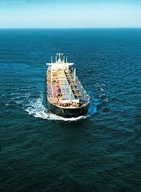
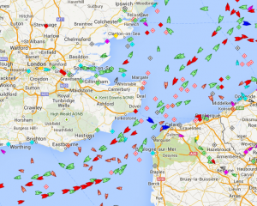
AIS data
AIS: Automatic Identification System
  AIS transponders on ships that automatically broadcast information - such as ship ID, position, speed, and navigational status - at regular intervals
  AIS required for many vessels: including those > 300 gross tonnage and upwards engaged on international voyages, on cargo ships of 500 gross tonnage and upwards not engaged on international voyages, and on passenger ships irrespective of size
AIS data will be available from NovaSAR
  Facilitate simultaneous AIS identifications and SAR ship detections
Range of applications
  Collision avoidance and vessel traffic services
  Accident investigation
  Fishing fleet monitoring and control

