Slide 1
China Brazil Earth Resource Satellite
Ivan Márcio Barbosa
Brazilian Satellite Data Center
National Institute for Space Research
ivan@dgi.inpe.br

Slide 2
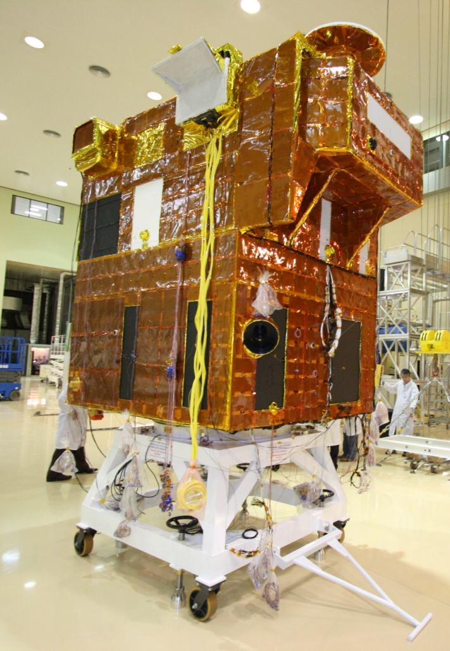
CBERS-3
Satellite | Solid-State Recorder 320 Gigabit
 | 1.950kg
Orbit | Sun-Synchronous (i=98.5°) 778 km
 | Descending Node 10:30 AM
Communications | Banda –S (4Kbps) Cuiabá-MT and Alcântara-MA
 | X-Band PAN (B01) 140 Mbps PAN (B02,03,04) – 100 Mbps IRS - 16 Mbps MUX - 68 Mbps WFI - 50 Mbps Cuiabá-MT Cachoeira Paulista-SP.
Sensors | MUX; PAN; AWFI;IRS;SEM e DCS
Launch | 09th December, 2013 (Long March 4B)
Life Time | 03 years

Slide 3
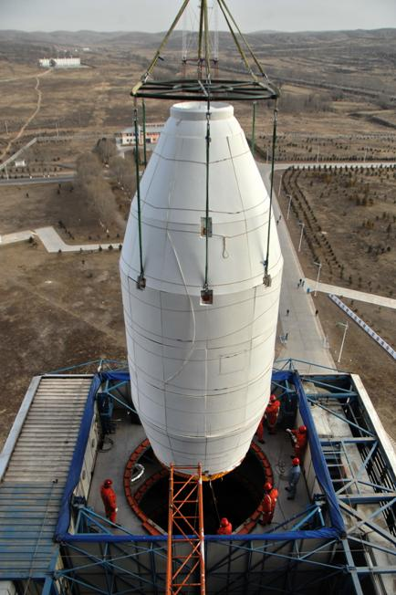
CBERS-3
The fourth CBERS satellite to fly was lost in a launch failure in 9th December 2013.
The Chang Zheng 4B (Long March 4B) rocket was used to launch CBERS-3 satellite.
The launch started at 03:26 UTC from the Taiyuan Satellite Launch Center in China.
The rocket failure in the third stage engine and caused the loss of the CBERS-3 satellite.

Slide 4
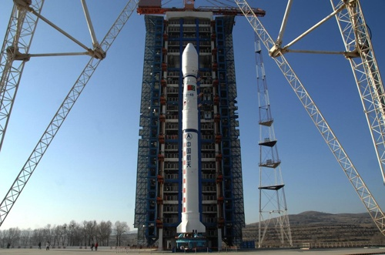
CBERS-3
China has begun an investigation into the causes of the failure.
In response to the failure, China and Brazil have called for an extraordinary committee meeting to discuss the causes for the accident, next steps to be taken in the program.
INPE and CAST engineers are working on CBERS-4 AIT in Beijing, China. The launch date
will be in December, 2014.

Slide 5
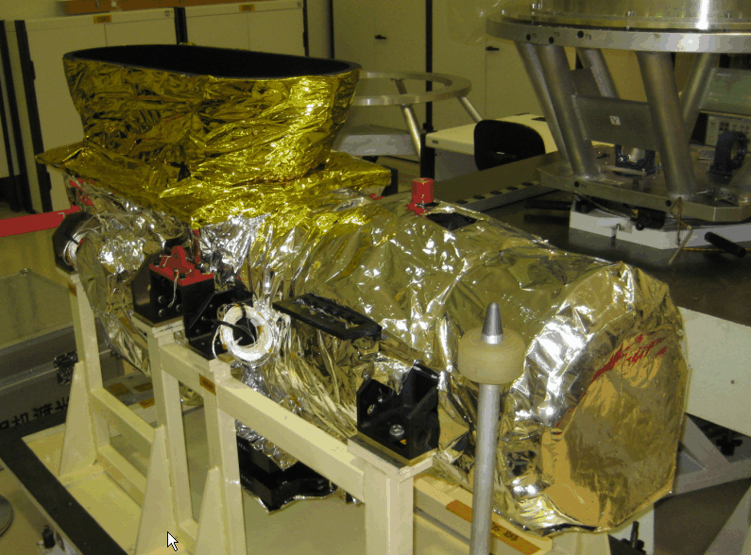
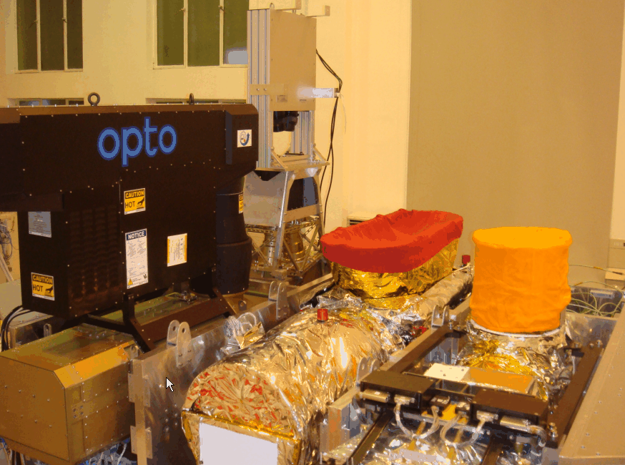
CBERS-4 – PAN Camera
PanMux Camera (PANMUX)
Spectral bands | B01: 0.51 – 0.85 µm B02: 0.52 – 0.59 µm B03: 0.63 – 0.69 µm B04: 0.77 – 0.89 µm
Swath width | 60 km
Spatial resolution | 5 m (B01)/10 m (B02, B03, B04)
Mirror pointing capability | ± 32º
Image data bit rate(Mbit/s) | 140 Mbit/s (B01) 100 Mbit/s (B02, B03, B04)

Slide 6
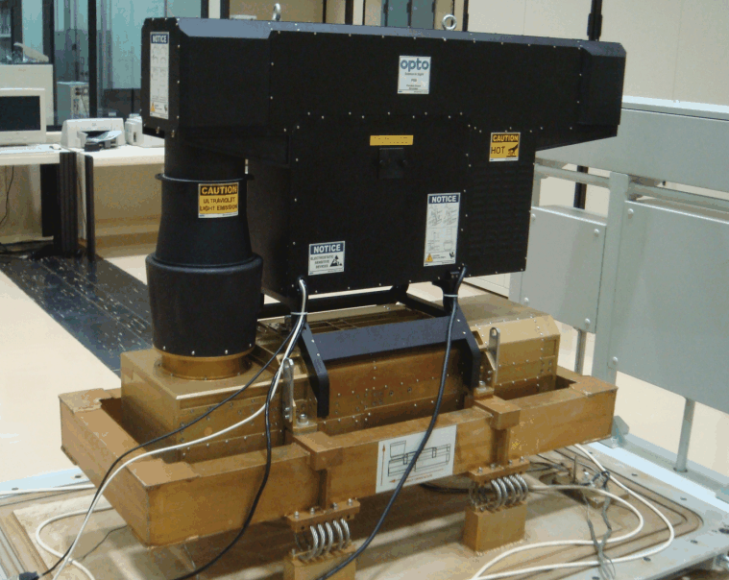
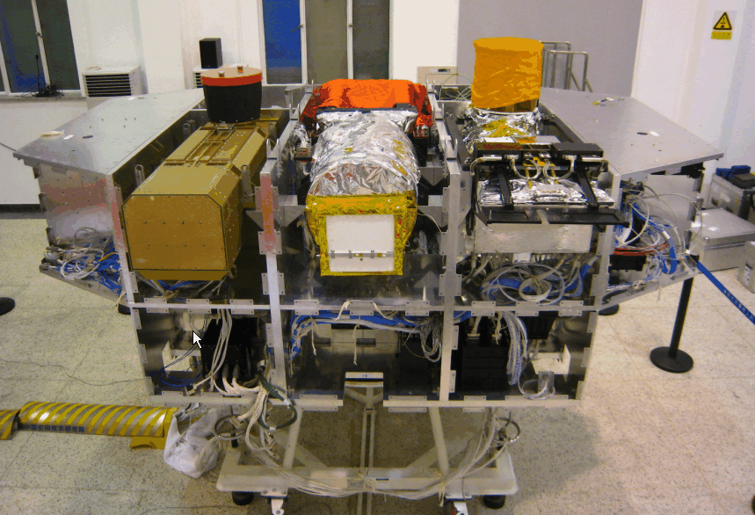
CBERS-3 – MUX Camera
Multispectral Camera (MUXCAM)
Spectral bands | B05: 0.45 – 0.52 µm B06: 0.52 – 0.59 µm B07: 0.63 – 0.69 µm B08: 0.77 – 0.89 µm
Swath width | 120 km
Spatial resolution | 20 m
Image data bit rate | 68 Mbit/s

Slide 7
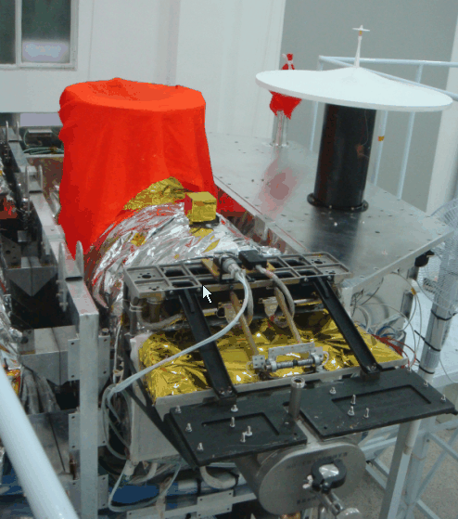
CBERS-3 – IRS (InfraRed Multispectral Scanner)
Infrared Medium Resolution Scanner (IRSCAM)
Spectral bands | B09: 0.50 – 0.90 µm B10: 1.55 – 1.75 µm B11: 2.08 – 2.35 µm B12: 10.4 – 12.5 µm
Swath width | 120 km
Spatial resolution | 40 m; 80 m (Thermal Band)
Image data bit rate | 16 Mbit/s

Slide 8
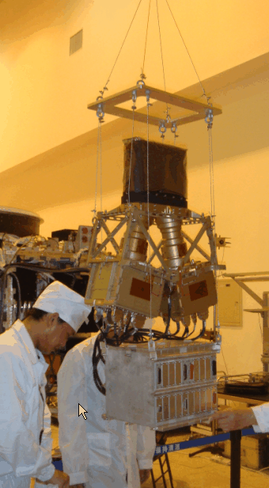
CBERS-3 – WFI (Advanced Wide Field Imager)
Wide Field Imaging Camera (WFICAM)
Spectral bands | B13: 0.45 – 0.52 µm B14: 0.52 – 0.59 µm B15: 0.63 – 0.69 µm B16: 0.77 – 0.89 µm
Swath width | 866 km
Spatial resolution | 64 m
Image data bit rate | 50 Mbit/s

Slide 9
CBERS-3 and 4 Cameras - Summary
 | MUXCAM | PANMUX | IRSCAM | WFICAM
Spectral bands (µm) | 0.45 – 0.52 0.52 – 0.59 0.63 – 0.69 0.77 – 0.89 | 0.51 – 0.85 0.52 – 0.59 0.63 – 0.69 0.77 – 0.89 | 0.50 – 0.90 1.55 – 1.75 2.08 – 2.35 10.40 – 12.50 | 0.52 – 0.59 0.63 – 0.69 (R) 0.77 – 0.89 (NIR) 1.55 – 1.75 (MIR)
Resolution (m) | 20 | 5 (pan) and 10 | 40 and 80 (thermal) | 64
Swath width | 120 km | 60 km | 120 km | 866 km
Pointing | None | ±32º | None | None
Revisit (days) | 26 | 5 | 26 | 5
Quantization | 8 bits | 8 bits | 8 bits | 10 bits
Image Data bit rate (Mbit/s) | 68 | 140 and 100 | 16 | 50

Slide 10
CBERS-4 Acquisition Strategy
Capacity to accommodate GFOI acquisition requests
Full coverage over Brazil (2 passes/day) and China (3 passes/day)
Full coverage over ground stations in Africa (2 passes/day)
Best effort to cover any other region using the OBDR (1 pass/day)
Capacity to augment plan “on the fly”
15 minutes duty cycle for each camera
Solid state OBDR with capacity of 320 Gbits
OBDR can record 15 minutes per day (maximum)
50% time share between Brazil and China

Slide 11
CBERS-4 Acquisition Strategy
CBERS-3 is driven by national and regional applications over Brazil, China and Africa, and to provide data to the International Charter on Space and Major Disasters
Application 1
Brazil and China
Default acquisition mode: full coverage, nadir viewing, 4 cameras
Application 2
CBERS for Africa initiative
Default acquisition mode: full coverage, nadir viewing, 4 cameras, over operational ground stations in Africa

Slide 12
CBERS-4 Data Processing and Distribution
Processing levels
Terrain corrected images, where digital elevation data are available
System corrected image data
Data formats
Standard GeoTIFF
Means of data distribution
Open access on http://www.dgi.inpe.br/CDSR/

Slide 13
Conclusão
O acervo de dados e imagens de satélites do INPE é um dos principais patrimônios do INPE;
O acervo do Centro de Dados contém dados de satélites de Observação da Terra, Meteorológico e Científicos;
O Centro de dados é o início da cadeia produtiva de serviços e produtos de satélites;
O Centro de Dados é a interface entre o Programa Espacial Brasileiro e a sociedade brasileira;
O centro de dados é interface entre os Programas Espaciais Internacionais e a sociedade brasileira;
O Centro de Dados necessita constantemente investimentos financeiros.
Thank you!
ivan@dgi.inpe.br

