Slide 1
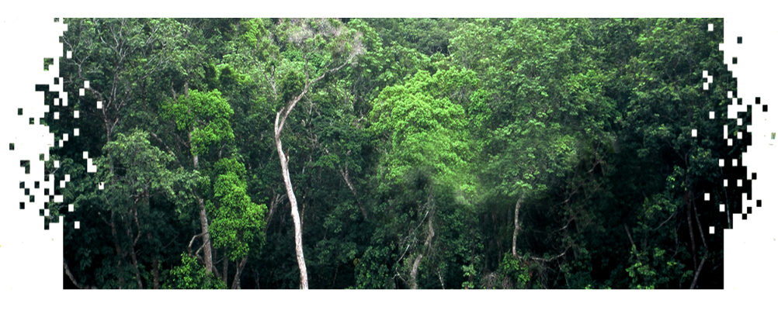
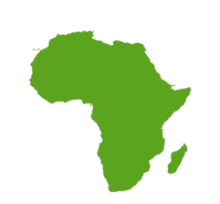
THE FRENCH INITIATIVE
FOR THE CONGO BASIN
STATUS: FEB 2014
Space Data Coordination Group Meeting (SDCG‐5)
ESRIN, Frascati, Italy
24‐28 February 2014
Camille PINET
IGN France International
cpinet@ignfi.fr

Slide 2
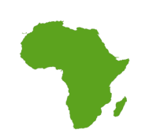
OVERVIEW
Background
Provision of SPOT Data
Status of data availability
Data access policy
Status of beneficiaries
Forest Mapping
Central African Republic
Cameroon
Capacity Building

Slide 3
BACKGROUND
Framework agreement between AFD & Astrium
2010-2015 programme: French cooperation to finance the coverage of the Congo Basin Tropical rainforest with SPOT satellite images
Project objectives
Provide an exhaustive coverage with recent images, and regular updates
Access to archive images of satellites SPOT 1, 2, 3, 4, 5
Products at basic level (1A) or ortho-rectified
some forest mappings
Open access to data for REDD+ users: public entities, research institutions, universities, NGOs, private companies) upon approval of ‘REDDSPOT’ licence
within the 6 countries: Cameroon, Gabon, CAR, DRC, Congo, Equ. Guinea
A consortium was set to coordinate the programme
IGN FI, CNES, IGN, IRD

Slide 4
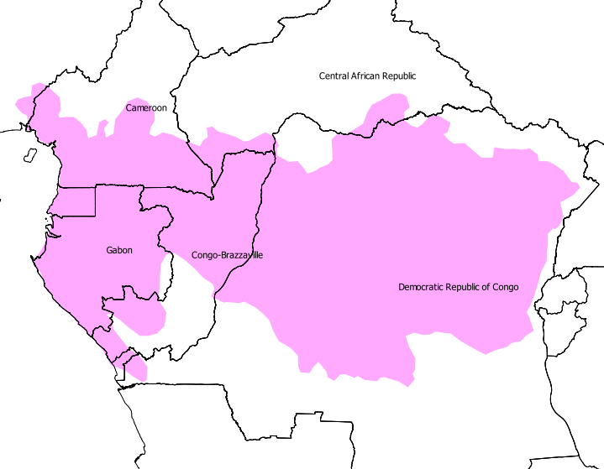
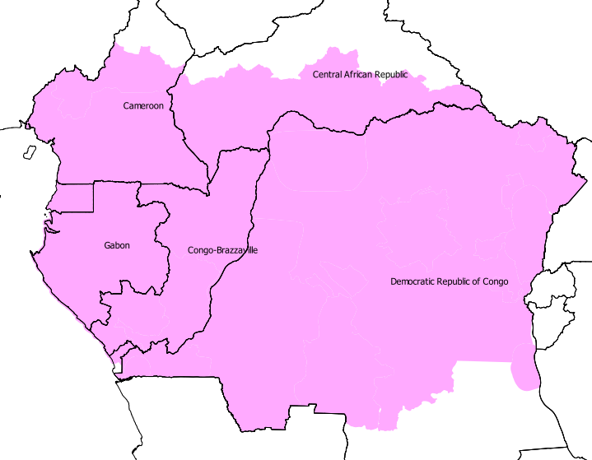
Area of interest
Initial AOI: tropical rain forest
2 millions sq.km
Current AOI: has been extended to
3.3 millions sq.km

Slide 5
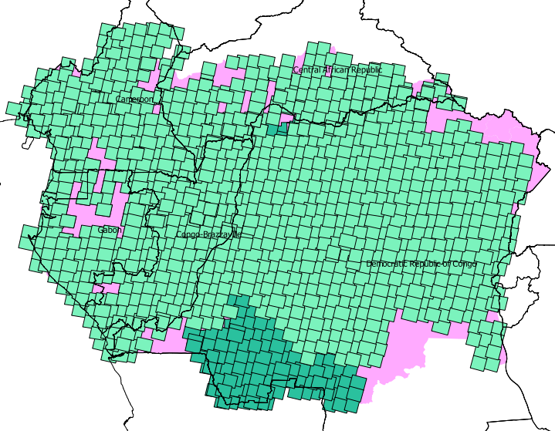
Status of data availability: 2008-2012
Overview of SPOT4 & SPOT5 availability for
2010 reference dataset
(images from 2008 to 2012)
All images with <20% cloud cover
All images have been orthorectified
by Spatio-triangulation

Slide 6
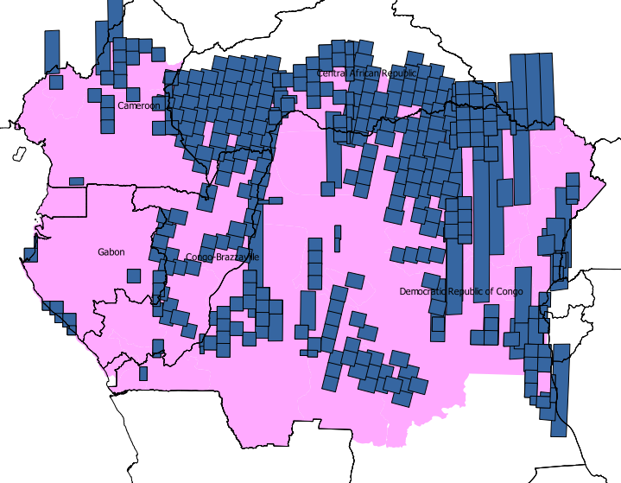
Status of data availability: 2013-ongoing
Overview of SPOT5 & SPOT6 availability for
2015 reference dataset (+/- 2years)
(images from 2013 - ongoing)
All images with <20% cloud cover

Slide 7
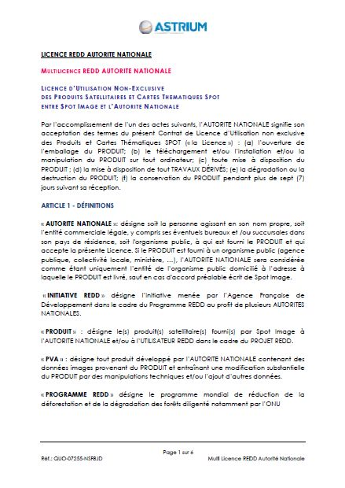
Data access policy
A specific SPOT « REDD license » has been created:
=> Free Access, Sharing and Usage provided on SPOT Products to End Users within the frame of projects approved by National authorities.
Status of licences signed:
Signature of National Authority licenses :
in Durban (December 2011): DRC / Congo / CAR
in Yaounde (June 2012): Cameroon
in Libreville (January 2013): Gabon
Sub-licences signed by National authorities yet (local projects):
in DRC, in Congo, in Cameroon, in Gabon, in CAR
Sub-licences signed by IGN FI (regional initiatives):
with JRC
with CIRAD

Slide 8
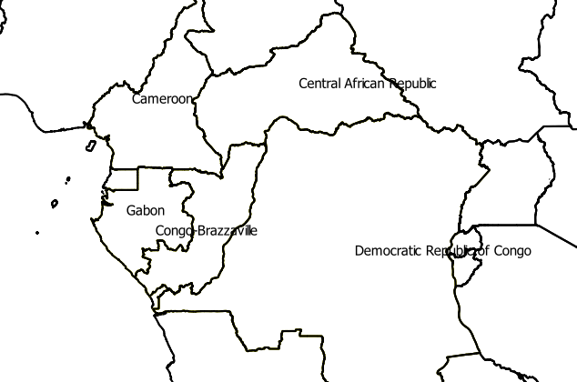
Overview of actual requests/users
In Cameroon, via MINEPDED/MINFOF:
Projet Ngoyla Mintom MINFOF - GEF
Université de Yaoundé 1 (AWO FREDERICK)
WWF Central Africa Regional Programme, CARPO Cameroun Country Programme
CEW - CAMEROUN ENVIRONMENTAL WATCH
Université de Yaoundé 1 (ANGOS ANGOS GISCARD)
CIFOR - Center for International Forestry Research
UMMISCO, Université de Yaoundé 1 (recherche / évaluation de biomasse forestière)
GAF-AG - PROJET REDDAF - REDD for Africa
MINEPDED (BELA MANGA ALLAIN)
Réserve de Biosphère du Dja
In CAR, via CN REDD:
Projet FP7 REDDAF sur la zone de démonstration du Sud-Ouest de la RCA
And also regional initiatives:
JRC TREES/OFAC
CIRAD CoForChange
In Gabon, via AGEOS:
Ressources en eau,
Cartographie des mangroves de la Mondha,
Cartographie du couvert forestier,
Gestion des ressources naturelles et forestières
Agriculture,
Plan National Géomatique,
Aménagement durable des permis forestiers,
Projet JRC TREES/OFAC,
Occupation et utilisation des sols,
Planification urbaine,
Recensement des débarcadères autour de Libreville,
Cartographie des zones touristiques du Parc National de la Lopé,
Dégradation des Ecosystèmes,
Dynamique urbaine.
In Congo, via CN-REDD:
CIB - UFE Pikounda Nord - projet REDD
GAF AG - "Cartographie du couvert forestier sur l'ensemble du territoire de la République du Congo en 1990, 2000, 2010"
projet PAGEF
projet "Appui au suivi de l'exploitation forestière par la production d'un atlas forestier interactif du Congo"
In DRC, via DIAF:
African Wildlife Fundation
Banque Africaine de Développement
cellule Infrastructure du ministère de l’aménagement du territoire, urbanisme et habitat,
infrastructure public et reconstruction
Conservation International
ERA – Congo
Novacel
WWF
WHRC

Slide 9
Forest mapping
Two countries involved so far
mapping of 290,000 sq.km over RCA completed => results presented in « l’état des Forêts »
Mapping going on over Cameroon
Methodology based on several principles:
Consistency with national strategies
Consistency with international recommendations (IPCC)
Adaptation to local methodologies
Adaptation of methods to existing forest maps
In addition, to ensure quality
Implementation of a verification methodology
Implementation of a validation methodology

Slide 10
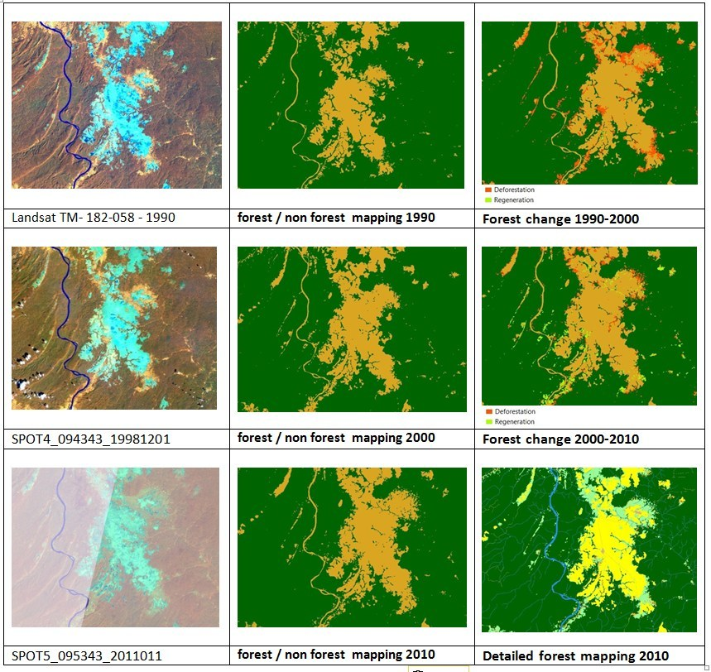
Forest mapping
High variability of the classes of land cover;
Presence of reference database data and/or field data;
Homogeneous and good distribution within the Central African Republic RainForest
Presence of a set of complex class of land cover such as: woodland, degraded forests, savannas, cultures, etc.
Archives data available
Products:
forest/non-forest maps – 20m
1990
2000
2010
changes maps – 20m
1990 / 2000
2000 / 2010
detailed reference map 2010 – 10m
Dense forest,
swamp forest
Degraded forest
Forest plantation
Savannah
Tree savannah
Agricultural cropland (mosaic cropland / semi-natural area)
Wetlands
Villages, towns
Water...

Slide 11
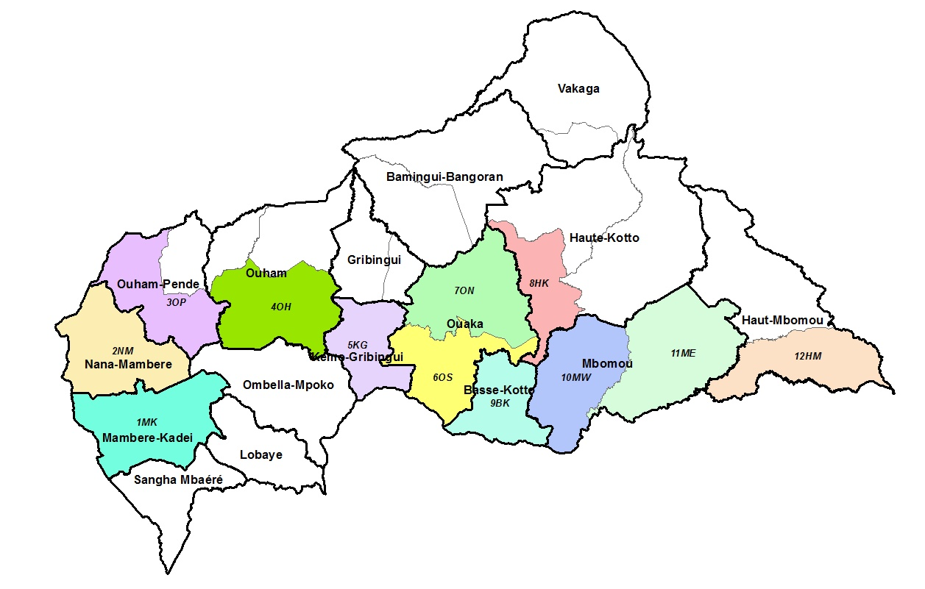
Forest mapping
Production of forest mapping over 290,000 sq.km in CAR:

Slide 12
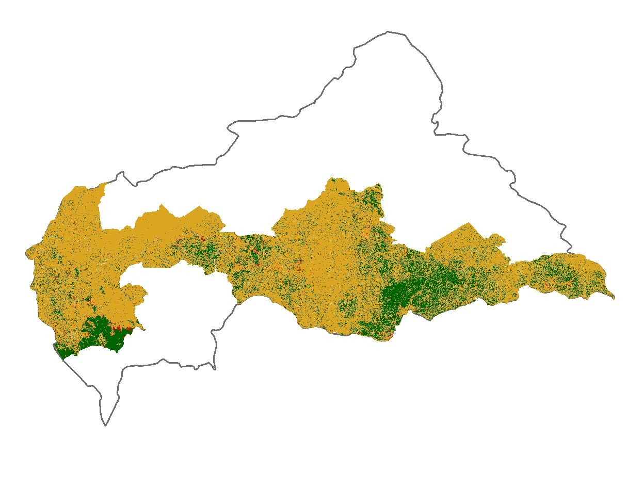
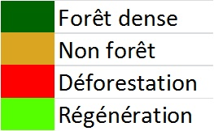
Forest mapping
2000: Forest / Non-Forest map
+ changes 1990 / 2000

Slide 13
Forest mapping
2010: Forest / Non-Forest map
+ changes 2000 / 2010

Slide 14
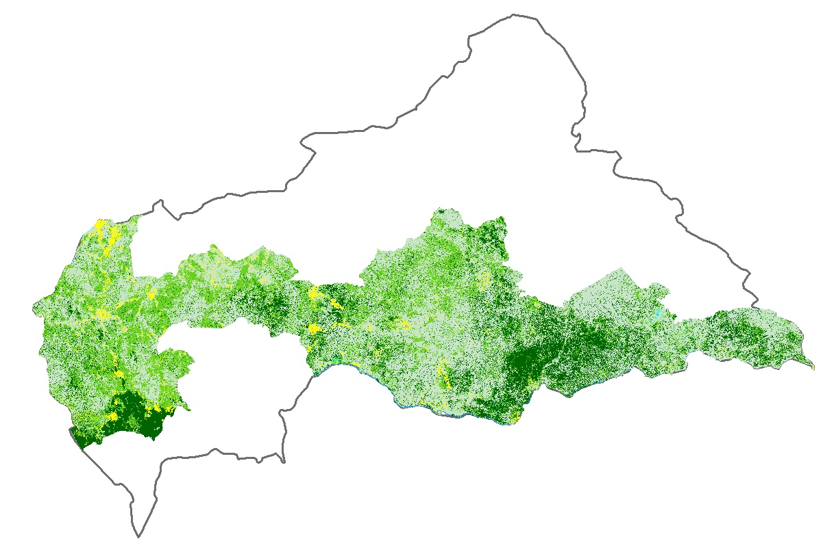
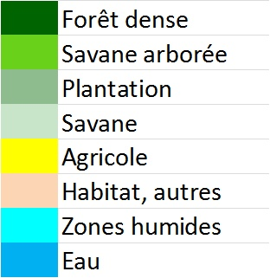
Forest mapping
2010: detailed map

Slide 15
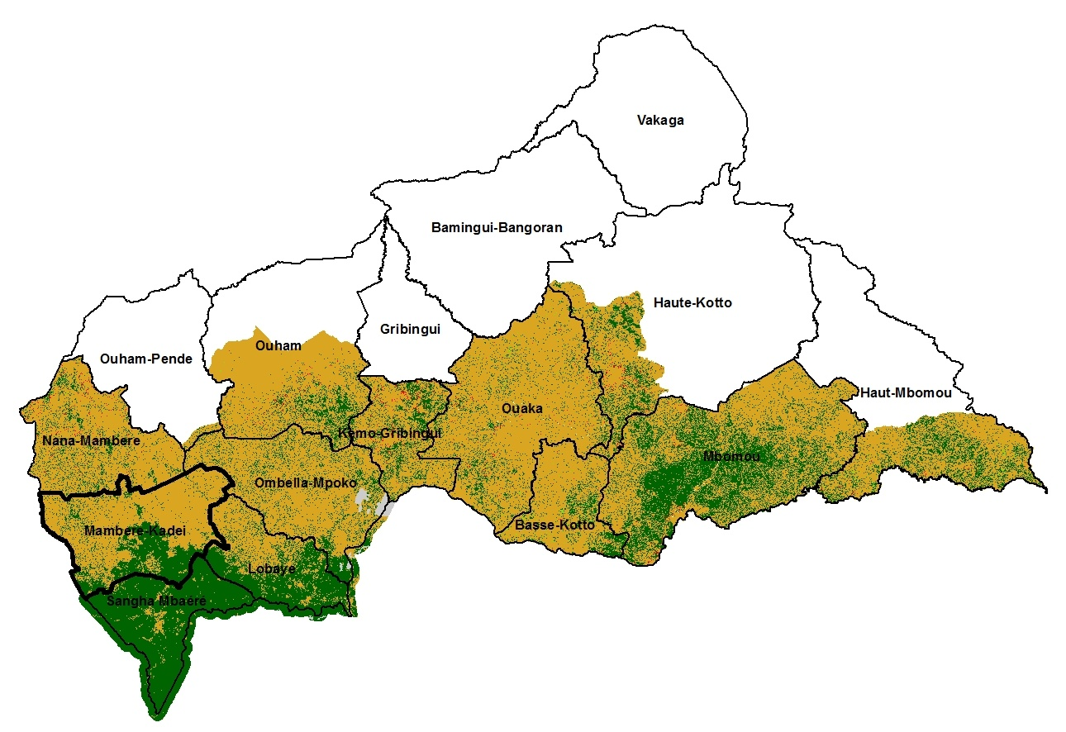
Forest mapping
results combined with 70,000 additional sq.km produced by REDDAF project

Slide 16
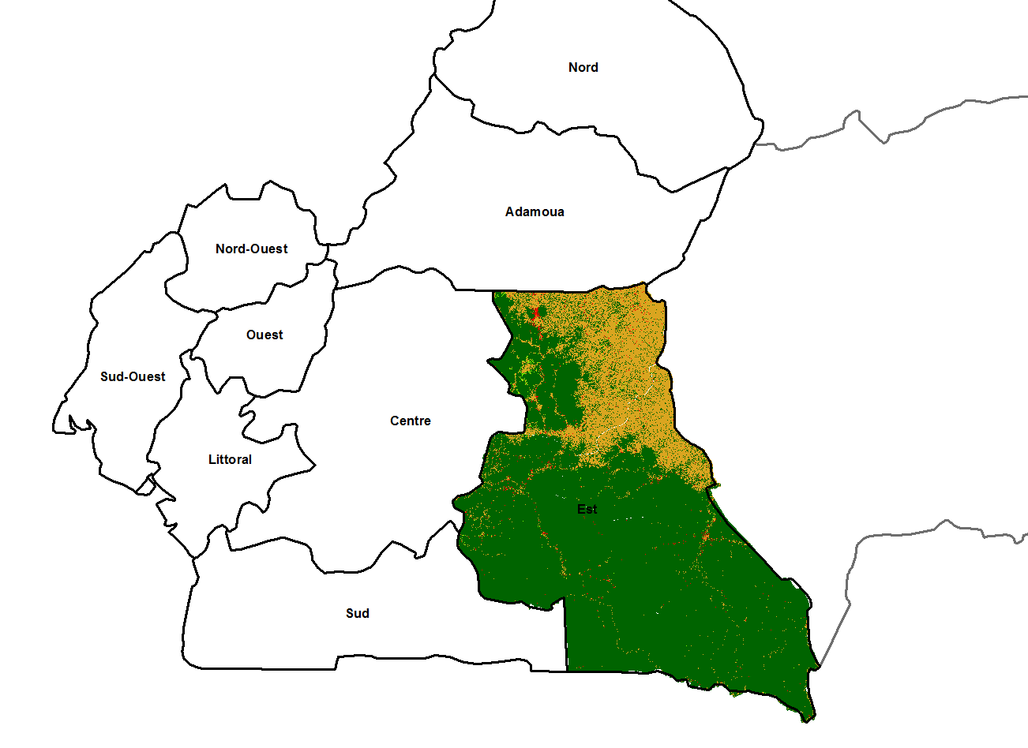
Forest mapping
MAPPING
Similar work started over Cameroon
290,000 sq.km to be mapped
UNDER
PROGRESS

Slide 17
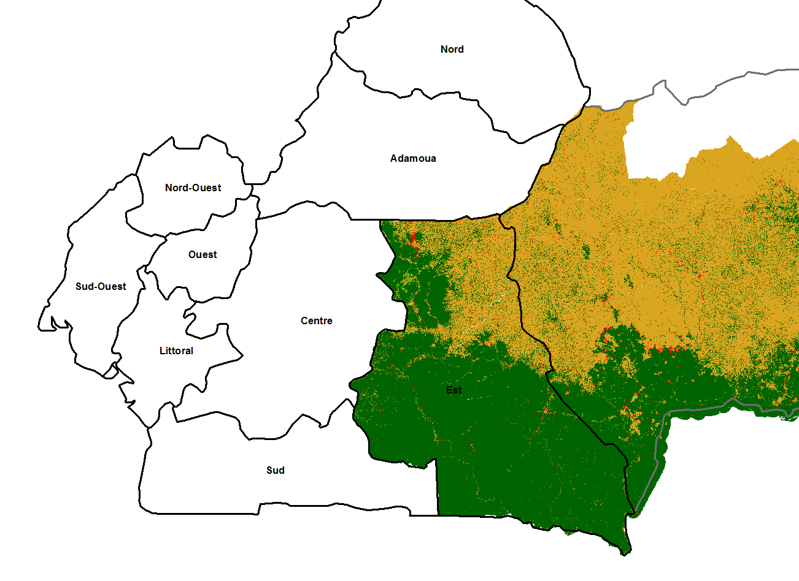
Forest mapping
=> Comprehensive and homogeneous mapping over adjoining regions

Slide 18
Capacity building
Countries involved in the work:
2013 : 4 staff from RCA ministry in France during 3 months have been participating in the production of their maps
2014 : 4 staff from Cameroon (MINEP + MINFOF) in France during 3 months will be participating in the production of their maps
Additional programme: GEOFORAFRI
Capacity building and access to earth observation data for monitoring forests in Africa

Slide 19
Thank you for your attention
Camille PINET
cpinet@ignfi.fr
bassinducongo.reddspot.org

