Slide 1

CEOS Systems Engineering Office (SEO) Capacities and Support to SDCG
Brian Killough
NASA LaRC, CEOS SEO
Presented at SDCG-5
Frascati, Italy
February 24, 2014

Slide 2

Agenda
SDCG-4 Actions
CEOS Mission Database (MIM)
CEOS Data Policy Portal
COVE Tool and Coverage Analyzer
USGS GloVis Tool
Google Earth Engine and API Tool
Element-2: Space Data Services

Slide 3
SDCG-4 Action 4-11
SDCG-4-11: SEO to perform a path/row analysis for each 2013/2014 country to determine which scenes have extreme cloudiness and would benefit from maximized L7 and L8 acquisitions. Report results to USGS (Eugene Fosnight) for consideration of LTAP adjustments.
RESULTS: The SEO has updated the 2012 and 2013 Landsat coverage tables for all 51 GFOI countries. The results are available in an EXCEL file with tabs for each country. The LTAP coverage is very good and the primary issue is cloudiness in a few specific locations.

Slide 4
2013 Coverage Summary
Landsat 7 and 8 acquired 71,587 images over 51 GFOI
countries in 2013. This includes only 8 months of L8 operation.
30% of those scenes were <10% cloudy, or nearly cloud-free.
Only 6% of the 2287 scene locations had moderate cloud problems where pixel mining could potentially be used to create cloud-free mosaics.
Only 1% of the 2287 scene locations had severe cloud problems. These locations will need to consider alternative data sources.
The 10 countries with severe cloud issues were:
Colombia, Ecuador, Gabon, Cameroon, Indonesia,
Papua New Guinea, Congo, Nigeria, Panama, Peru
The current Landsat Element-1 coverage will achieve 99% of the GFOI data goals, assuming some minor pixel mining.

Slide 5
Example for Ecuador
  SEVERE Cloudiness: 4 scenes with NO clear-sky (<10% cloud cover) acquisitions in 2013 and <= 5 scenes with <60% cloud cover.
  These scenes are considered EXTREMELY CLOUDY and would unlikely benefit from pixel mining.

Slide 6
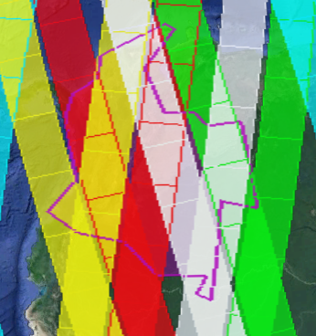
SDCG-4 Action 4-30
SDCG-4-30: SEO to do an analysis of RadarSat-2 ScanSAR coverage for early warning detection over Colombia first, and then consider and recommend further countries to analyze.
ScanSAR Narrow (299 km swath) and
ScanSAR Wide (508 km swath)
Partial coverage of Colombia every ~1-2 days.
Full coverage of Colombia every ~5 days
(using both ascending and descending)
Questions ...
Is 1 to 5 days reasonable
timing for early warning detection?
Can we use both ascending and
descending paths?
Example of ScanSAR (Narrow, 299 km swath) coverage for 5 days. Ascending and Descending paths.

Slide 7
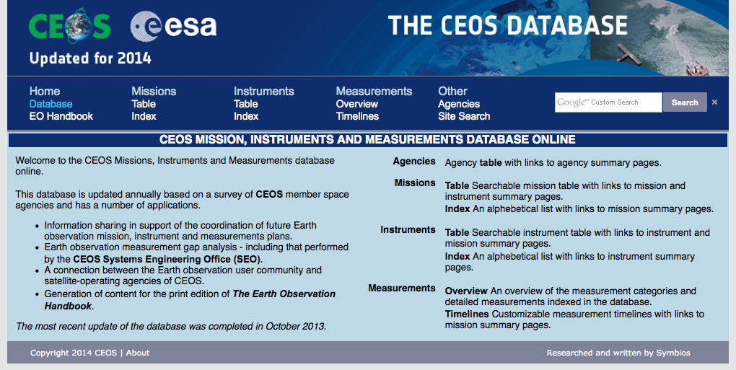
CEOS MIM Database
database.eohandbook.com
CEOS Mission, Instruments and Measurements (MIM) Database is the “official” database of agency missions (now and in the future).
Developed by ESA, with support from the CEOS SEO.
Details about agencies, launch dates, orbital parameters, instrument parameters (i.e., swath, bands, resolution, accuracy), measurement applications, data access websites.
The community utilizes the MIM as the “best” site for Earth mission information.
CEOS MIM Database
Includes 259 CEOS missions
(past, present and future)

Slide 8
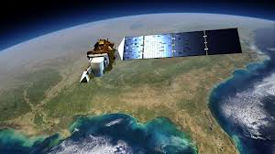
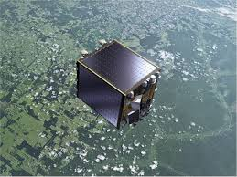
CEOS Missions
CEOS agencies curently operate 109 missions and 286 instruments.
2013 = 8 CEOS launches + one failure (CBERS-3)
  NASA/USGS – Landsat 8
  ESA – Proba-V and SWARM
  ISRO – SARAL and INSAT-3D
  Vietnam – VNREDSat-1A
  KARI – KOMPSAT-5
  NSMC/CMA China – FY-3C
2014 = 8 planned CEOS launches
  ESA – Sentinel-1A
  NASA – GPM Core, OCO-2, SMAP
  JAXA – ALOS-2
  INPE/China – CBERS-4
  KARI – KOMPSAT-3A
  CNES - VENUS
Notes:
8

Slide 9
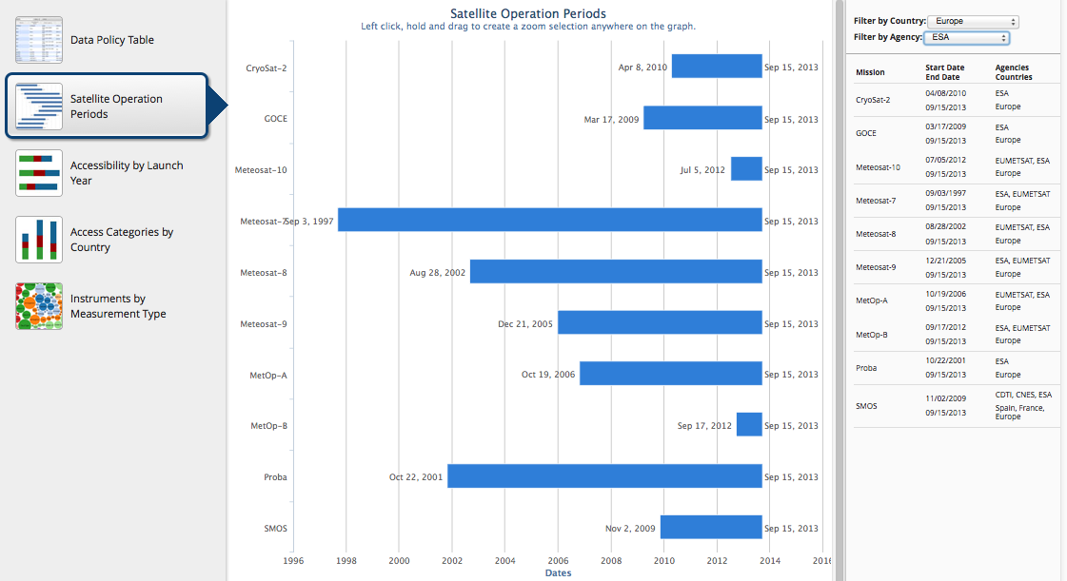
Data Policy Study and Portal
www.ceos-datapolicy.org
  107 Missions,
  292 Mission-Instrument Pairs,
  from 26 CEOS Agencies
  Open (no registration) = 47%
  Open (simple registration) = 21%
  Open (advanced approval) = 5%
  Restricted = 22%
  Unknown = 5%
  Comments
  73% of CEOS mission data
  is OPEN and accessible. This includes all missions since 2000.

Slide 10
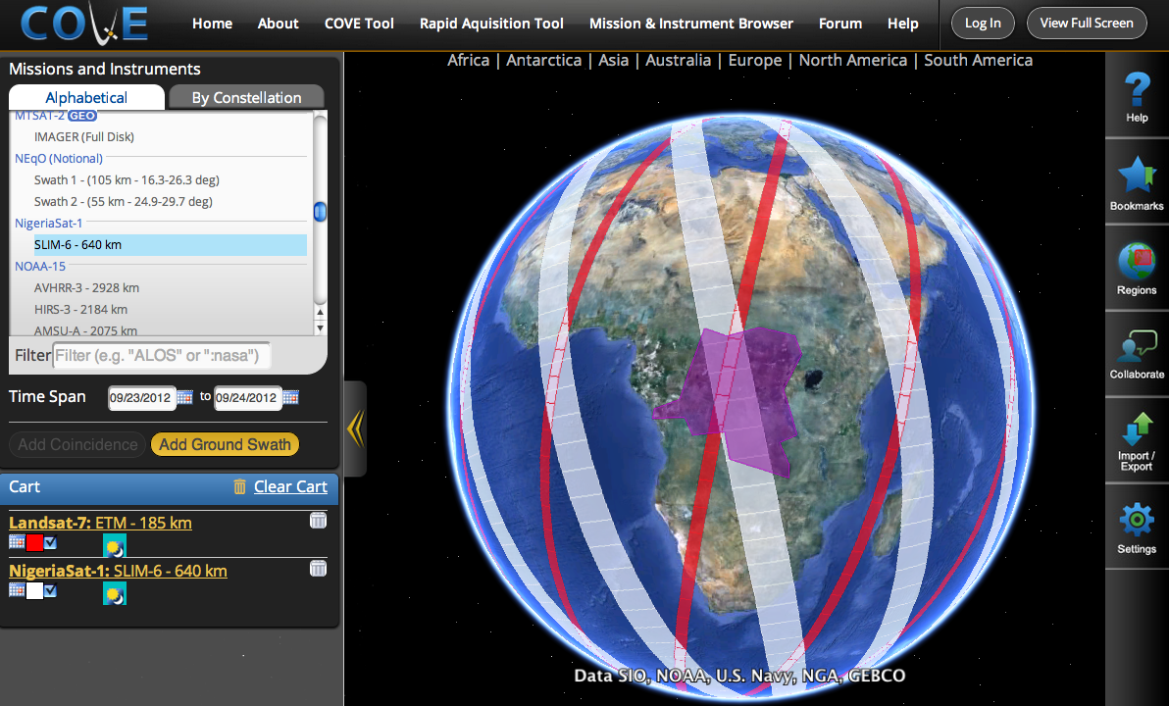
CEOS Visualization Environment (COVE)
www.ceos-cove.org
Browser-based tool using Google-Earth to display satellite coverage swaths and calculate coincidence scene locations.
Automated daily satellite position data from CelesTrak.
Saved bookmarks and states, Google-Earth KML and Shapefile compatibility, collaborative sessions.
Output: position, UTC time, viewing angles, solar angles, day/night, and EXCEL tables
Large mission database:
237 missions, 644 Mission-Instrument combinations
Did you know ....
There are 1046 Earth orbiting missions
There are 109 active CEOS missions

Slide 11
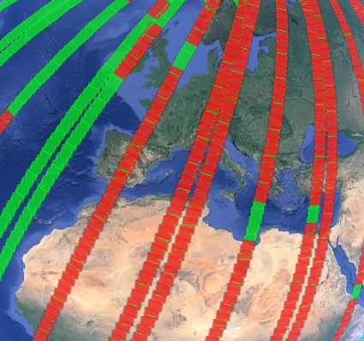
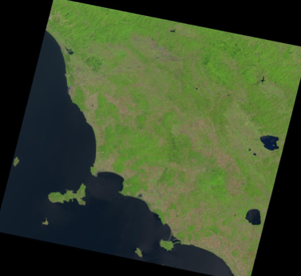
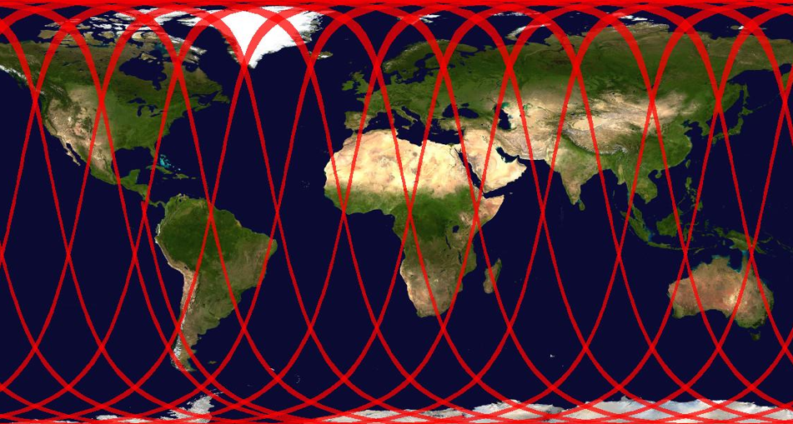
New Features in COVE
Links to Mission archives for: Landsat 7/8, SPOT 1-6, Pleaides-1A/1B, TerraSAR-X, TanDEM-X. Clicking on any actual scene retrieves the browse image. Plans to add RapidEye and Radarsat-2 soon.
2D global output in JPEG format and KML output for Google Earth.
Overlays ... GlobCover, MODIS Land Cover Classification (LCC), Cloud Cover (global monthly statistics).
Conversion to Spanish.
Landsat 8, Aug 1-3, over Europe
Green (potential), Red (actual)
Browse ... over northern Italy on Aug 3, 2013
2D global map of Radarsat-2 (W3 mode) coverage on Aug 1, 2013

Slide 12
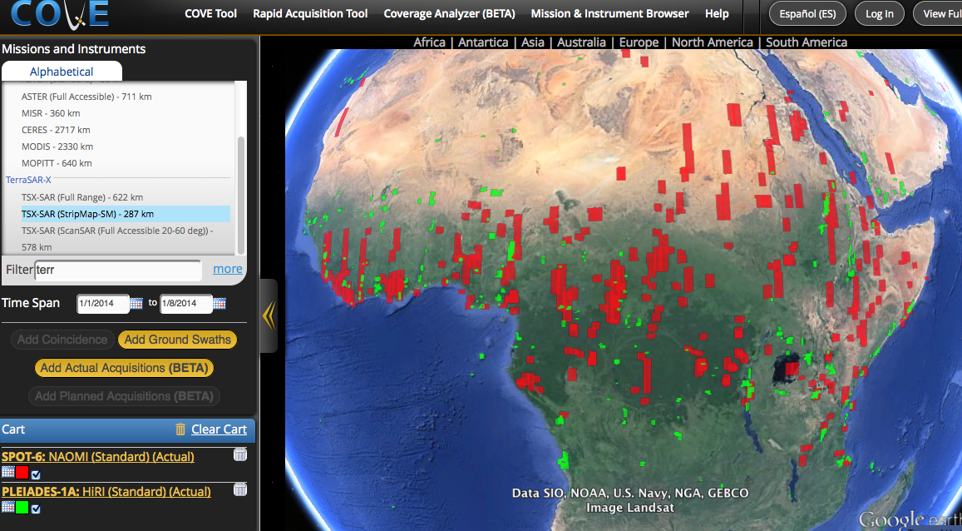
SPOT-6 and Pleaides-1A in COVE
January 1-8, 2014 over Africa

Slide 13
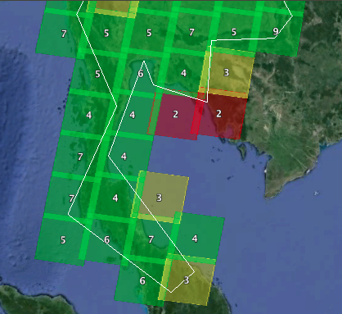
Coverage Analyzer Tool
Coverage Analyzer (BETA)
New analysis tool for archive analyses. Users select the date range, region, grid size (or fixed Landsat WRS) and cloud cover threshold. Output shows the number of acquisitions meeting the criteria within that region.
Table output is coming soon ...
Landsat-8 in 2013 over southern Thailand
<40% cloudy, Level-1T processed
NOTE: Colors ranges can be defined by the user. Numbers are total acquisitions meeting criteria.
Still in early BETA testing ....

Slide 14
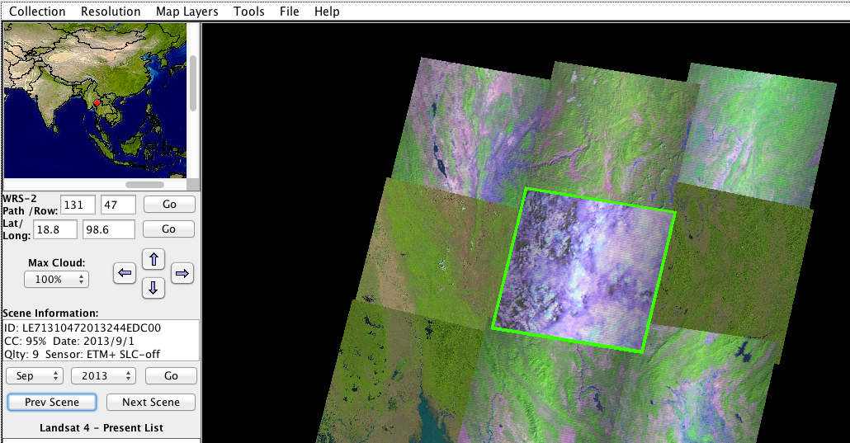
USGS GloVis Tool
glovis.usgs.gov
USGS Global Visualization Viewer (GloVis) allows users to search and view browse images for L7 and L8 and then download images. Includes metadata (scene ID, processing level, cloudiness). Allows fast screening and viewing of scenes ...

Slide 15

Google Earth Engine
https://earthengine.google.org
Google has developed a new platform for exploring satellite data, called
“Google Earth Engine”. It was developed by the philanthropy division of Google.
The tool contains the entire Landsat-7 and Landsat -8 archive (Level-1T only) and other satellite datasets (MODIS and SRTM). Access to these data is rapid and analysis tools utilize cloud computing. Users will find Landsat scenes, multi-day composites and cloud-free mosaics.
A small group of “trusted testers” are able to utilize a dedicated workspace for analyses and have access to an Application Programming Interface (API) for powerful programming.
Earth Engine datasets are currently open to the public. Access to analysis tools will be public in 2014.

Slide 16
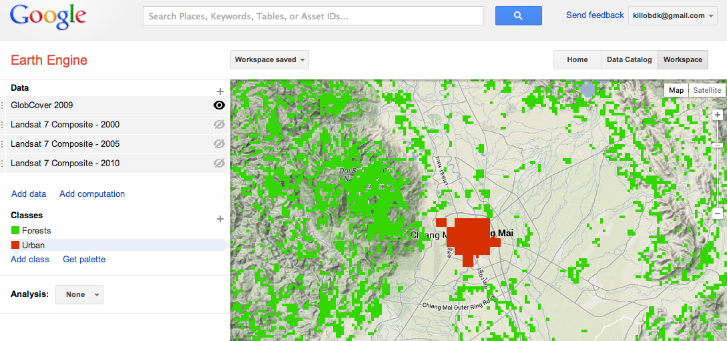
Google Earth Engine
Annual Landsat-7 cloud-free composites (1999 to 2012) are available.
GlobCover 2009 Land Cover Classification: ABOVE ... Added classifiers for Urban (RED) and Forests (GREEN). Notice forest east of Chiang Mai in the National Park.

Slide 17
Earth Engine “API Playground”
https://ee-api.appspot.com
The Earth Engine “API Playground” is a Javascript programming tool for users to program their own algorithms. Access to the API is only available to “trusted testers” but will be open to the public soon. The SEO plans to have these tools in the future Element-2 Data System.
Earth Engine is also linked to “Maps Engine” where users can upload their own data for analysis purposes. We are working with RapidEye to obtain some sample images for testing.
The following charts will demonstrate 3 examples of the capabilities of the Earth Engine API for deforestation studies ... Landsat-7 Cloud-Free Composite, Landsat-8 Cloud Mask, Landsat-8 Cloud-Free Mosaics.

Slide 18
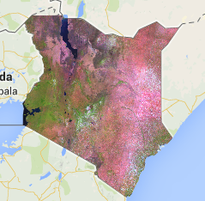
Landsat-7 Cloud-Free Composite
Kenya Landsat-7 Cloud-Free Composite (Mosaic)
RGB (5,4,3) image created from gathering “median” pixels over 13-21 scenes per path-row in 2013.
Additional analyses could be performed to calculate the final cloud cover % for testing the effectiveness of the mosaic.

Slide 19
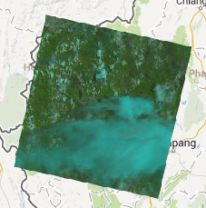
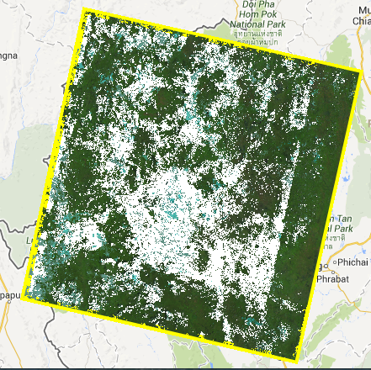
Landsat-8 Cloud-free Mosaics
It is possible to use the Landsat 8 Quality Band to build a cloud-free mosaic (composite) for a collection of scenes over any time period.
A composite was produced for the 4 months of June through September. 6 scenes during this period had average cloud cover of 83%, 94%, 52%, 87%, 94%, and 80%. This may represent a period when vegetation is active and a forest map is desired.
The 52% scene is on the top-right and the resulting mosaic is on the bottom-right. The results show the final mosaic is 33% cloudy. This is certainly not a cloud-free mosaic!

Slide 20
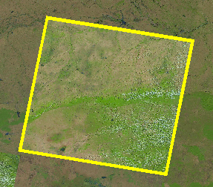
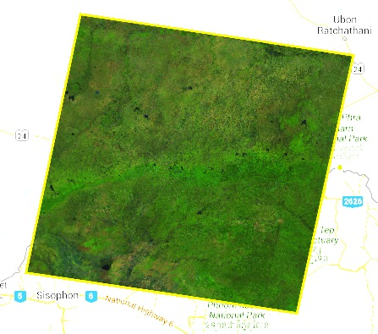
Mosaic Testing in Thailand
Case 1
Path=127, Row=50, Location: North East
TOP = 6% cloud cover (8.7% with cirrus)
BOTTOM = 0.00% cloud cover mosaic
(all images in table)
Mosaic with only images shaded in GREEN = 0.15% cloudy

Slide 21
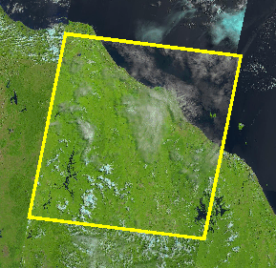
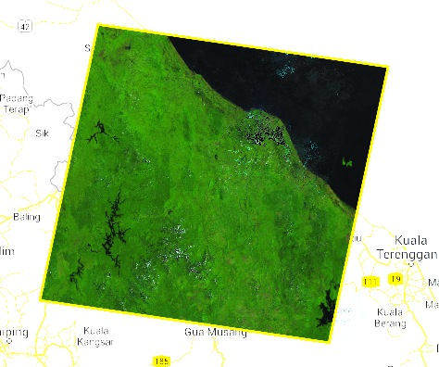
Mosaic Testing in Thailand
Case 2
Path=127, Row=56, Location: South Tip
TOP = 19% cloud cover (19.2% with cirrus)
BOTTOM = 0.37% cloud cover mosaic
(all images in table)
Mosaic with only images shaded in GREEN = 0.8% cloudy

Slide 22
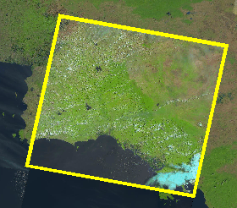
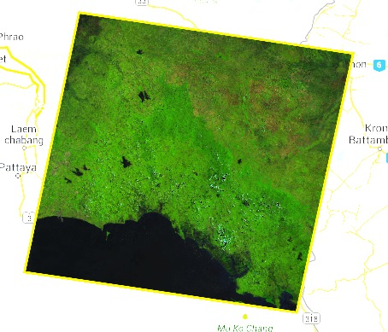
Mosaic Testing in Thailand
Case 3
Path=128, Row=51, Location: North East
TOP = 13% cloud cover (28.6% with cirrus)
BOTTOM = 0.09% cloud cover mosaic
(all images in table)
Mosaic with only images shaded in GREEN = 5.6% cloudy

Slide 23
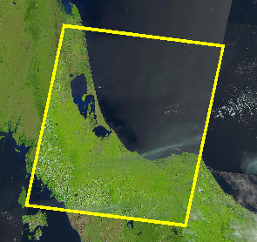
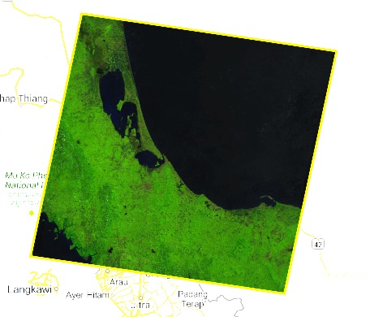
Mosaic Testing in Thailand
Case 4
Path=128, Row=55, Location: South
TOP = 5% cloud cover (11.9% with cirrus)
BOTTOM = 0.00% cloud cover mosaic
(all images in table)
Mosaic with only images shaded in GREEN = 9.3% cloudy

Slide 24
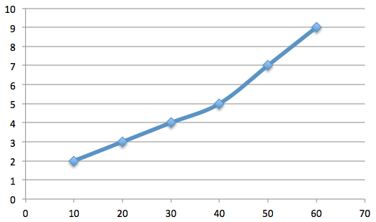
Theoretical Analysis of
Cloud-Free Mosaics
A first order approximation for data acquisition planning ...
The number of scenes needed to obtain a cloud-free (<1% cloudy) mosaic is a product of the cloudiness of the compiled scenes
Example: 50% + 50% scene = 0.5*0.5 = 0.25 = 25% mosaic
Example: 20% + 20% + 20% = 0.2*0.2*0.2 = 0.008 = 0.8% mosaic
Theoretical Approximation
Number of Scenes required to generate a cloud-free (<1% cloudy) Mosaic image
Number of Scenes
Cloudiness of Scenes

Slide 25

Summary of Resources
CEOS Website: http://www.ceos.org
MIM Database: http://database.eohandbook.com
COVE Tool: http://www.ceos-cove.org
Data Policy Portal: http://www.ceos-datapolicy.org
USGS Global Visualization Viewer: http://glovis.usgs.gov
Google Earth Engine: https://earthengine.google.org
Google Earth Engine: ???

Slide 26
Element 2: Space Data Services for GFOI
Concept Summary
Brian Killough
NASA, CEOS SEO
February 24, 2014

Slide 27
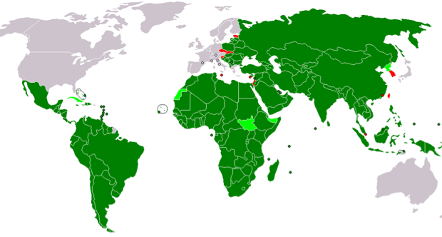
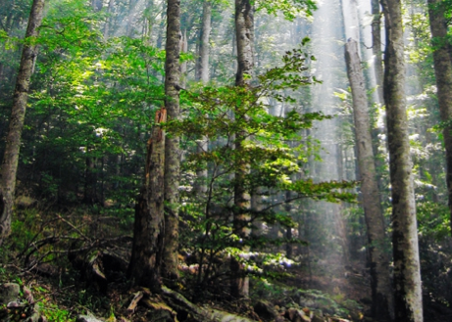


Element 2: Space Data Services
Why do we need such a system?
  Developing nations lack the knowledge and infrastructure to access, process and utilize space-based data for local decision-making and national policies.
  Countries do not understand how to access the diversity of space data systems and do not have sufficient storage or internet bandwidth to manage relevant datasets.
  Countries would benefit from a dedicated space data services system to support national-level reporting.
  A Space Data Services system would benefit CEOS initiatives such as the Global Forest Observation Initiative (GFOI) and the Group on Earth Observations Global Agriculture Monitoring (GEOGLAM) initiative.

Slide 28
Element 2: Questions and Answers
  What does the Space Data Services (Element 2) system provide?
  Data ... Includes processed images (free or commercially purchased) and cloud-free mosaics (Google, WELD). Users can also upload other datasets and products.
  Tools ... Data processing and analysis tools, COVE coverage analyzer, scene visualization
  Infrastructure ... Centralized storage and cloud processing
  NOT thematic products ... Element 2 will deliver data and not be responsible for creating thematic products. Products are the responsibility of the end-user.
  What is the operational plan for Element 2?
  The CEOS SEO will lead the development of Element-2 prototypes and related tools and infrastructure, but will not be responsible for long-term operations.
  The long-term operations plan is TBD. These operations may be carried by other groups within the projects (e.g., GFOI, GEOGLAM).
  Provisions for data updates, tool updates, server maintenance and training and capacity-building must be considered.

Slide 29
Space Data Services: Concept
  CEOS, through the Space Data Services (Element 2), will facilitate access to space datasets and analysis tools to support country-based reporting and decision-making.
Datasets
Tools
  Features on the CEOS interface:
  Dedicated storage and cloud-computing analyses
  Data archives provided to users and updated over time
  Analysis Tools: Data Processing, COVE, Coverage Analyzer, Google Earth Engine API
  Training and Capacity Building
Optical
SAR
Mosaics
CEOS
Element 2
Space Data Services
Interface
Country
  Features on the Country interface:
  Secure access to datasets and tools
  Ability to download and/or upload datasets and analysis tools
  Ability to conduct analyses and develop reports for delivery or local storage.
Reports
Datasets
Space
In-Situ
Ground

Slide 30





SDMS Pilot Project for FAO
  United Nations FAO (Food and Agriculture Organization) Forestry Department, KSAT (Kongsberg Satellite Services), NASA’s CEOS Systems Engineering Office (SEO), and AMA (Analytical Mechanics and Associates, Inc.) are partnering to develop and demonstrate a prototype Space Data Management System (SDMS).
  The 7-month planned effort (ends July 2014) will develop an operational prototype SDMS focused on 3 pilot countries (from FAO): Ecuador, Tanzania and Uganda.

Slide 31
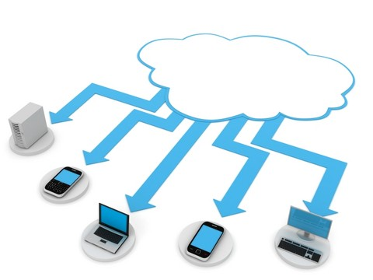
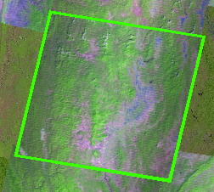
Some Questions for Discussion ...
  Should we duplicate complete datasets for each country on the server using dedicted storage? Would it be better to consider temporary storage for processing and analysis and access all data from other main sources (e.g., Earth Explorer, Google, Blackbridge) ?
  Should the Element-2 service provide annual mosaics for countries? These might come from Google or WELD. In addition, we could provide the tools and training for countries to develop their own seasonal cloud-free mosaics.
  What approaches should be considered for countries with very poor internet? Desktop versions on a local computer, mobile devices or even GEONETCast?
  Should SDCG create a services matrix whereby countries could identify their needs? This might include data needs, processing needs, storage needs, personnel access, desire for cloud-free mosaics, support needs. Any other items?
Cloud
Computing

