Slide 1

Session 5
CEOS SDCG Role
& GFOI Space Data Services
S Ward

Slide 2
SDCG role
Committee on Earth Observation Satellites (CEOS) ..”accepts responsibility for …coordination of the regular and routine (systematic) observations and measurements for effective reporting – ensuring continuity of data supply for maintenance of time series and consistent reporting through GFOI”
CEOS established a dedicated Space Data Coordination Group (SDCG) for GFOI in late 2011 as part of THE CEOS STRATEGY FOR SPACE DATA COVERAGE AND CONTINUITY IN SUPPORT OF THE GEO GLOBAL FOREST OBSERVATIONS INITIATIVE (GFOI) AND FOREST CARBON TRACKING (FCT) TASK

Slide 3
CEOS Data Strategy for GFOI
Element 1: A baseline, coordinated global data acquisition strategy involving a number of ‘core data streams’ that can be used free-of-charge for GFOI purposes. This will involve systematic and sustained wall-to-wall acquisitions of forested areas globally
Element 2: A coordinated strategy for national data acquisitions
Element 3: Data supply in support of the FCT activities, including in support of: the science studies assisting the development and evolution of the GEO-branded methods and protocol documents for GFOI

Slide 4
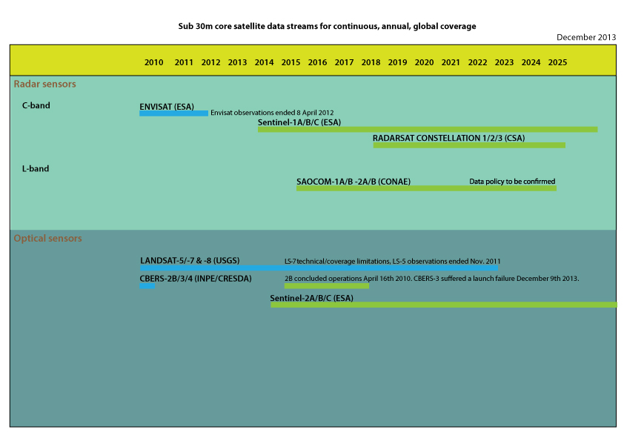
Core Data Streams

Slide 5
Global baseline coverage plan
 | Americas | Africa | Asia & Pacific | Number of Countries | Area (Mkm²) | Total Area (Mkm²)
2013: Geo-FCT NDs and GFOI Participating Countries | Brazil, Columbia, Costa Rica, Ecuador, Guyana, Mexico, Peru, Panama, | Cameroon, Democratic Republic of the Congo, United Republic of Tanzania, | Cambodia, Indonesia, Nepal, Viet Nam | 15 | 20.5 | 205
2014: UN-REDD National Programme Countries WB-FCPF PCs CD-REDD project countries | Argentina, Bolivia (Plurinational State of), Chile, El Salvador, Guatemala, Honduras, Nicaragua, Paraguay, Suriname, Uruguay | Algeria, Central African Republic, Congo, Ethiopia, Gabon, Ghana, Kenya, Liberia, Madagascar, Morocco, Mozambique, Nigeria, South Africa, Tunisia, Uganda, Zambia | Bhutan, Kyrgyzstan, Lao People’s Democratic Republic, Papua New Guinea, Philippines, Solomon Islands, Sri Lanka, Tajikistan, Thailand, Vanuatu | 36 | 18.5 | 39.0
2015: UN-REDD & FCPF Partner countries Other pan-tropical countries | Belize, Dominican Republic, Jamaica | Benin, Burkina Faso, Burundi, Chad, Côte d'Ivoire, South Sudan, Sudan, Togo, | Bangladesh, Fiji, Malaysia, Mongolia, Myanmar, Pakistan, | 17 | 9.0 | 48.0
2016 | All remaining countries globally |  |  | 127 | 84.8 | 132.8

Slide 6
2013

Slide 7
2014

Slide 8
Element 2
Global baseline is a statement of capability & facilitates global policy
Element 2 requires national needs of individual governments to be explored and coverage to be guaranteed in detail
  Take account of readiness and existing activities – strategy may be modified if readiness not confirmed
  Engagement of relevant institutions in-country
  Establish supply channels and arrangements
  Practical data coverage strategy and detailed plan for the immediate year ahead
  Identify role for non-core data streams, engage suppliers

Slide 9
GFOI Space Data Services
Regional GFOI Space Data Workshops
Impartial national space data needs assessment
National historical coverage reports
Ensured on-going coverage
Core data delivery
Cloud storage, processing and analysis of satellite data
  via a new GFOI Space Data Management System (SDMS)

Slide 10
GFOI Space Data Services
Draft paper circulated for consultation
Looking for feedback from countries
SDCG-5 an opportunity to shape the nature of the GFOI Space Data Services to meet actual needs
Please include feedback at every opportunity during your national reports
And provide further written comments to SDCG EXEC
Questions?

Slide 11
Methods and Guidance Documentation (MGD)
The other main GFOI deliverable besides space data
GFOI involves application of the MGD in unison with the space data supply
Available from the GFOI website and Programme Office

