Slide 1
Remote sensing in the REDD+ context lessons learned and way forward
Dr. Inge JONCKHEERE
UN-REDD Team (FAO HQ Rome, Italy)
SDCG-6
October 2014
Oslo, Norway

Slide 2
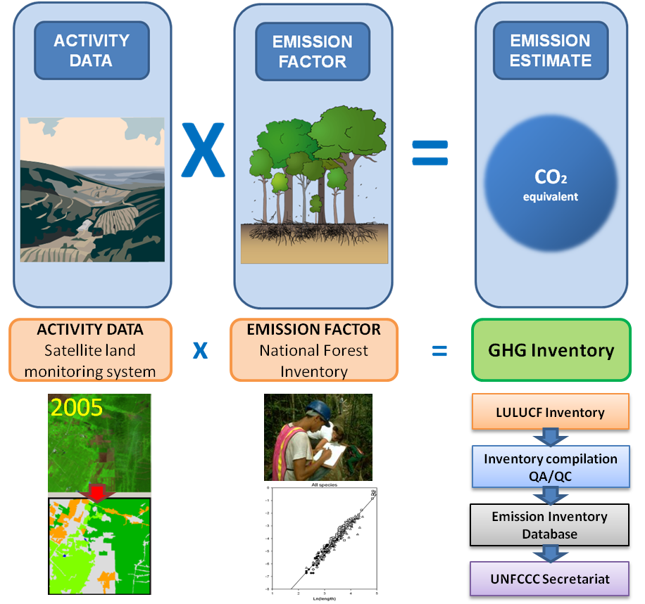
MRV: Measurement
The IPCC’s methodological approach to calculate anthropogenic GHG emissions by sources and removals
by sinks related to forest land.
Notes:
IPCC Guidance and Guidelines provide information on how to do undertake a GHG inventory, an central element of the MRV system. The IPCC approach requires the collection of AD (through remote sensing) and EFs (through field measurements), and is a requirement under Decision 4/CP.15.
The IPCC (2003) proposes three approaches to measure AD.
Approach 1 identifies the total area for each individual land-use category, but does not provide information on changes of area between categories and is not spatially explicit.
Approach 2 expands on Approach 1 by introducing tracking of land-use changes between categories.
Approach 3 extends Approach 2 by tracking land-use changes on a spatial basis (i.e. geographically explicit).
The UNFCCC (2006) and the IPCC (2003) call for an adequate, consistent, complete and transparent approach to AD reporting. AD to go back 20 years, cover the entire territory of the country, and assign uncertainty values to the reported data. Given these methodological considerations, it is advisable for to use Approach 3.
This implies the use of geographically explicit data collected in the field or through remote sensing techniques. The strategic methodological option of using remote sensing data rather than field data to assess AD simultaneously allows (i) the assessment of forest area change; (ii) the observation of trends in forest area change (at present and up to 20 years back); and (iii) significant reduction of the amount and cost of measurements to be undertaken in the field
As the removal of emissions in one place could result in an increase of emissions elsewhere, the concept of ‘displacement of emissions’ will need to be addressed in the context of REDD+ To address national-level leakage (as opposed to international leakage), the SLRS needs to provide full coverage (wall-to-wall) of the national territory, to detect and prevent leakage occurring from one region to another.
Countries seeking to implement REDD+ need to focus their efforts on forest-related emissions and removals from key activities
need to implement a forest stratification system, where key activities should be associated with strata (species composition, management practices or drivers of carbon stock changes) For each stratum and/or sub-stratum, technical and methodological arrangements aimed at achieving the highest quality estimates in a cost-effective manner should be implemented
Trier: increase accuracy and complexity (higher trier for key activity: major source of emission)
The IPCC identifies two methods to assess carbon stock changes in the carbon pools:
‘Gain-Loss Method’, which estimates the net balance of additions to and removals from a carbon stock
‘Stock Difference Method’ which estimates the difference in carbon stocks at two points in time.
The Gain-Loss Method includes all processes that bring about changes in a pool including statistics on losses by harvest, fires, etc; while the Stock Difference Method measures the carbon stocks in relevant pools at two points in time to assess carbon stock change.
the Gain-Loss Method for reporting in Phase 2 of REDD+ and Stock Difference in Phase 3.
The IPCC defines five carbon pools: aboveground biomass, belowground biomass, dead wood, litter and soil organic matter, which have to be measured and reported for GHG inventories. Continuous processes can affect carbon stocks in all areas in each year, while discrete events cause emissions and redistribute ecosystem carbon in specific areas (i.e. where the disturbance occurs) in the year of the event
Countries will also have to divide their national territories into the following six land-use categories that the IPCC has defined for GHG reporting (IPCC 2003): (i) forest land; (ii) cropland; (iii) grassland; (iv) wetlands; (v) settlements and (vi) other land. the IPCC advices the use of the ‘managed land’ concept as a proxy to discriminate human induced emissions and removals

Slide 3
Information, Monitoring and MRV Development through the 3 REDD+ Phases
REDD+ PHASES
Phase I
- Readiness
- Development of P&Ms
Phase II
- Implementation of P&Ms and demonstration activities
Phase III
- Positive incentive for verified performance
Year 1
Year 2
Year 3
Year ...
Year ...
Year ...
Year ...
Capacity building & development
REDD+ Safeguards Information System
REDD+ Safeguards Information System
Monitoring System
Monitoring System
MRV System
SLMS
SLMS:
AD
NFI: EF
GHG-I:
CO2e
Notes:
Information, Monitoring and MRV Systems should be developed following the three phases of the REDD+ mechanism, ensuring results-based demonstration activities in the Phase 2, and fully measured, reported and verified (i.e. performance-based) REDD+ mitigation activities in Phase 3 (Figure 3). Each phase aims to build capacity and prepare for the subsequent phase, meaning that there can be an element of overlap between phases, e.g. preparing and building capacity for the NFI and REDD+ GHG inventory in Phase 2. The length of time it takes to progress through the three phases will vary from country to country, depending on existing capacities and capabilities, national circumstances and levels of international support received.
Phase 2 will involve the operationalisation of the REDD+ Safeguards Information System and the Demonstration Activities Monitoring System, both of which should derive data and imagery from a Satellite Land Representation System (SLRS). The transition to Phase 3 should be achieved through the operationalisation of the full Information, Monitoring and MRV System, involving the production of Activity Data (AD) from the SLRS, and Emission Factors (EF) from a National Forest Inventory (NFI), which should be compiled into a REDD+ GHG Inventory. The REDD+ Safeguards Information System remains active in Phase 3, while the Demonstration Activities Monitoring System is upgraded to a National Performance Monitoring System.
Phased approach: Following the three phases of REDD+, development and implementation of the Information, Monitoring and MRV System should be undertaken in phases:
Phase 1: Development and testing of the monitoring and Safeguards Information System (1 year);
Phase 2: Operationalisation of the Safeguards Information System with a domestic sub-national monitoring system and basic national land cover data (2-4 years) that should support an interim results-based fund (such as the Amazon Fund);
Phase 3: Full operationalisation of the Information, Monitoring and MRV System for mitigation actions under the UNFCCC (after 3-4 years from the beginning of the Phase II).

Slide 4
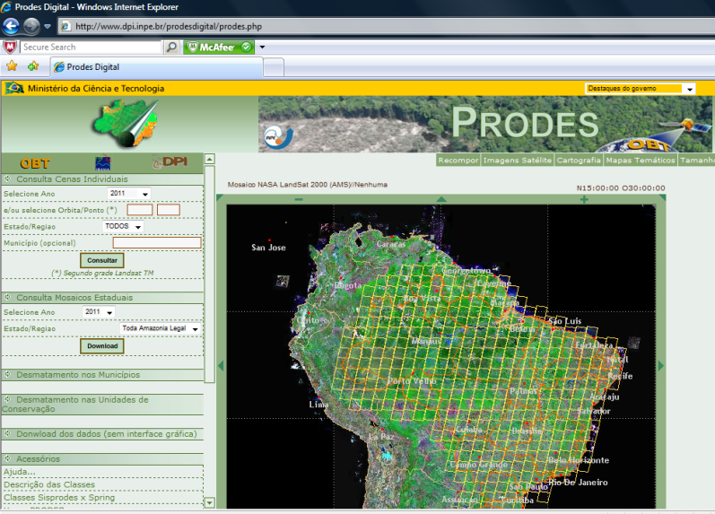
Forest monitoring system : Brazil
PRODES – Amazon Deforestation Monitoring Project
(Annual Deforestation Assessment)
DETER – Near real-time Deforestation Detection with MODIS (Support for Law Enforcement for Deforestation Control)
DEGRAD – Amazon Degradation Monitoring Project
DETEX - Selective logging activities
TerraClass - Land use monitoring of deforested area (2008)
www.dpi.inpe.br/prodesdigital/prodes.php
Notes:
A Satellite Land Representation System can generate the requisite data on the location, extent and related changes of the five REDD+ activities
Brazil uses remote sensing satellite data to monitor deforestation and degradation in the Brazilian Amazon biome, which covers an area of 4.7 million square kilometers
The monitoring system requires complete satellite image coverage, with 20 to 30 meters resolution, which is acquired and processed automatically, then analyzed by technicians
TERRA-AMAZON – Platform that manages all operations using a unique database
TerraAmazon, developed by INPE integrates geographical information systems ( GIS,) image processing and database management functionalities
A deforestation map and deforestation rates are produced annual and disseminated over the internet
Monitoring shows result as outcomes from the activities (MRV translates them into GHG I, assesses the performance of redd+ activities )

Slide 5
Remote Sensing support UN-REDD
Lots of requests: both NP and TS in three regions
OpenForis widely used in-country
Launched in IUFRO: www.openforis.org
Use of global products and linkages with other initiatives (WWF, GFOI, WRI, USAID, Silvacarbon)
Other tools and software mostly country-tailored/dependent
So far optical data, considering radar
Strong link with INPE/CRA
In-country trainings and central trainings in Rome and Belem
Coordination and collaboration for RS capacity building
Use of Methods and Guidance document (MGD) of GFOI as standard

Slide 6
RS using MGD document
Easy-to-understand language and exercices package: no one fits all approach
Overview methodologies and data requirements for RS using OpenForis and other open source initiatives
Advantages and disadvantages methodologies
Use of global products and linkages with other initiatives (WWF, WRI, USAID, Silvacarbon)
Coordination and collaboration for RS capacity building
Manual can be downloaded at www.gfoi.org

Slide 7
Issues and plans
Coordination with in-house activities: channeling of requests
Prioritization of country support: selection and minimal criteria?
More user-friendly version of OpenForis needed and on its way
Follow-up in-country
Sustainability of training/trainees
LCCS and data accuracy assessment
Use top-down approach vs bottom-up
Link with SDMS (Space Data Management System project)

Slide 8
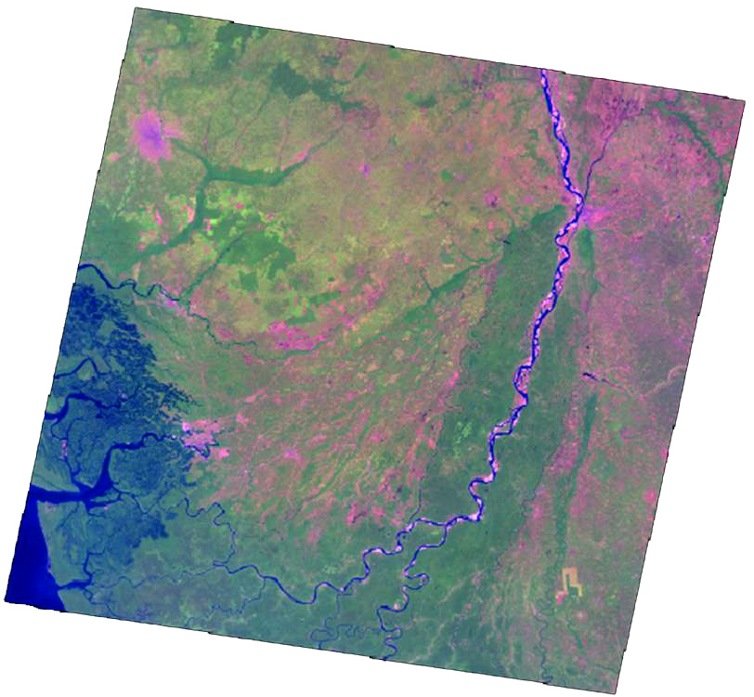
Processing chain: FRA RSS,FAO-FIN,UN-REDD collaboration
FAO FRA RSS
LC/LU sample sites
checked by regional experts
OpenForis tool kit
Pre-processing
Segmentation
Supervised classification
Edition in TA
Notes:
Pre-processing : image selection, co-registration, conversion to TOA reflectance, Cloud and cloud shadow masking, De-hazing, normalization
Use of Open Foris Tool for image processing: pre-processing, segmentation and classification trained on FRA/RSS sample sites
Results edited in TA
Could be either classification of LU/LC or classification of change

Slide 9
RS data used in countries
RS data (mainly satellite data) used in
-training: both in-country, HQ and INPE (so free access needed)
-AD: forest area detection (changes)
-NFI design (multisource inventory design and stratification)
-Other: R(E)L, Location of households for surveys (HR), Use of HR for field plot location, Mapping of co-benefits, Biodiversity mapping
Main RS data needs from countries:
-time series needed (historical data? Sensor interoperability?)
-data availability and cost analysis
-data acquisition (actual purchase)
-data preprocessing
-data processing
-generation of statistics
-accuracy assessment: using national and global products
-web dissemination

Slide 10
Methodologies and technology for NFMS and MRV
z
Countries require easy and inexpensive access to technology and tools to develop their NFMS
Experience
Lessons learned
Access to technology is sometime quite limited, particularly for remote-sensing technologies and data
The basics are often missing (e.g. steady electricity, high-speed internet, performing computers, software packages)
Certain technologies are costly (e.g. HR images, Lidar wall-to-wall, commercial software packages), limiting large-scale deployment and sustainability
Not promote specific tools/data sets but provide overview of available options
Help governments make informed decisions
Support country decisions and tailor best available approaches while maintaining consistency and comparability of results
Heavy reliance on complex & costly technology may not be in all developing countries’ best interest
Open source, free software and data set that meet REDD+ requirements are available. If not, new tools can be developed
FAO Forestry

Slide 11
What we’ve learned
A few dedicated individuals can make all the difference
Use of international advisors hand-in-hand with national technicians
Need to see capacity building in broader terms
Training of resilient national institutions and consultants
Mandate of institutions should be clear
Integration NFI and RS
On-the-job training is key
Trainings are geared towards producing results
Essential to get faster delivery
Sharing data and data access is crucial and key
Near-real time monitoring for early warning (e.g. Global Forest Watch), not for reporting
Resilience is often at risk
Easy to develop quickly elements of NFMS, but resilience will be lacking
Long-term commitment is required by government and partners in order to secure sustainability

Slide 12
Thank you for your attention! Contact: inge.jonckheere@fao.org www.un-redd.org www.openforis.org

