Slide 1
SDCG-6 Meeting Objectives & Agenda SDCG-6 Session 1

Slide 2
SDCG-6 Meeting Objectives
Confirm progress in implementing the 2014 global baseline and ensure upcoming core missions are optimised in support of GFOI. Prepare 2015 implementation plan (Element 1).
Confirm progress in implementing the CEOS Space Data Services (Element 2), including the pilot activities and secure feedback.
Continue the promotion and expansion of Element 2 to interested countries, in cooperation with the GFOI Capacity Building component.
Review the status of the contacts database and consider the future size and scope of SDCG country engagement. Confirm the role of World Bank and FAO relating to Element 2.
Notes:
Busy agenda for coming years and are trying to figure out how to manage the demands on us by creating a 3-year plan that manages expectations of governments approaching GFOI

Slide 3
SDCG-6 Meeting Objectives
Progress the R&D Data Support Strategy (Element 3) definition towards submission at SIT-30 for endorsement.
Finalise the SDCG 3-Year Work Plan and confirm the detailed outcomes and paths and contributions for their realisation – including specific technical systems and capabilities.
Define and action the coordination required with the Methods and Guidance Component so that space data is being applied consistent with GFOI principles.
Review the impact of GEOGLAM acquisition requests on the GFOI strategy and develop appropriate adjustments as relevant, and plan for liaison.
Notes:
Busy agenda for coming years and are trying to figure out how to manage the demands on us by creating a 3-year plan that manages expectations of governments approaching GFOI

Slide 4
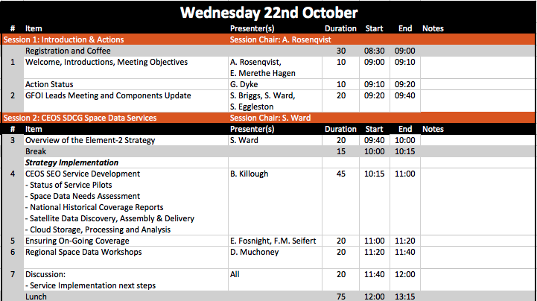
Agenda (1/6)
Notes:
Busy agenda for coming years and are trying to figure out how to manage the demands on us by creating a 3-year plan that manages expectations of governments approaching GFOI

Slide 5
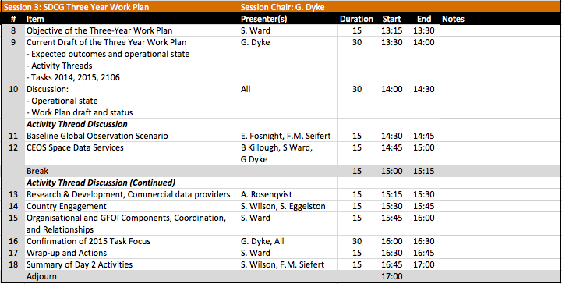
Agenda (2/6)
Notes:
Busy agenda for coming years and are trying to figure out how to manage the demands on us by creating a 3-year plan that manages expectations of governments approaching GFOI

Slide 6
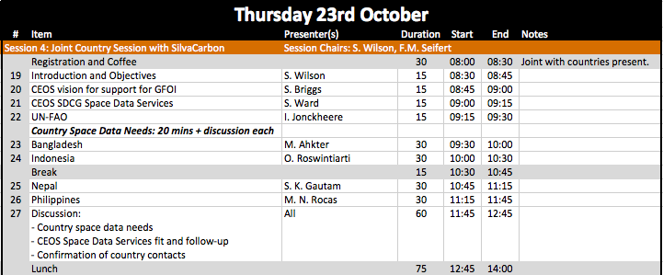
Agenda (3/6)
Notes:
Busy agenda for coming years and are trying to figure out how to manage the demands on us by creating a 3-year plan that manages expectations of governments approaching GFOI

Slide 7
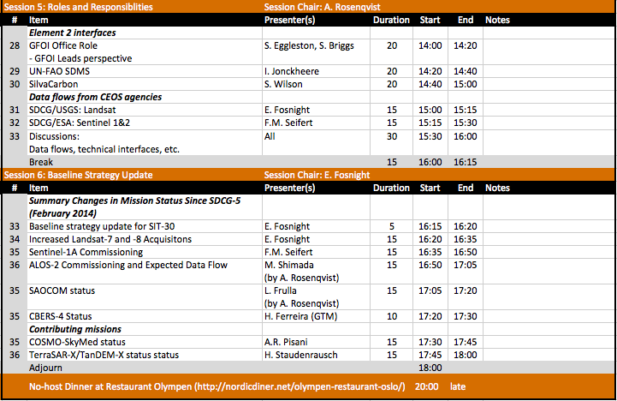
Agenda (4/6)
Notes:
Busy agenda for coming years and are trying to figure out how to manage the demands on us by creating a 3-year plan that manages expectations of governments approaching GFOI

Slide 8
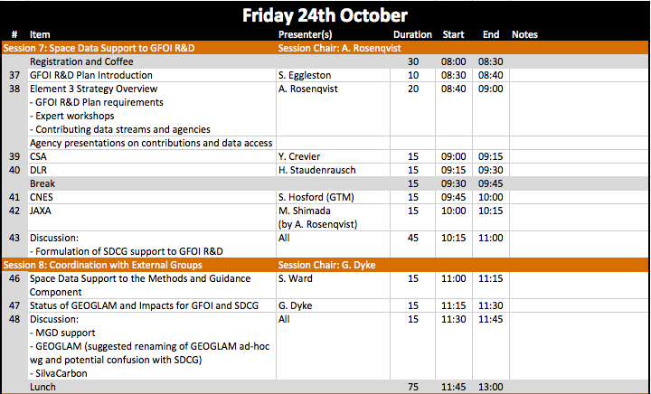
Agenda (5/6)
Notes:
Busy agenda for coming years and are trying to figure out how to manage the demands on us by creating a 3-year plan that manages expectations of governments approaching GFOI

Slide 9
Agenda (6/6)
Notes:
Busy agenda for coming years and are trying to figure out how to manage the demands on us by creating a 3-year plan that manages expectations of governments approaching GFOI

Slide 10
Joint (no-host) Dinner Tomorrow – Thu@20:00
Restaurant Olympen
Grønlandsleiret 15, Oslo
3-course set menu (fish or meat)
Price: NOK 349 + drinks
Notes:
Busy agenda for coming years and are trying to figure out how to manage the demands on us by creating a 3-year plan that manages expectations of governments approaching GFOI

Slide 11
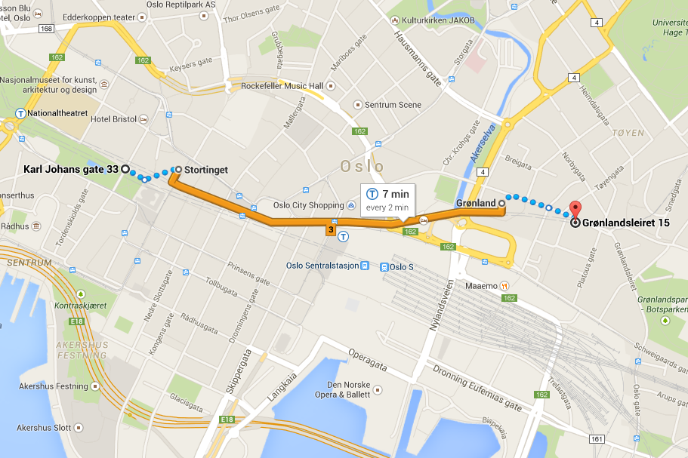
Joint (no-host) Dinner Tomorrow – Thu@20:00
Karl Johan Hotel → Restaurant Olympen
7 minutes by subway (Stortinget stn. → Grønland stn.)
Notes:
Busy agenda for coming years and are trying to figure out how to manage the demands on us by creating a 3-year plan that manages expectations of governments approaching GFOI

