Slide 1
Current Draft of the SDCG 3-Year Work Plan SDCG-6 Session 3, Item #9
G. Dyke
SDCG SEC

Slide 2
Overview
Stephen has covered the Background, Purpose, Approach, GFOI Vision
Section 1, 2.1
Continue the Review of the Current Draft
Section 2.2 – Outcomes
Section 3 – Schedule and Milestones
Section 4 – Work Plan
Thread leads to follow with more detail

Slide 3
Reminder - Session Objective
“Finalise the SDCG 3-Year Work Plan and confirm the detailed outcomes and paths and contributions for their realisation – including specific technical systems and capabilities.”
Review the Work Plan outcomes and confirm
Activity Tread Leads to start the discussion around the required tasks

Slide 4
Reminder - Session Objective
Objective is to have the SDCG 3-Year Work Plan:
Confirmed as of SDCG-7 (early-March 2015)
Endorsed at the SIT-30 meeting (late-March 2015)
Intention is that the 3-Year Plan will guide SDCG work and reporting at future SDCG meetings
Plan will be updated annually

Slide 5
Section 2.2 - Outcomes
16 outcomes defined for the next three years
Organised in four activity threads
Baseline Global Observation Scenario: 4
GFOI Space Data Services: 8
Support to R&D: 1
GFOI Component/Country Coord’n: 3
Lead(s) defined for each activity thread

Slide 6
A Rosenqvist (TBC), with GFOI Office
GFOI Office, S Ward, G Dyke, S Wilson, with FAO
E Fosnight, FM Seifert
B Killough, S Ward, G Dyke

Slide 7
Section 2.2 – Baseline Outcomes
Multiple annual global coverages by 2017 of the world’s forested areas
Realisation of the baseline strategy
2) Efficient and effective global flows of data
To accommodate in-country development of GFOI recommended Forest Map products

Slide 8
Section 2.2 – Baseline Outcomes
3) Commitment of core data stream providers to include GFOI requirements
Initiatives such as WELD, and the European Forestry TEP
4) Core data stream providers offering consistent information products
Climate data records such as surface reflectance

Slide 9
Section 2.2 – Baseline Outcomes
5) GFOI Space Data Services will be defined and delivered
In collaboration with FAO, World Bank, closely integrated the interactive MGD and SilvaCarbon
6) A program of regional space data workshops
Including national space data needs, and associated assessments provided for the priority countries identified by FAO, World Bank, and SilvaCarbon

Slide 10
Section 2.2 – Baseline Outcomes
7) Ensured on-going coverage customised for all of the priority countries
Semi-automated tools for national core data stream archive characterisation, as required
8) Interoperable satellite data discovery tools
For all core data streams through a single access point

Slide 11
Section 2.2 – Baseline Outcomes
9) Assembly & delivery of core data streams
Emphasis on using the core data stream portals for direct download, additional delivery services (i.e. media) on a case-by-case basis, via the Capacity Building component
10) Integration of space data within the MGD
Agreement on the derivation of GFOI standard products using space data

Slide 12
Section 2.2 – Baseline Outcomes
11) Conclude pilots investigating fundamental issues around the provision of cloud computing
Processing and presentation of GFOI products as the basis for national MRV consistent with MGD.
12) Creation of a model national GFOI cloud computing search, storage and processing system
Incorporating all lessons learned during the pilot investigations.

Slide 13
Section 2.2 – R&D Outcomes
13) Providing the satellite data required to progress the GFOI priority R&D topics
As outlined in the GFOI R&D plan.
Support move to to pre-operational or operational status.
In coordination with the R&D component, and in support of the MGD component.

Slide 14
Section 2.2 – GFOI Components and Countries
14) Delivery of a coherent customer experience for GFOI countries
Efficient coordination among the GFOI Space Data component, the other GFOI components (i.e. MGD, Capacity Building, R&D), and the GFOI Office Support move to to pre-operational or operational status.

Slide 15
Section 2.2 – GFOI Components and Countries
15) Space data support and services provided to all priority countries
Including coordination and integration with the Methods and Guidance and the GFOI Office.
16) Effective management of country interfaces
Based on interactions by the GFOI Office.
Regional workshops in coordination with FAO, SilvaCarbon, and others.

Slide 16
Section 3 – Schedule and Milestones
Comprises a table of milestones for each of the 16 outcomes for 2015, 2016, and 2017
To be used as a basis for reporting and progress assessment at future SDCG meetings
Expressed in terms of top-level outcomes for each year

Slide 17
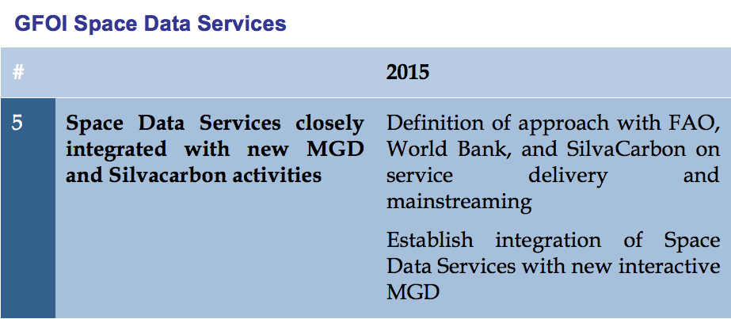
Section 3 – Example

Slide 18
Section 4 – Work Plan
Adds top-level tasks under each of the 16 outcomes
Assigns lead(s) to each of the activity threads responsible for defining, management, reporting
Additional detail to be managed by the activity thread leads

Slide 19
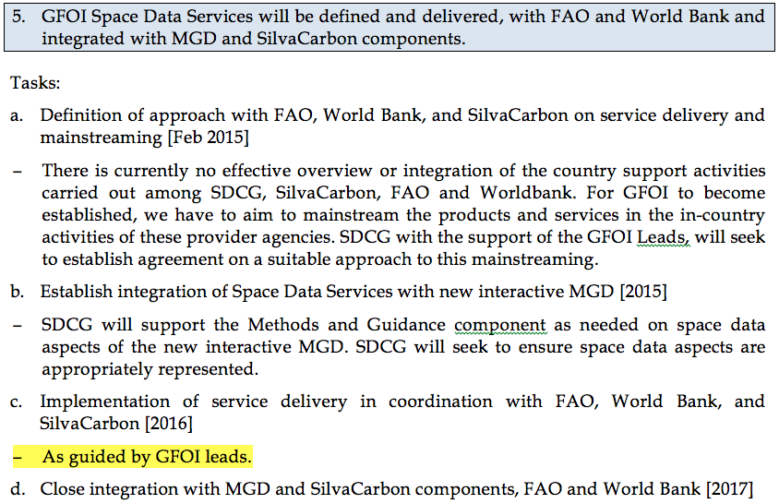
Section 4 – Example

Slide 20
Next Steps on the 3-Year Plan
Share and discuss feedback during Session 3
Iterate draft based on SDCG-6 discussion and have a near-final revision before end of year
Final polishing cycle before SDCG-7
Finalisation at SDCG-7
Presentation for endorsement at SIT-30

Slide 21
Session 10 Discussion
30 minute discussion
Operational state
Work Plan draft and status
Key Issues to Confirm …

Slide 22
Key Issues to Confirm
Operational State and Vision for GFOI (S 1, 2.1)
From Stephen’s slides.
Overall outcomes for 2015-2017 (S 2.2)
Missing outcomes? Revisions to existing outcomes?
Outcomes for each of 2015, 2016, and 2017
Confirmation of timing?
Confirmation of activity thread lead(s) and outcome tasks
Are those named OK to take on the responsibility?

Slide 23
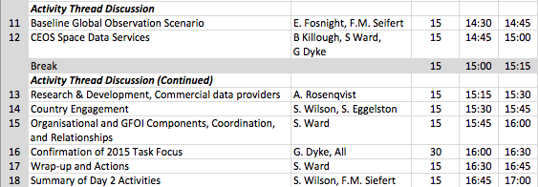
Balance of Session 3
Next Up Gene and Frank Martin on the Baseline …

