Slide 1
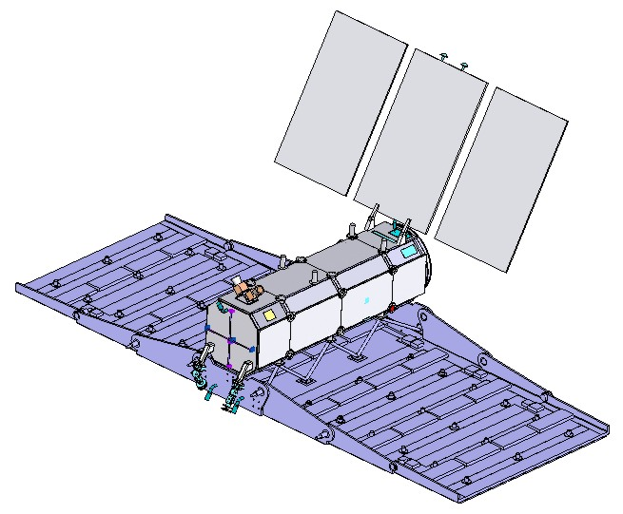
COMISION NACIONAL DE ACTIVIDADES ESPACIALES
SAOCOM PROJECT
a joint Argentine-Italian SAR-L Mission
Mission update 2014 and
outline of the Global Background Mission
Laura Frulla
CONAE
CEOS SDCG-6
Oslo, Norway – 22-24 Oct. 2014
Notes:
1

Slide 2
Mission Update
Mission Critical Design Review (M-CDR) in Nov. 2013
Passed OK
Flight Segment Qualification Review Step 1: April 2014
SAR Protoflight Model: March 2015
Flight Segment Qualification Review Step 2: May 2015
Ground Segment Qualification Review: Sept. 2015
Launch Readiness Review: Nov. 2015
Launch schedule:
SAOCOM 1A: 2015
SAOCOM 1B: 2016
Notes:
2

Slide 3
Satellite and Ground segments
Satellite segment capacity specifications:
Capacity to acquire and downlink >225 images per day per satellite, i.e. >450 for the constellation.
Ground segment capacity specifications:
Average daily number of catalogue consultations: in the order of 5000
The CONAE user Service shall be able to handle at least 500 image requests per day. Each request may induce one or more SAOCOM programming requests to be issued to the MOC.
The CONAE user Service shall be able to process 200 SAOCOM products per day, inside the response time, up to level 1D products.
Notes:
3

Slide 4
Integrated Mission Acquisition Strategy
The SAOCOM Integrated Mission Acquisition Strategy (IMAS) is a comprehensive data acquisition plan that aims to integrate all anticipated requirements for SAOCOM data known to date to maximise the amount of useful data that can be acquired and optimise the use of available system resources.
It simultaneously addresses the requirements of the Baseline, Foreground and Background Missions to minimise programming conflicts between the components.
It is fully compliant with the SAOCOM Key Mission Scenario Requirements:
≤ 10 minutes continuous acquisitions (in visibility of ETC)
≤ 15 minutes per orbit in average per day
≤ 20 minutes of non-continuous acquisitions in one orbit
Assure capacity for continuous every opportunity observations over the Pampas Strategic Application region in TWQP mode.

Slide 5
Phased implementation
Phased implementation of the IMAS, corresponding to the operational availability of SAOCOM 1A and 1B
Epoch 1: One satellite operational
Plan to be used for SAOCOM-1A following commissioning and until the end of the Commissioning Phase for SAOCOM-1B.
Epoch 2: Two satellites operational
Plan for the main period when both SAOCOM-1A and SAOCOM-1B are operational.
Epoch 1 plan applicable as Contingency Plan in events of unavailability of one of the two satellite systems.

Slide 6
IMAS components
The Integrated Mission Acquisition Strategy comprises five components:
Argentina National Acquisition Plan
Sensor Calibration
SIASGE
Global Background Mission
Other applications

Slide 7
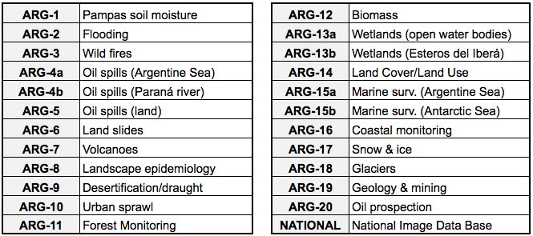
IMAS 1: Argentina National Acquisition Plan
Argentina National Acquisition Plan - User requests
20 Application Areas identified by CONAE

Slide 8
IMAS 1: Argentina National Acquisition Plan
User requests: Conflict resolution
User requests developed independently from each other → initially a large number of conflicting requests
Conflicts handling:
Separation by time (cycle)
Separation by observation direction (DESC/ASC)
Modification of PATH coverage
Separation by SAO-1A/SAO-1B (Epoch 2)
Attention taken to assure that request modifications did not compromise requests' original science/operational objectives

Slide 9
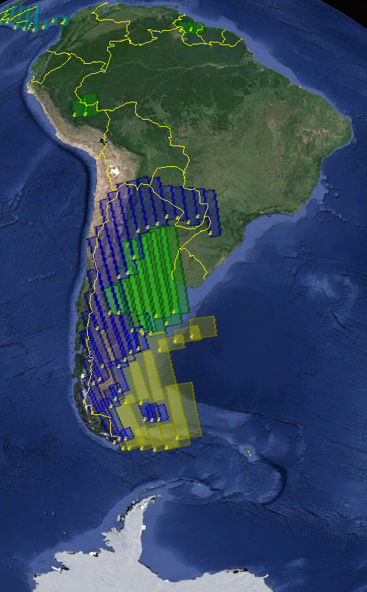
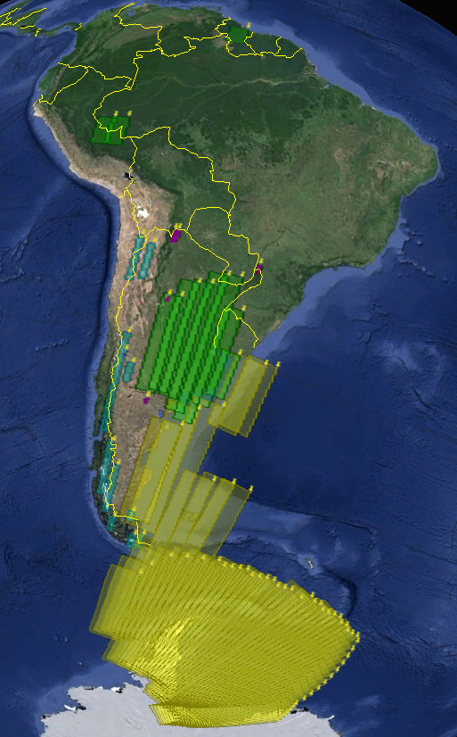
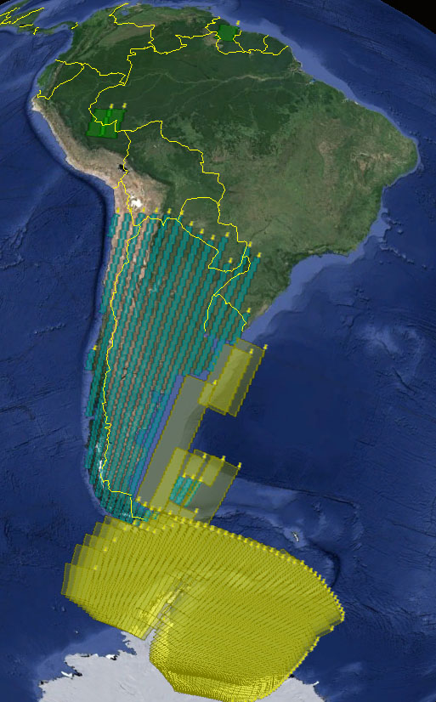
IMAS 1: Argentina National Acquisition Plan
PATH-based planning to optimise system resources use
All requests integrated into one single conflict-free plan
Cycle 1 ASC
Cycle 1 DESC
Cycle 5 DESC
Example: Observation patterns over South America

Slide 10
IMAS 4: Global Background Mission
CONAE objectives for GBM:
Thematic driver: Forest biomass and change
Building consistent time-series archives over key global forest regions
Supporting global initiatives: GEO, UNFCCC REDD+
GBM consistent with recommendations from CEOS Space Data Coordination Group
Repetitive annual observations over key forest regions
Dual season observations
Fine spatial resolution
At least dual polarisation

Slide 11
IMAS 4: Global Background Mission Observation modes and beams used for the GBM
Stripmap Dual polarisation [10m(rg) x 5m(az); 1-look@gr. range]
3 beams required for regional gap-free coverage
33.7° ~ 38.3° inc. angle
38.2° ~ 41.3° inc. angle
41.2° ~ 44.6° inc. angle
TOPSAR Narrow Quad-polarisation [10m(rg) x 50m(az); 1-look@gr. range]
Both beam combinations (A&B) required for gap-free coverage
17.6° ~ 27.3° inc. angle (SQP beams 1-5)
27.2° ~ 36.6° inc. angle (SQP beams 6-10)

Slide 12
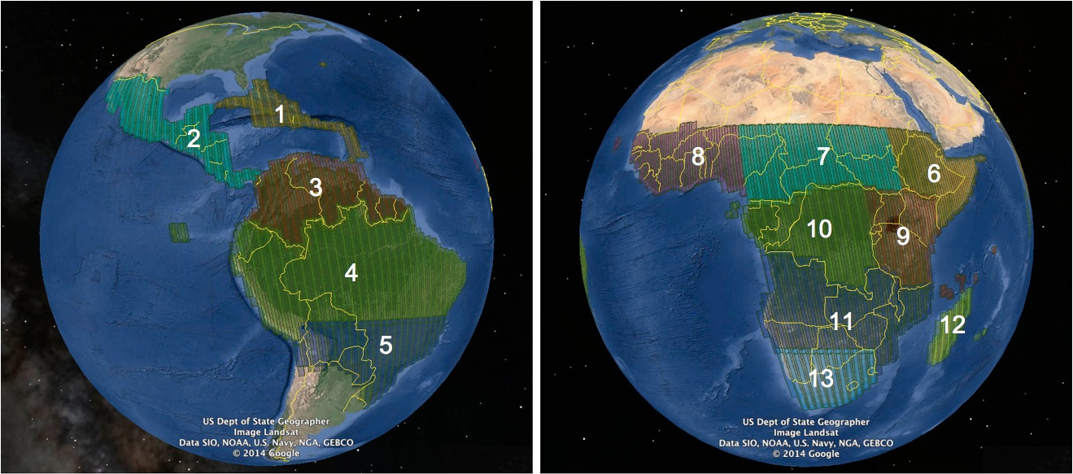
IMAS 4: Global Background Mission
Annual observations in Stripmap Dual-pol (SDP) mode (3 beams)
Annual observations in TOPSAR Narrow Quad-pol (TNQP) mode (2 beams)
Central & S America SDP+TNQP Africa SDP+TNQP

Slide 13
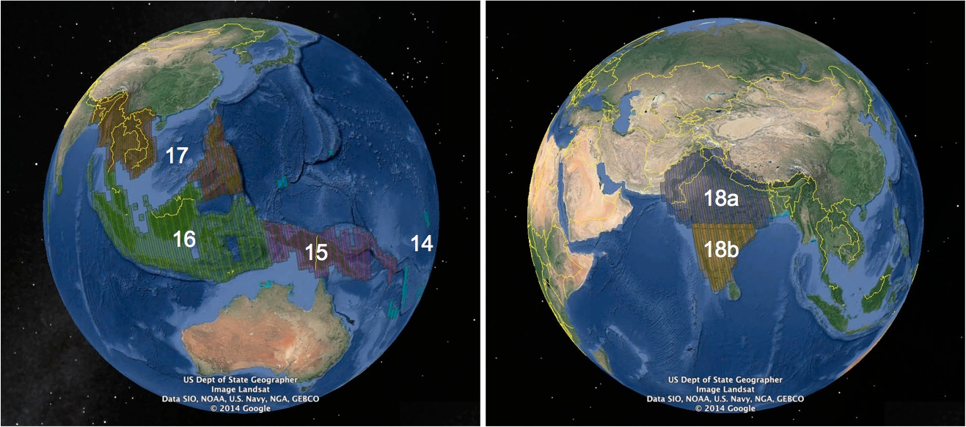
IMAS 4: Global Background Mission
Annual observations in Stripmap Dual-pol (SDP) mode (3 beams)
Annual observations in TOPSAR Narrow Quad-pol (TNQP) mode (2 beams)
SE-Asia & Oceania SDP+TNQP South Asia TNQP + SDP

Slide 14
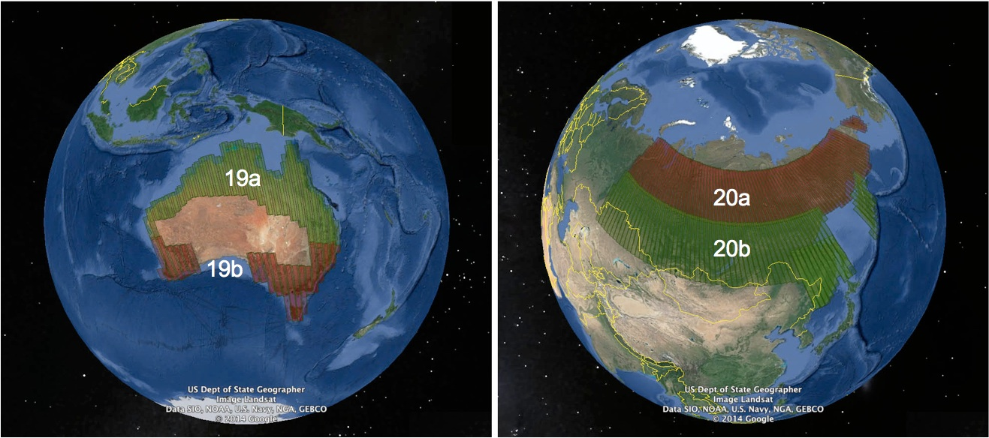
IMAS 4: Global Background Mission
Annual observations in Stripmap Dual-pol (SDP) mode (3 beams)
Annual observations in TOPSAR Narrow Quad-pol (TNQP) mode (2 beams)
Australia TNQP + SDP Siberia TNQP + SDP

Slide 15
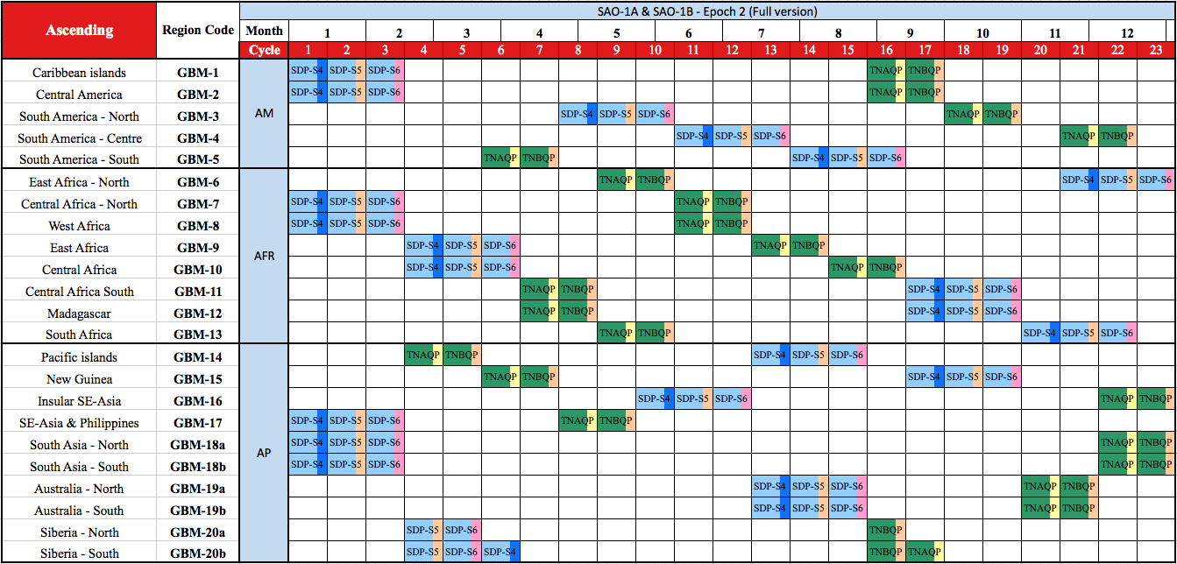
IMAS 4: Global Background Mission
Stripmap Dual-pol
TOPSAR Narrow Quad-pol
Epoch 1: SAO-1A
Epoch 2: SAO-1A = SAO-1B

Slide 16
IMAS 4: Global Background Mission
Identical GBM plans for SAOCOM-1A and SAOCOM-1B
during Epoch 2 yield:
Stripmap Dual-pol InSAR coverage (8-day baseline) over all GBM regions on annual basis
Full GBM scenario: "Sampled" 8-day Pol-InSAR coverage over all GBM regions on annual basis (TNQP mode InSAR available "on opportunity" only)
Identical plans also reduce impact of failed acquisitions by provision of an “automatic gap-filling” capacity.

Slide 17
Summary
An Integrated Mission Acquisition Strategy (IMAS) has been developed for SAOCOM-1A and 1B.
Comprises 5 components which fully respond to the Mission objectives of SAOCOM
Argentina National Acquisition Plan
Sensor Calibration
SIASGE
Global Background Mission
Other applications
Global Background Mission compliant with SDCG recommendations
Final IMAS plan conflict-free and within capacity of mission resources

Slide 18
Gracias
Takk
Thank you

Slide 19
Extra slides

Slide 20
IMAS 2: Sensor Calibration
CAL/VAL
Acquisition plans for External Calibration developed for SAOCOM-1A and SAOCOM-1B
Commissioning phase and Operational phases
Argentina: Corner Reflectors and transponders
Amazon and Congo basins: antenna pattern and pointing
Operational phase CAL/VAL acquisition plans have been developed in synchrony with the Argentina National Acquisition Plan (IMAS 1) and the Global Background Mission (IMAS 4) with no conflicts resulting.

Slide 21
IMAS 3: SIASGE
SIASGE
Acquisition requests from the Italian Space Agency (ASI) within the framework of SIASGE to be incorporated into IMAS.
SIASGE: Italo-Argentine Satellite System for Social benefit, Emergency management and Economic development

Slide 22
IMAS 5: Other Applications
SMAP – Soil Moisture Active and Passive mission
Observations planned in support of the US/NASA SMAP mission to accommodate SAOCOM-SMAP intercalibration and joint research.
SAOCOM beam mode: TWQP ( = Pampas Soil Moisture)
19 SMAP calibration sites [1°x 1°] distributed globally
Volcanoes and glaciers (global)
Potential new sites to be added
SAOCOM beam mode: Stripmap Dual-pol (SDP)
Synergy with GBM plan to be assured.

Slide 23
PATH-based planning
PATH-based planning
Planning undertaken by orbital visualisation software and Google Earth-type interface, using SAOCOM orbital (Two-Line Element) parameters
Allows detailed and accurate geographic PATH visualisation of all SAOCOM observation modes
Direct PATH based planning (as opposed to polygon-based) provides full flexibility and precision in handling of the satellite swaths.
It allows detailed "trimming" of the PATH coverage to minimise conflicts and maximise the amount of useful data acquired → accommodates optimal use of system resources.

Slide 24
Global PATH System (1/3)
A ground-based numbering system for the orbital tracks has been defined to aid acquisition strategy development - referred to as the global PATH system.
The PATH system is based on, and is fully compliant with, the SAOCOM orbit parameters;
A PATH is defined as the satellite observation track on the ground at 35 degrees off-nadir angle;
PATH numbers start and end in the Arctic (rather than at the ascending Equator crossing) to avoid complications with a change of PATH number over land;
PATH 1 is defined as a path that crosses mostly water in both descending and ascending directions

Slide 25
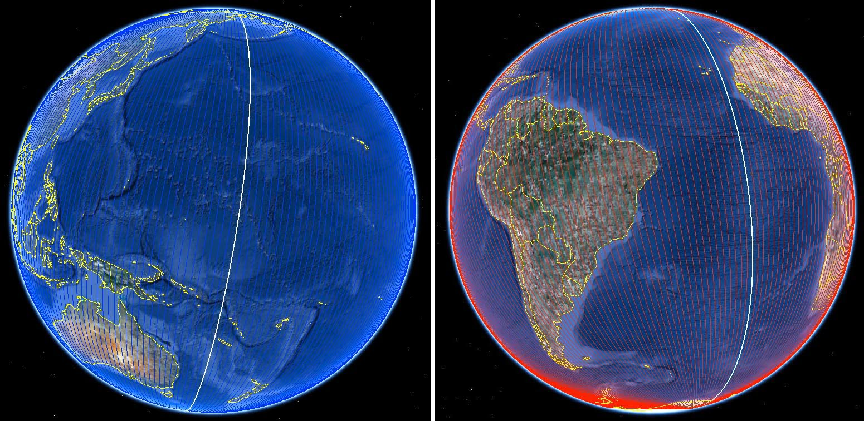
Global PATH System (2/3)
Descending passes. Ascending passes
PATH 001 in white

Slide 26
Global PATH System (3/3)
There are 237 PATHS that are repeated on cycles of 16 days;
PATHs are numbered sequentially in westward direction;
Neighbouring PATHs have consecutive numbers;
As a naming convention, the letter “D” is added to the PATH number to indicate the descending part of a PATH, and “A” is added to indicate ascending part
E.g. Continental Argentina is covered by passes D142 - D153 and A029 – A050).
A PATH segment – an observational unit – can have an arbitrary length and is defined by its start and end latitude.

