Slide 1
SDCG-6 Session 7, Item #38 Element 3 plan development Ake Rosenqvist Anthea Mitchell

Slide 2
R&D Support (Element 3)
Element 3: data supply in support of GFOI R&D activities
Transition from GEO-FCT to GFOI R&D programme → "intermission" in data requests/supply
Foreseen to resume in 2014/2015 in accordance with Element 3 strategy.
Core missions – data provision "business as usual"
Contributing missions – opportunity as many missions can provide limited amounts of data free of charge for scientific purposes

Slide 3
R&D Support (Element 3)
The Element 3 strategy outlines different means for CEOS space agencies to support the GFOI R&D component:
• Provision of satellite data over GFOI R&D study sites
- New data acquisitions (satellite tasking)
- Historical (archive) data
• Coordinated research announcements (RA) and solicitations
- RAs targeted at selected GFOI priority R&D topics
- Coordinated open calls targeted at GFOI support
- Funding opportunities
- Others
Notes:
Busy agenda for coming years and are trying to figure out how to manage the demands on us by creating a 3-year plan that manages expectations of governments approaching GFOI

Slide 4
R&D Support (Element 3)
Satellite Data in support of the
Global Forest Observations Initiative (GFOI)
Research & Development (R&D) Activities
– SDCG Element 3
Draft version 0.11
Notes:
Busy agenda for coming years and are trying to figure out how to manage the demands on us by creating a 3-year plan that manages expectations of governments approaching GFOI

Slide 5
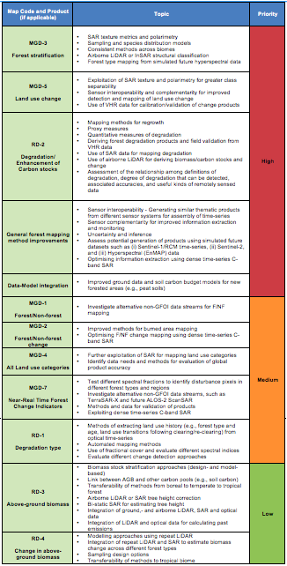
Element 3 – Table of Contents
1. Introduction (3 pages)
1.1 Background and purpose
1.2 Joint strategy for R&D
1.3 Document scope
2. The GFOI R&D component (7 pages)
2.1 GFOI R&D Plan
2.2 MGD Forest Map Products
2.3 GFOI Review of Priority R&D Topics →
2.4 R&D Landscaping study
Notes:
Busy agenda for coming years and are trying to figure out how to manage the demands on us by creating a 3-year plan that manages expectations of governments approaching GFOI

Slide 6
Element 3 – Table of Contents
3. Collection of user requirements (12 pages)
3.1 GFOI R&D Expert workshops
- Sensor interoperability (Woods Hole, June 2014)
- Degradation (Wageningen, Oct 2014)
3.2 Country consultations
- SDCG-4 (Pasadena); SDCG-5 (Rome) (+ SDCG-6 (Oslo))
- GFOI/SilvaCarbon workshops (Chiang Mai, Jan 2014)
- GEOSS-AsiaPacific Symp, GFOI session (Tokyo, May 2014)
3.3 Experiences from GEO-FCT R&D activities and National Demonstrator (ND) countries
- GEO-FCT Science & Data Summits (Woods Hole 2010, Rome 2011, Arusha 2012, Sydney 2013)
- GEO-FCT PD team annual Technical Reports (2010, 2011, 2012)
Notes:
Busy agenda for coming years and are trying to figure out how to manage the demands on us by creating a 3-year plan that manages expectations of governments approaching GFOI

Slide 7
Element 3 – Table of Contents
3. Collection of user requirements (cont'd)
3.4 Data requirement summary
Summary of requirements per sensor type:
Medium-resolution optical data
L-band SAR
C-band SAR
X-band SAR
Bistatic X-band SAR
VHR optical
Archive data
Requirements addressing a diversity of Priority R&D Topics, each with specific satellite data requirements
→ risk for complex acquisition plan!
Notes:
Busy agenda for coming years and are trying to figure out how to manage the demands on us by creating a 3-year plan that manages expectations of governments approaching GFOI

Slide 8
The Element 3 strategy: Simple and robust
→ a simple acquisition plan is desirable.
The proposed Element-3 strategy aims to address several of the priority R&D topics simultaneously
It aims to accommodate the same data sets to be used to assess multiple R&D topics.
Limited number of multi-diciplinary Study Sites
Local focus (not w2w)
Consistent time-series with multiple sensors.
Clear instructions to contributing space agencies
Notes:
Busy agenda for coming years and are trying to figure out how to manage the demands on us by creating a 3-year plan that manages expectations of governments approaching GFOI

Slide 9
Element 3 – Table of Contents
3. Collection of user requirements (cont'd)
3.5 GFOI R&D Study Sites
The GFOI R&D Study Sites are the sites over which CEOS space agencies will be asked to focus their efforts within the Element 3 framework.
• Sites where ground data have been collected and research activities relevant to the GFOI R&D plan are ongoing
• Sites are multi-disciplinary and address multiple GFOI priority R&D topics.
• Sites are mostly located in the pan-tropical zone, with few sites located outside this region (temperate, boreal).
• Active GEO-FCT ND sites are being used, so as to build on previous R&D effort.
• Additional Study Sites will be included, based on expression of interest from expert workshops and country consultations
• The sites are conceived to be used on a long-term basis, in combination with permanent sample plots or NFI.
Notes:
Busy agenda for coming years and are trying to figure out how to manage the demands on us by creating a 3-year plan that manages expectations of governments approaching GFOI

Slide 10
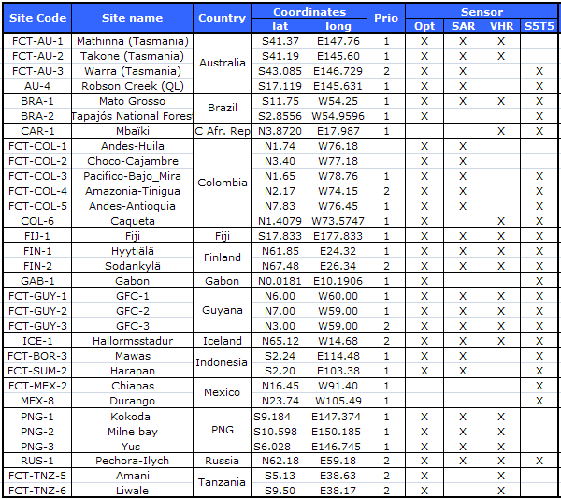
3.5 GFOI R&D Study Sites
Notes:
Busy agenda for coming years and are trying to figure out how to manage the demands on us by creating a 3-year plan that manages expectations of governments approaching GFOI

Slide 11
Element 3 – Table of Contents
4. Coordinated Strategy for satellite observations in support of GFOI R&D (cnt'd)
4.1 A consolidated strategy
4.2 CNES
4.3 CSA
4.4 DLR
4.5 JAXA
4.6 VHR optical
4.7 ASI
4.8 USGS
4.9 ESA
4.10 INPE
Notes:
Busy agenda for coming years and are trying to figure out how to manage the demands on us by creating a 3-year plan that manages expectations of governments approaching GFOI

Slide 12
Element 3 – Table of Contents
5. The Way Forward
5.1 Governance
Responsibilities of SDCG, the GFOI Office and the GFOI research partners
5.2 Recommendations
• The Element-3 plan will be updated on a regular basis
• Space agencies are requested to provide a list of archive data available over GEO-FCT ND verification sites and new study sites
• Space agencies are encouraged to start acquiring data over ND and new study sites as soon as can be accommodated in their acquisition plan.
Notes:
Busy agenda for coming years and are trying to figure out how to manage the demands on us by creating a 3-year plan that manages expectations of governments approaching GFOI

Slide 13
Element 3 – Table of Contents
5. The Way Forward
5.3 Coordinated research announcements
Coordinated research announcements (RA) and solicitations
- RAs targeted at selected GFOI priority R&D topics
- Coordinated open calls targeted at GFOI support
- Funding opportunities
- Others
Notes:
Busy agenda for coming years and are trying to figure out how to manage the demands on us by creating a 3-year plan that manages expectations of governments approaching GFOI

Slide 14
Element 3 – Table of Contents
Annex A. Contributing agencies and missions
Annex A outlines the CEOS agencies and satellite missions willing to contribute data to support Element-3 GFOI R&D activities. Data specifications and access procedures are included.
SPACE AGENCY REPS TO COMPLETE
Annex B. Archive Data acquired over GFOI Study sites 2009-2011
Confirm what data exists in the archives over GEO FCT ND sites and new study sites
SPACE AGENCY REPS TO COMPLETE
Notes:
Busy agenda for coming years and are trying to figure out how to manage the demands on us by creating a 3-year plan that manages expectations of governments approaching GFOI

Slide 15
Element 3 – Table of Contents
Annex B. GFOI research partners and R&D topics
Description of each Study Site and research team
C.1. Australia
C.1.1 Mathinna and Takone (Tasmania)
Principal Investigator: A.Mitchell (UNSW, Sydney)
Site description: Eucalypt-dominated wet and dry forest, pockets of rainforest. Agriculture (cropping) and plantations (hardwood/softwood) dominate the rural sector.
Previous R&D: Previous research focussed on the interoperability of time-series optical and SAR datasets for forest information monitoring.
New R&D topics to be addressed: Improved use of time-series SAR-Optical data for generating activity data, and methods development with the integration of SAR and optical data for degradation assessment and carbon estimation.
Notes:
Busy agenda for coming years and are trying to figure out how to manage the demands on us by creating a 3-year plan that manages expectations of governments approaching GFOI

Slide 16
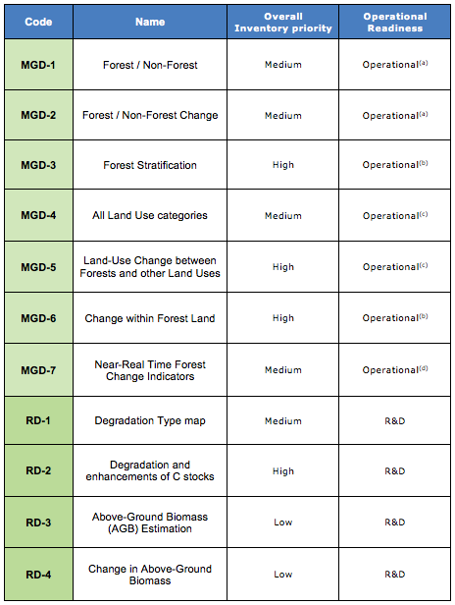
R&D Support (Element 3)
Notes:
Busy agenda for coming years and are trying to figure out how to manage the demands on us by creating a 3-year plan that manages expectations of governments approaching GFOI

Slide 17
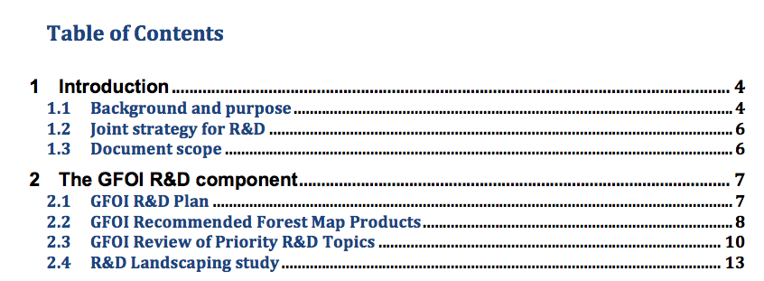
R&D Support (Element 3)
Notes:
Busy agenda for coming years and are trying to figure out how to manage the demands on us by creating a 3-year plan that manages expectations of governments approaching GFOI

Slide 18
R&D Support (Element 3)
Notes:
Busy agenda for coming years and are trying to figure out how to manage the demands on us by creating a 3-year plan that manages expectations of governments approaching GFOI

Slide 19
R&D Support (Element 3)
Notes:
Busy agenda for coming years and are trying to figure out how to manage the demands on us by creating a 3-year plan that manages expectations of governments approaching GFOI

Slide 20
R&D Support (Element 3)
Notes:
Busy agenda for coming years and are trying to figure out how to manage the demands on us by creating a 3-year plan that manages expectations of governments approaching GFOI

Slide 21
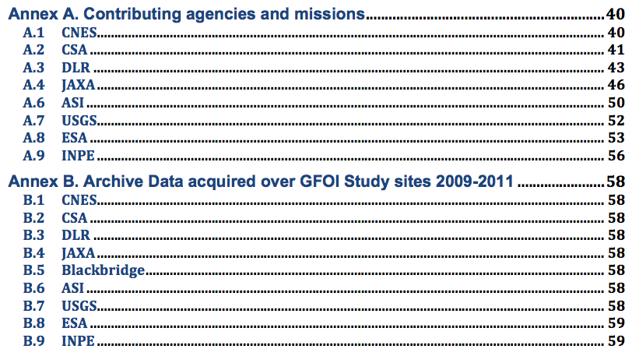
R&D Support (Element 3)
Notes:
Busy agenda for coming years and are trying to figure out how to manage the demands on us by creating a 3-year plan that manages expectations of governments approaching GFOI

Slide 22
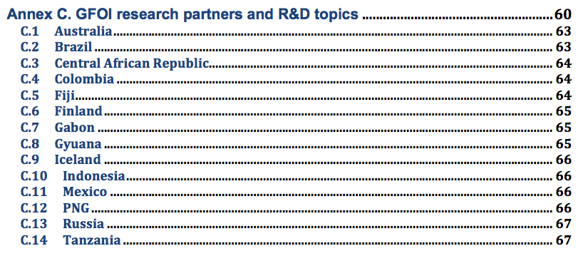
R&D Support (Element 3)
Notes:
Busy agenda for coming years and are trying to figure out how to manage the demands on us by creating a 3-year plan that manages expectations of governments approaching GFOI

