Slide 1
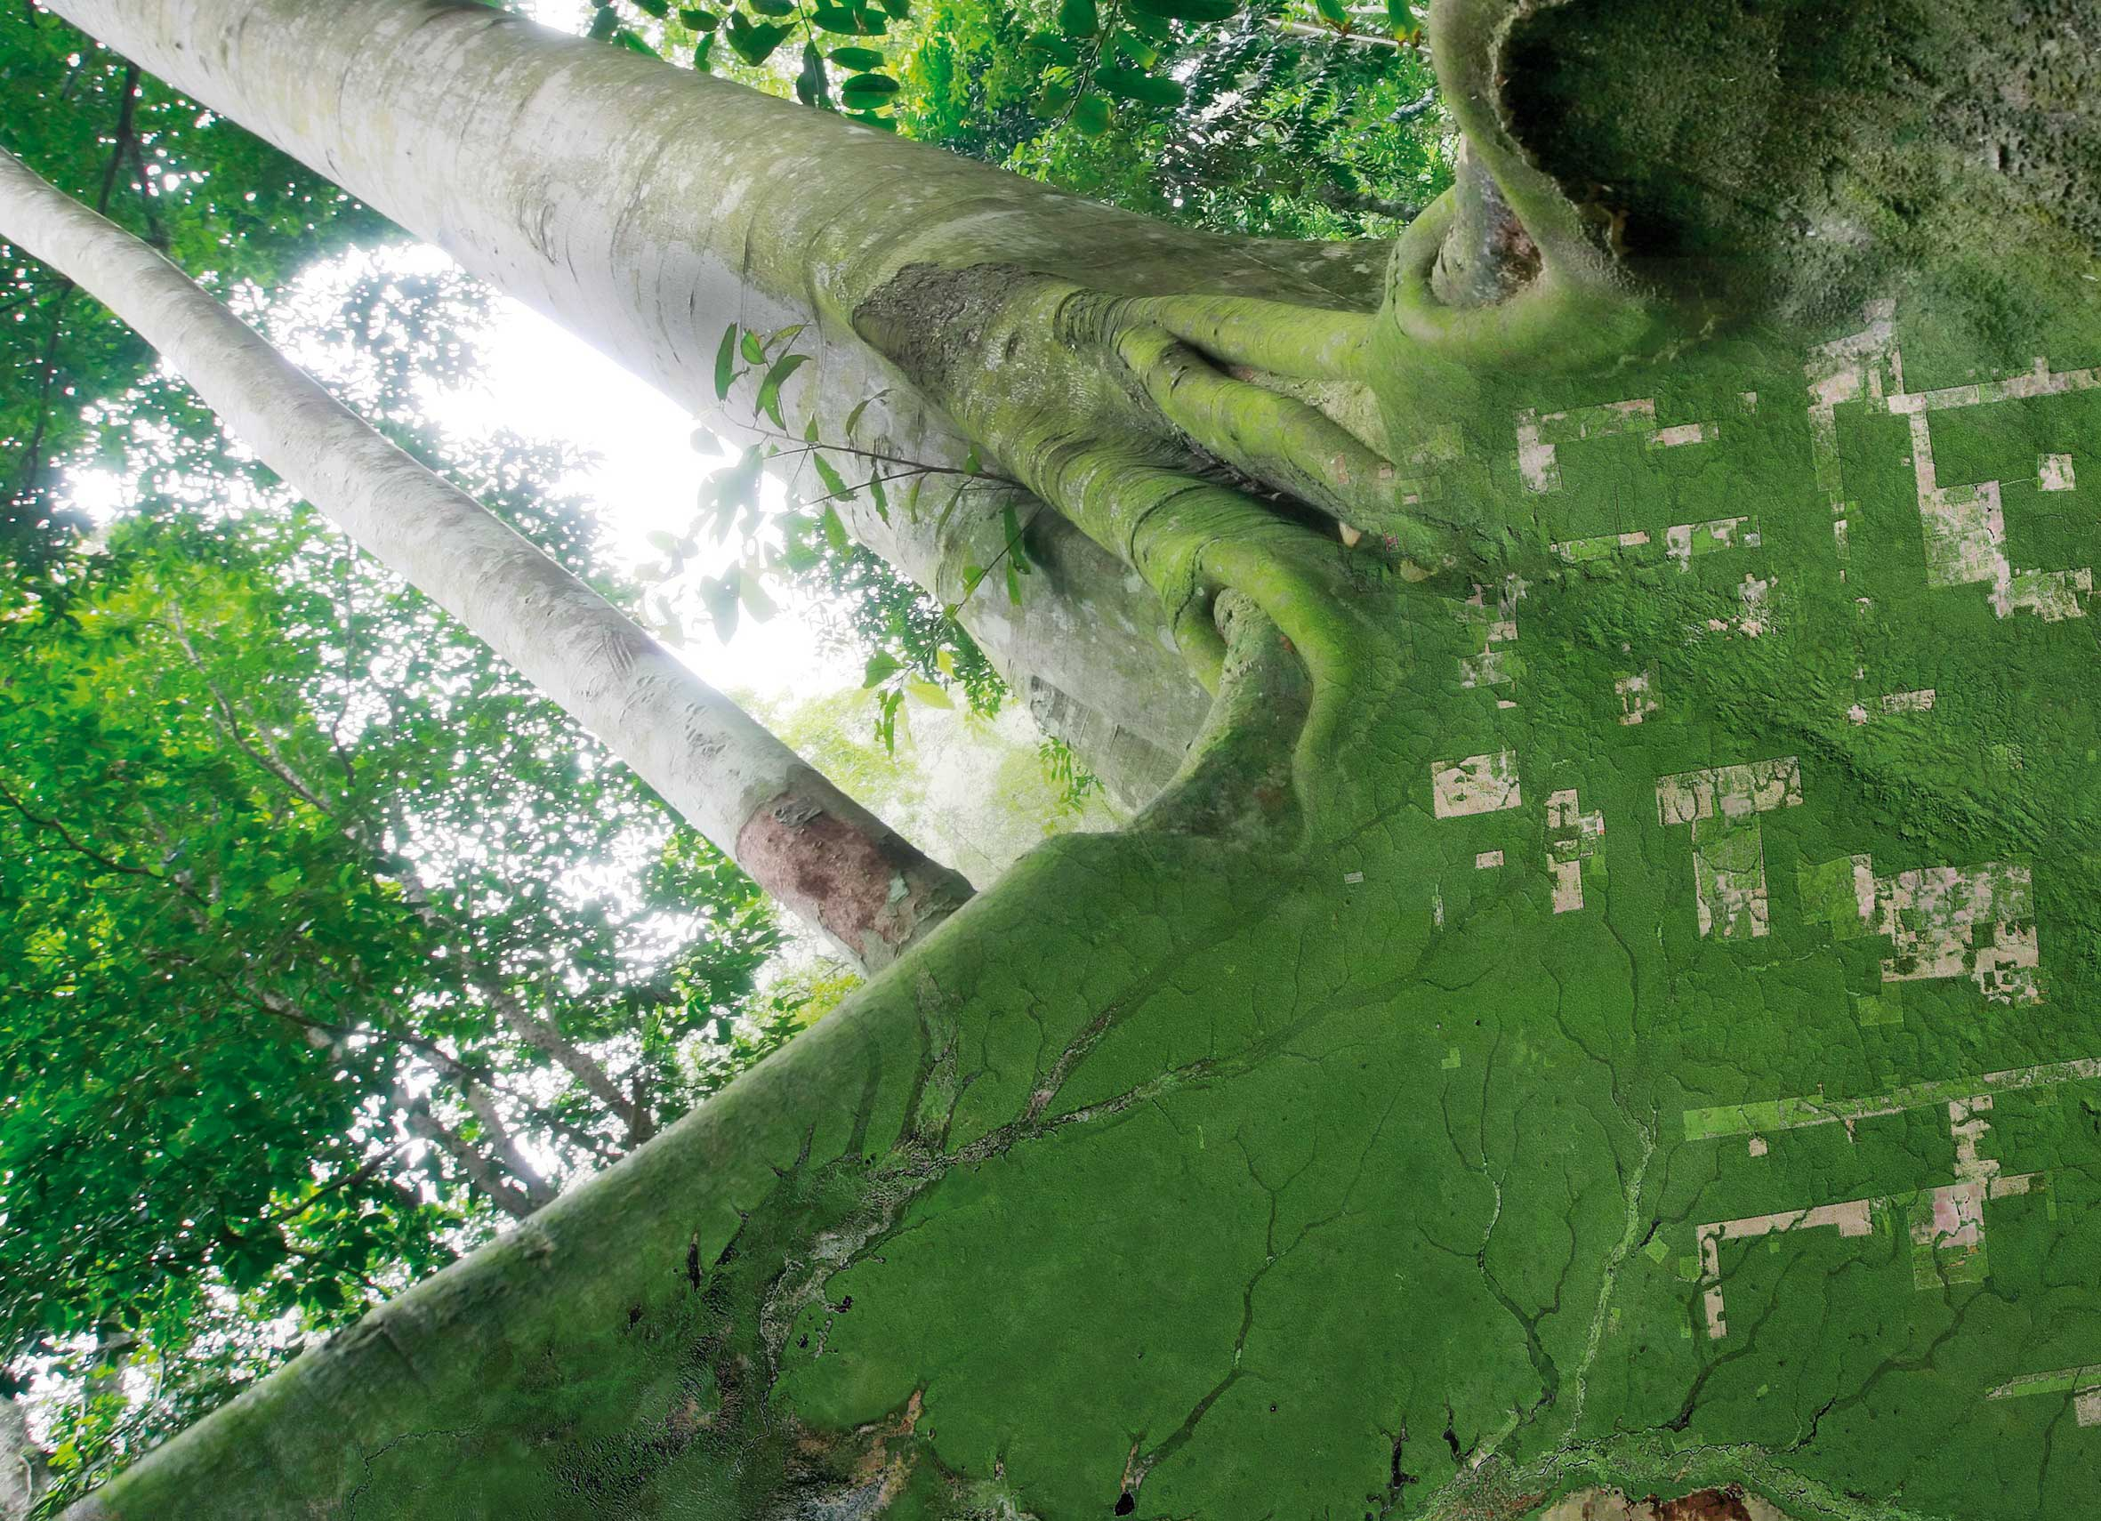
Wrap-up Discussion SDCG-7
Stephen Ward, SDCG EXEC for Australia
SDCG-6: Oslo, Norway 22-24 October, 2014

Slide 2
Discussion topics
3 Year Work Plan Review and Conclusion
GFOI Products & Services Delivery to Countries
GFOI Outreach, inc SilvaCarbon
SDMS issues
Sentinel-2 preparations
SDCG-7
MGD linkages
Co-Chair

Slide 3
3-year work plan
ACTION to review vision and outcomes within a week
ACTION to ask SB to solicit equivalent & syncronised plans from other components to support GFOI Strategy
EXEC to progress document through to SDCG-7/SIT-30

Slide 4
Country interface
Leads directed us to assume FAO & WB as the main delivery mechanisms
Do we see the necessary progress?
Ask Leads to confirm and support necessary coordination?

Slide 5
GFOI Outreach
GFOI Deliverables are emerging
The Brand is essentially unknown
Outreach identified by Leads as the #1 priority
How should SDCG take the initiative?
Continue the pilots (Kenya, Colombia..)
Confirm role of FAO/UN-REDD and World Bank
Make the most of bilaterals (Australia, Norway, Germany…)
Agree a path with SilvaCarbon
Explore new channels (Clinton + ..)

Slide 6
SDMS Issues
Resolve the naming/ownership – GFOI SDMS is the goal and leads are contributing ingredients
SDMS vision seeks to remove data management challenges from developing country users
Getting a common vision of an SDMS-oriented future amongst core SDCG participants is crucial
We need to make the most of the funding and developments of the core data stream providers – the data cube could be a USP for GFOI
ACTION on EXEC to work a collaborative way forward with Norway and FAO

Slide 7
Sentinel-2 preparations
If its full promise is realised, Sentinel-2 data will have a major impact on land surface imaging applications
FAO/UN-REDD confirmed that they have zero plans or experience with Sentinel-2
This is another USP of GFOI/SDCG and we need to get into the details of how to ensure S-2 data can be used/blended/applied with L-8 (again making best use of heavy lifting by USGS/ESA)
We will fail unless the TEP and GFOI/SDCG efforts are synchronised and good communication established - ACTION

Slide 8
SDCG-7
Lets ensure a great turnout
Please make best efforts to attend
Milestone meeting approving the 3-year work plan, progressing SDMS/Data Cube etc and S-2 preparations
Finalised R&D plan

Slide 9
MGD linkages
MGD already getting good traction, including within FAO
MGD v2 has to link to the SDCG Services
Respond to Carly’s requests – ACTION for REP and FAQs/requirements
Sydney discussions

Slide 10
Co-Chair
Norwegian funding for Co-Chair concludes on 31st Dec
Early discussions with Germany
Could also tap Japan
Others?
We need to sustain the capacity

