Slide 1
Arrangements for SDCG-7
Stephen Ward, SDCG EXEC for Australia
SDCG-6: Oslo, Norway 22-24 October, 2014

Slide 2
SDCG-7: The basics
Australia has offered to host SDCG-7 in Sydney in the week of 2nd March 2015
Venue is Nielsen Park – home to the 1st GFOI Summit
SDCG-7 will be part of a full week of meetings of the components and Leads, individually and collectively

Slide 3
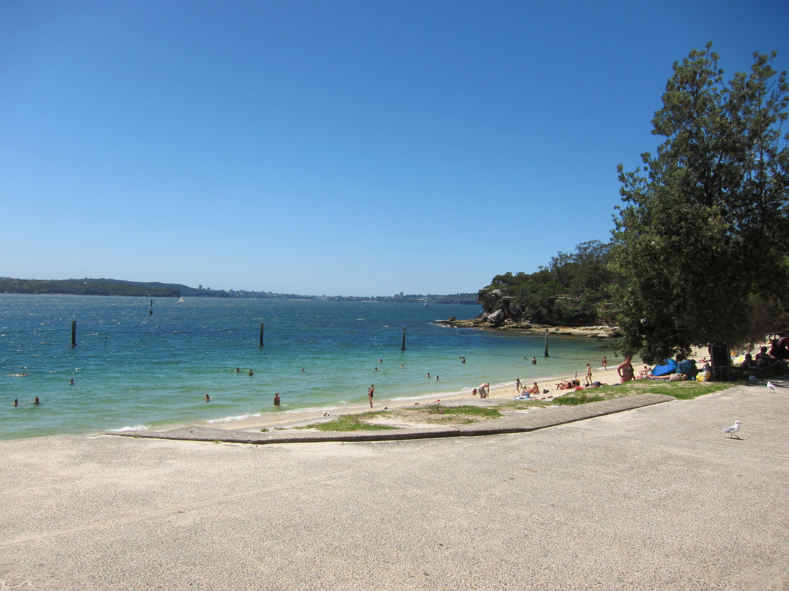
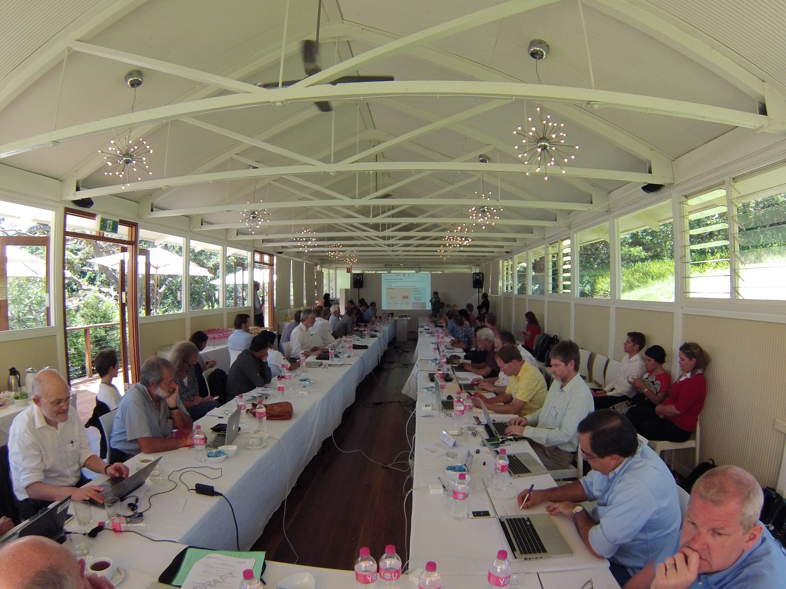
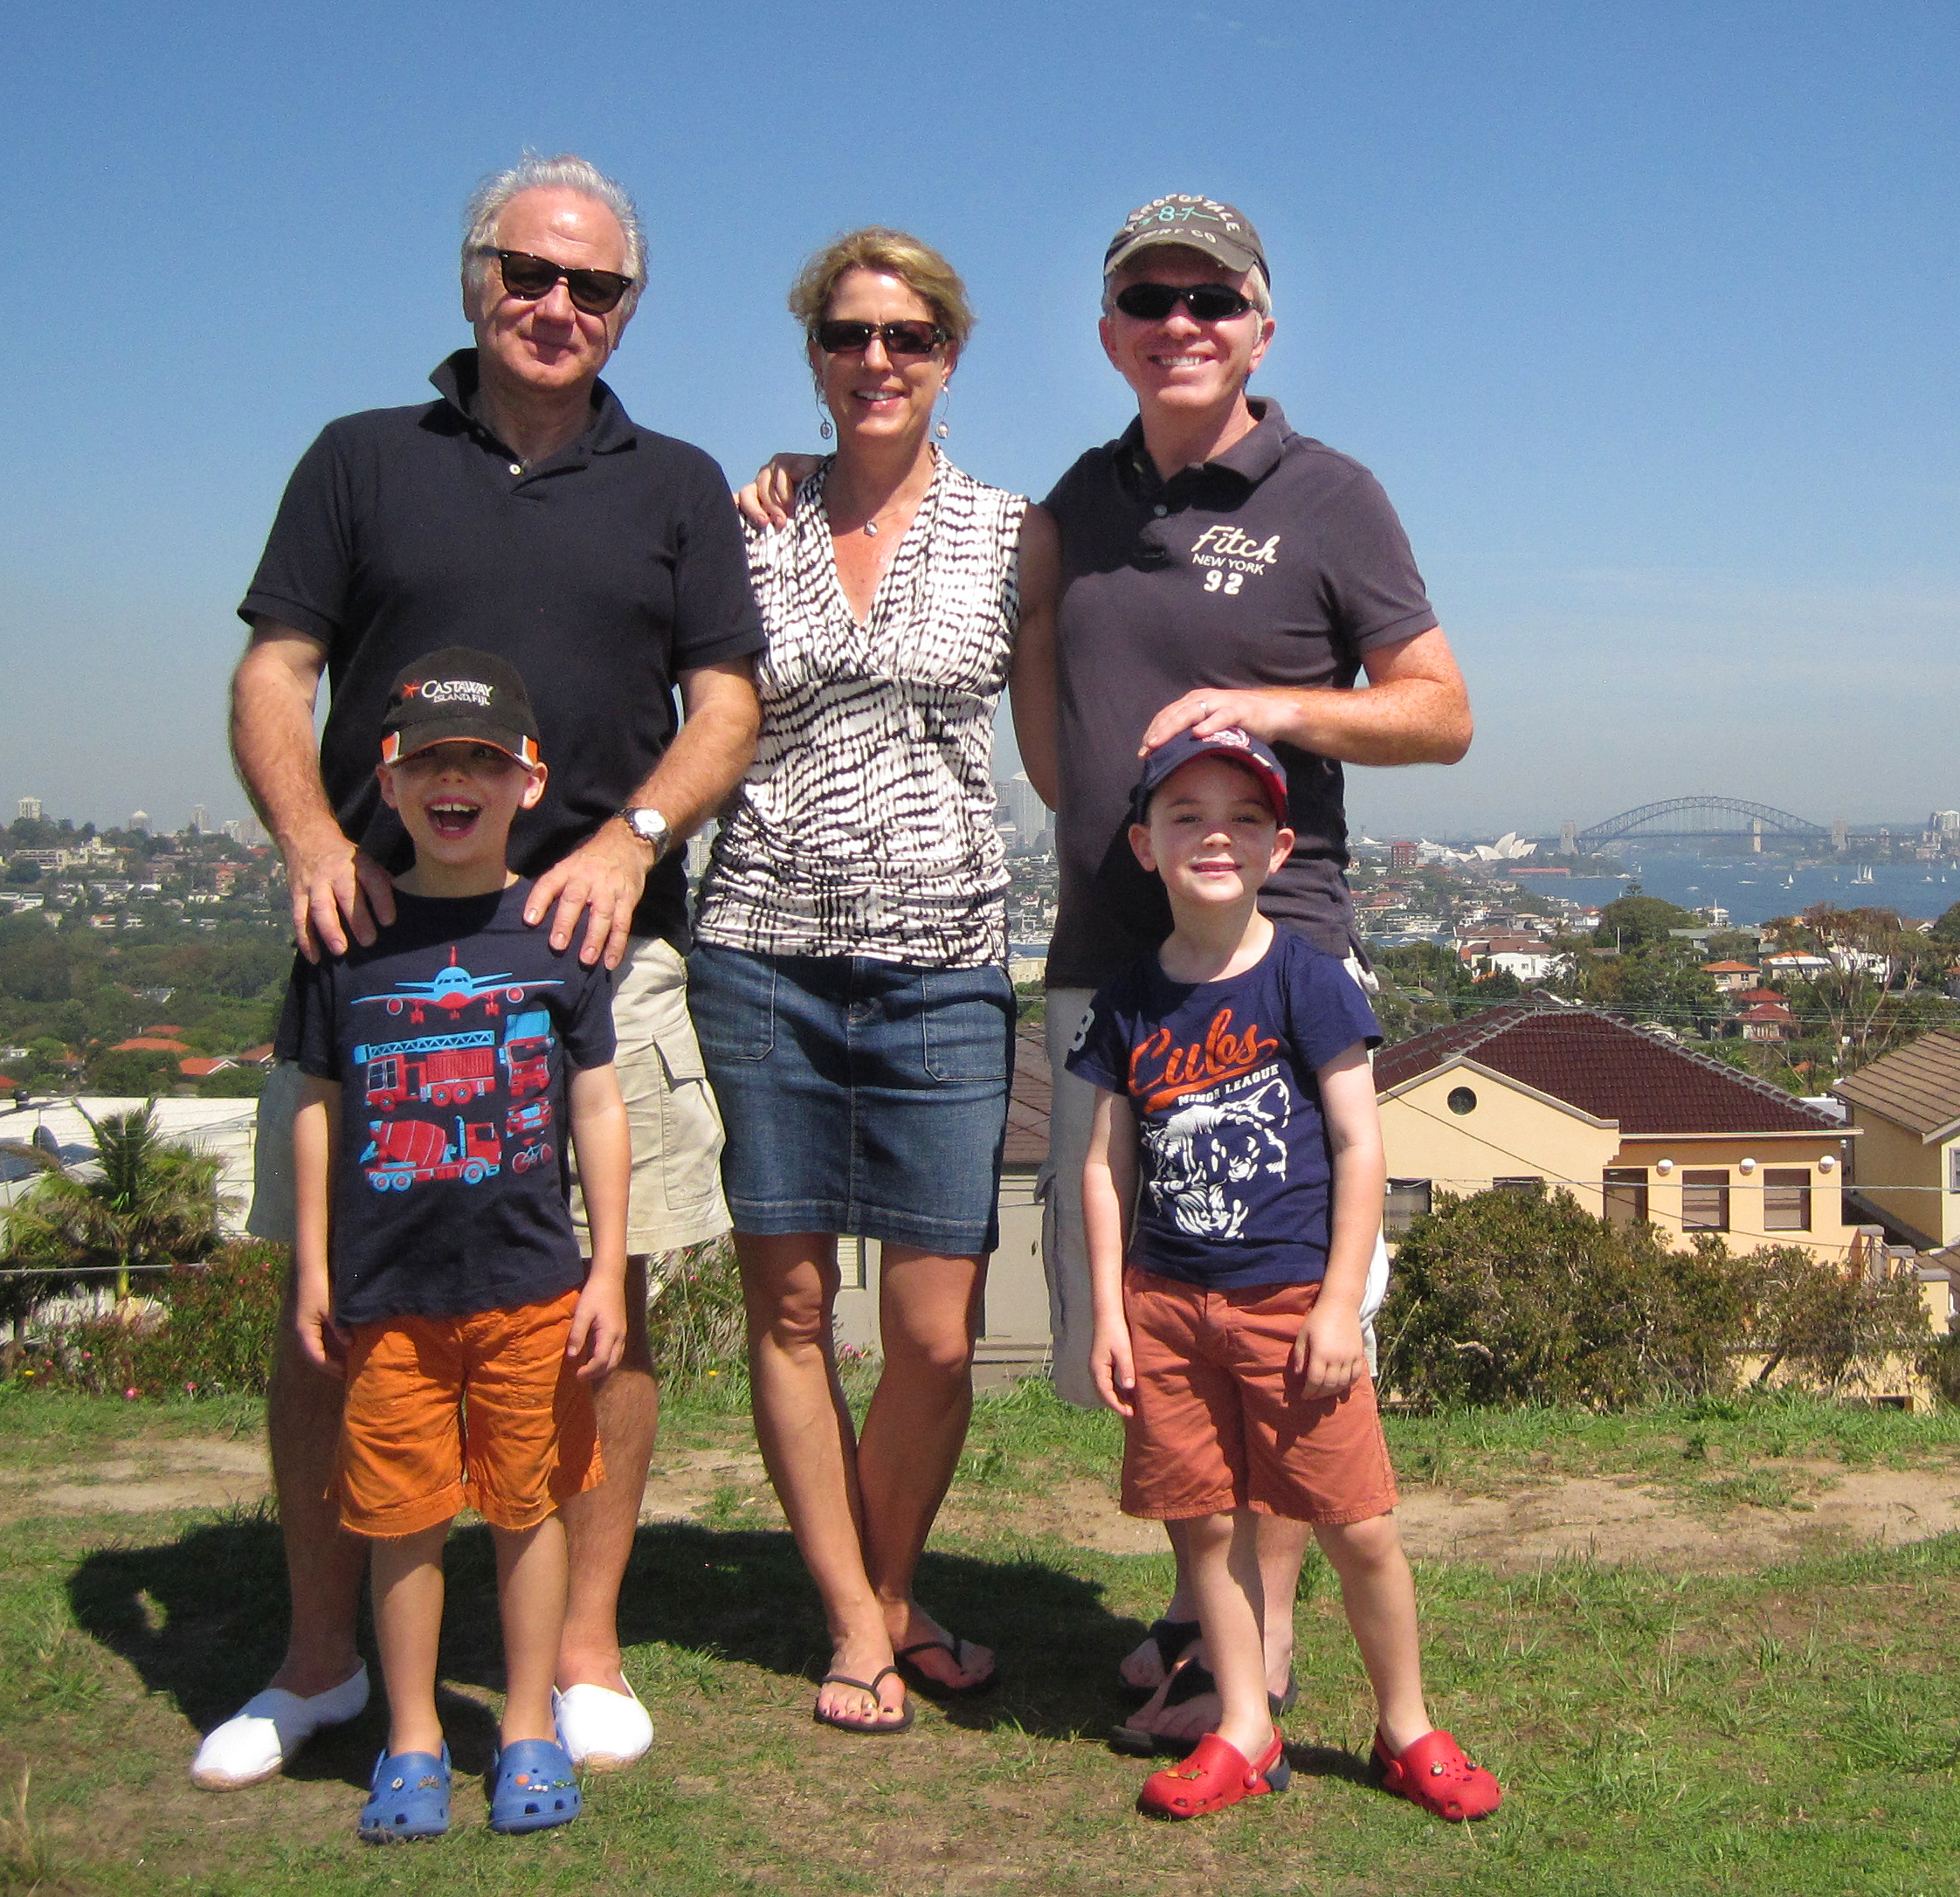
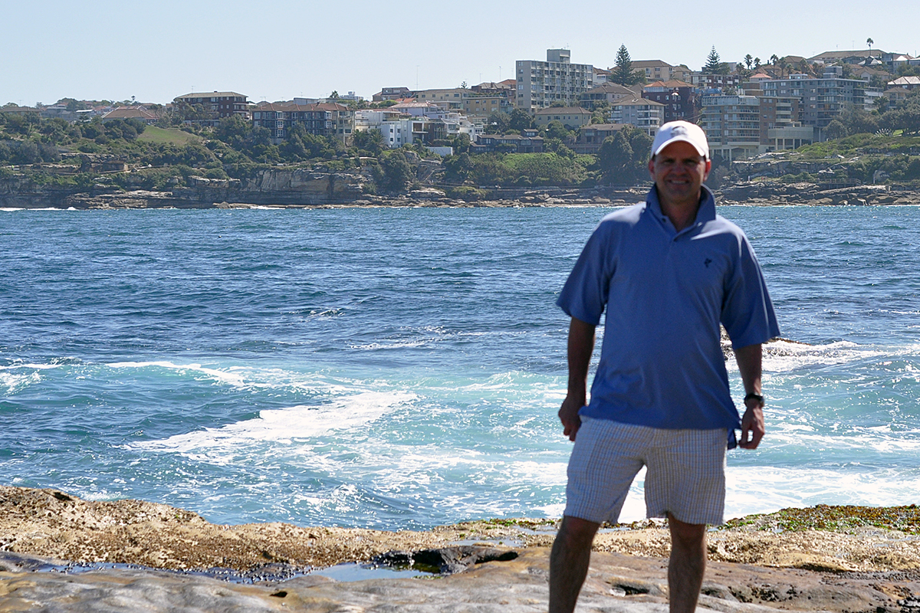
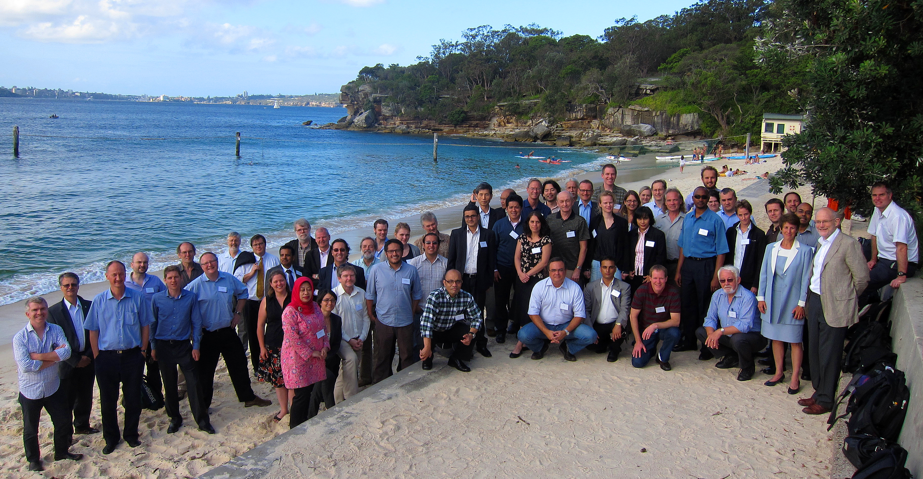
The Venue
3

Slide 4
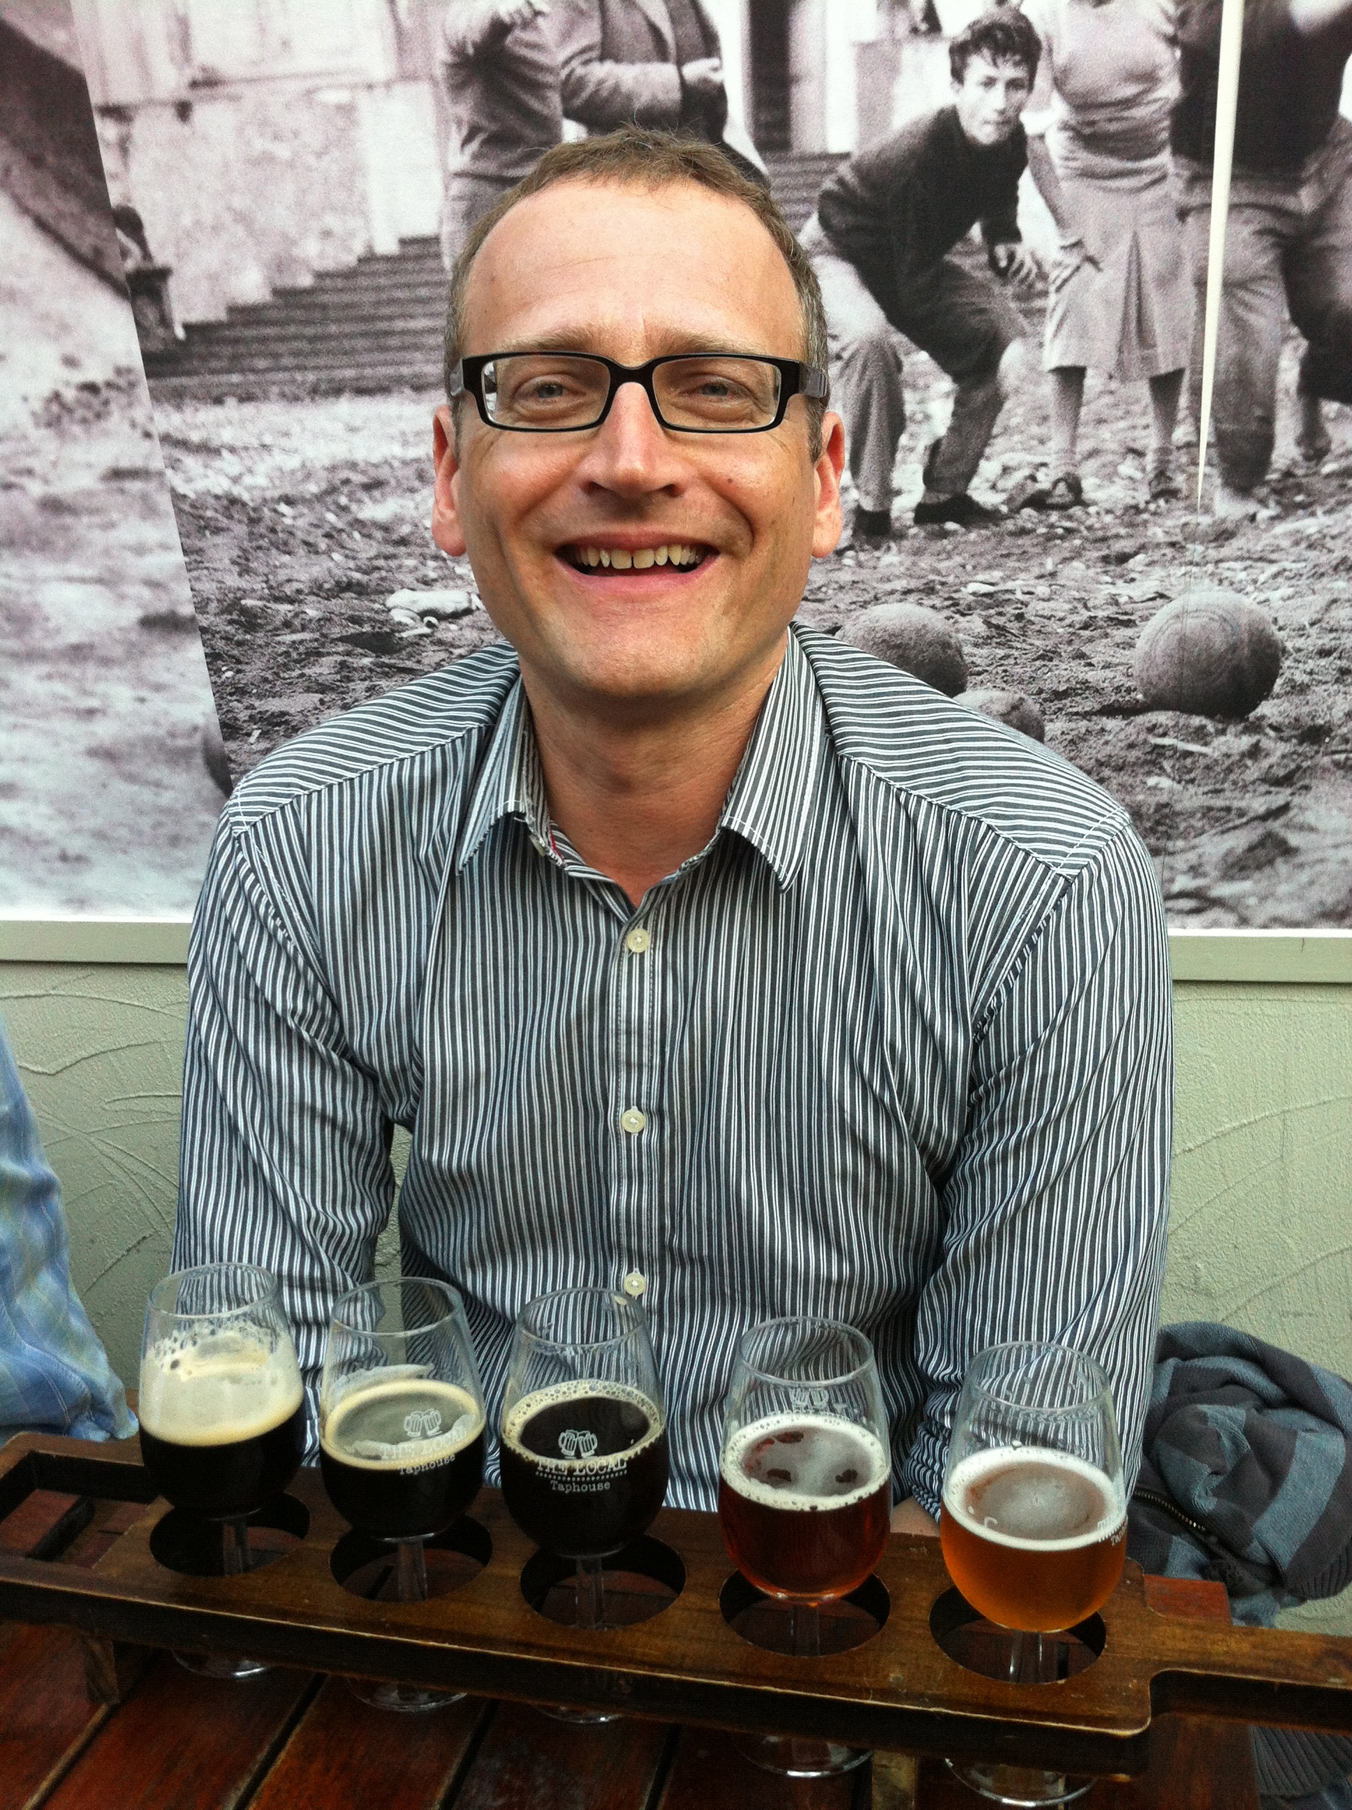
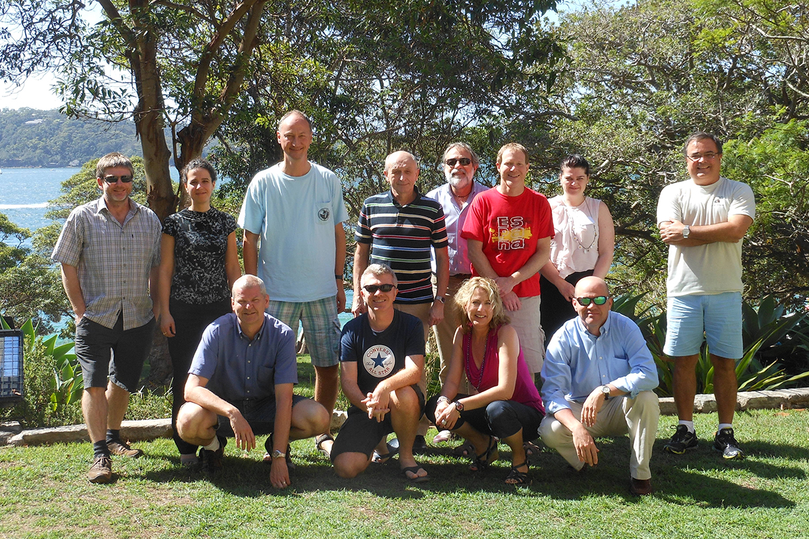
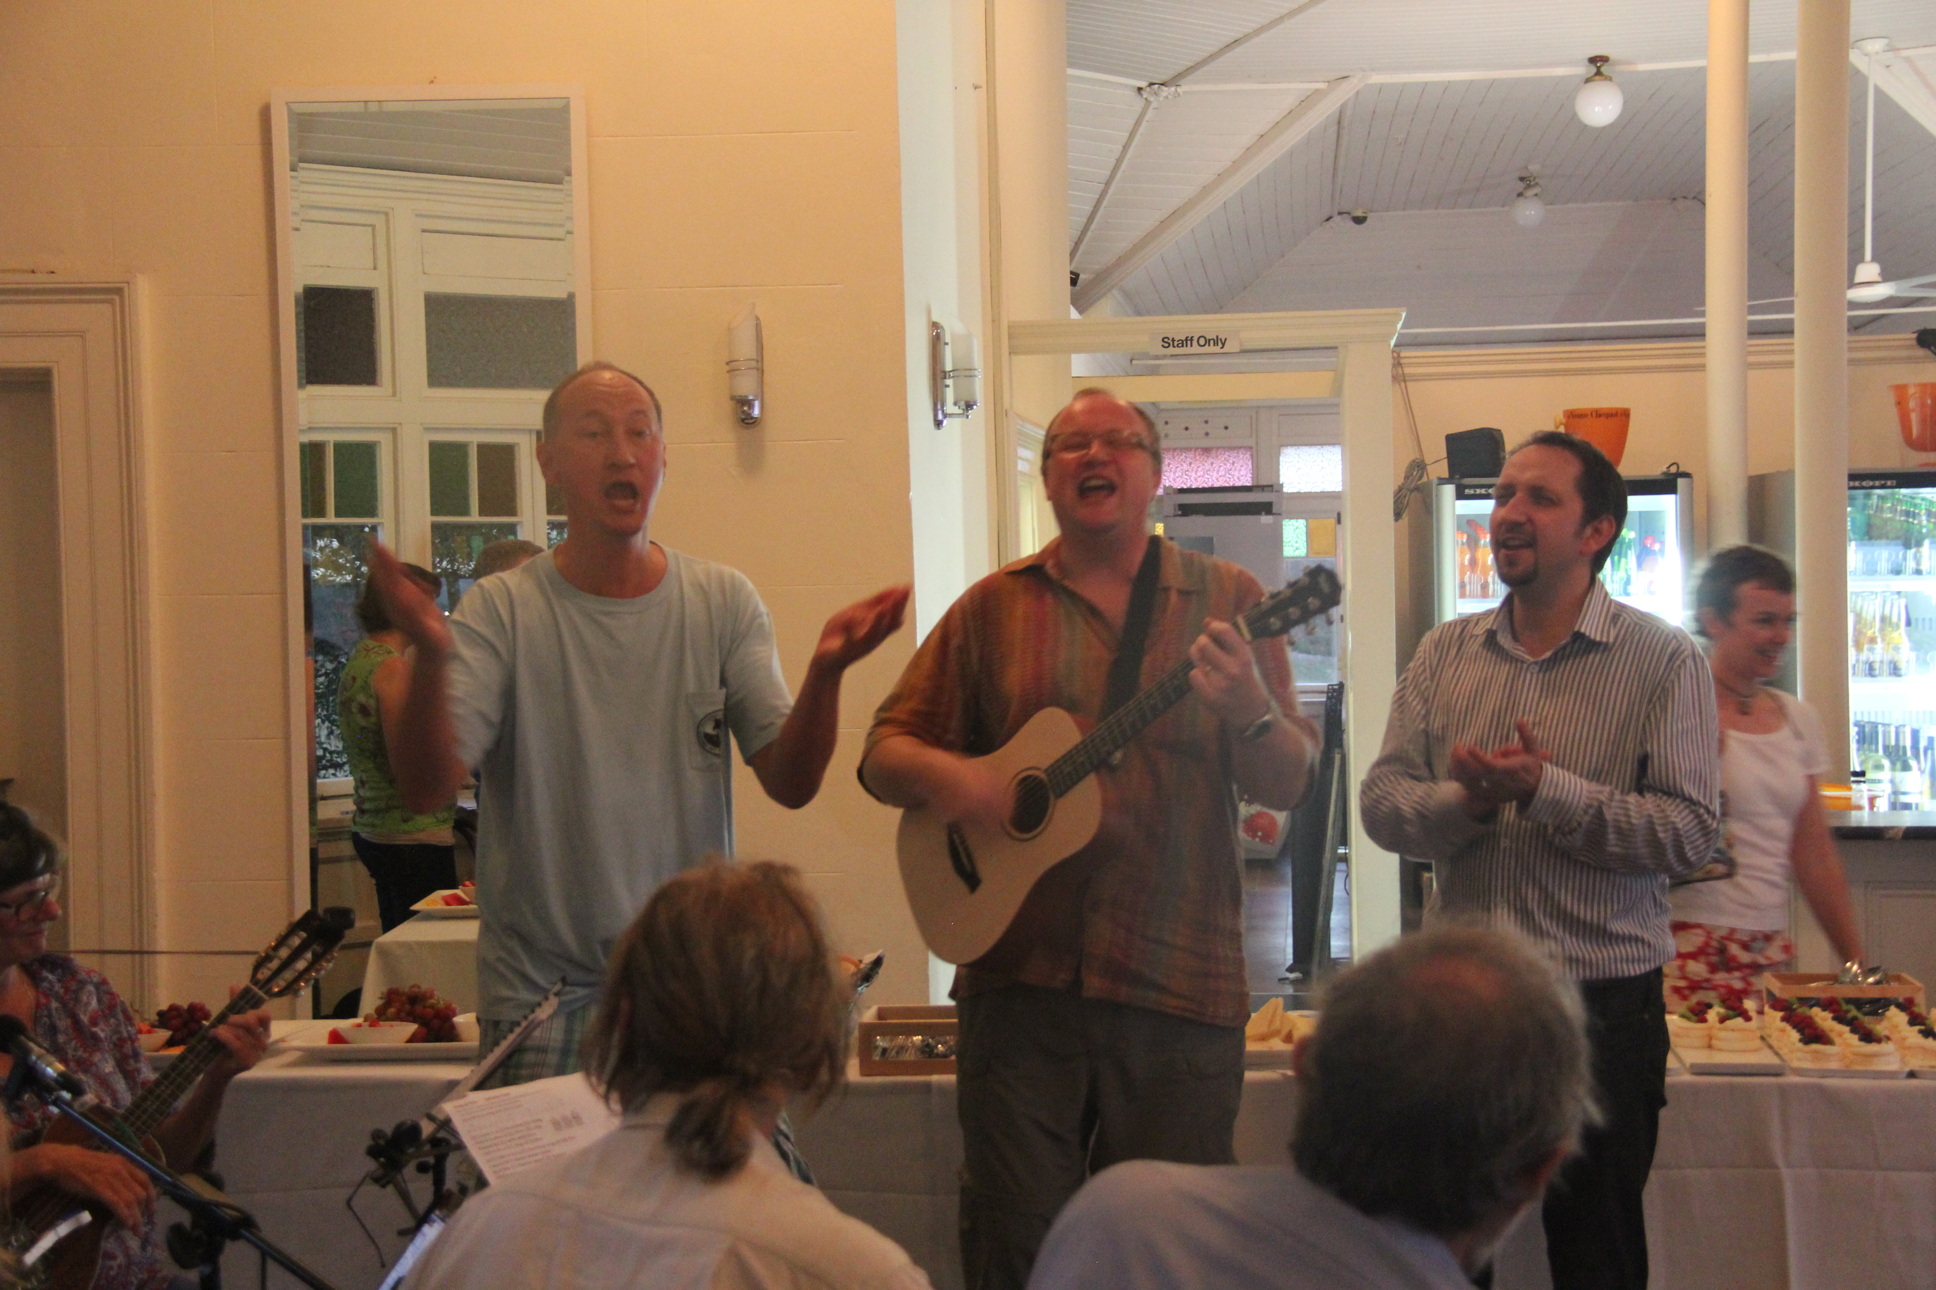
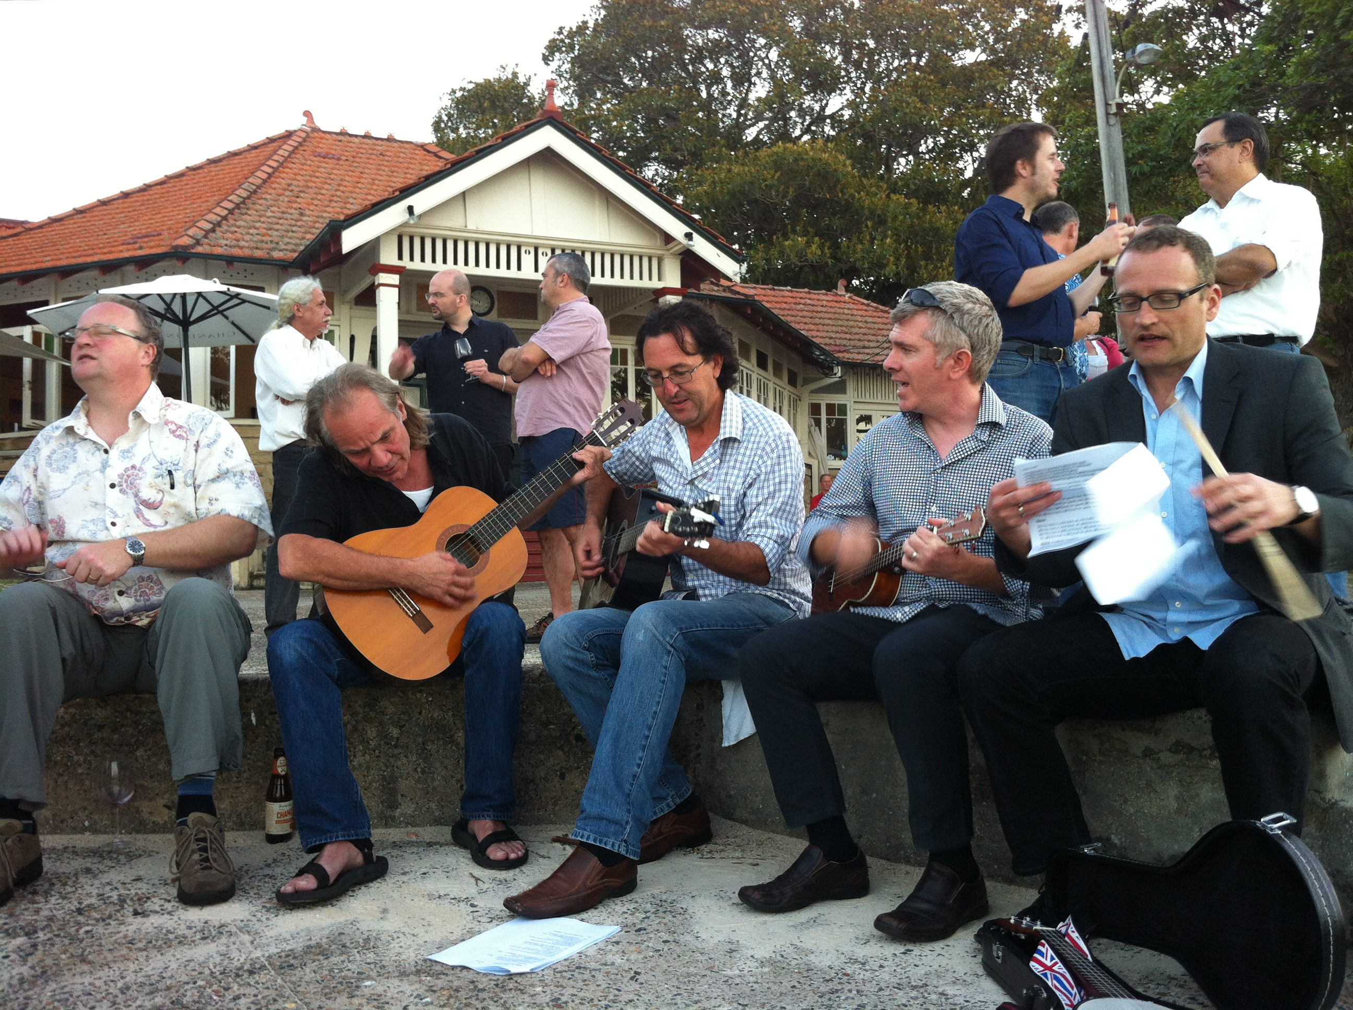
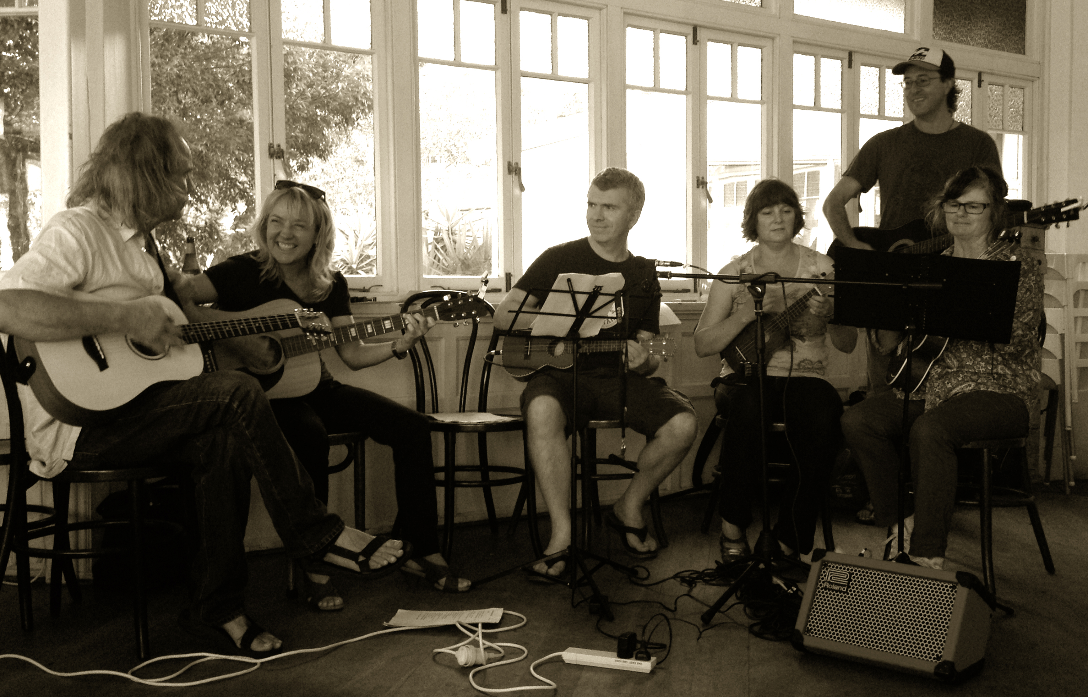
Approach
4

Slide 5
SDCG-7: The business
Need to be connected to the other components and plan joint sessions and outcomes
Data Cube discussions with GA
Need early agreement with SilvaCarbon on countries
Finalise 3-year Work Plan
SDCG-3 was extremely productive – can we agree on the no shoes, no wifi?!
Save the date – logistics to follow

Slide 6
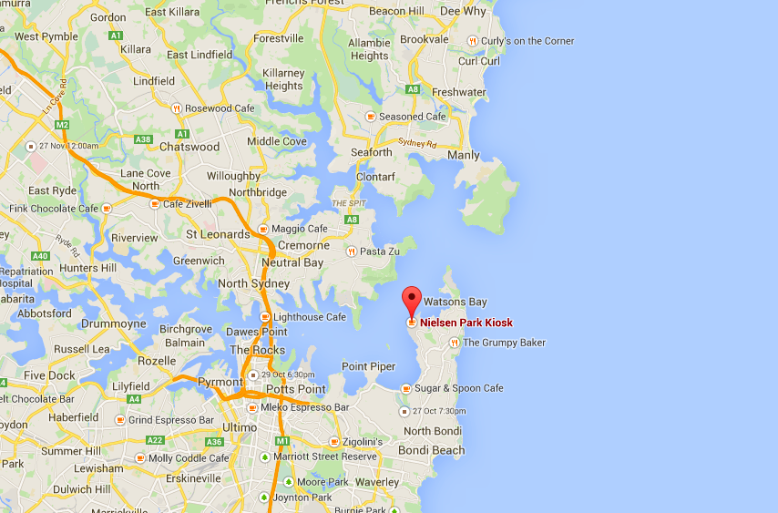
A short flight from US/Europe

