Slide 1
Spot World Heritage
Steven Hosford

Slide 2
General Principles
Products are
Orthorectified images
Older than 5 years (rolling limit) – currently older than 2009
Decametric resolution (20 and 10m SPOT multispectral data)
Non commercial use
“Global change” applications

Slide 3
General Principles
SPOT archive
(Raw data)
~30 million images acquired since 1986
SPOT World Heritage Archive
(Ortho/1A images)
Resources necessary
3

Slide 4
Current Status
CNES has launched the programme by covering costs to process the first 200,000 images
Around 130,000 1A images already delivered
Processing to ortho level in progress
Call for AOIs
Desire to promote initiative/CEOS/GFOI in COP-21 context

Slide 5
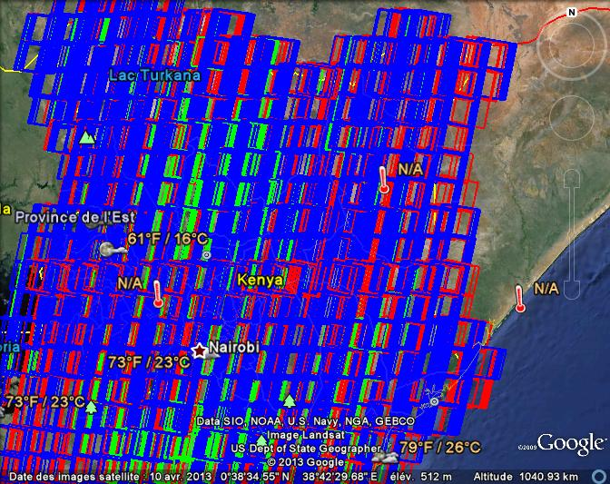
Country coverage examples
Kenya
~8000 images

Slide 6
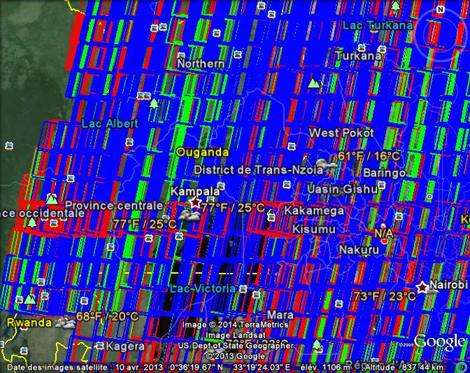
Country coverage examples
Uganda
~5000 images

Slide 7
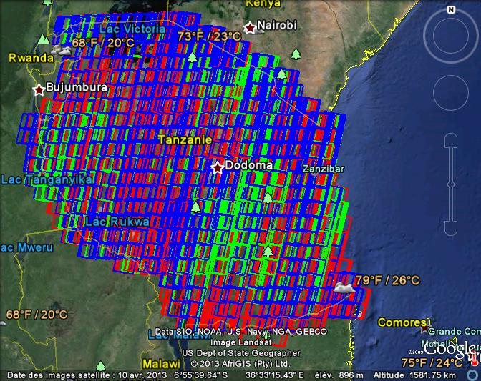
Country coverage examples
Tanzania
~5000 images

