Slide 1
Mission updates
RADARSAT CONSTELLATION MISSION
Canadian Space Agency
Yves Crevier
yves.crevier@asc-csa.gc.ca

Slide 2
Internal work on Forest Monitoring
Relevant to GFOI
Work conducted under the auspices of the Canadian Forest Service
  Development of a National monitoring framework (NTEMS – forest, agriculture, ecosystems, habitats, etc.)
  Improve interoperability usage for optical sensors (eg. LS8, S2)
  Assess interoperability between SAR and optical missions
  Seeking to contribute Canada’s forest information to GFOI

Slide 3
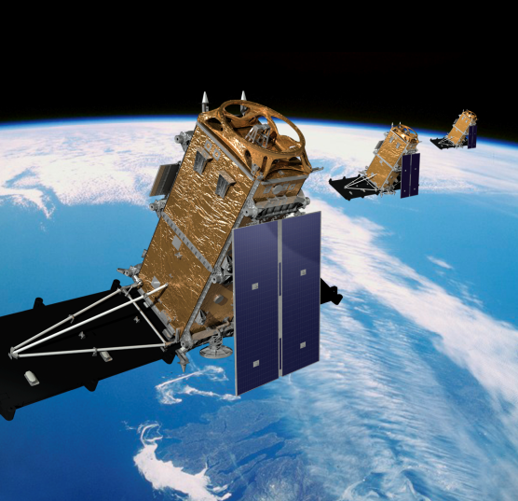
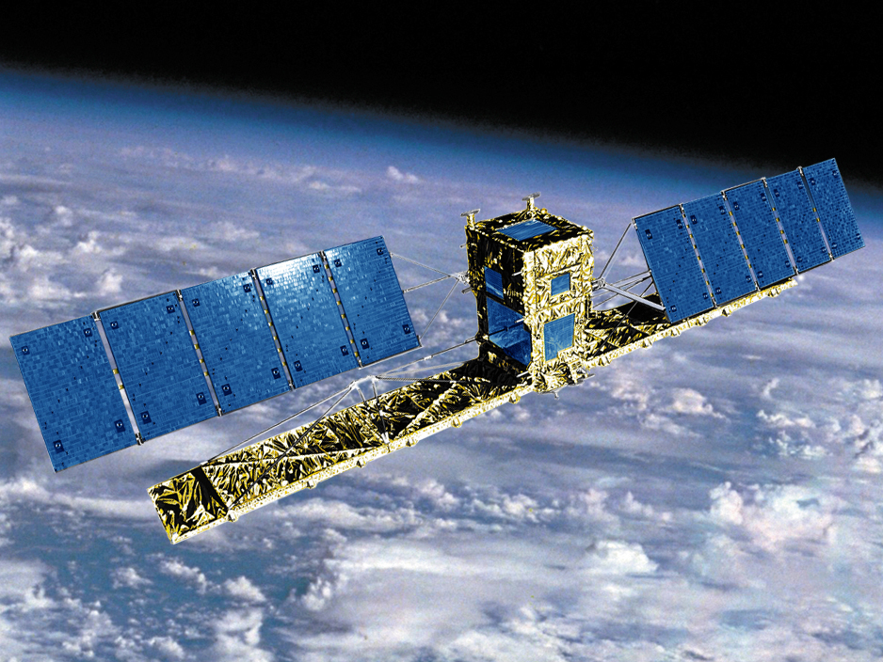
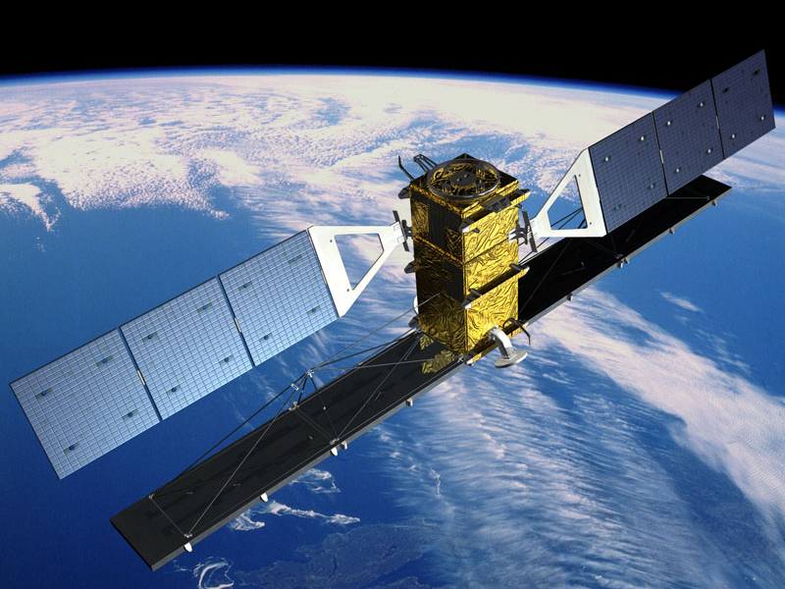
RADARSAT Continuity
RADARSAT-1 (1995)
RADARSAT-2 (2007)
RCM (2018)
 | RADARSAT-1 | RADARSAT-2 | RCM
Mass | 2750 kg | 2280 Kg | 1430 Kg
Complete Coverage | 2-3 days | 2-3 days | Daily coverage
Exact Revisit | 24 days | 24 days | 4 days
Imaging time /orbit | 28 min | 28 min | 15 min /sat
antenna span | 15 m | 15 m | 6.75 m
Polarization | Single HH | Single, Dual, Polarimetric | Single, Dual, Compact Pol
Altitude | 800 km | 800 km | 600 km
Notes:
RADARSAT-1 – Examples of success stories
One of the primary objectives was to provide SAR data to the Canadian Ice Service. Number of images used annually varied from and average of 4000 images per year in the early years to over 6000 images in 2007-08.
Mosaics were produced for Canada, USA, Africa, Australia and Antarctica using mostly ScanSAR Narrow (50 m resolution).
The CSA is member of the International Space and Major Disasters since 2000. RSAT-2 has provided 193 archive images and 268 NRT images
… and much more
RADARSAT-2
First image that was acquired was a Quad-Pol of extremely high quality. It was acquired only 4 days after Launch.
Improved resolution of 3 meters
All heritage beams are available in selective single or Dual polarization. Thunder Bay ScanSAR Narrow B with dual polarization (Transmit VV; Receive VH)
Example of Freeman decomposition highlighting single bounce (blue) double bounce (red) and volume scattering (green). Complete Polarimetry with R-2 Quad-Pol Data offers much more than 4 images. Using Decomposition algorithms, polarimetric signatures or other types of tools allow to retrieve information that would difficult to get otherwise. The Advanced Polarimetry Workshop on Thursfay (by Ridha Touzi) will discuss tools and methods to get the most out of your polarimetric datasets.
RCM
- Better coverage and revisit period (next slide gives more details on similarities and differences)

Slide 4
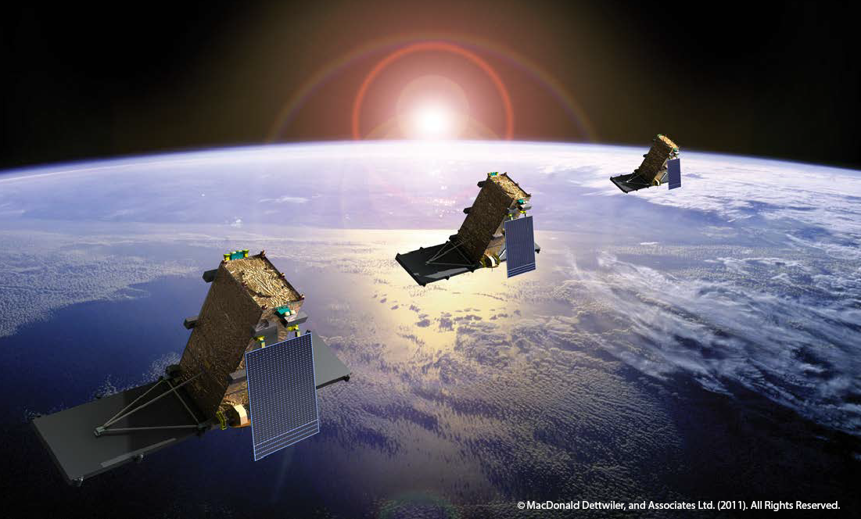
RADARSAT Constellation Mission (RCM)
Construction phase
Satellites and data (SAR and AIS) are Government-owned
Planned for launch in 2018
Include an Automatic Identification System (AIS) on each satellite
Assessment of Capacity for the GoC – 12 to 15 minutes of SAR on-time per orbit
Equally spaced on orbital plan – 30 minutes apart. 4-day coherent change detection

Slide 5
Schedule
Notes:
Based on MCP minus E1
Phase A: 1.4% (State between 1 – 2%)
Phase B: 4.4% (State between 4 – 5%)
Phase C: 21.3% (State between 15 – 25%)
Phase D: 72.8% (State between 70 – 75%)
Phase E1 is 3% of the total MCP cost.

Slide 6
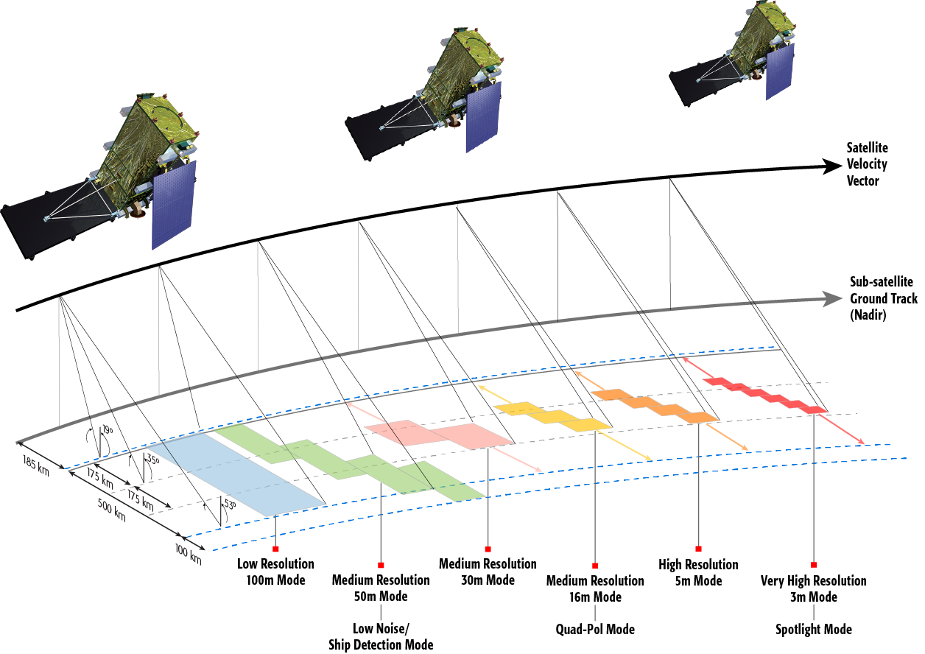
RCM Imaging Modes

Slide 7
Image Products
Raw Products
  Raw Radar data in FRED format
Image Products
  Variety of processing levels
    single-look complex products (SLC)
    multi-looked power-detected geo-referenced products (GRD, GRC)
    geo-coded products (GCD, GCC)
  Include a “Doppler Grid” with 2 km spacing
  Same formats as RADARSAT-2: GeoTIFF images with XML meta-data + NITF 2.1 format.
GCC = GeoCoded Complex
GCD = GeoCoded Detected
GRC = Ground range georeferenced Complex
GRD = Ground range georeferenced Detected
Notes:
- Doppler centroid values from orbit and attitude data and Doppler Centroid values adaptively estimated from the signal data, on a grid with sample spacing no greater than 2 km in both ground range and azimuth.

Slide 8
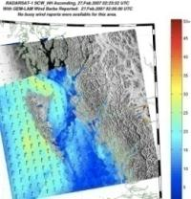
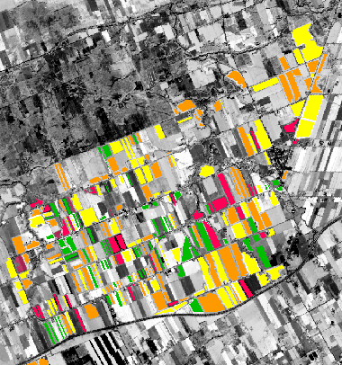
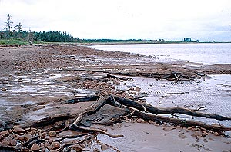
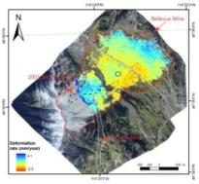
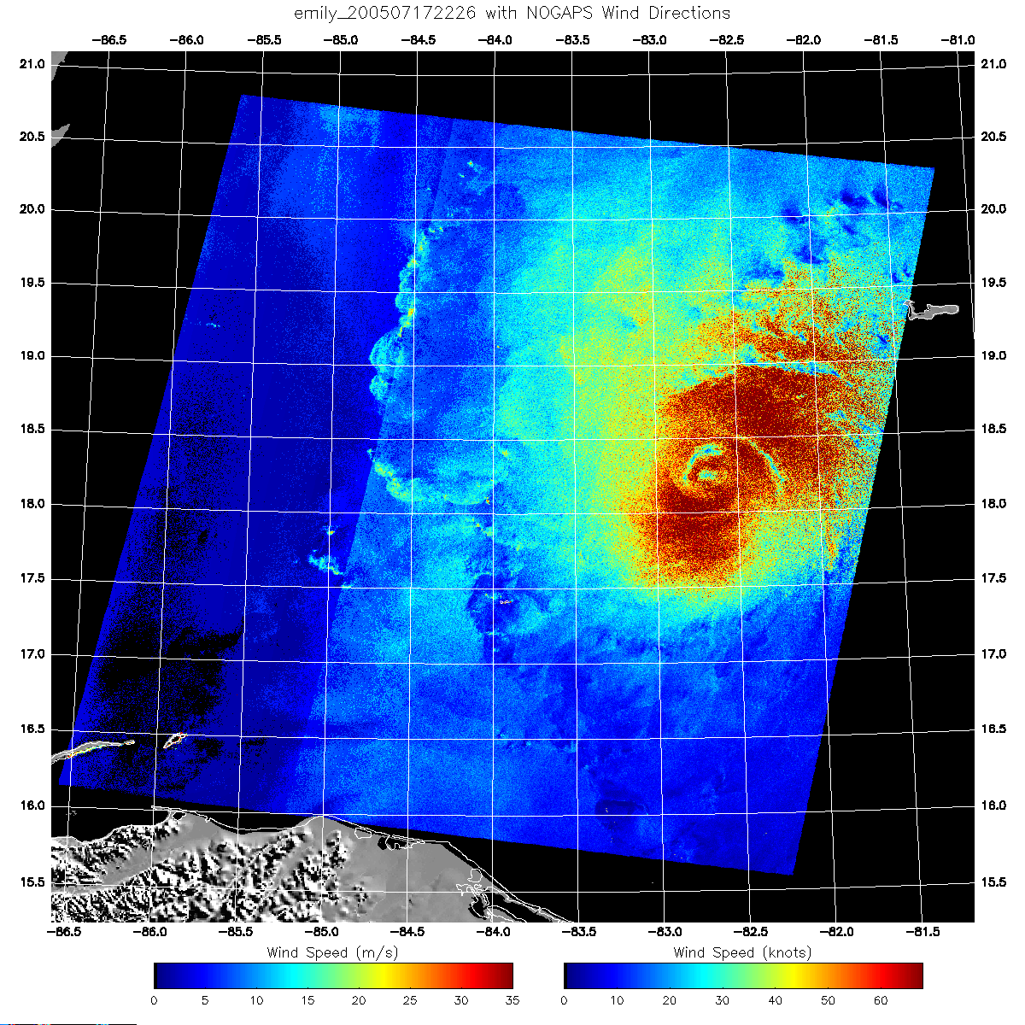
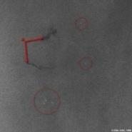
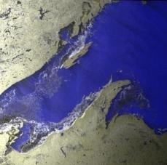
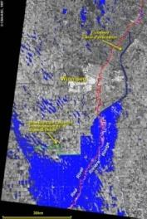
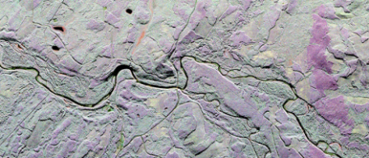
Core Use Areas
Maritime Surveillance
Environmental Monitoring
Disaster Management
Ice & Iceberg Monitoring
Pollution Monitoring
Vessel Detection
  Including AIS
Marine Winds
Forestry
Protected Areas & Wildlife Habitat
Agriculture
Wetlands
Coastal Change
Flood Monitoring
Windstorms
Earthquakes
Landslides
Volcanic Activity
Permafrost

Slide 9
Standard Coverage Concept -
Coherent, consistent and systematic
RCM will introduce a pre-defined and pre-programmed recurrent data acquisitions concept based on users specific parameters such as revisit, geographic area, time frame (all year or season-specific) and modes.
Issue
  Large geographic and temporal overlaps in users and applications requirements
  Various preferred imaging modes
Approach
  Analyse user imaging requirements spatially and temporally over the annual cycle to determine a "feasible" imaging plan, with agreed upon compromises in overlapping zones
Result → Standard Coverage
  Collections of data acquired routinely in harmonized and de-conflicted imaging modes intended to optimize and maximize the utility of the data across all User requirements

Slide 10
RCM Data Policy Objectives
  Priority access for Canadian operational users over Canada.
  Data freely and openly available to public as much as possible (world-wide trend toward full and open data sharing principles).
  Maintain commercial thrust initiated by previous RADARSAT missions as much as possible.
  Enable a level-playing-field for all Canadian value-added service providers and re-invigorate this industry.
Protect and preserve data in the long-term.
Comply with the Remote Sensing Space Systems Act and other GoC regulations.
Status: Currently in development.

