Slide 1
Baseline Global Observation Scenario
SDCG-8, Session 3
Gene Fosnight (USGS); Frank Martin Seifert (ESA)
24 Sep 2015, Bonn

Slide 2
Session Introduction
Overview of 2015 Outcomes

Slide 3
Outcome 1: Acquire Data
Multiple annual Global Coverages by 2016 of the world’s forested areas
2015: Building to a total of 67 countries in line with the Global Baseline Data Acquisition Strategy
Optical core missions with free and open data policies
Landsat 7 and Landsat 8 – operational - global
Sentinel-2a – 2015 launch (launched!) and commissioning - global
CBERS-4 – 2014 launch and 2015 commissioning - regional
Radar core missions with free and open data policies
Sentinel-1a – operational! - global
Sentinel-1b – 2016 launch and commissioning – global

Slide 4
Outcome 2: Data Access
Efficient and effective global flows of data
2015: Complete global data flow study

Slide 5
Outcome 3: Data to Information
Global coverage with consistent information products
Identify Space Agency and expert partner information product initiatives relevant to GFOI and MDG.
GA Data Cubes
ESA Thematic Exploitation Platforms (TEP)
USGS Land Change, Monitoring, Assessment and Prediction (LCMAP)
FAO SEPAL
Intercalibration and interoperability studies

Slide 6
Landsat 7 & 8 Status
SDCG-8, Session 3
Gene Fosnight (USGS)
24 Sep 2015, Bonn

Slide 7
USGS Core Data Stream Report
Landsat 7 and Landsat 8 Status
Land Change Monitoring, Assessment and Prediction (LCMAP)

Slide 8
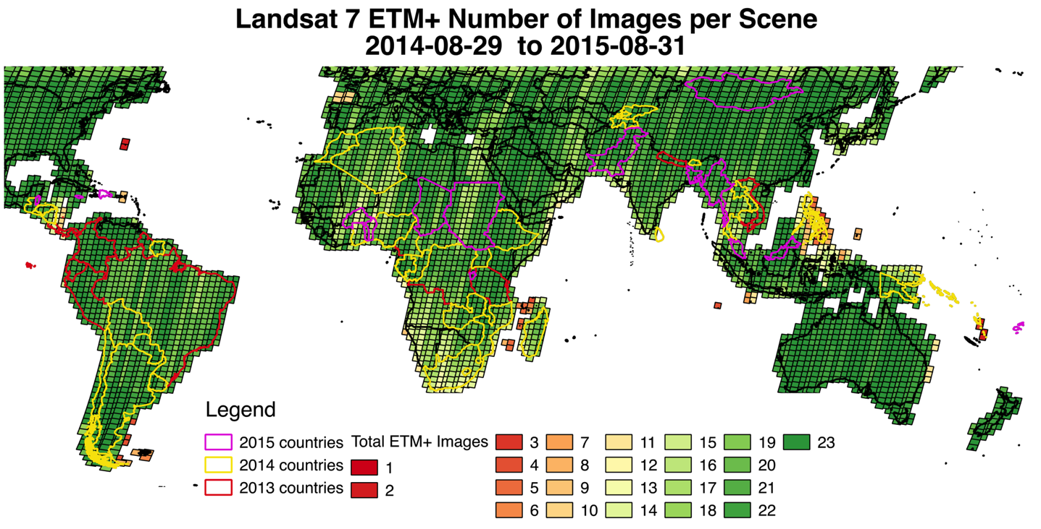
Landsat 7 status - 2015
Median: 443 images/day
Max: 529 images/day

Slide 9
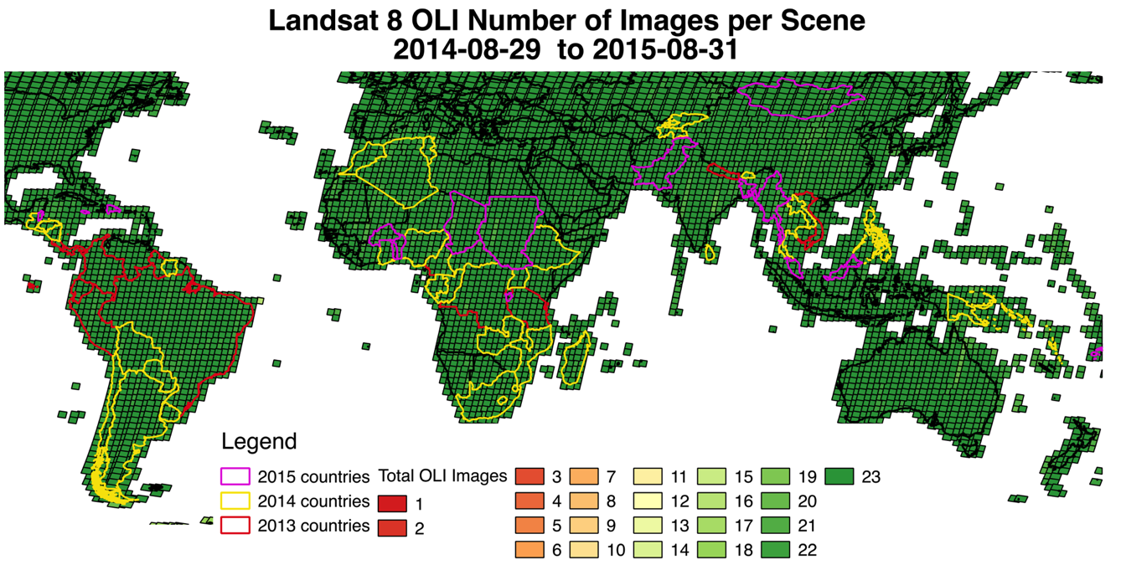
Landsat 8 status - 2015
Mid latitude (57°)
421 images/day
Reject 1.5 image/day
99.6%
High latitude
226 images/day
Reject 16 images/day
93.3%

Slide 10
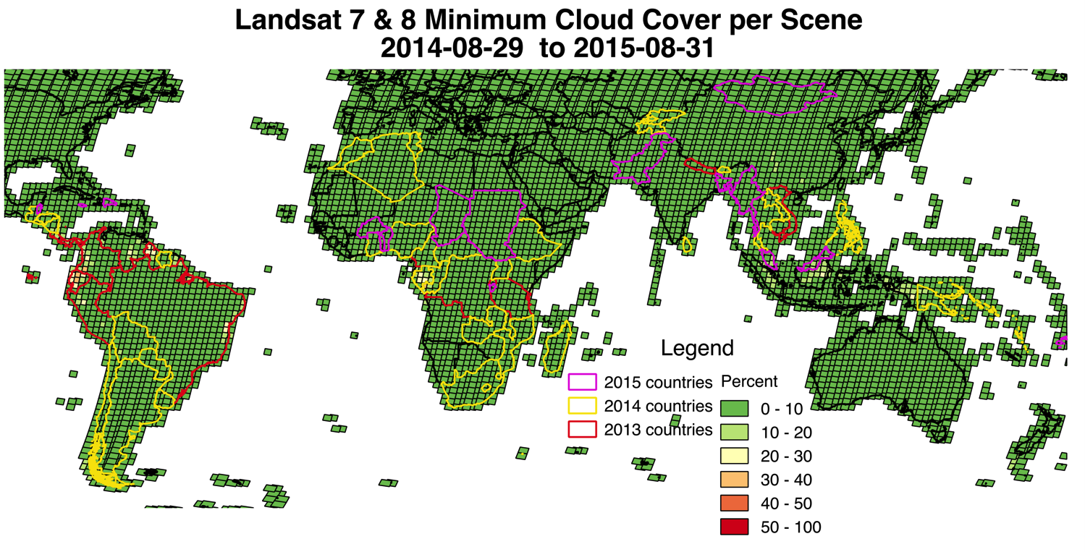
Landsat 7 & 8 combined Best Cloud Cover
percent cloud cover | <=10 | >10 & <=20 | >20 & <=30 | >30 & <=40 | >40 & <=50 | >50
Number of Scenes | 4375 | 121 | 22 | 4 | 0 | 0

Slide 11
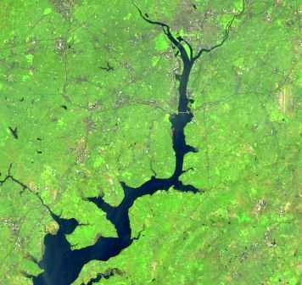
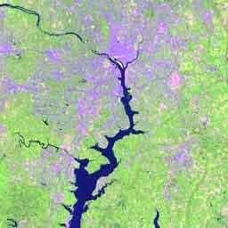
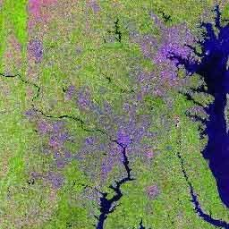
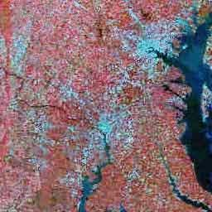
Global Landsat Archive Sep 1, 2015 (Jan 2, 2015)
OLI-TIRS: Landsat 8
549,218 (385,345) scenes
average scene size 1813 MB
ETM+: Landsat 7
1,995,562 (1,858,501) scenes
average scene size 487 MB
TM: Landsat 4 & Landsat 5
2,110,943 (1,988,982) scenes
average scene size 263 MB
MSS: Landsat 1 through 5
1,300,087 (1,299,626) scenes
average scene size 32 MB
Total:
5,955,810 (5,532,454) scenes
All average scenes sizes are for uncompressed data

Slide 12
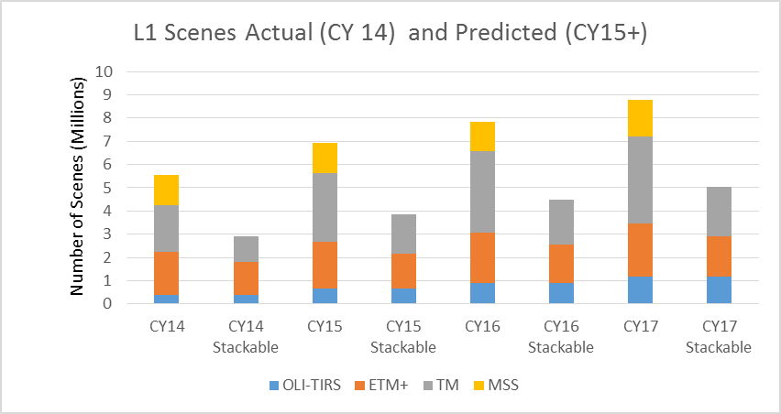
Archive Distribution Products
Notes:
Goal is precision terrain corrected products. Without manual intervention, systematic products are not stackable or ready for higher-level processing.
While certain MSS products are stackable, we don’t consider them ready for higher-level processing yet.

Slide 13
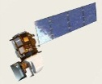
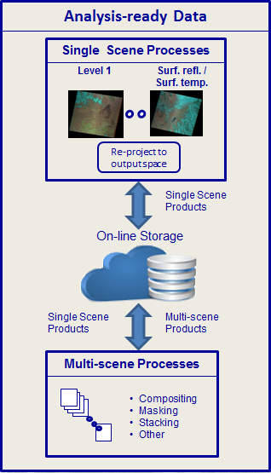
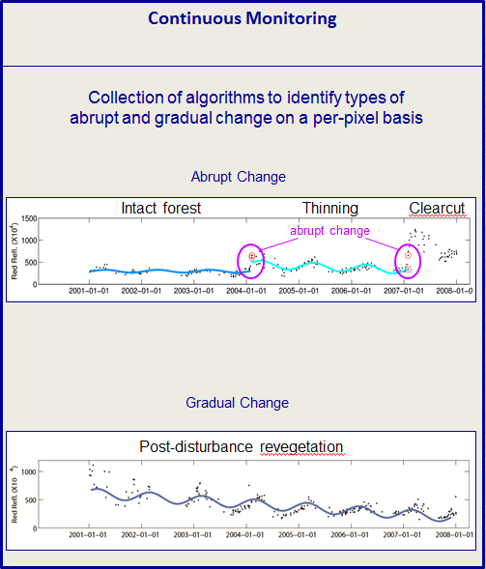
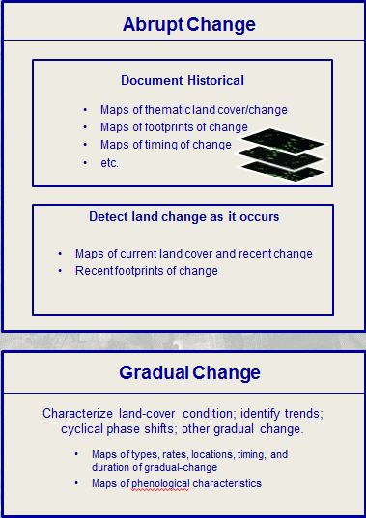
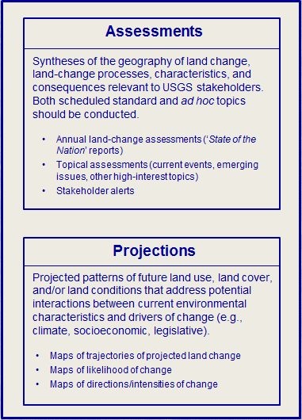
EROS Land-Change System
(connections and other important details)
Communications, applications services, outreach, and other users and stakeholder support
Communications & outreach
Web-based access to all products
Web-based analysis portal
Applications support
Continuous Monitoring
Spatial analyses of change
SDCG-8 Bonn, Germany September 23rd – 25th 2015

Slide 14
The spectral history of a pixel.
Gradual change
Landsat Band 5 observed reflectance per overpass
Reflectance (scale factor 0.0001)
1984 1986 1988 1990 1992 1994 1996 1998 2000 2002 2004 2006 2008 2010 2012
Date
Abrupt break in pattern of temporal sequence of reflectance levels
Model trajectory for estimated reflectance
14

Slide 15
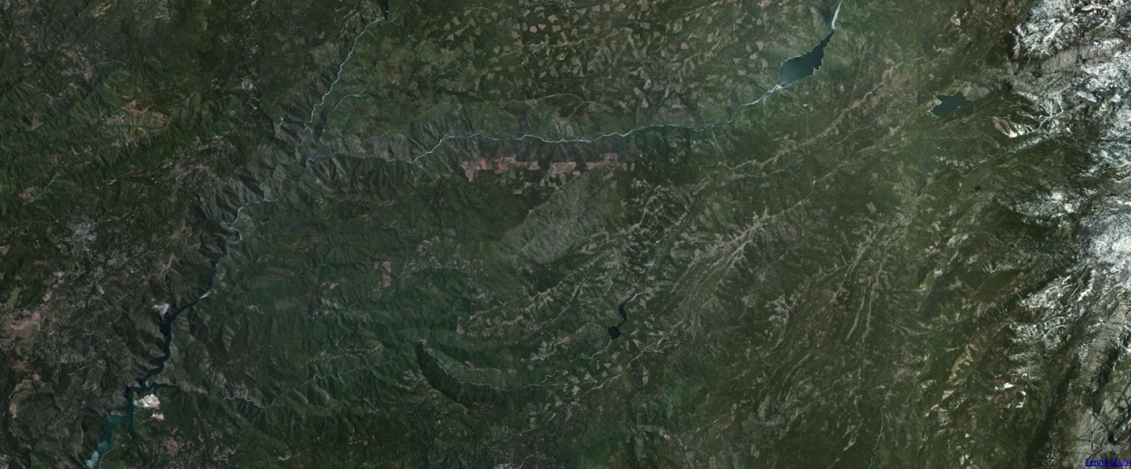
The spectral history of a pixel
in Stanislaus National Forest, California
This pixel
from 1984 to 2013
Landsat Band 5
Reflectance (scale factor 0.0001)
1984 1986 1988 1990 1992 1994 1996 1998 2000 2002 2004 2006 2008 2010 2012
Date
15

Slide 16
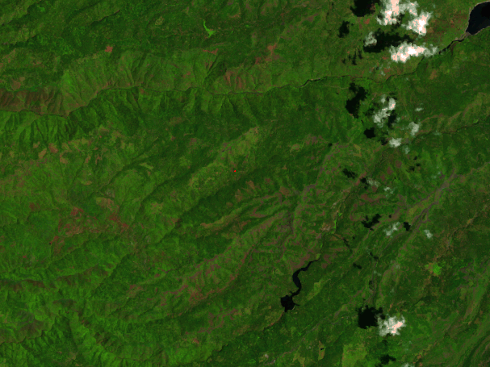
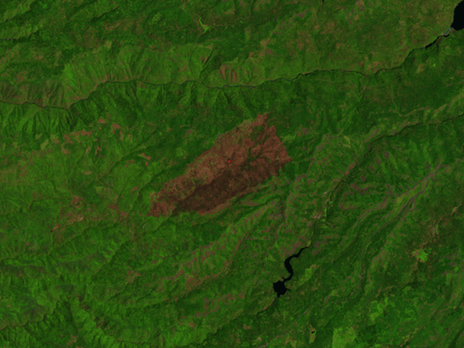
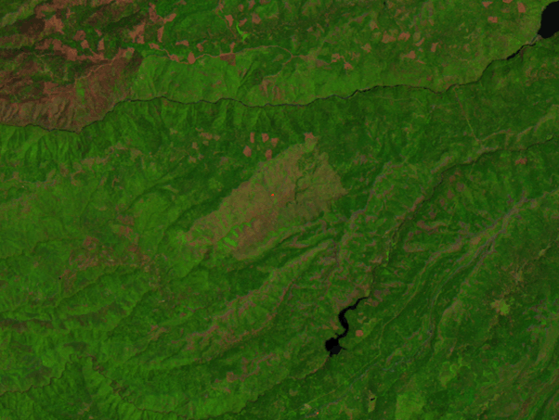
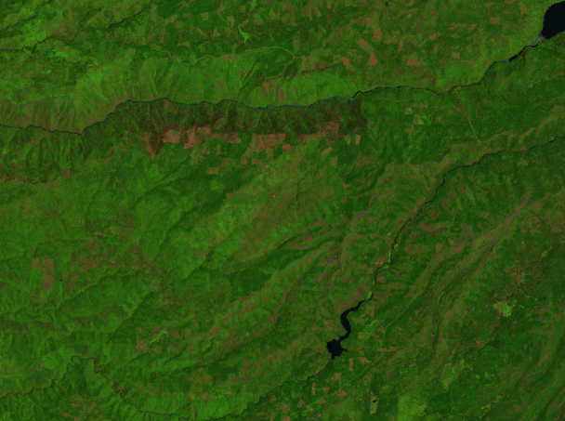
The spectral history of a pixel in Stanislaus
National Forest, California
Pre-fire
Crop field
Year fire occurred
Post-fire recovery
Longer-term recovery
Landsat Band 5
Reflectance (scale factor 0.0001)
1984 1986 1988 1990 1992 1994 1996 1998 2000 2002 2004 2006 2008 2010 2012
Date
16

Slide 17
EROS Land-Change System
Communications, applications services, outreach, and other users and stakeholder support
Communications & outreach
Web-based access to all products
Web-based analysis portal
Applications support
New: Get answers without moving data!

Slide 18
EROS Land-Change System
(connections and other important details)
Communications, applications services, outreach, and other users and stakeholder support
Communications & outreach
Web-based access to all products
Web-based analysis portal
Applications support
R&D
Continuous Monitoring
Spatial analyses of change
Information Warehouse and Data Store
Metadata
Land cover change/condition products
Outputs from assessments
Non-Landsat remote sensor data
Satellite data
Airborne
Non-Landsat rem. sens. prods.
DEMs & derivatives
Orthoimagery
Evapotranspiration
Vegetation phenology
Others
Ground-based data
Cal/Val data
Land cover accuracy/valid.
Others

Slide 19
EROS Land-Change System
(Example R&D opportunities)
Analysis
portal: get
answers, not data.
Communications, applications services, outreach, and other users and stakeholder support
Communications & outreach
Web-based access to all products
Web-based analysis portal
Applications support
R&D
Continuous Monitoring
Multidimensional change visualization
Spatial analyses of change
Method
trade-offs
Relations
between climate
and land-use change
Gradual-change algorithms.
External data
Information Warehouse and Data Store
Metadata
Land cover change/condition products
Outputs from assessments
Non-Landsat remote sensor data
Satellite data
Airborne
How to store pixel response histories
Non-Landsat rem. sens. prods.
DEMs & derivatives
Orthoimagery
Evapotranspiration
Vegetation phenology
Others
Ground-based data
Cal/Val data
Land cover accuracy/valid.
Others

Slide 20
EROS Land-Change System
Benefits:
Gains economies of scale for data processing, storage, and analysis while removing burden (and redundancies) of data preparation from individual science projects
Helps clarify interconnections and interdependencies among Center components.
Provides a framework to strategize and prioritize R&D activities throughout EROS.
Provides data infrastructure that enables USGS to produce cyclical reports on land change and be more agile and responsive to interests in land-change assessments related to current events and emerging issues.
Provides a framework to understand the value of external inputs (partnerships, R&D, data, etc.) to the overall system.
Provides foundation for a more cohesive and aggressive strategy for outreach, communications, and user-support that draws upon shared responsibilities across the Center.
20

