Slide 1
Space Data Services
Session 2: Space Data Country Outreach and Delivery
Agenda Item #3
Brian Killough CEOS Systems Engineering Office (SEO)
February 25, 2016

Slide 2
Topics
What can we provide countries in terms of systems analysis and tools to support the provision of satellite data?
Country Coverage Reports ... 70 total, Landsat only, plans to expand to Sentinel
COVE tool ... coverage, data acquisitions, and cloudiness assessment. Adding Sentinel missions soon.
Data Cubes ... new approaches to store and utilize data and take advantage of computing technologies. Open source software to stimulate innovation and expansion. Testing in Colombia (now) and Kenya (2017).
What can we offer toward capacity building opportunities?
FAO partnership ... country-level workflow improvements
GFOI partnership ... supporting MGD and country reporting process
Silva-Carbon ... supporting in-country training and capacity building with tool training and data initiation
Amazon partnership ... testing cloud-based computing advantages and the business model
SERVIR partnership ... testing regional data hub concept and storage or computing advantages

Slide 3
Final Questions
How can we communicate GFOI Data Services better?
What can we change or adjust in our current data services plans?
What do countries need that we are not providing?

Slide 4
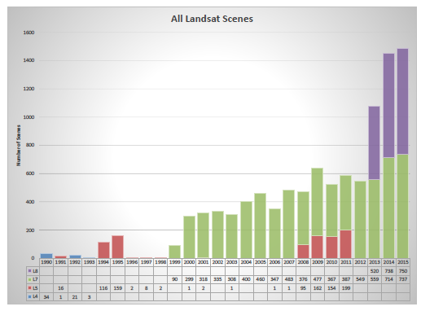
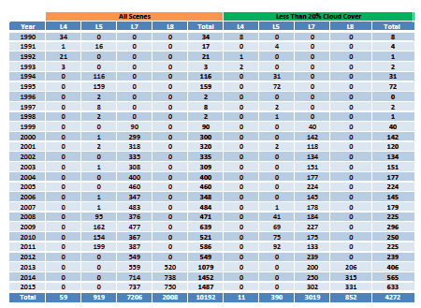
Landsat Country Reports
We have prepared detailed historic Landsat coverage reports for 70 GFOI countries.
Sentinel-1A and Sentinel-2A coming soon!
Reports were created using automated scripts connected to the Landsat archive. All Landsat scenes (missions 5,7,8) from 1990 through 2015 were included.
These reports (PDF and EXCEL format) are here: http://tinyurl.com/GFOIcountryreports
These reports will be valuable for countries to assess available scenes and cloud cover for future data ordering.
We will plan to update these annually.

Slide 5
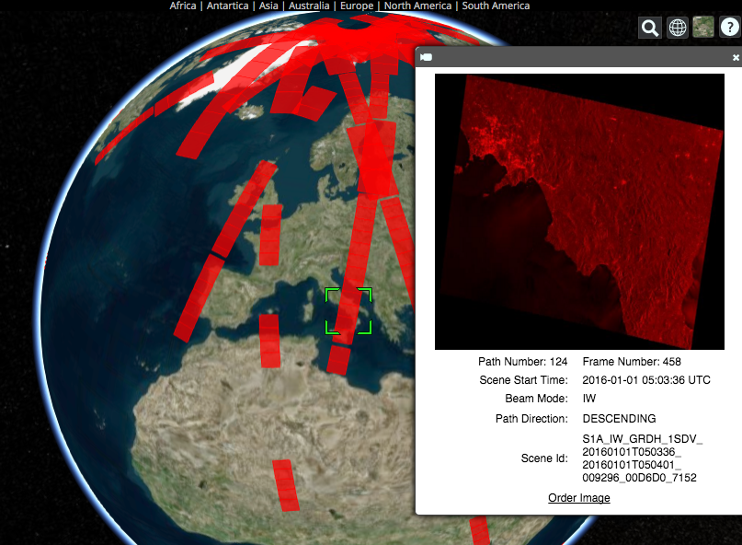
Recent COVE Updates
January 2016: Changed from Google Earth to Cesium for globe interface
New Missions: Sentinel-1A/2A, CBERS-4, RCM 1-3 (notional), FY-3C, PROBA-V, TET-1.
New Overlays: Landsat/Sentinel constellation revisit performance, Global Phenology (2001/2014 monthly NDVI Min/Max)
New Analysis Tools: Custom Mission Tool allows the creation of a notional mission for analyses.
New Archive Link: Sentinel-1A !!!!
Future Archive Links: Sentinel-2A ... coming soon
Example of COVE connection to the Sentinel-1A data archive. COVE now shows actual acquired data locations, quick-look images, and links to order the data.

Slide 6
Data Cube Architecture
Analysis-Ready Data Products
Working with CEOS Space Agencies to develop plans for sustained provision of Analysis Ready Data (ARD).
Sentinel-1A and Sentinel-2A are the highest priority.
Ingestor
Testing prototype Data Cubes for Kenya and Colombia. Testing local, regional hub and cloud deployment.
Developing ingestors to add more datasets: Priority on Sentinel-1A/2A.
Data Cubes
Developing and testing prototype user interfaces for custom mosaic creation.
Investigate connections to other tools ... QGIS
Developing Advanced Programming Interfaces (APIs) for users to create their own user interfaces
API
User Interface

Slide 7
New Collaborations
The SEO is pursuing two separate opportunities for collaboration to test deployment of Data Cubes.
A proposal was submitted to SERVIR in Nov 2015 to include their Kenya Data Hub at RCMRD in their project plan, funded by USAID, for the coming 2016 year. Both SERVIR and USAID believe the Data Cube concept would be a great addition to the project plan and they are eager to demonstrate regional Data Cube hosting.
A proposal was submitted in Jan 2016 to Amazon’s Open Data Project to obtain free cloud-based storage and processing. Amazon believes the proposal has a high chance of acceptance and they look forward to exploring cloud-based computing approaches for Data Cubes.

Slide 8
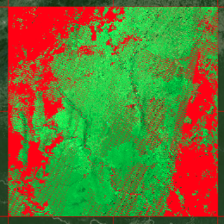
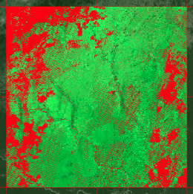
Custom Mosaic Tool
Product: Landsat 7 Region: Southern Colombia
Output: RGB Bands-7,4,2 (SWIR2, NIR, GREEN)
Filter (RED): = Cloud, Shadow, Water, No Data
January-February 2014
16 scenes
70% no data (mostly clouds)
January-April 2014
30 scenes
36% no data (mostly clouds)
<2 minutes run time
for each mosaic with
output in GEOTIFF
January-June 2014
46 scenes
27% no data (mostly clouds)

Slide 9
Data Cube Vision
CEOS understands the diversity of country data needs and the need for Data Services to improve data access and use.
Countries desire traditional scene-based products, but the expanding amount of data from Landsat and Sentinel will add complexity to storage, processing and downloading.
CEOS is investigating the use of a Data Cube architecture, proven by Australia, as a more efficient and effective long-term solution.
Our VISION is that the Data Cube infrastructure will become a highly utilized free and open source software toolset for creating local, regional or national pixel-based time-series of multiple datasets that are spatially aligned. Users will connect free/open user interface tools to the Data Cube for common analyses (mosaics, change detection) or utilize APIs to develop their own tools to query the content.
This vision depends on CEOS Space Agencies systematically supplying analysis-ready data products that are easily ingested into Data Cubes.

