Slide 1
GFOI Space Data Services
Brian Killough / NASA, CEOS SEO
SDCG-9, Session 5
Agenda Items 14 and 15

Slide 2
Agenda – Session 5
3-Year Work Plan Tasks and Outcomes
#6: Ensured On-going Coverage
#7: Interoperable Data Discovery Tools
#8: Assembly and Delivery of Core Data
#10: Cloud-Computing Pilot Projects
#11: Model National GFOI Data Services
CEOS Data Cube Development and Demo - Reported by Matt Jondrow / Sanjay Gowda

Slide 3
#6: Ensured On-going Coverage
Archive Characterization
The SEO has completed 25+ past country reports to characterize Landsat coverage. These were delivered to countries at past SDCG and SilvaCarbon meetings.
The SEO has now automated the production of these reports and they are posted online for all 70 GFOI countries! We plan to update these reports on an annual basis and keep the reports current. More on the next chart ...
The SEO has provided additional detailed support to countries, as needed. For example, we recently performed more extensive analyses for Kenya and Colombia.

Slide 4
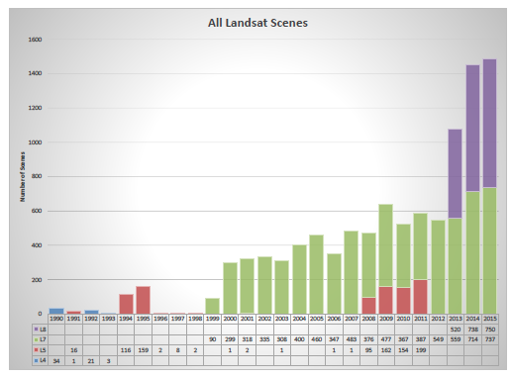
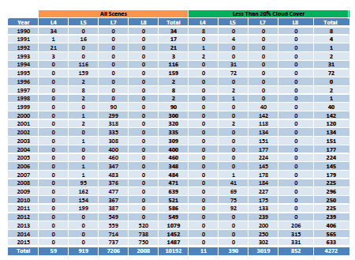
Landsat Country Reports
The CEOS Systems Engineering Office (SEO) has prepared detailed historic Landsat coverage reports for 70 GFOI countries.
The SEO created these reports using automated scripts connected to the Landsat archive. All Landsat scenes (missions 4,5,7,8) from 1990 through 2015 were included.
These reports (PDF and EXCEL format) are here: http://tinyurl.com/GFOIcountryreports
The reports include summary graphs, tables, and other detailed data for every acquired scene (mission, path/row, cloud%, processing level).
These reports will be valuable for countries to assess available scenes and cloud cover for future data ordering.

Slide 5
#7: Interoperable Data Discovery Tools
The COVE Tool now includes links to archive databases from: Landsat 7/8, SPOT 1-6, Pleaides-1A/1B, Radarsat-2, ALOS-1 and Sentinel-1A (new).
Adding an archive link for Sentinel-2A will be completed after the mirror archive is in place at USGS.
The SEO vision is that the COVE tool can provide a “one-stop” location to perform coverage assessments and “discovery” of valid images. We just need access to mission archives to make this happen. Once discovered, users can find links to the data ordering sites in COVE.

Slide 6
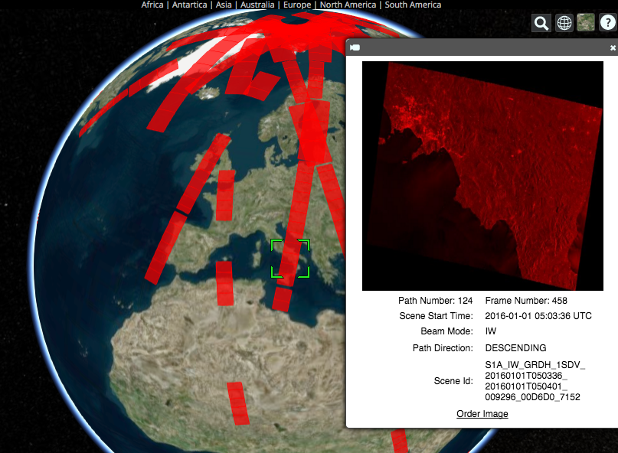
Recent COVE Updates
January 2016: Changed from Google Earth to Cesium for globe interface
New Missions: Sentinel-1A/2A, CBERS-4, RCM 1-3 (notional), FY-3C, PROBA-V, TET-1.
New Overlays: Landsat/Sentinel constellation revisit performance, Global Phenology (2001/2014 monthly NDVI Min/Max)
New Analysis Tools: Custom Mission Tool allows the creation of a notional mission for analyses.
New Archive Link: Sentinel-1A !!!!
Future Archive Links: Sentinel-2A (end 2016).
Example of COVE connection to the Sentinel-1A data archive. COVE now shows actual acquired data locations, quick-look images, and links to order the data.
www.ceos-cove.org

Slide 7
#8: Assembly/Delivery of Core Data
The Global Data Flow Study is focused on this topic.
There are 2 methods of data delivery: (a) Business-As-Usual data over the internet or on hard drives and (b) Capacity Building cloud-computing data hubs (e.g. Amazon, Google, Microsoft).
Countries can use scene-based tools (e.g. SEPAL) or new Data Cube tools as methods for utilizing data for analyses.
The use of Analysis Ready Data (ARD) significantly improves the efficiency and effectiveness of core satellite data.
The new “GFOI Space Data Portal” will be a significant asset to improve the knowledge of countries on how to identify and obtain needed satellite datasets.

Slide 8
#10: Cloud Computing Pilot Projects
The SEO is pursuing collaborations with SERVIR and Amazon to test the use of regional data hubs and cloud computing for Data Cubes. More on another chart ...
The SEO is testing Data Cube implementation for Kenya and Colombia. More on another chart ...
The SEO and FAO met on February 9 and identified some collaboratinve tasks for 2016. More on another chart ...

Slide 9
New Collaborations
The SEO is pursuing two separate opportunities for collaboration to test deployment of Data Cubes.
A proposal was submitted to SERVIR in Nov 2015 to include their Kenya Data Hub at RCMRD in their project plan, funded by USAID, for the coming 2016 year. Both SERVIR and USAID believe the Data Cube concept would be a great addition to the project plan and they are eager to demonstrate regional Data Cube hosting.
A proposal was submitted in Jan 2016 to Amazon’s Open Data Project to obtain free cloud-based storage and processing. Amazon believes the proposal has a high chance of acceptance and they look forward to exploring cloud-based computing approaches for Data Cubes.

Slide 10
Kenya Pilot Project
The project is led by NASA-SEO and supported by the Australian Government and the Clinton Foundation (CCI and SLEEK).
Two operating versions of the Kenya Data Cube: Amazon Cloud and a local SEO computer. Considering options for the SERVIR-Africa hub.
11.5 TB of Landsat data (7500+ scenes back to 2000). Pixel data from 42 path-row regions were extracted and reformatted into a cube. 68 time-series stacked tiles (1-deg square). 933 million pixels.
The Kenya team is still utilizing scene-based methods to develop historic forest maps. Future testing of Data Cube concepts is likely in 2016.

Slide 11
Colombia Pilot Project
The project is led by NASA-SEO and the Colombian Government. Supported by CSIRO and IDEAM (Institute of Hydrology, Meteorology and Environmental Studies).
A mini-cube (4 Landsat path-row regions) was delivered in Oct 2015. Cube includes data since 2000. 20 time-series stacked tiles (1-deg square). 273 million pixels.
The Colombia government presented the Data Cube concept to the Ministry in late 2015 and was approved to implement the architecture for national scale applications in 2016.
The Colombia team is working closely with the NASA-SEO team to expand their Data Cube to the full country. They are also very interested in user interface tools to produce custom mosaics, detect change, and conduct time series analyses (land and water).

Slide 12
SEO and FAO Meeting
Brian Killough (CEOS SEO) and Erik Lindquist (FAO, Forestry) met in Washington on February 9, 2016.
Discussed CEOS and FAO efforts in the area of data management to support GFOI objectives.
FAO primarily uses Landsat data in its scene-based SEPAL tool to support the generation of baseline reference maps for countries.
The CEOS SEO is developing a Data Cube infrastructure that may be able to help FAO prepare “best pixel” mosaics and run change detection analyses with improved performance and less effort.
The SEO and FAO agreed to collaborate on 5 specific tasks in 2016.

Slide 13
SEO and FAO Collaboration Tasks
Five SEO/FAO Tasks for 2016
SEO and FAO agree to demonstrate a GEOTIFF data connection between the Data Cube Custom Mosaic user interface tool and SEPAL using their respective Amazon cloud accounts.
The SEO will demonstrate that the Data Cube Custom Mosaic user interface can create a “raster brick” time series stack that is compatible with R-based tools.
The SEO will modify the BFAST change detection code (written in R) to work directly with the Data Cube storage format. Computing performance results will be compared with the standard FAO approach that uses a “raster brick”.
SEO and FAO agree to share Sentinel-1A processing progress. FAO plans to update their OpenSARKit. The SEO will pursue several processing options to obtain analysis-ready data products.
SEO will investigate BRDF corrections to remove “scene edge effects” from Landsat data due to solar angle variations. This issue is commonly seen with dark forests and impacts scene classification.

Slide 14
#11: Model National GFOI Data Services
It is expected that the prototypes in Kenya and Colombia will be ideal testbeds toward a model national GFOI data services system.
It is likely the future will require both scene-based (e.g. SEPAL) and Data Cube methods to support countries.
More on the Data Cube is next ...

Slide 15
The Data Cube Vision
The CEOS Data Cube infrastructure will become a highly utilized free and open source software toolset for creating local, regional or national pixel-based time-series of multiple datasets that are spatially aligned according to user needs (spatial region, time period, data layers, grid projection).
Users will connect free/open user interface tools to the Data Cube for common analyses (cloud-free mosaics, change detection, time series statistics) or utilize Advance Programming Interface (API) connections to develop their own interface tools.
Space Agencies will systematically supply analysis- ready data products that are easily ingested into Data Cubes.

Slide 16
Data Cube Architecture
Analysis-Ready Data Products
Working with CEOS Space Agencies to develop plans for sustained provision of Analysis Ready Data (ARD).
Sentinel-1A and Sentinel-2A are the highest priority.
Ingestor
Testing prototype Data Cubes for Kenya and Colombia. Testing local, regional hub and cloud deployment.
Developing ingestors to add more datasets: SRTM, ALOS Mosiacs, MODIS, SPOT-5, Sentinel-1A/2A.
Data Cubes
Developing and testing prototype user interfaces for custom mosaic creation, time-series statistics, change detection (water, land, vegetation).
Developing Advanced Programming Interfaces (APIs) for users to create their own user interfaces
API
User Interface

Slide 17
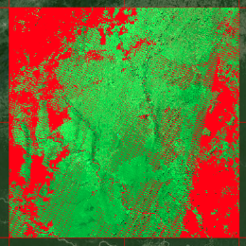
Custom Mosaic Tool
Product: Landsat 7 Region: Southern Colombia
Output: RGB Bands-7,4,2 (SWIR2, NIR, GREEN)
Filter (RED): = Cloud, Shadow, Water, No Data
January-June 2014
46 scenes
27% no data (mostly clouds)
January-February 2014
16 scenes
70% no data (mostly clouds)
<2 minutes run time
for each mosaic with
output in GEOTIFF
January-April 2014
30 scenes
36% no data (mostly clouds)

Slide 18
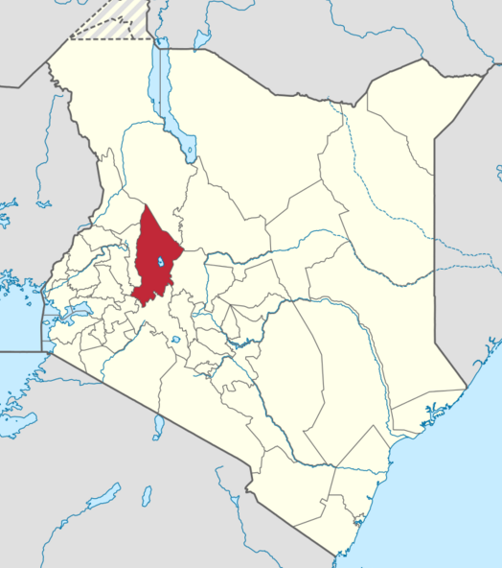
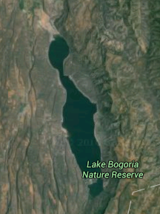
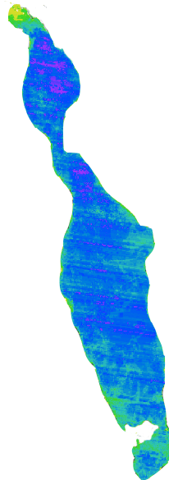
Water Detection Tool
Western Kenya, County of Baringo
Lake Bogoria Nature Preserve
Year 2013
Flooding is seen in the northern tip of the lake
* Counts water / non-water QA flags
* Landsat-7 “banding” needs to be removed
* Blue = Often water, Yellow = Infrequent
* Able to assess drought/flood risk extent

Slide 19
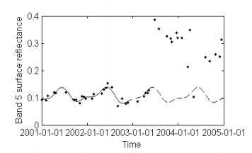
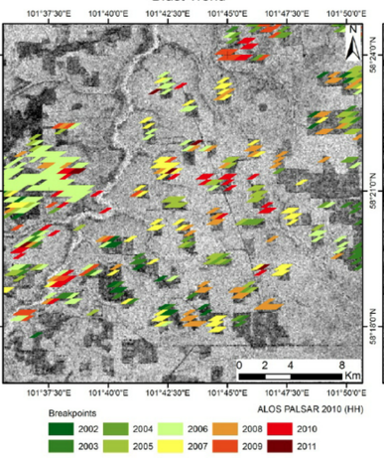
Change Detection Tools
The SEO is investigating a common land Change Detection tool. Breaks For Additive Seasonal and Trend (BFAST) is being used by FAO and Colombia for change detection analyses. An example of BFAST using ALOS-PALSAR is below.
Rapid analyses of dense time series will utilize the power of the Data Cube. The SEO is planning to develop a tool to plot pixel-level time series for any band or index to support change detection validation. This is strongly desired by Colombia.

