Slide 1
ASI contributions to R&D Support strategy (Element 3) – Status update
Laura Candela, Anna Rita Pisani, Simona Zoffoli
SDCG-9 Session #8

Slide 2
ASI – COSMO-SkyMed
Introduction
Background to your Agency’s interest to contribute to the GFOI R&D activities
The Italian Space Agency has joined the CEOS SDCG in occurrence of the 2014 SDCG-6 in Oslo.
ASI is interested to support R&D activities involving
Validation studies;
Activities taking advantages from the use of X-band:
exploit the information content of dual and quad-polarised SAR data;
synergy with L-band, C-band and optical data;

Slide 3
ASI – COSMO-SkyMed
Acquisitions and data provision
Please indicate R&D Groups [El-3 doc, Annex B] and R&D topics (e.g. degradation, sensor synergy etc.) of main interest/relevance to your agency (see extra slides for listing of current data requests)
Group # | Contacts established (Y/N) | Data provision started (Y/N) | Key R&D topic
6 | Y (waiting for docs to start acquisitions) | N | BOR3, SUM2: Forest degradation, sensor interoperability
10 | Y (PI contacted, waiting for reply) | N | FCT-AU3: Method forest disturbance monitoring, SAR-Optical interoperability and complementarity studies AU4: forest canopy profile; SAR-Optical interoperability; AU5: SAR and sensors synergy (SAR/Optical/LiDAR) for deforestation, degradation

Slide 4
ASI – COSMO-SkyMed
Acquisitions and data provision
Please indicate whether your agency would be able to accept
(a) modification of existing Study Sites (e.g. location, timing, etc.)
(b) addition of new Study Sites (not currently listed for your mission in the Element-3 plan) by existing R&D groups
(c) addition of new R&D groups and new Study Sites during 2016
ASI is able to accept the 3 options according to the following requirements:
OK. [Location, timing, etc. have to be evaluated in the framework of the projects according to existing acquisition plans and products provision will be evaluated by ASI on the basis of project requirements];
OK;
OK. [PI of the new R&D groups/Study Sites have to be eligible for COSMO-SkyMed data (i.e. institutional users)].

Slide 5
ASI – COSMO-SkyMed
Data provision procedures
Indicate whether anything has changed (since SDCG-8) regarding your agency's procedures provide data to GFOI R&D groups (e.g. scene limitations, data sharing, data request/access procedures, etc.)
Regarding the access procedures nothing has changed :
Access for research/institutional users;
Submission of an R&D project to ASI for the exploitation of COSMO-SkyMed data;
Accepted proposals must sign an agreement with ASI and obtain a data license;
The access to the COSMO-SkyMed archive available through the website http://87.241.31.78/index.php by subscription;
Research Announcements
Please indicate any forthcoming research announcement(s) or funding opportunities that may be relevant to the GFOI R&D plan.
The “Open Call for Science” has started on 25th February 2015, details for application available at the following link: http://www.asi.it/en/agency/bandi_en/calls/cosmoskymed_open_call_for_science
Land Cover & Vegetation is among the primary application domains.

Slide 6
ASI – COSMO-SkyMed
Extra slides (for your easy reference only)
GFOI R&D satellite data requests according to El-3 plan

Slide 7
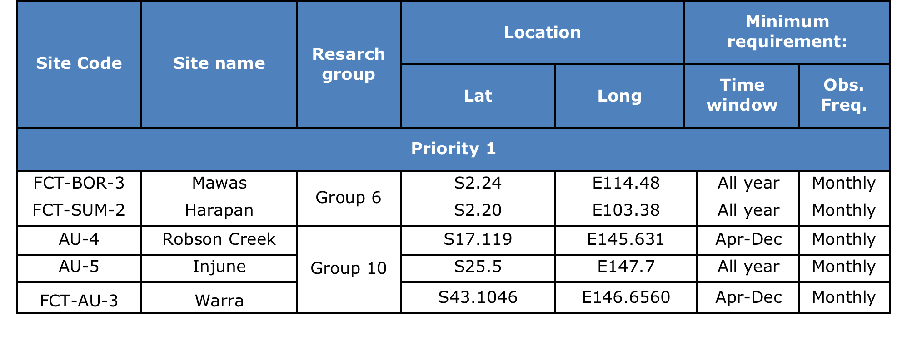
ASI – COSMO-SkyMed
GFOI R&D requests for COSMO-SkyMed

Slide 8
ASI – COSMO-SkyMed
GFOI R&D requests for COSMO-SkyMed
GFOI Group 6
Study Sites: SUM-2 (Harapan, Indonesia) and BOR-3 (Mawas, Indonesia)
Principal Investigator: Dirk Hoekman
Observation mode: STR_HIMAGE HH, Asc/Desc, Right); Inc. angle 30-40 deg;
Observation time window: Jan 2016 – Feb 2017;
Observation frequency: Monthly;
Processing level: Level 1A_SCSB
Request status (updated to February 21, 2016):
- agreed 80 scenes/year for one year, until February 2017;
- process to be completed: feasibility study sent, waiting for signatures on the license and the data order forms filled out in order to start the acquisitions;

Slide 9
ASI – COSMO-SkyMed
GFOI R&D requests for COSMO-SkyMed
GFOI Group 10
Study Site: AU-5 (Injune, Australia)
Principal Investigator: Richard Lucas
Archive data: not available in the requested time window => TBD;
Observation mode: SpotLight VV. Same geometry as archived data => TBD;
Observation mode: STR_PingPong VV+VH. Same geometry as archived data => TBD;
Observation time window: Dec 2015 - Jan 2016;
Observation frequency: Once for each mode;
Processing level: Level 1D
Request status (updated to February 21, 2016):
- process not completed: PI contacted, waiting for a reply;

Slide 10
ASI – COSMO-SkyMed
GFOI R&D requests for COSMO-SkyMed
GFOI Group 10
Study Sites: AU-3 (Warra, Australia) and AU-4 (Robson Creek, Australia)
Principal Investigator: Neil Sims
Observation mode: STR_PingPong VV+VH;
Observation time window: Jan - Dec 2016;
Observation frequency: Monthly;
Processing level: Level 1D (and Level 0 products if both are available)
Request status (updated to February 21, 2016):
- process not completed: PI contacted, waiting for a reply;

