Slide 1
CNES contributions to R&D Support strategy (Element 3) – Status update
Steven Hosford
SDCG-9 Session #8

Slide 2
CNES Pléiades
Introduction
Demonstrate utility of Pléiades data for forest applications

Slide 3
CNES Pléiades
Acquisitions and data provision
Please indicate R&D Groups [El-3 doc, Annex B] and R&D topics (e.g. degradation, sensor synergy etc.) of main interest/relevance to your agency (see extra slides for listing of current data requests)
Group # | Contacts established (Y/N) | Data provision started (Y/N) | Key R&D topic
None

Slide 4
CNES Pléiades
Acquisitions and data provision
Please indicate whether your agency would be able to accept
(a) modification of existing Study Sites (e.g. location, timing, etc.)
(b) addition of new Study Sites (not currently listed for your mission in the Element-3 plan) by existing R&D groups
(c) addition of new R&D groups and new Study Sites during 2016
Any reconfiguration possible within currently allocated resources (20 000km2 in 2016)

Slide 5
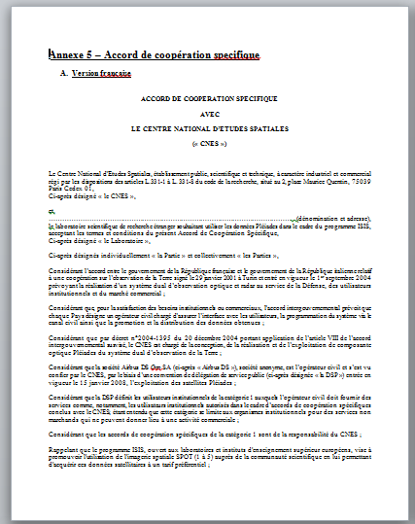
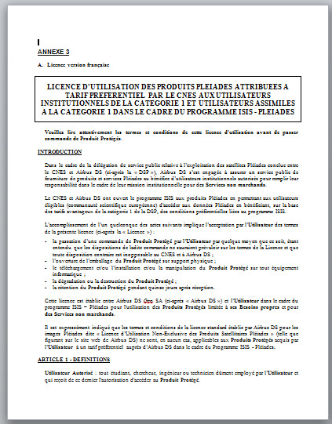
CNES Pléiades
Data provision procedures
Data distribution framework to international institutional research teams now finalised
Once signed by CNES and ADS, pleiades data can be distributed
Each participating laboratory must sign an agreement with CNES
A licence must be signed for the images

Slide 6
Agency name and mission
Other information
Own slides or other points of relevance

Slide 7
Agency name and mission
Extra slides (for your easy reference only)
GFOI R&D satellite data requests according to El-3 plan

Slide 8
Agency name and mission
GFOI R&D requests for COSMO-SkyMed

Slide 9
Agency name and mission
GFOI R&D requests for Pléiades

Slide 10
Agency name and mission
GFOI R&D requests for Pléiades

Slide 11
Agency name and mission
GFOI R&D requests for RADARSAT-2

Slide 12
Agency name and mission
GFOI R&D requests for TerraSAR-X

Slide 13
Agency name and mission
GFOI R&D requests for TanDEM-X

Slide 14
Agency name and mission
GFOI R&D requests for CBERS-4

Slide 15
Agency name and mission
GFOI R&D requests for ALOS-2

