Slide 1
GFOI SPACE DATA COMPONENT Accessing and Analysing Space Data
GFOI Open Forum, Feb 2016

Slide 2
Contents
Please keep strictly to time.
Questions and discussion reserved to end of session unless within allocated time.
Introduction and overview of the Space Data component heritage and outputs | S Briggs (ESA/ CEOS Lead for GFOI) | 10
Space Data Services and Natioal Pilots | B Killough (NASA) | 10
Space Data Portal | S Ward (SDCG SEC) | 5
Future directions, inc. Global Data Flows | G Fosnight (USGS) | 10
Open Foris and SEPAL | A Pekkarinen | 10
ESA Forestry TEP | T Häme (VTT) | 10
Copernicus capabilities and requirements capture | J Yagüe (GMV) | 10
GFW: Cooperation with DigitalGlobe and Urthecast | F Stolle (WRI) | 10
Discussion |  | 25

Slide 3
Global Forest Observations Initiative Space Data component heritage and outputs
Stephen Briggs, ESA
GFOI Plenary, 24 February 2016

Slide 4
Space Data component heritage
The CEOS Space Data Coordination Group for GFOI has worked with the world’s largest providers of Earth observation data to ensure that all countries have access to the satellite data required for national forest monitoring and annual reporting of greenhouse gas emissions and forest carbon stocks to the UNFCCC under the provisions of REDD+ and consistent with IPCC guidelines
Notes:
I would second what Steve has said. We need to encourage large implementation supporters like GIZ to consider seeing GFOI as an approach whose MGD and supporting data can ensure fidelity and acceptance of their investment in national MRV systems. Its an insurance policy to guarantee the results of the investment in a policy context. If they were to require consideration of GFOI as part of their aid project process it would be ideal. I guess you will not be so explicit but you should show the path…?
For me, the important issue for us is to maximise the different paths for delivery of services to the final users. This can be done by FAO, by Silvacarbon, through Australia/ClInton but I would like to be less dependent on, especially, FAO hence my attempts to get UK and Germany involved. Ideally we would have the infrastructure of GFOI - data, MGD, CapB and R&D - helping to support a range of delivery mechanisms, as broad as possible, with no extra effort in principle. Hence what we would really like is for GFZ to support in-country activities and service delivery using the GFOI data/MGD, and as part of the overall GFOI partnership. I hope UK will also do so.

Slide 5
CEOS Space Data Strategy for GFOI - 3 Elements:
Implementation of Baseline Global Data Acquisition Strategy
Space Data Services Available
Data Supply in Support of GFOI R&D Activities
Publicly open (“core”) satellite data, phased implementation - full global coverage by 2016.
A coordinated strategy for national data acquisitions accommodating countries’ specific technical requirements, heritage, and experience.
Covers a wider range of satellite data sources, including commercial.
Includes support for science studies assisting the development and evolution of the MGD for GFOI and addressing specific country needs.
Assuring the availability of consistent time-series of optical and radar (SAR) satellite data over global forest cover.
At least one annual national cloud-free optical coverage over each country.

Slide 6
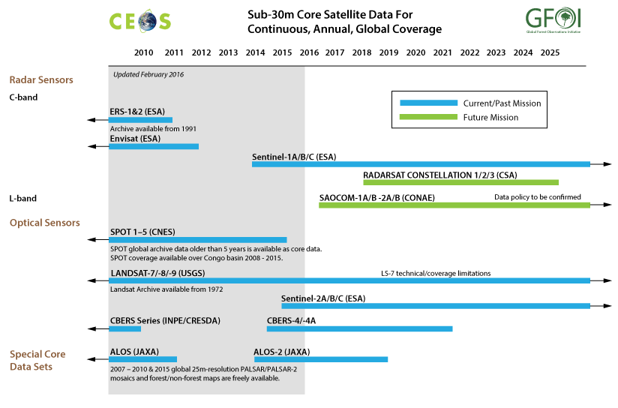
SDCG Data Streams – Core free and open

Slide 8
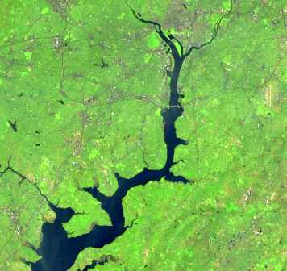
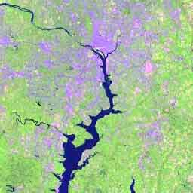
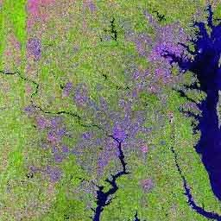
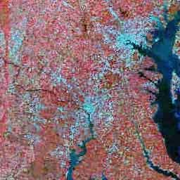
U.S. Landsat Archive Overview (February 1, 2016)
OLI-TIRS: Landsat 8: 660,847 scenes
~ 2,285 TB Raw and L0Ra Data
average scene size 1813 MB
ETM+: Landsat 7: 2,057,361 scenes
~ 1,911 TB Raw and L0Ra Data
average scene size 487 MB
TM: Landsat 4 & Landsat 5: 2,196,703 scenes
~ 1,101 TB Raw and L0Ra Data
average scene size 263 MB
MSS: Landsat 1 through 5: 1,300,419 scenes
~ 79 TB Raw and L0Ra Data
average scene size 32 MB
Total: 6,215,330 scenes
~ 5,376 TB Raw and L0Ra Data

Slide 9
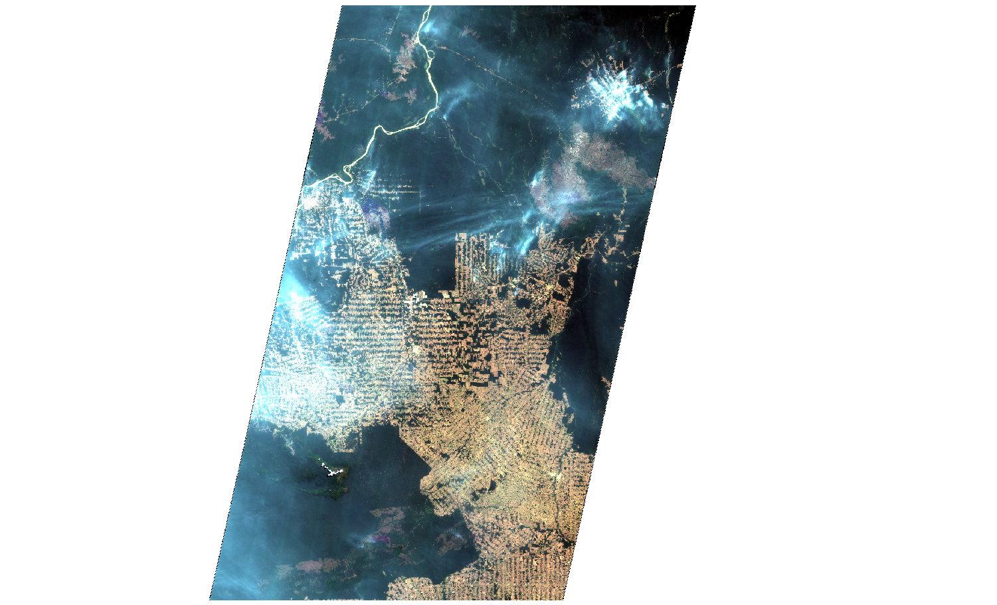
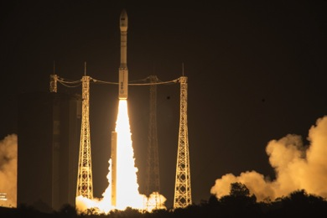
New Core Data: Sentinel-2
Sentinel-2A launched on 23 June 2015
Data available publicly online
➔ https://sentinel.esa.int/
⬅ 290 km ➔
Notes:
Example over Amazon forest in Brazil ➔ zoom to full resolution

Slide 10
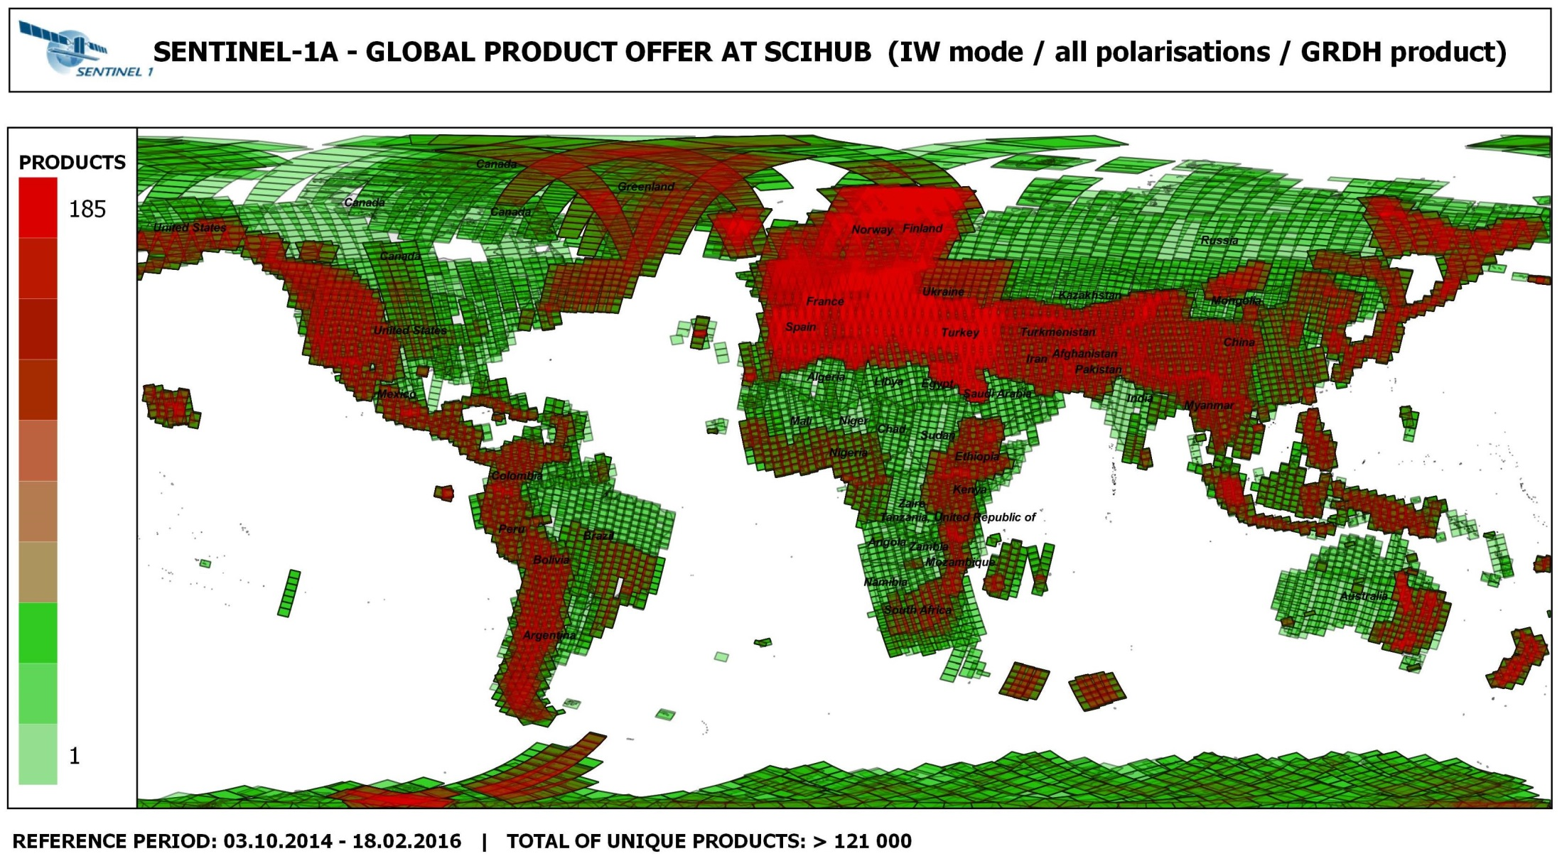

Slide 11
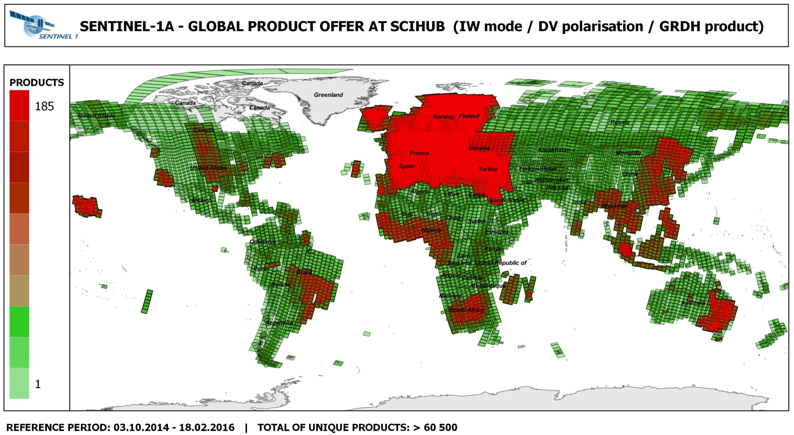

Slide 12
Space Data Support to GFOI R&D (Element-3)
Complement to the Global Baseline Data Acquisition Strategy (Element-1) and National Space Data Services Strategy (Element-2)
R&D focus provides a mechanism also for space agencies and data providers with commercial satellite missions to support GFOI aims
Developed to support the GFOI R&D Component needs for satellite data which are not available through the “core” missions:
Very High Resolution (optical and radar)
Radar (L-, C-, X-band SAR) data
Research undertaken by international team of experts managed by the GFOI R&D component (details in separate presentation)
Ultimate aim to help progress high priority applications – which are not yet included in the MGD – to operational status.

Slide 13
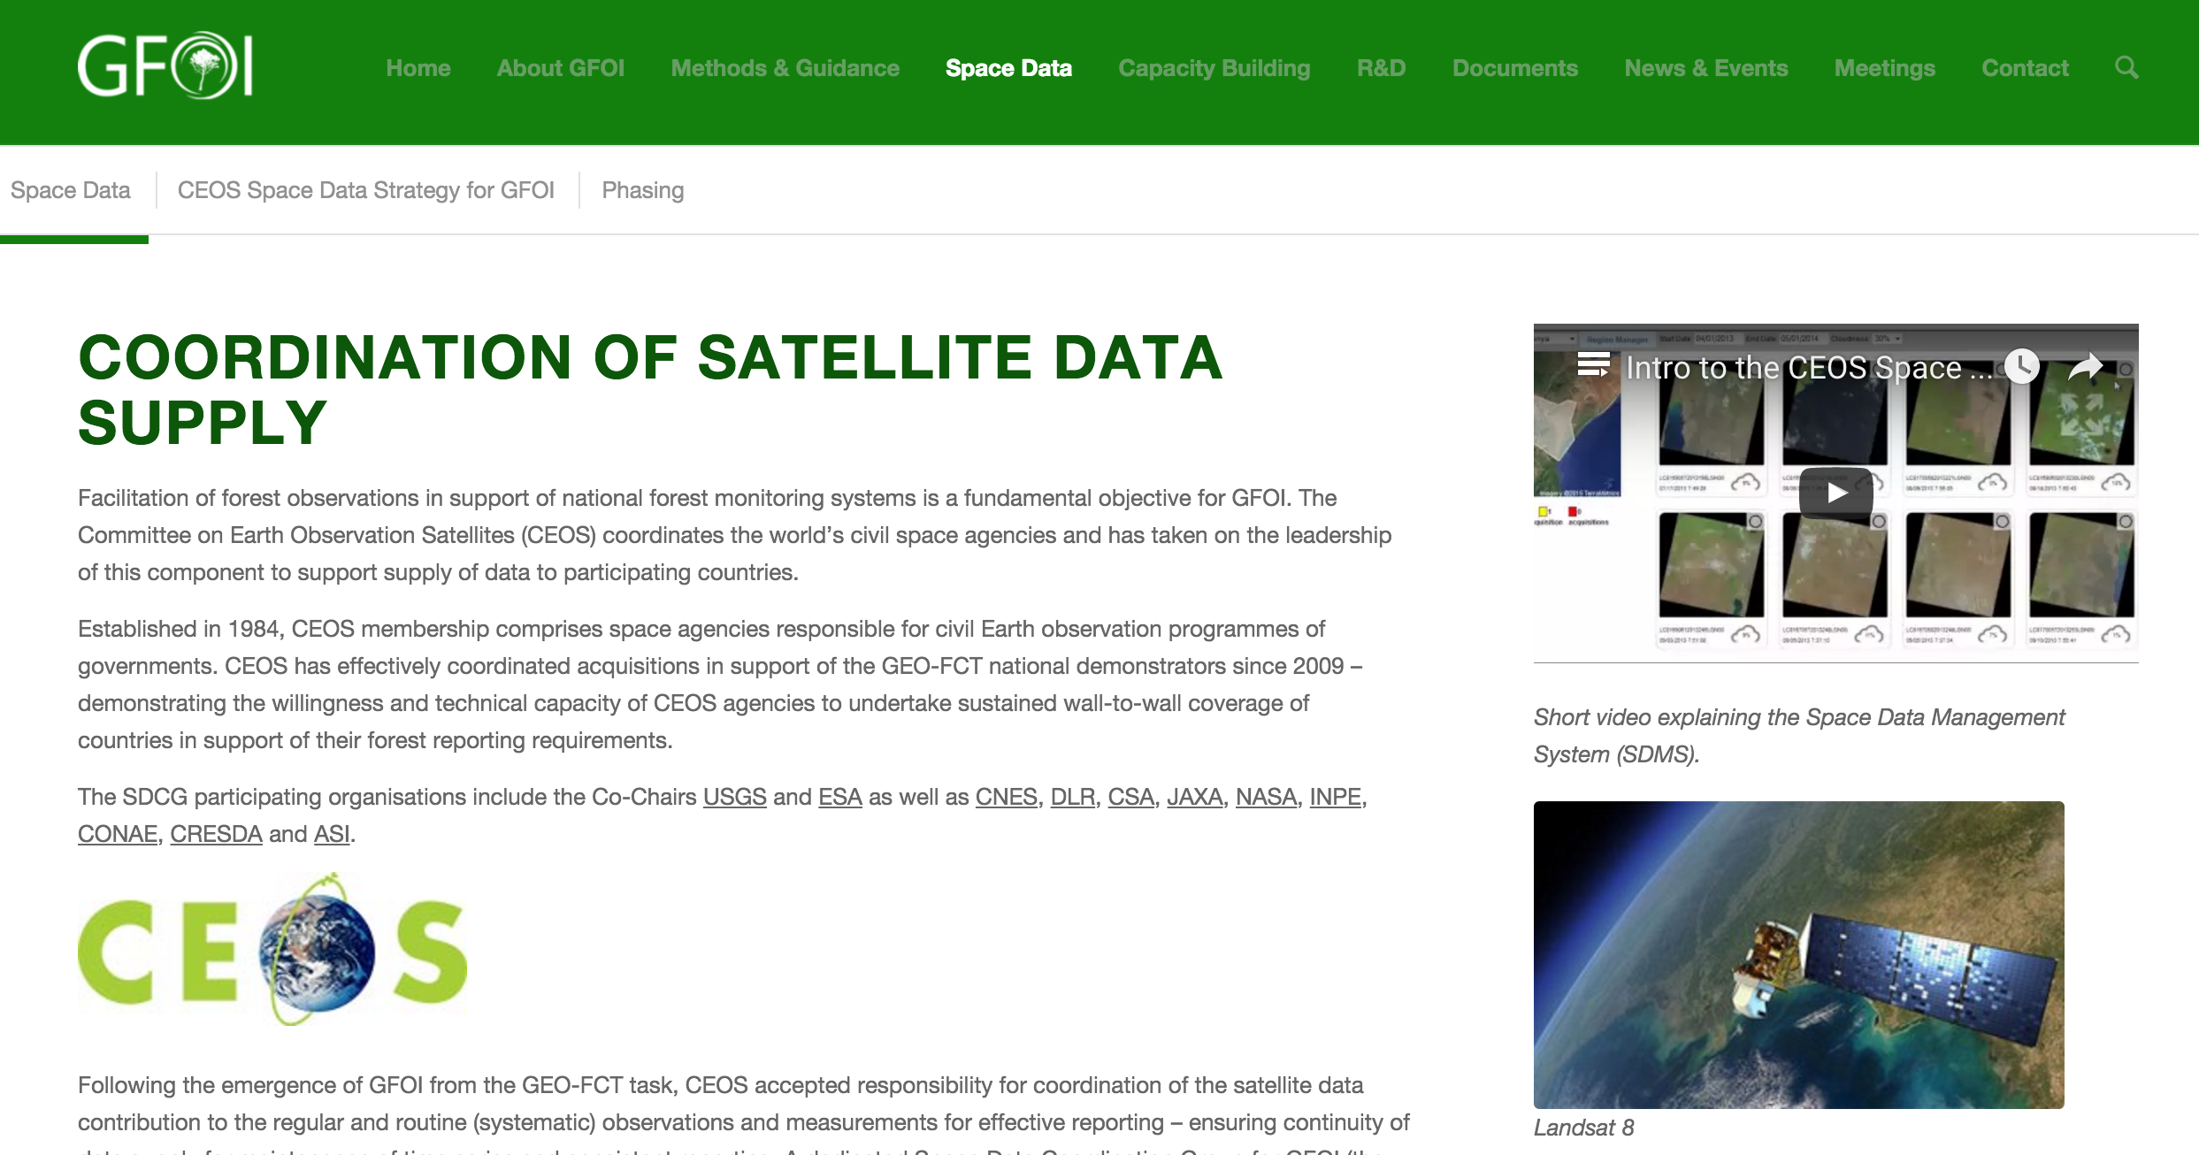
Thanks
http://www.gfoi.org/space-data/

Slide 14
Space Data Services and National Pilots
Brian Killough CEOS Systems Engineering Office (SEO) and SDCG
GFOI Plenary 24 Feb 2016, Frascati

Slide 15
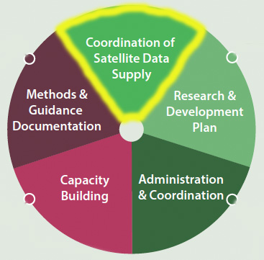
Six GFOI Space Data Services
Regional GFOI Space Data Workshops
National Space Data Needs Assessments
National Historical Coverage Reports
Ensured on-going Coverage
Satellite Data Discovery, Assembly and Delivery
Cloud Storage, Processing and Analysis of Satellite Data

Slide 16
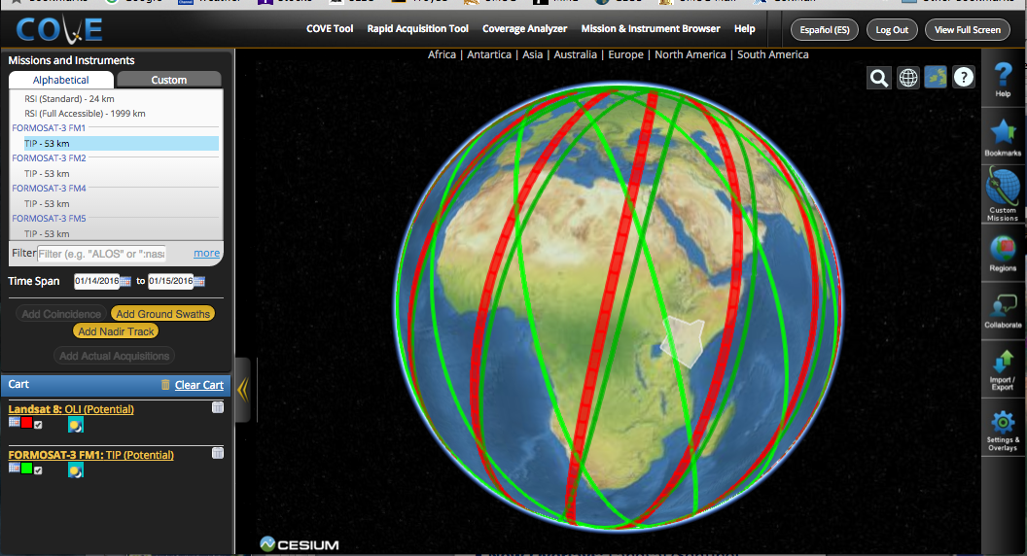
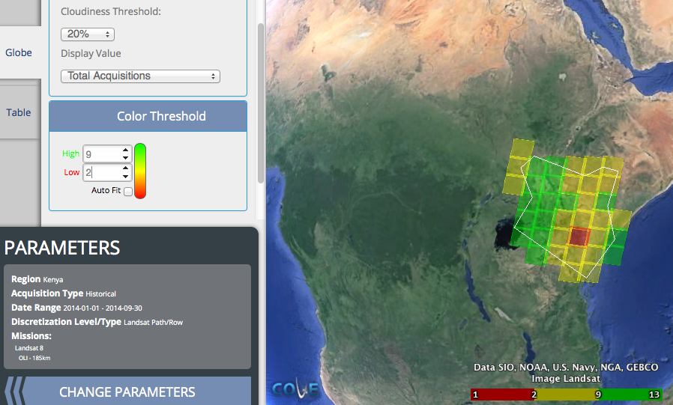
How is CEOS supporting?
Regional GFOI Space Data Workshops
COVE Training for satellite coverage analyses (www.ceos-cove.org)
Facilitating training for the use of new satellite datasets, beyond Landsat.
National Space Data Needs Assessments
Conducting system analyses to assess data storage, processing and analysis requirements
National Historical Coverage Reports
Produced Landsat country coverage reports for 70 GFOI countries ... next

Slide 17
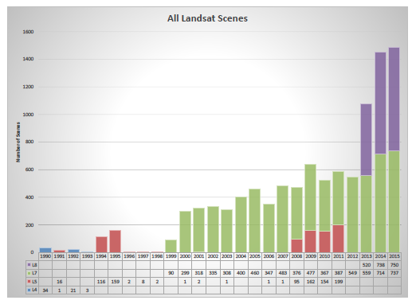
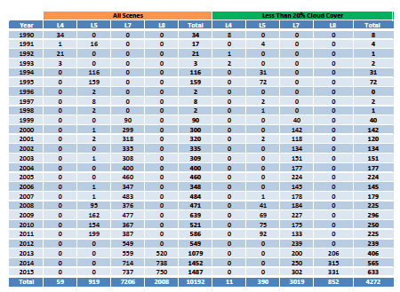
Landsat Country Reports
The CEOS Systems Engineering Office (SEO) has prepared detailed historic Landsat coverage reports for 70 GFOI countries.
The SEO created these reports using automated scripts connected to the Landsat archive. All Landsat scenes (missions 5,7,8) from 1990 through 2015 were included.
These reports (PDF and EXCEL format) are here: http://tinyurl.com/GFOIcountryreports
The reports include summary graphs, tables, and other detailed data for every acquired scene (mission, path/row, cloud%, processing level).
These reports will be valuable for countries to assess available scenes and cloud cover for future data ordering.

Slide 18
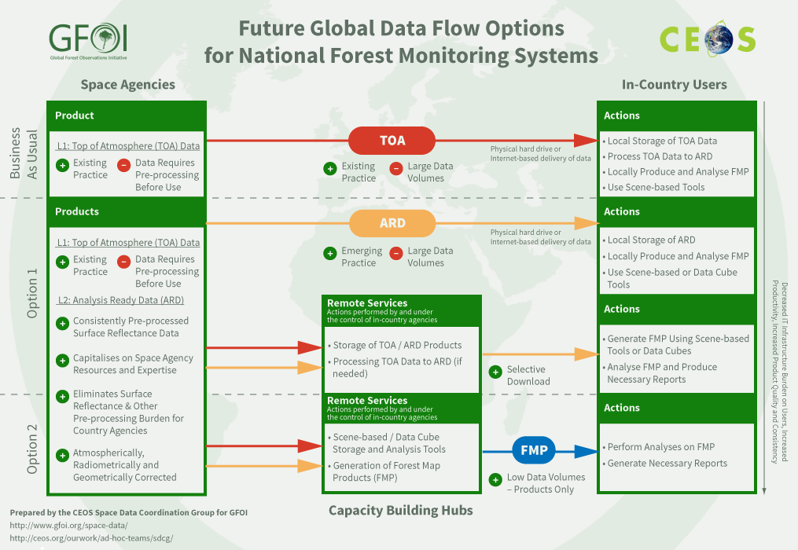
How is CEOS supporting?
Ensured on-going Coverage
Facilitating CEOS Agency interactions to ensure national baseline data
Satellite Data Discovery, Assembly and Delivery
Assessment of global issues through the recent Global Data Flow report
Facilitating solutions with Space Agencies, Capacity Building partners and Countries
Cloud Storage, Processing and Analysis of Satellite Data
Development of a CEOS Data Cube architecture to enhance data flows .. next
Leading National Pilots for testing ... next

Slide 19
The Data Cube Architecture
Analysis-Ready Data Products
Working with CEOS Space Agencies to develop plans for sustained provision of Analysis Ready Data (ARD).
Sentinel-1A and Sentinel-2A are the highest priority.
Ingestor
Testing prototype Data Cubes for Kenya and Colombia. Testing local, regional hub and cloud deployment.
Developing ingestors to add more datasets: SRTM, ALOS, MODIS, SPOT-5, Sentinel-1A/2A.
Data Cubes
Developing and testing prototype user interfaces for custom mosaic creation, time-series statistics, change detection (water, land, vegetation).
Developing Advanced Programming Interfaces (APIs) for users to create their own user interfaces
API
User Interface

Slide 20
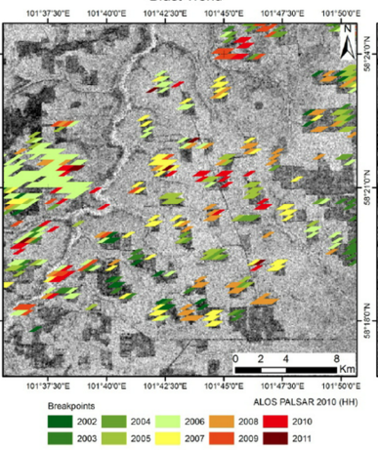
Data Cube User Interface Concepts
Investigating the BFAST land Change Detection Tool. Used by FAO and Colombia for change detection analyses. An example of BFAST using ALOS-PALSAR is below.
Currently testing a Custom Mosaic Tool. The tool allows users to create custom cloud-free mosaics for specified regions and time periods. Colombia example above uses 46 scenes from Jan-Jun 2014. Output to GEOTIFF allows connections with other GIS tools.

Slide 21
Kenya Pilot Project
The project is led by NASA-SEO and supported by the Australian Government and the Clinton Foundation (CCI and SLEEK).
Two operating versions of the Kenya Data Cube: Amazon Cloud and a local SEO computer. Considering options for the SERVIR-Africa hub.
11.5 TB of Landsat data (7500+ scenes back to 2000). Pixel data from 42 path-row regions were extracted and reformatted into a cube.
The cube contains 68 time-series stacked tiles (1-deg square) with 933 million pixels.
The Kenya team is currently utilizing scene-based methods to develop historic forest maps. Future testing of Data Cube concepts is in planning.

Slide 22
Colombia Pilot Project
The project is led by NASA-SEO and the Colombian Government. Supported by CSIRO and IDEAM (Institute of Hydrology, Meteorology and Environmental Studies).
A mini-cube (4 Landsat path-row regions) was delivered in Oct 2015. Cube includes data since 2000. 20 time-series stacked tiles (1-deg square). 273 million pixels.
The Colombia government presented the Data Cube concept to the Ministry in late 2015 and was approved to implement the architecture for national scale applications in 2016.
The Colombia team is working closely with the NASA-SEO team to expand their Data Cube to the full country. They are also very interested in user interface tools to produce custom mosaics, detect change, and conduct time series analyses (land and water).

Slide 23
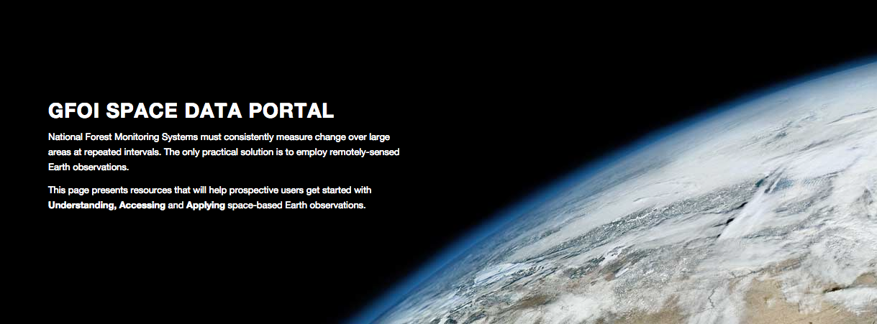
Space Data Portal
Understanding Accessing Applying
http://www.gfoi.org/space-data-portal/

Slide 24
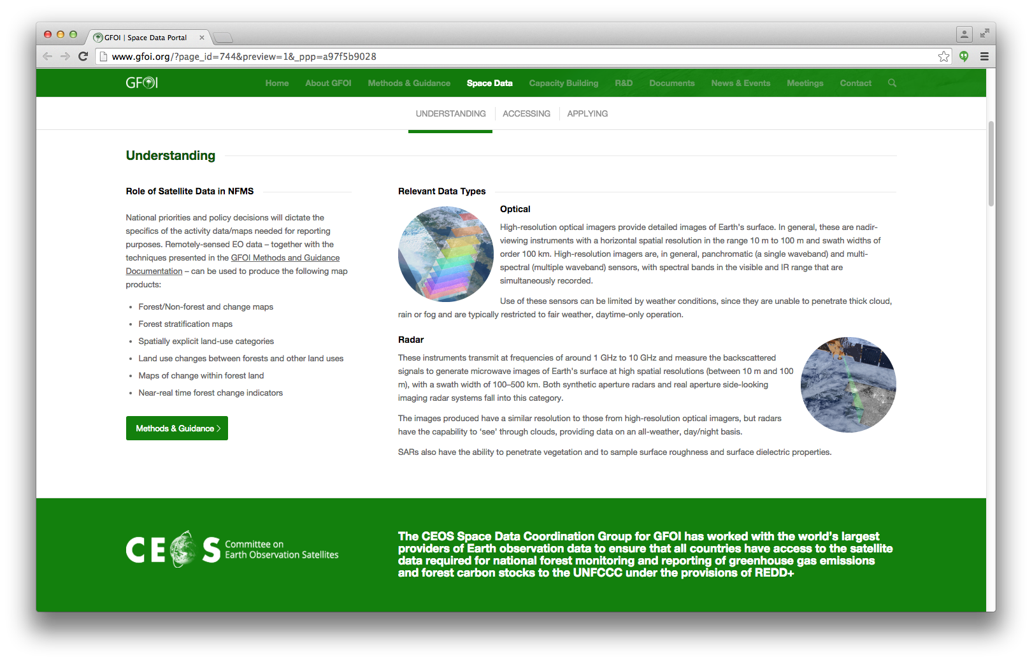
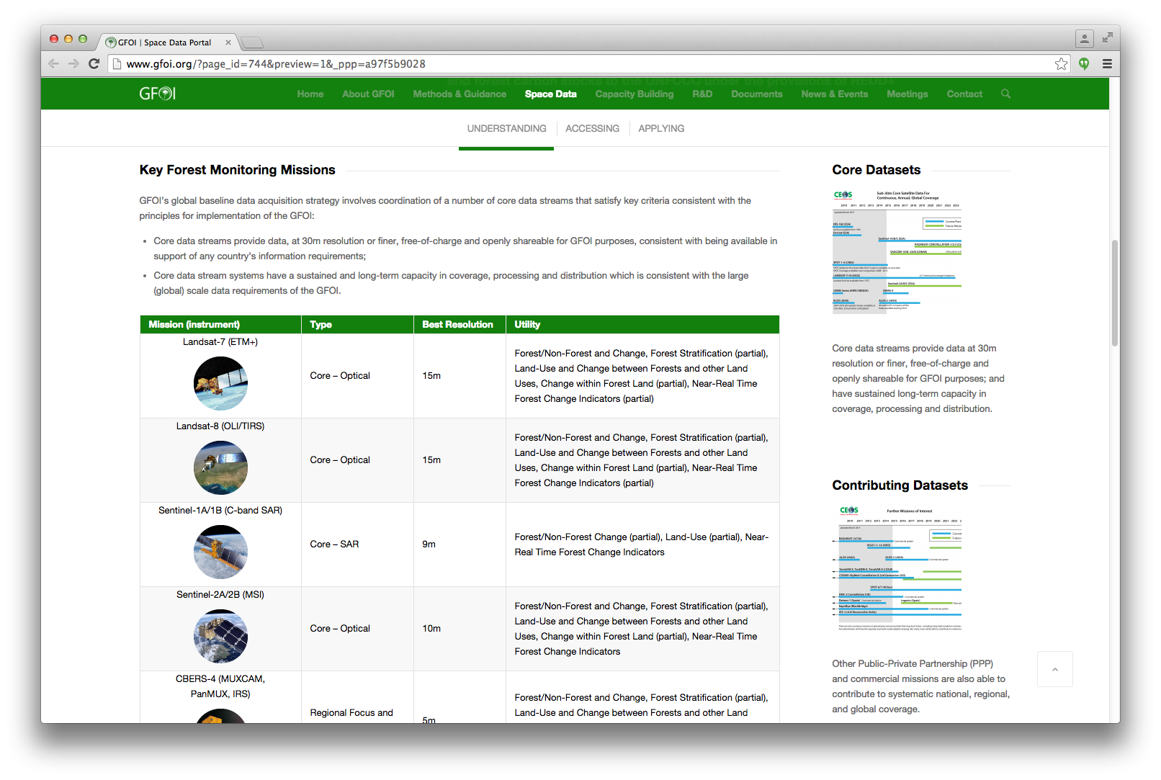
Understanding
Role of remote sensing in NFMS
Data types and key missions (Core and Contributing)
Links to CEOS resources (MIM Database, EO Handbook, Data Policy Portal)

Slide 25
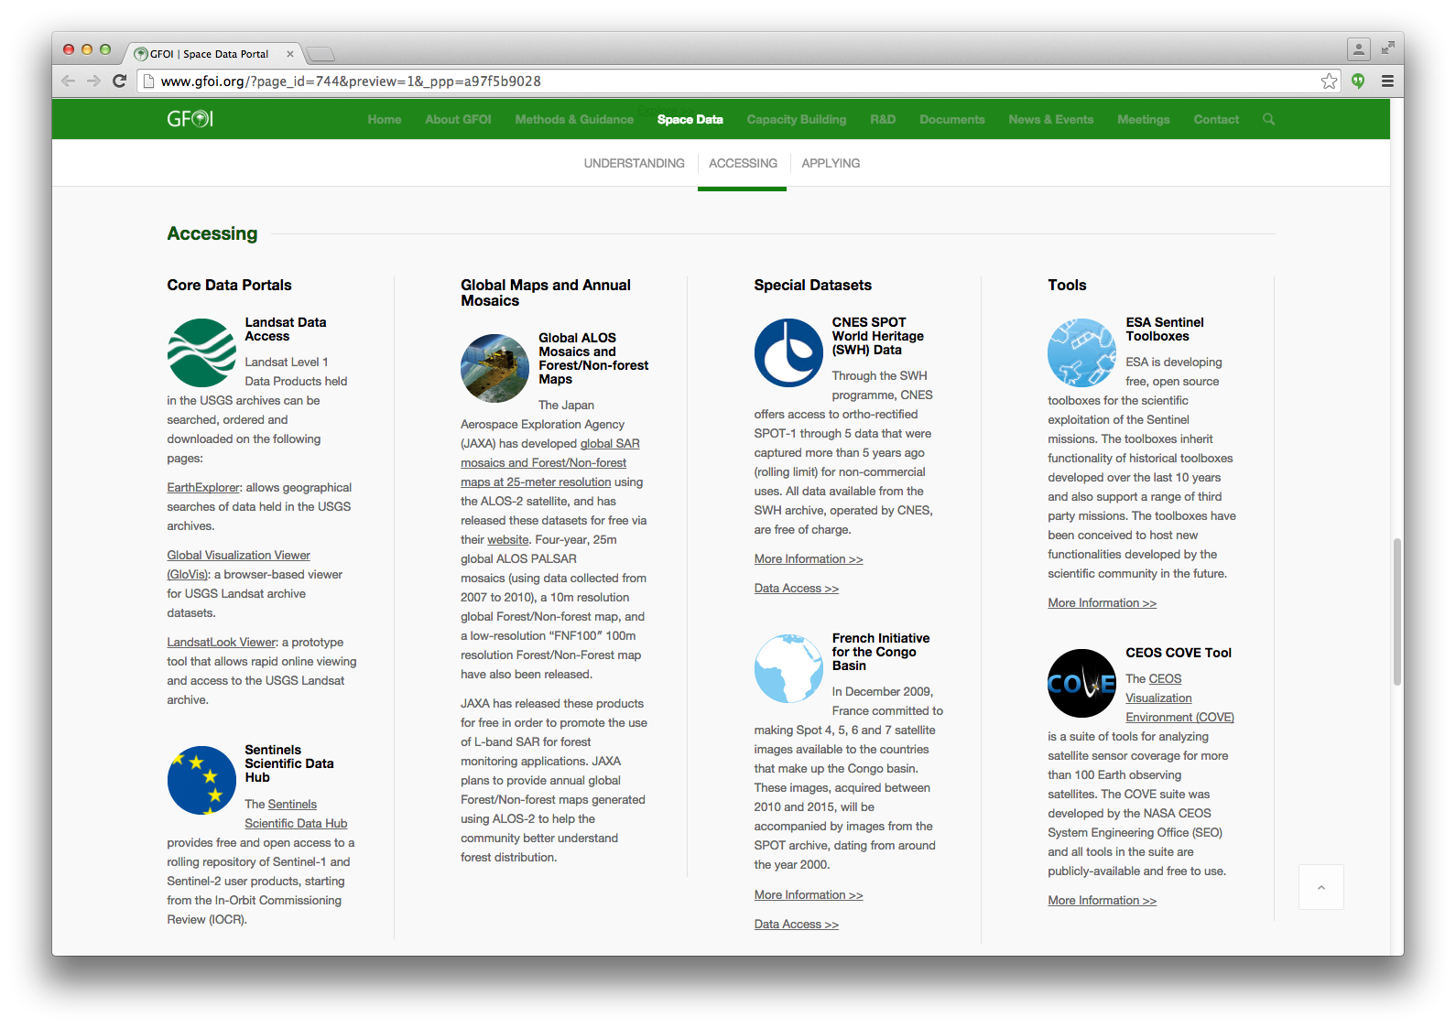
Accessing
Core Data Portals
Global Maps
Annual Mosaics
Special Datasets
Tools

Slide 26
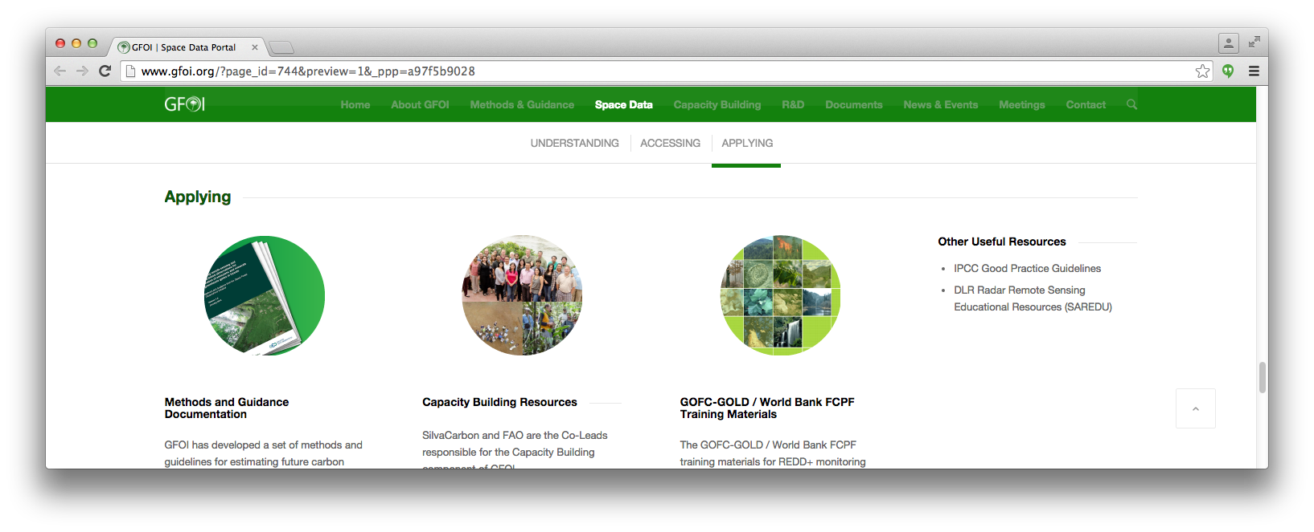
Applying
MGD and Portal
SilvaCarbon and FAO/UN-REDD resources
GOFC-GOLD/FCPF training materials
Other resources

Slide 27
Way Forward
The GFOI Space Data Portal is a living resource that will be updated over time
Will evolve alongside the MGD Portal
Seeking user feedback and suggestions for further content!
http://www.gfoi.org/space-data-portal/
Feedback
spacedata@gfoi.org

Slide 28
Global Data Flows Study
GFOI Plenary 24 Feb 2016, Frascati

Slide 29
Global Data Flows - Objective
Evaluates alternate solutions for reducing barriers to effective use of satellite data in implementing measurement, reporting and verification (MRV) methodologies within national forest monitoring systems (NFMS) in support of REDD+.

Slide 30
Why Global Data Flows
Access to and the processing of Space data have always been barriers to their use.
Extremely large volumes of data are now available at no cost to the user.
The global data flows study seeks to identify the data flows needed to bring analysis ready data to resource agencies.

Slide 31
Global Data Flows
Analysis Ready Data is the future of space data and will remove barriers to its use.
Analysis ready data are geometrically, radiometrically and atmospherically corrected and ready for use in resource applications
Resource staff should not need data preprocessing skills
Data supply is no longer the limiting factor
Data access and data rich applications is limiting factor
Huge data volumes
Multiple core data sources

Slide 32
Data Flows

Slide 33
Way forward
Encourage CEOS Space Agencies to coordinate production of and access to Analysis Ready Data
Invite Users and Capacity Building partners to provide feedback and recommendations
Integrate commercial data providers and services into data flows
Data
Requirements
Facilitators
Product
Requirements
Capacity Building Partner
Space Agency
National Forest Agency
Technology Partner
Donor

