Slide 1
EUMETSAT and Carbon Monitoring
Kenneth Holmlund
Chief Scientist

Slide 2
EUMETSAT’s MISSION
The primary objective is to establish, maintain and exploit European operational meteorological satellite systems, taking into account as far as possible the recommendations of the WMO
A further objective is to contribute to operational climate monitoring and detection of global climatic changes
Through fulfilling these objectives, contribute to environmental monitoring, where interactions with the ocean and the atmosphere are involved

Slide 3
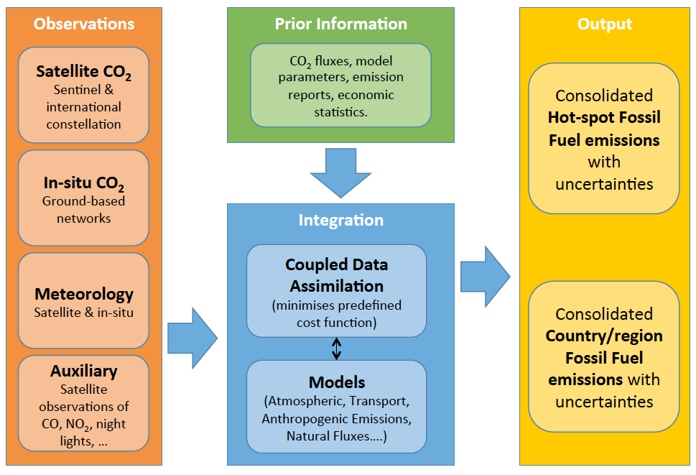
Overview of the Core Elements of the Copernicus CO₂ Emission Monitoring & Verification Support capacity

Slide 4
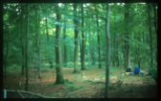
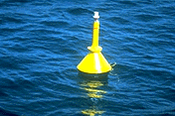
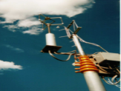
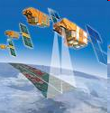
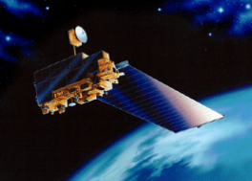
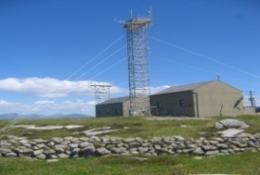
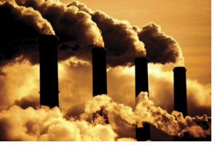
Monitoring CO2 and CH4 emissions
A scientific challenge involving observation and modelling
(Adapted from EU CO2 report)
Model of natural fluxes
Land use data
Notional components of a Fossil Fuel emission data assimilation system
Land & ocean networks
Remote sensing
Atmospheric
transport
model
Atmospheric in situ networks
CO₂ column concentration
Emissions
Model
Emission inventories
Maps of CO2 anthropogenic emissions
Uncertainties & Trends
Notes:
In terms of models, the recommendation is to develop a fossil fuel data assimilation system, that combines in the same operational model high resolution emission products, and transport model capable to assimilate both satellite and ground based measurements to deliver Near real time maps of improved fossil fuel emissions
[ Further such a system will be capable to perform an attribution to the different human activities, regional drivers, and to quantify uncertainties & trends, the latter being of paramount importance in the context of climate treaties ]
In Europe, thanks to the Copernicus program, excellent capabilities to run operational transport models of CO2 and to assimilate massive amounts of satellite data is already in place, e.g. at ECMWF. A future fossil fuel data assimilation system should build upon these capacities and reinforce them, namely by working with higher resolution transport models and coupling them with operationally updated emission maps.

Slide 5
Zoom over Europe with daily coverage with three satellites

Slide 6
Three satellite daily revisit time is globally under 50% except for 60-70 deg latitude which is slightly better
Notes:
This is demonstrating the daily coverage that can be achieved with three satellites with characteristics of Sentinel-7. So as an example in 40-60 degree band we only cover half of the area on a daily basis and lower latitudes e.g. 0-20 degrees is worse with only 30 & coverage (minimum 1 obs per day). Note: Clouds are not accounted for and will make all much worse.

Slide 7
COSMO model simulation on Cray XE6 «Monte Rosa» at Swiss Supercomputing Center CSCS
Simulation: Yu Liu & Nicolas Gruber (ETH)
Animation: Dominik Brunner (Empa)
Anthropogenic CO₂: EDGAR v4.2 (JRC)
Biospheric CO₂: VPRM (MPI Jena)

Slide 8
Coordination Matters: Daily coverage of best phasing 40 to 60 deg latitude band misses 15-25%
Notes:
Here we introduce another 3 satellites at optimum altitude and phasing. We have now very good coverage in 40-60 degree band with 80-90 % coverage (1-2 times per day) and also significant improvement at low latitudes.

Slide 9
Coordination Matters: Daily coverage gets significantly worse if phasing is poorly chosen
Notes:
But, if we fly the satellites at the same altitude but with poor phasing we will get a significant degradation over the optimized situation with very little improvements over all latitudes at certain times. Note: In case the altitude is different for the two constellations the coverage will oscillate between worst case (this slide) and best case (previous slide) performance

Slide 10
Moving Forward from “Science” to “Operational” GHG Missions
With the exception of the Sentinels, all of the existing and planned GHG missions are “science” missions, designed to identify optimal methods for measuring CO₂ and CH₄, not “operational” missions designed to deliver policy relevant GHG products focused on anthropogenic emissions
Following the model developed by the operational meteorological satellite constellation, future GHG constellation will also need to focus on orbit and mission coordination, data distribution, data exchange, and data format requirements
To fully exploit the information collected by future GHG constellations, the missions will also have to invest in training and capacity building as well as public outreach
CEOS should exploit the experience of CGMS and other organizations to foster the development of these capabilities

Slide 11
Coordination Group for meteorological satellites (CGMS)
- Outcome from CGMS-46 (June 2018)
CGMS reconfirmed its commitment to support the establishment of an operational greenhouse gas monitoring system and its space based component
CGMS brings experience build on the meteorological systems, in particular on mission coordination, data exchange, training, outreach
CGMS interacts with WMO for the inclusion of a space-based carbon monitoring system in Tier 1 of WIGOS2040
CGMS is part of the CEOS AC-VC writing team for a Greenhouse Gas White Paper
CGMS is working towards establishing a joint team with CEOS to support current activities towards an operational space-based carbon monitoring system targeting provision of systematic data supporting the activities of UNFCCC and other bodies

Slide 12
EUMETSAT and Copernicus
EUMETSAT Strategy – Challenge 2025
“In the short term, EUMETSAT will focus on the proposed additional Sentinel missions that are relevant to its Convention, create synergies with its own missions or Sentinel missions it already exploits, and deliver benefits to EUMETSAT and EU Member States, e.g. for monitoring atmospheric CO2, the ocean and the polar regions. “
“In principle, EUMETSAT will seek responsibility for operations of these Sentinel missions on behalf of the EU, making maximum reuse of its multi-mission ground infrastructure and of its specific expertise, and cooperation with ESA in the development of the ground segment, as necessary to appropriate the new systems and prepare for their safe operations.”

Slide 13
EUMETSAT and Copernicus
Currently operates/will operate Sentinel-3, 4, 5 and 6
Part of the S-7 taskforce and supported the drafting of the first MRD and CO2 reports
Is part of the S-7 MAG activities
Will operate the S-7 spacecrafts and generate associated products

Slide 15
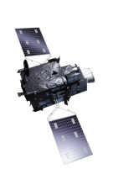
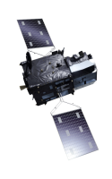
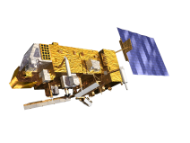
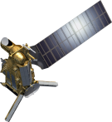
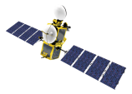
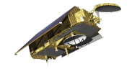
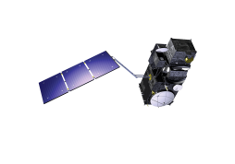
EUMETSAT mission planning
YEAR...
03
04
05
06
07
08
09
10
11
12
13
14
15
16
17
18
19
20
21
22
23
24
25
26
27
28
29
30
31
32
33
34
35
36
37
38
39
40
METEOSAT SECOND GENERATION
METEOSAT-8
METEOSAT-9
METEOSAT-10
METEOSAT-11
METEOSAT THIRD GENERATION
MTG-I-1 : IMAGERY
MTG-S-1: SOUNDING
Mandatory Programmes
MTG-I-2: IMAGERY
MTG-I-3: IMAGERY
EUMETSAT POLAR SYSTEM (EPS)
MTG-S-2: SOUNDING
METOP-A
MTG-I-4: IMAGERY
METOP-B
METOP-C
EUMETSAT POLAR SYSTEM SECOND GENERATION (EPS-SG)
METOP-SG A: SOUNDING AND IMAGERY
METOP-SG B: MICROWAVE IMAGERY
JASON (HIGH PRECISION OCEAN ALTIMETRY)
Optional
Programmes
JASON-2
JASON-3
SENTINEL-6 (JASON-CS)
COPERNICUS
SENTINEL-3 A/B/C/D
Third Party
Programmes
SENTINEL-4 ON MTG-S
YEAR...
03
04
05
06
07
08
09
10
11
12
13
14
15
16
17
18
19
20
21
22
SENTINEL-5 ON METOP-SG A
23
24
25
26
27
28
29
30
31
32
33
34
35
36
37
38
39
40

Slide 16
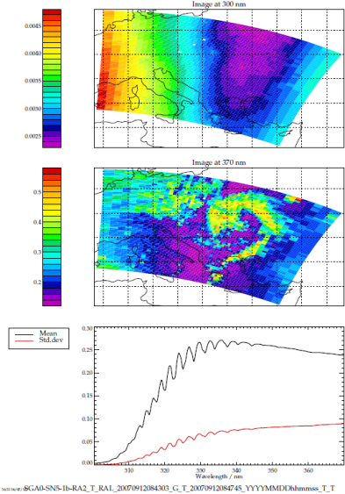
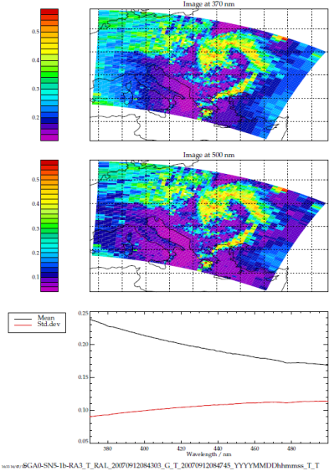
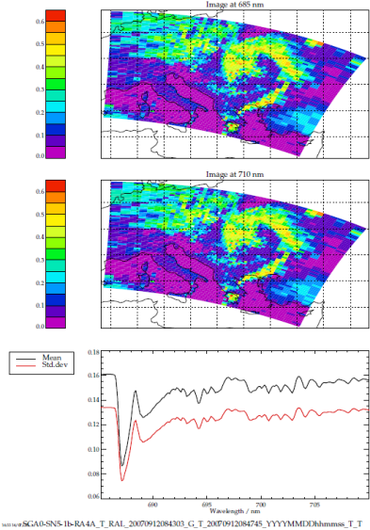
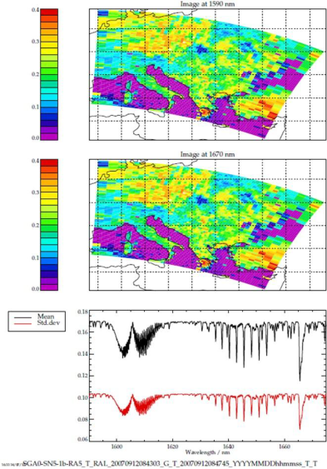
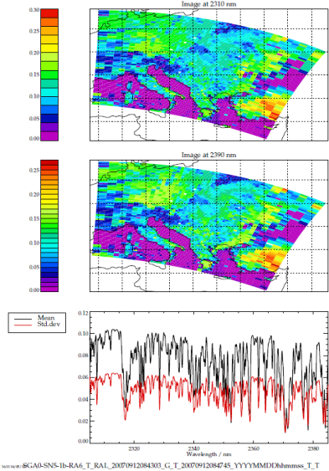
Instruments and Products – Trace Gases & GHG
Metop GOME-2 (Radiance, Irradiance, O3, NO2, SO2, HCHO, BrO, UV Index, H2O, surface reflectance, SIF)
Metop IASI (Radiance, CO, SO2, O3, HNO3, NH3, CH4)
EPS-SG UVNS (S5) (Radiance, Irradiance, O3, NO2, SO2, HCHO, CHOCHO, surface reflectance, surface UV, CH4, CO) EPS-SG IASI-NG (Radiance, CO, SO2, O3, HNO3, NH3, CH4)
Copernicus-CO2 (Radiance, Irradiance, CO2, CH4, SIF, NO2 )
MTG UVN (S4) (Radiance, Irradiance, O3, NO2, SO2, HCHO, CHOCHO, surface reflectance)
MTG IRS (Radiance, CO, O3 )

Slide 17
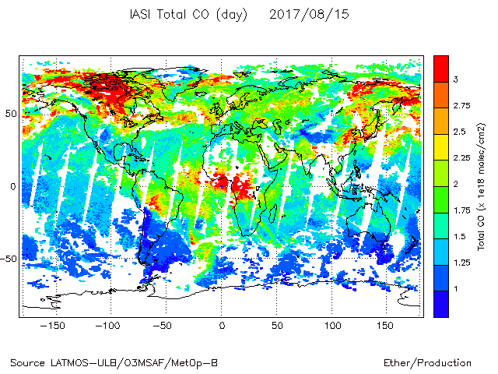
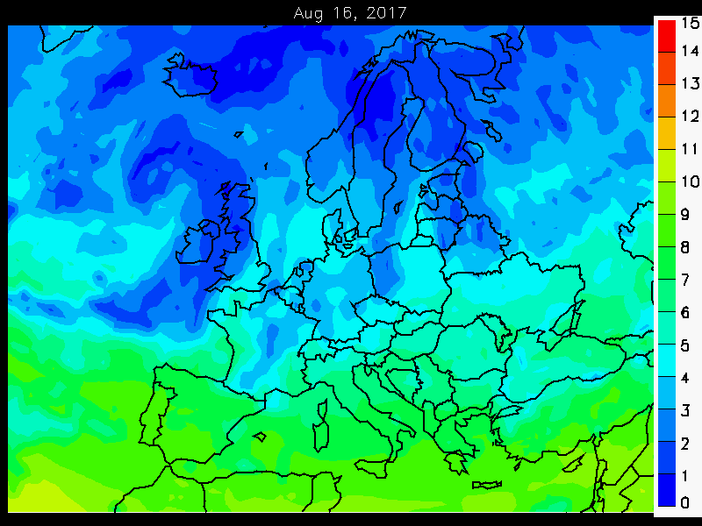
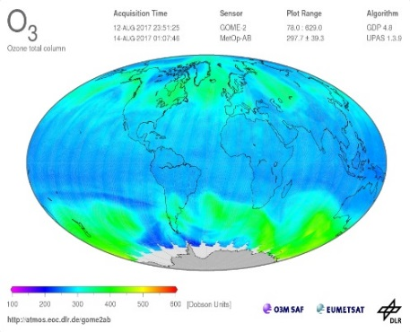
SAF on Atmospheric Composition Monitoring

Slide 18
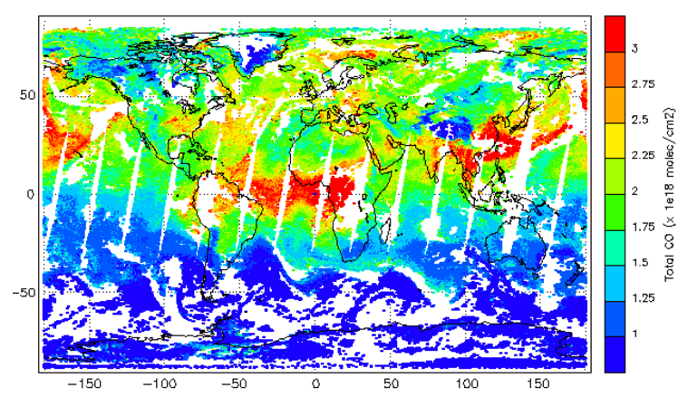
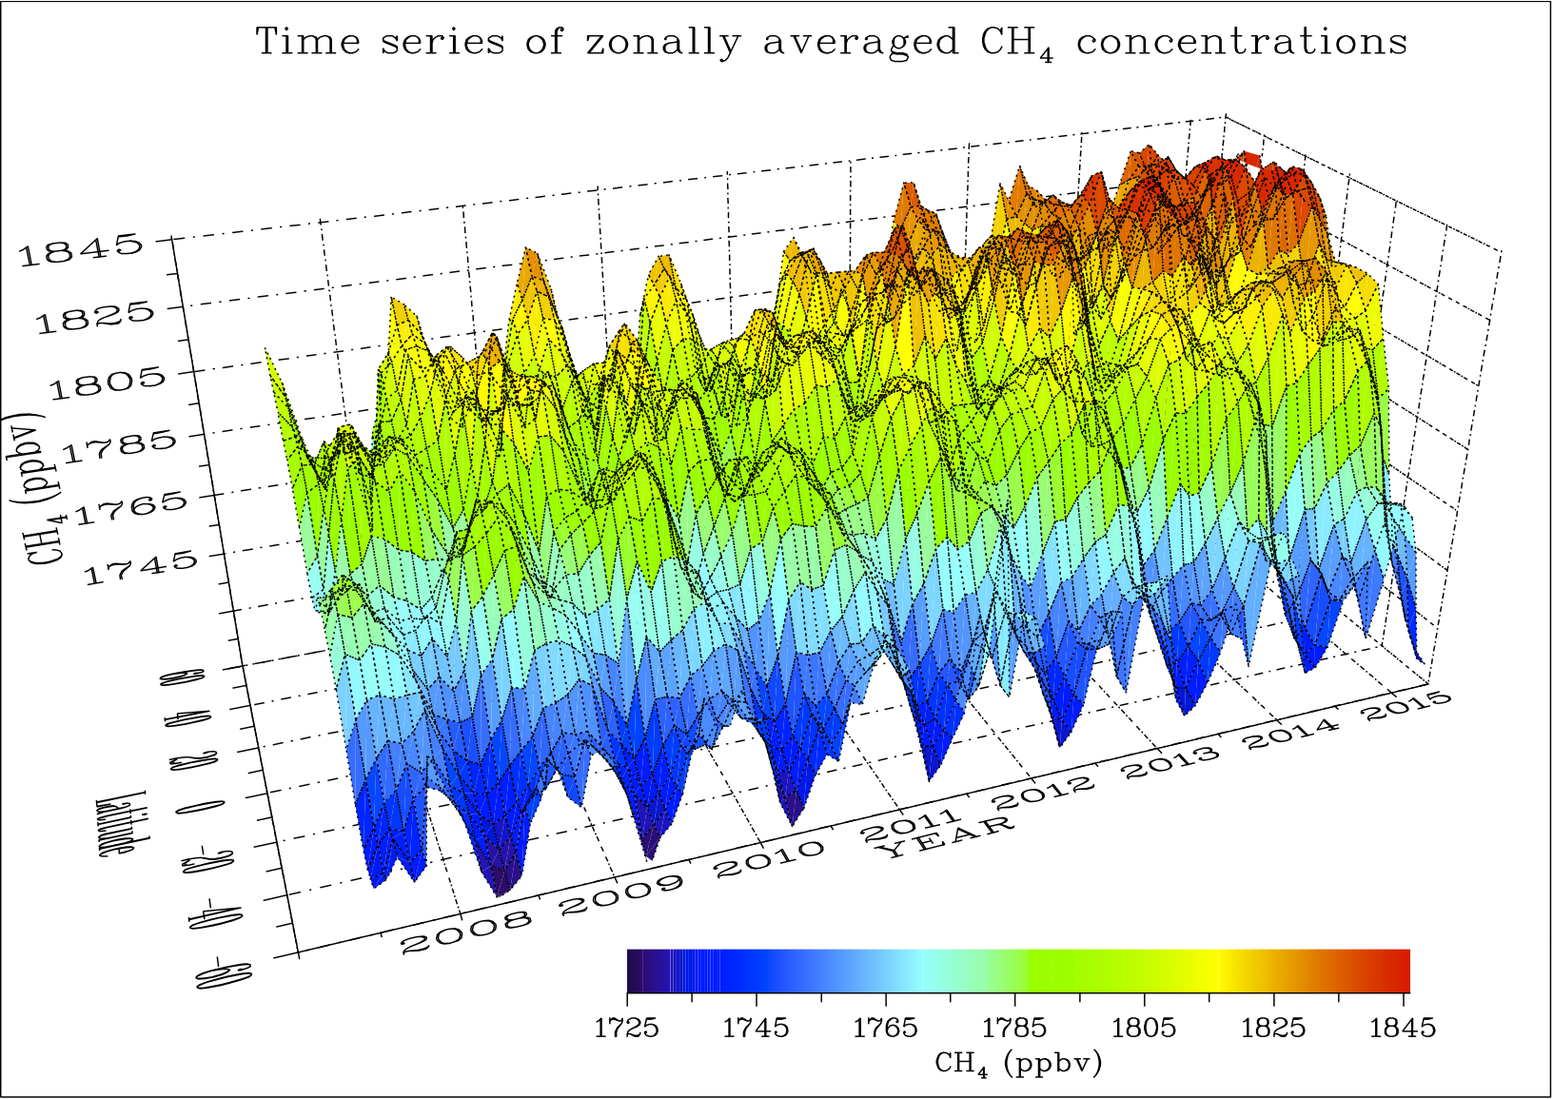
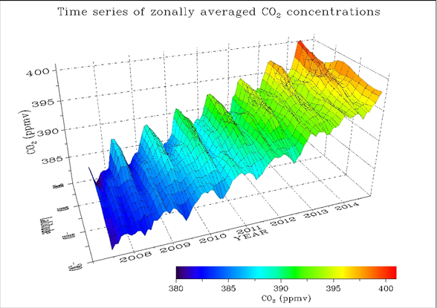
Greenhouse gases - preparing for Sentinel-7
CH₄ (ppb)
Notes:
seasonal variations and inter-annual trend for these two green-house gases.

Slide 19
Aerosol Product Commitments
Metop PMAp (GOME2/AVHRR/IASI) (AOD, Volcanic Ash Flag)
Metop GOME-2 (AAI, Absorbing Aerosol Layer Height)
Metop IASI (Dust, Volcanic Ash)
MSG SEVIRI (AOD, Volcanic Ash Flag & Layer Height)
MTG UVN (S4) (AAI, Absorbing Aerosol Height)
MTG IRS (Volcanic Ash, Dust)
MTG FCI (AOD, Volcanic Ash Flag & Layer Height)
EPS-SG 3MI & MAP (AOD, Single Scattering Albedo, Refractive Index, Effective Radius, Aerosol Layer Height, Aerosol Type) EPS-SG UVNS (S5) (AAI, Absorbing Aerosol Layer Height) EPS-SG IASI-NG (Volcanic Ash, Dust) EPS-SG METimage (AOD, Volcanic Ash Flag & Layer Height)
Sentinel-3 SLSTR (AOD, Angstrom coefficient)
Sentinel-3 SLSTR & OLCI (AOD, Angstrom component)

Slide 20
Thank You – Questions?

