Slide 1

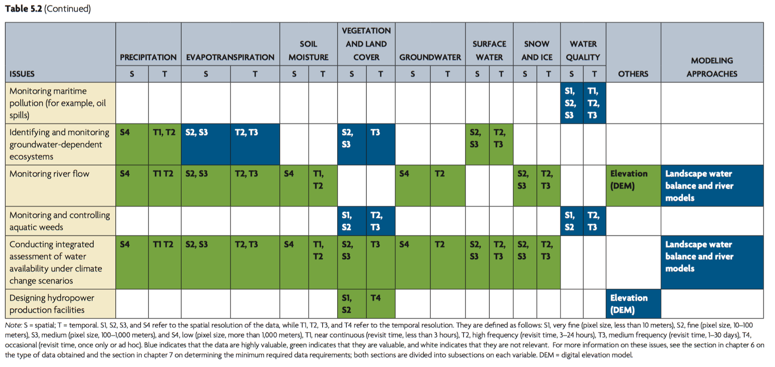
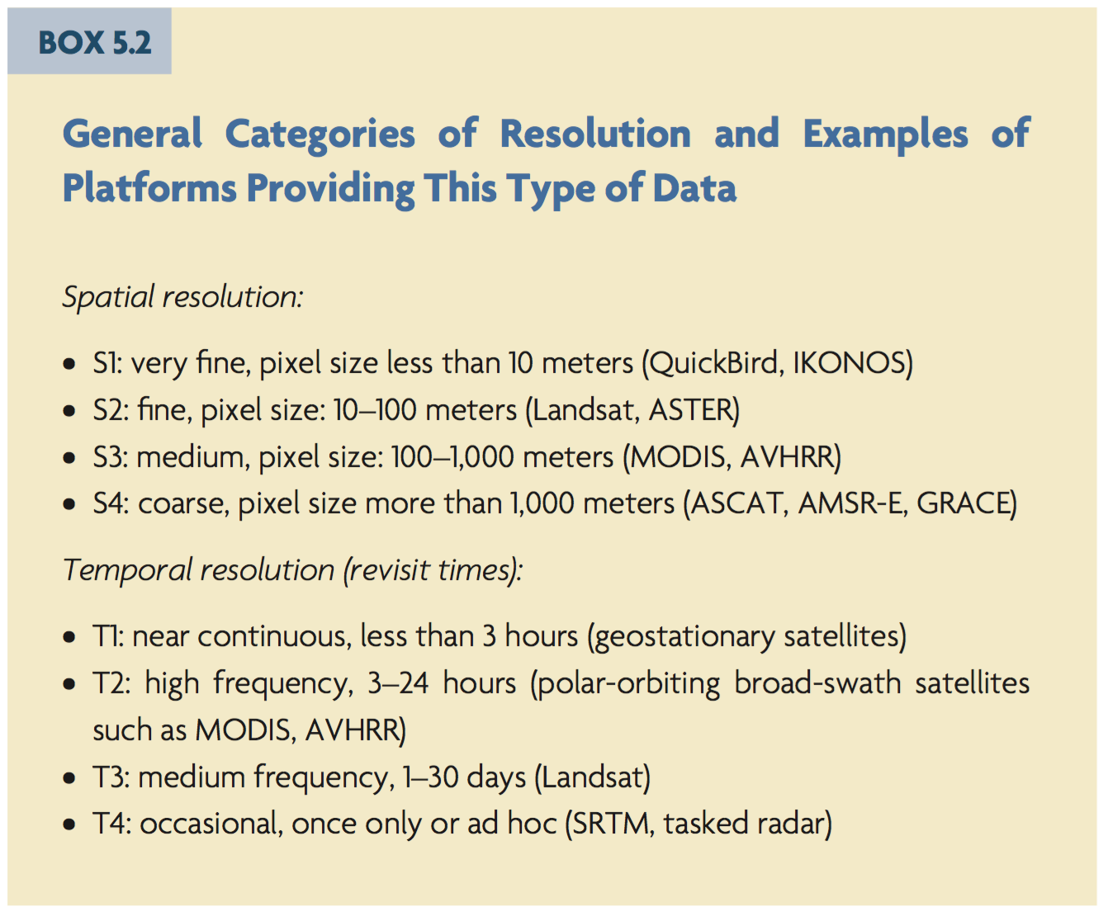

Slide 2
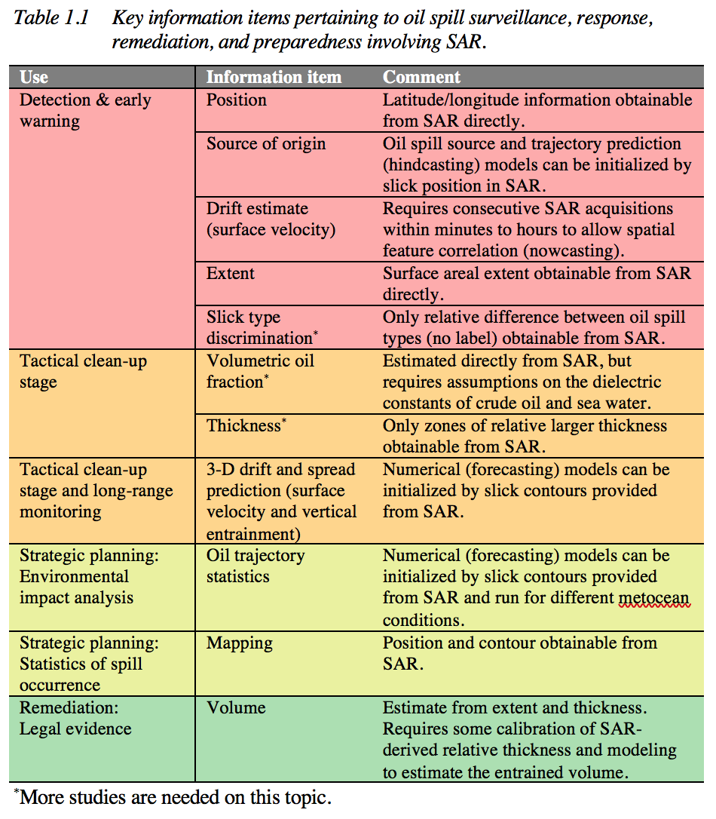
Water Quality: SAR Observations of Oil Spills & Biogenic Slicks & Mineral Oil Seeps
Detection vs. Characterization
Detection: Binary indicator of slicked vs. unslicked water
Characterization: Qualitative or quantitative identification of a material property that potentially can vary within the slick

Slide 4
Bragg Model:
Ocean scattering is predominantly from ocean wave components in coherence with the radar
Primary effect of oil:
Wave damping
Secondary effect:
Dielectric change
ocean wave spectral density
in-plane facet tilt angle
out-of-plane facet tilt angle
complex dielectric constant
Bragg coefficients

Slide 5
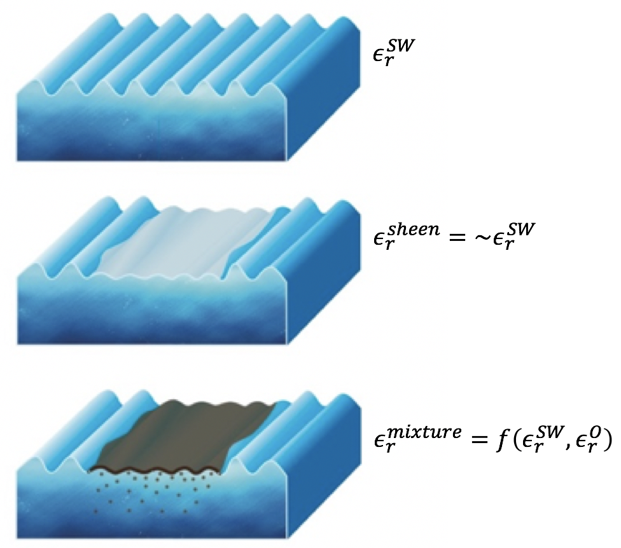
Dielectric Constant
Sea Water
Mineral oil sheen
or
Biogenic slick*
Thick crude
or
emulsion
*Biogenic slicks form monomolecular layers

Slide 6
Algal Bloom
Mineral Oil Slick

Slide 7
Slick Detection
Information Obtained Directly from SAR
Position
Extent
Information Obtained w/ Modeling
Trajectory
Hind-casting: Source of origin
Now-casting: Surface velocity
Fore-casting: 3D trajectory
Status
SAR detection capability is well-proven, oft-used for position, extent
Trajectory capability is poor (now-casting) to moderate (forecasting, hindcasting)
Requires more rapid temporal repeats, preferably tens of minutes to few hours (T2)

Slide 8
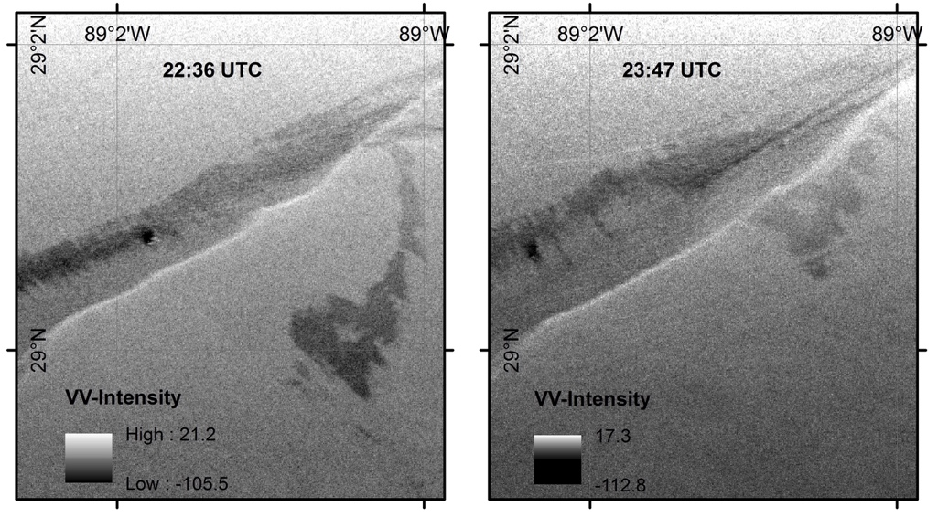
Slick Trajectory from Rapid Repeat Time Series
Coastal Gulf of Mexico (~10 km from MR exit)
UAVSAR VV intensity [dB] from two images acquired 71 minutes apart of a slick originating from a seep. A mat of red-brown emulsion, identified visually from a low-flying aircraft and identifiable by the low radar return, is moving to the west-southwest.
Complex current field in coastal waters
(front visible along plume from Mississippi River)

Slide 9
Slick Characterization
Information Obtained Directly
Slick type (mineral vs. look-alike)
(using shape, statistics)
Thickness (relative)
Information Obtained w/ Modeling and/or Calibration
Volumetric Oil Fraction
Thickness (absolute)
Status
All require more study
Discrimination from shape requires fine resolution (S2-to-low S3, ~100-m)
Thickness/volume requires high SNR (band-, imaging geometry- and wind-dependent)
Other RS methods
IR to ID thick oil (varies with time of day, temperature); airborne hyperspectral

Slide 10
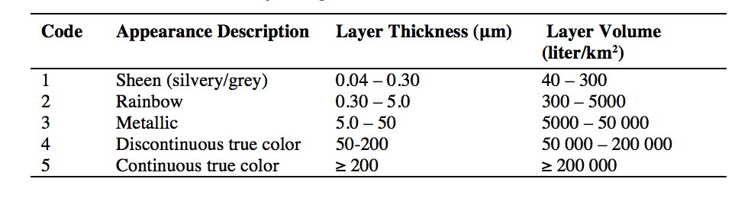
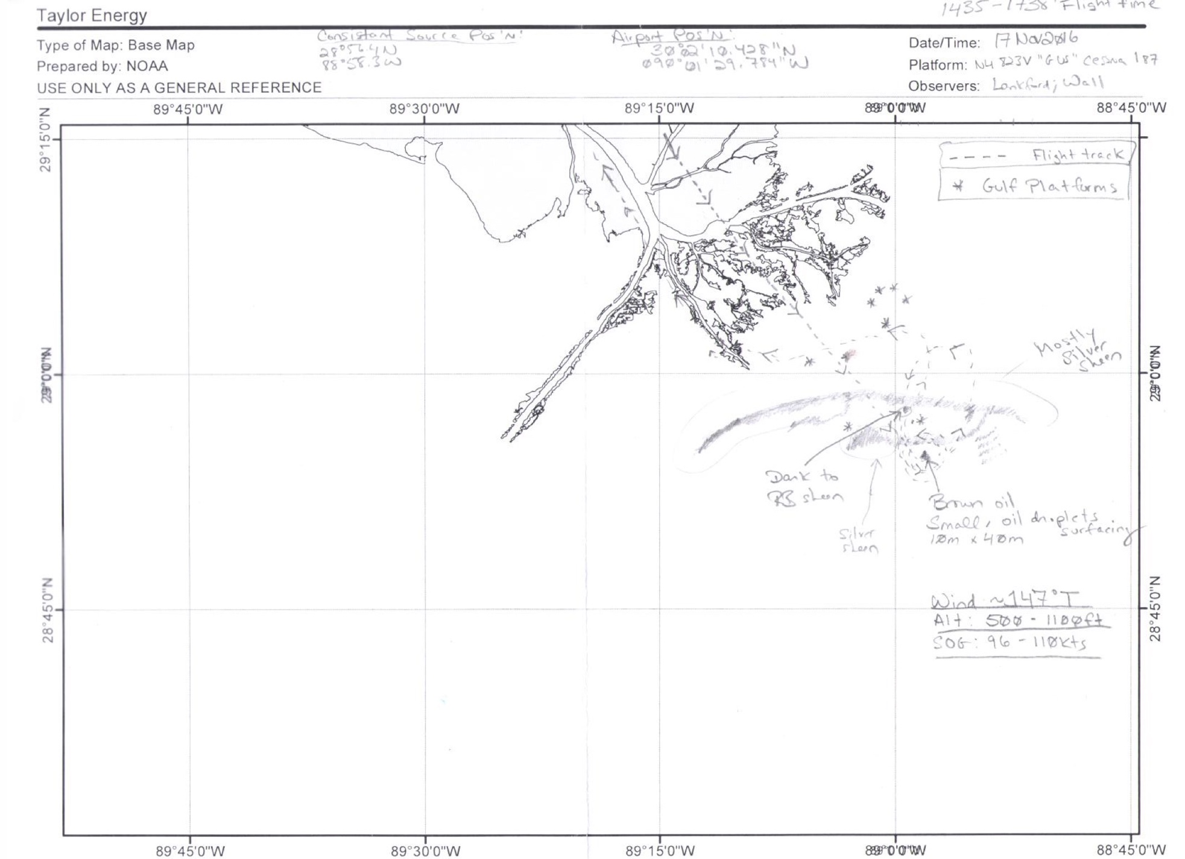
Conventional Method:
Visual Survey by
Trained Observer

Slide 11
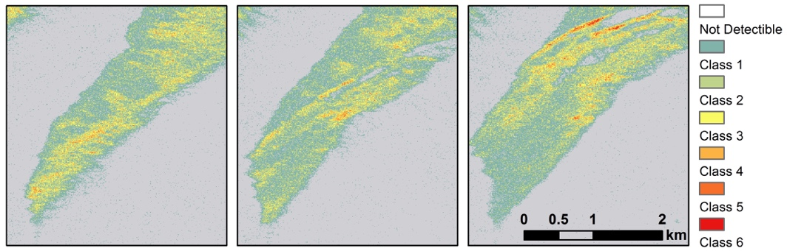
Relative Thickness (SAR)
Relative thickness classification based upon thresholding the VV-intensity damping ratio of a slick from a seep in the MC20 block of the Gulf of Mexico. The series of images were separated in time by one hour each, with the earliest image on the left. In situ observations and measurements indicated that this area was mainly covered with sheen from silver to rainbow, with patches of discontinuous true color oil.
Combine Slick Relative Thickness + Trajectory: Transport & Weathering

Slide 12
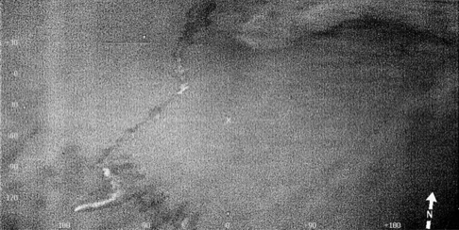
Relative Thickness (SAR vs. IR, thick oil only)
SAR VV-intensity damping ratio
IR (from Air Patrol Squadron Finland/SYKE)
RISAT-1 FRS-2 , C-band

Slide 13
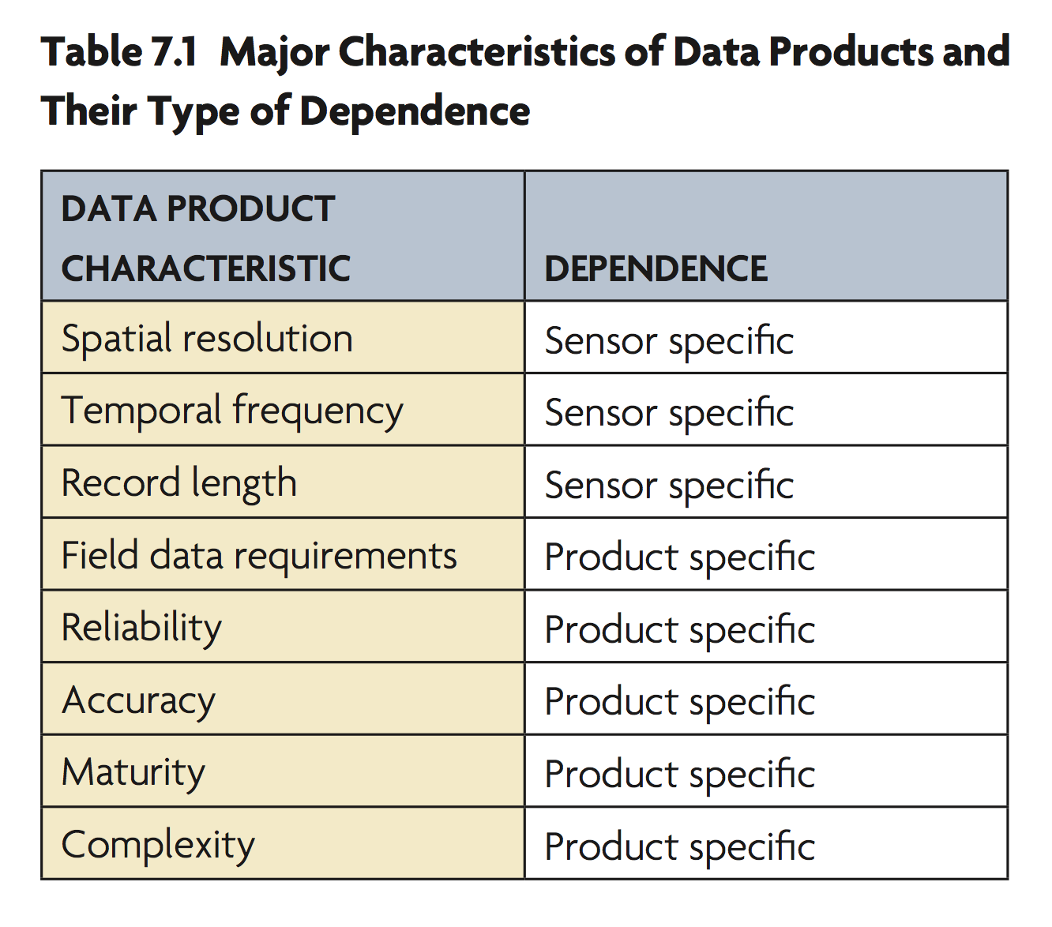
Requirements
Next Gen Missions
Concurrent SAR + Optical:
SAR slick detection + improve slick type ID (Algae bloom, look-alikes)
Rapid Repeat SAR:
Trajectory modeling, improve reliability of source location (hindcasting) and forecasting.
High SNR:
Improve response by targeting recoverable oil
Reduce ecological & economic impact by removing most persistent forms (emulsions)
100-m
<= few hours
Short (episodic)
Metocean + currents (model or measured)
Low

Slide 14
Extra Slides

Slide 15
Combine Slick Relative Thickness + Trajectory: Transport & Weathering

