Slide 1


The GEWEX Global Data Products
CEOS Freshwater Space Workshop
Delft, November 13 – 15, 2018

Slide 2
GEWEX
We as a community part of the World Climate Research Programme initiate, stimulate, facilitate and foster international research collaboration on energy and water cycle related processes in climate and weather science

Slide 3
GEWEX Data and Analysis Panel (GDAP) is the most involved in production, assessments and stewardship of global observational data products
  Co-Chairs: Remy Roca & Tristan L’Ecuyer
GEWEX Hydroclimatology Panel (GHP) more involved at the regional scale, application and evaluation/validation
  Co-Chairs: Jason Evans & Joan Cuxart

Slide 4
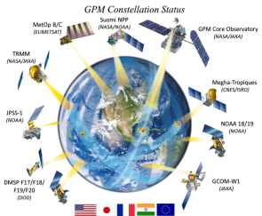
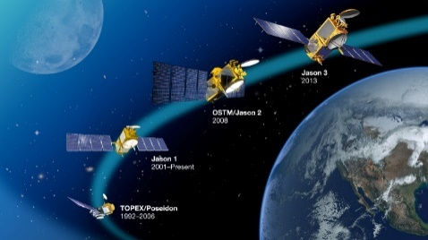
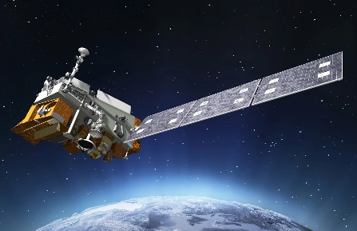

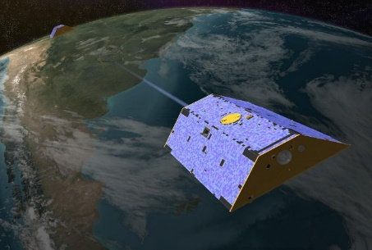
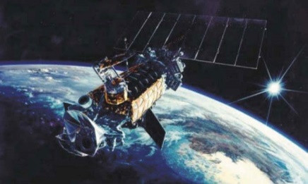
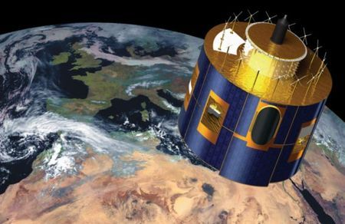
A New GDAP Vision
An integrated approach to energy-water-mass consistency based on refined uncertainty characterization
Consistency as a way of life!
Precipitation
Sea level
Radiation
Gravimetry
Surface Flux
Cloud
Notes:
Part of a bigger initiative to further advance the science benefit of GDAP assessment activities ... propose a new paradigm of integration and integrated assessment
At the core of this are three GDAP initiatives: (1) The long-awated GEWEX Integrated Product (just released); (2) several new integrated assessments (highlight land energy-water flux/storage activity (LST, soil moisture, ET, surface radiation, heat storage); (3) leadership in cross-WCRP activity centered on understanding Earth’s energy imbalance and its variability on seasonal to decadal timescales. Central to all of these goals are NASA observing system capabilities past, present, and future such as those here (add some future from decadal survey).
Also active participation in the activities of relevant other GEWEX panels and PROES (what is ACPC?)

Slide 5
A mission
  Run Core buissness
  Sponsor production and analysis of dataset from satellite (e.g., ISCCP, GPCP)
  Sponsor assessment of dataset to improve uncertainty estimation for data records
  Sponsor ground based network (e.g., BSRN, GPCC)
Act as an interface between the GEWEX activities and the data
  PROES, GAP, GASS …, Concept-Heat , conference 2018 organisation
Represent GEWEX at various WCRP meetings, WMO and other requests
  From to assess adequacy of observing system to data prize to DOI …..

Slide 6
ENDORSED DATA PRODUCTS
Cloud (ISCCP): https://www.ncdc.noaa.gov/isccp
Precipitation (GPCP): http://gpcp.umd.edu/
Surface turbulent flux (Seaflux) http://seaflux.org/
Radiation (surf+ toa) (SRB) https://gewex-srb.larc.nasa.gov/
Aerosols http://aerocom.met.no
Land flux* https://halo.kaust.edu.sa/Pages/GEWEX_Landflux.aspx
Integrated Product
Soil moisture
Ground water
Surface wate/runoff
Snow/Icr
All teams are involved in producing, validating and improving their products
*unclear future continuation

Slide 7
Int. Sat. Cloud Climatology Project (1982) https://www.ncdc.noaa.gov/isccp https://isccp.giss.nasa.gov/ (legacy product) https://www.ncdc.noaa.gov/cdr/atmospheric/cloud-properties-isccp
ISCCP Production NOAA NCEI (National Centers for Environmental Information)
To develop the expertise and capabilities to producs, understand, and operationally maintain the International Satellite Cloud Climatology Project (ISCCP) H-Series Climate Data Record
Additional Goals to sufficiently maintain the products and expand user base:
  Understand end-user needs for ISCCP Cloud Products to shore up stakeholder involvement and feedback
  Engage SPC partners to acquire QC’d geostationary data
  Drive and support analysis of climate indicators using ISCCP data

Slide 8
Continuing a Key Climate Data Record:
ISCCP-Next Generation
Cloud properties constitute a core geophysical climate record
Instruments and expertise exist to generate a calibrated, global, 10-channel, multi-parameter cloud at 3 km with 30 minute coverage
  Heritage to deal with such data volumes also exists (e.g. AIRS and MODIS)
Excellent opportunity for coordinated NASA and NOAA activity to maximize scientific benefits of new geostationary and low-earth orbiting satellites
GDAP endorses the formation of a team to develop a unified analysis approach built around the current geostationary radiance data record augmented by MODIS/VIIRS and sounder cloud information
  Agency support for a series of international workshops
  Target 2021 for initial implementation
A multi-institutional (multi-national) processing chain similar to ISCCP is encouraged
  Individual satellite operators, collect, quality control, and sub-sample radiances and provide these data to an analysis center that would conduct a refined calibration and the quantitative cloud analysis.
  Data products to be archived and distributed by existing data centers.

Slide 9
GPCP Global Precipitation Products
Version 2.3 NASA, NOAA, DWD, UMD, GMU, others http://gpcp.umd.edu/
• Monthly, 2.5° Merged Analysis (1979-present) Adler et al. (2003), J. Hydromet.
Huffman et al. (2009) GRL
• Pentad, 2.5° Merged Analysis (1979-present) Xie et al. (2003) J. Climate
• Daily, 1° Merged Analysis (1997-present) Huffman et al. (2001) J. Hydromet.
[although produced using different data sets and algorithms, products are integrated,i.e. they add up]
normally produced ~ 3 months after observation time

Slide 10
SeaFlux
International project under the auspices of the GEWEX Data and Assessments Panel: to improve our understanding and determination of ocean surface turbulent fluxes
Our main questions:
  What is feasible in terms of resolution and length-of-time series for satellite data?
  Can we produce a high resolution dataset using satellites that is better than conventional climatology and NWP products?
  What are the best methods for creating this dataset?
  How do the different datasets perform under varying applications?
Elements of the project include:
  Evaluation of global flux products
  Providing library of flux datasets and in situ data sets for easy comparisons by researchers
  Production of a high-resolution (1º, 3 hourly) turbulent flux dataset

Slide 11
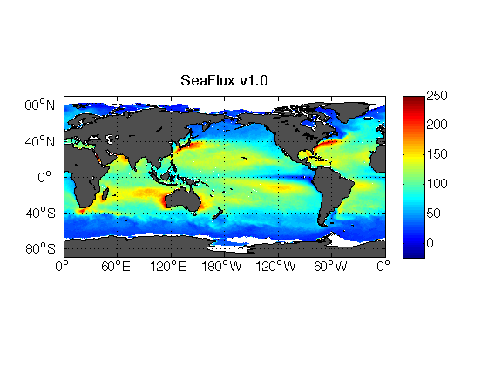
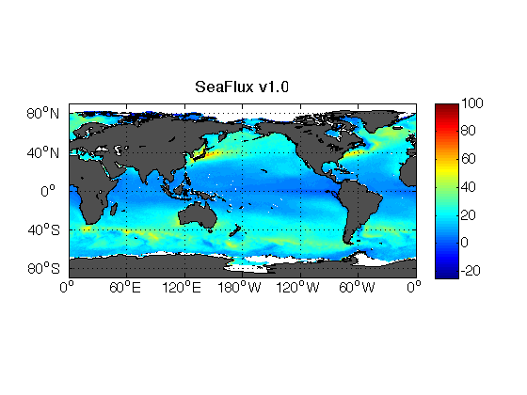

SeaFlux CDR version 2
Near-surface air temperature, humidity, and winds
  Based on Roberts et al. (2010) neural net technique
    CLW content used to remove rain-contamination (except for F08)
    F10 – F18, pixels segregated by clear/cloudy sky
    One neural net for F08, two for all others (total)
  SSM/I and SSMIS from CSU FCDR
SST
  Pre-dawn based on Reynolds OISST
  Diurnal correction
  Uses SRB, CERES, FLASHFlux for radiation, HOAPS, GPCP and now MERRA for precipitation
Land mask from NOAA GSHHG, ice mask from AVHRR ice fraction, ISCCP ice shelf
Uses neural net version of COARE
Gap-filling methodology -- use of MERRA2 variability – 3 hour
Available from 1988 through mid-2017
1999 Latent Heat Flux
1999 Sensible Heat Flux

Slide 12
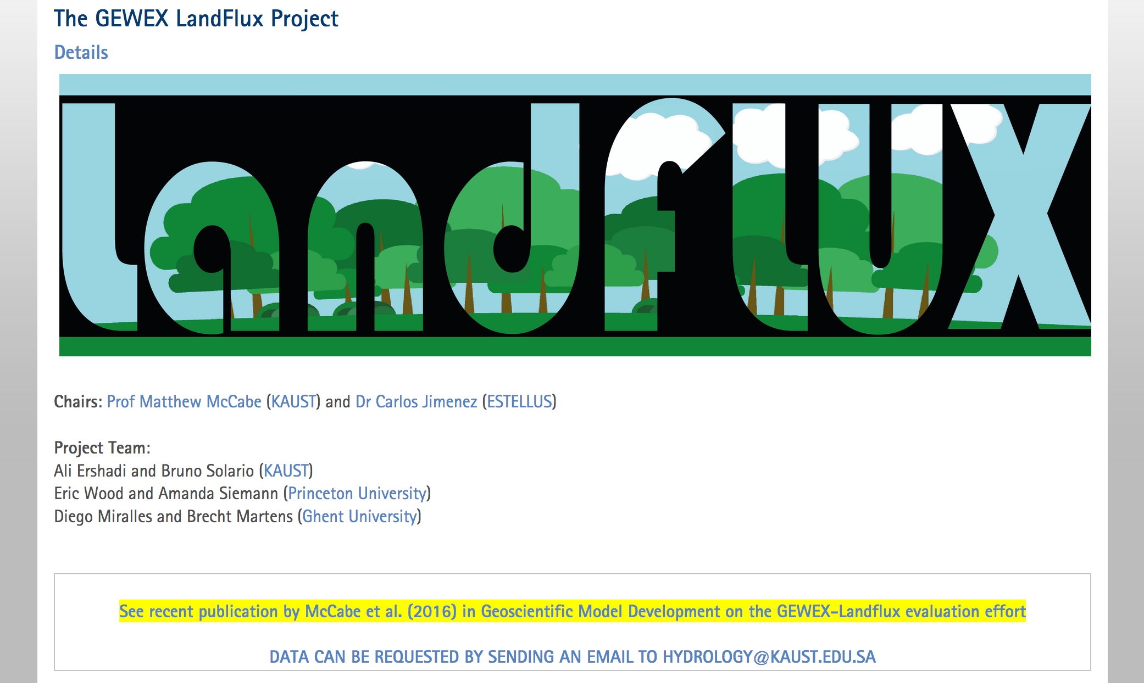
LandFlux: data production – V1
V1:1984-2007 3-hourly global runs of latent heat flux from GLEAM, PT-JPL, PM-MOD with “GEWEX-like” forcings (mainly SRB), publicy available from the LandFlux website.
https://hydrology.kaust.edu.sa/Pages/GEWEX_Landflux.aspx

Slide 13
The GEWEX Surface Radiation Budget Project: Release 4 Integrated Product Progress and Plans
GEWEX Data and Assessments
Panel Meeting
Boulder, CO
10-12 October, 2017
Paul W. Stackhouse, Jr. – NASA LaRC
Stephen J. Cox, J. Colleen Mikovitz,
Taiping Zhang – SSAI

Slide 14
SRB Release 3 Data Products
(Spatial Resolution: 1º x 1º; 7/83 – 12/07)
Data Types | Model Name | Temporal Resolution | Parameters
SW | GEWEX SW (Pinker/Laszlo) (v3.0) | 3-hourly, Monthly Averaged 3-hourly, Daily and Monthly Averaged (UTC and local sun time) | All-sky: Surface down, up, PAR down; TOA Down, Up
 |  |  | Clear-Sky: Surface Down, Up; TOA Up
 | LPSA (Staylor/ Gupta) (v3.0) | Daily, Monthly | All-sky: Surface Down, Net, and Albedo
 |  |  | Clear-sky: Surface Down
LW | GEWEX LW (Fu/Liou/ Stackhouse) (v3.1) | 3-hourly, Monthly Averaged 3-hourly, Daily and Monthly Averaged | All-sky and clear-sky: TOA up; Surface Up and Down
 | LPLA (Gupta) (v3.0) | 3-hourly, Monthly Averaged 3-hourly, Daily and Monthly Averaged | All-sky Surface Downward, Net; Cloud Radiative Forcing
Input Property | CLDPROPS | 3-Hourly | Surface emissivity, skin temperature, atmospheric profile; cloud phase, fraction, optical depth and LWC
Note: The LPSA and LPLA algorithms are also used in CERES Surface-Only

Slide 15
SRB Rel 4 versions, global fluxes: 2007
 | Rel 3.0 | Rel 4 baseline (OLD algorithm, NEW inputs – HXS Beta1) | Rel 4 gamma (NEW algorithm, OLD inputs - DX) | Rel 4 iota (NEW algorithm, NEW inputs -HXS Beta1) | Rel 4 nu (NEW algorithm, NEW inputs – HXS V01)
Surface down | 186.1 | 186.1 | 182.3 | 184.3 | 184.8
Surface down diffuse | 104.1 | 105.8 | 95.0 | 96.2 | 100.1
TOA Up | 104.4 | 104.2 | 103.1 | 100.4 | 100.5
Clear surface down | 247.6 | 246.8 | 240.5 | 239.9 | 239.9
Pristine surface down | 258.5 | 258.5 | 252.8 | 252.1 | 252.2
Surface albedo | 0.131 | 0.132 | 0.137 |  | 0.126
Surface net | 163.5 | 163.7 | 158.7 |  | 161.9
Cloud Radiative Effect | -61.5 | -60.7 | -58.2 | -55.6 | -55.1

Slide 16
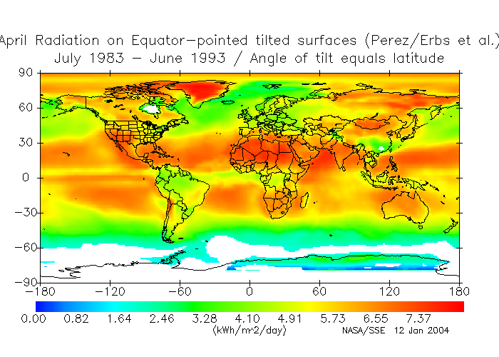
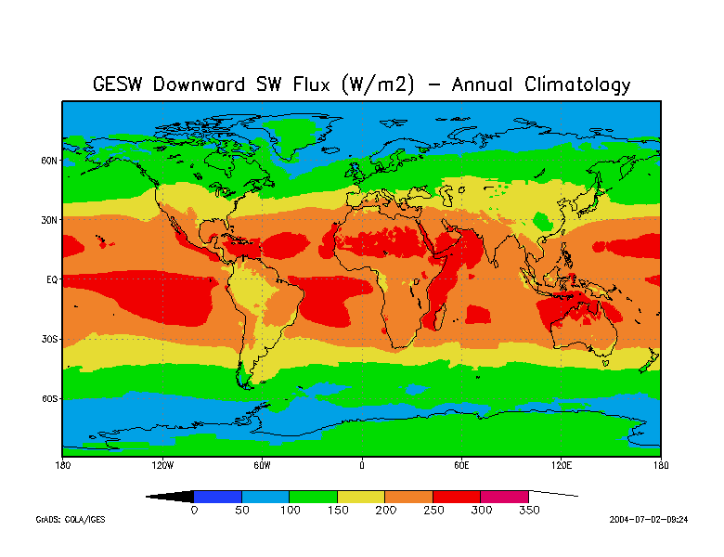
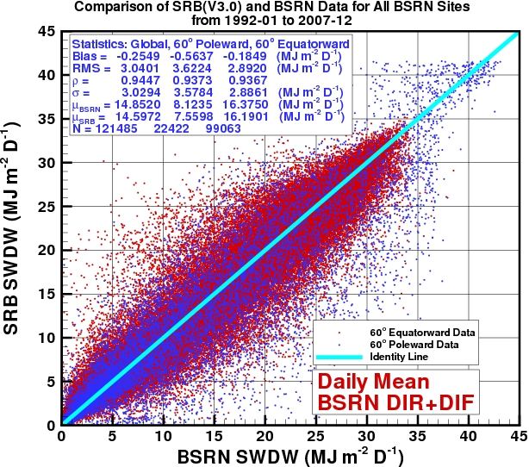
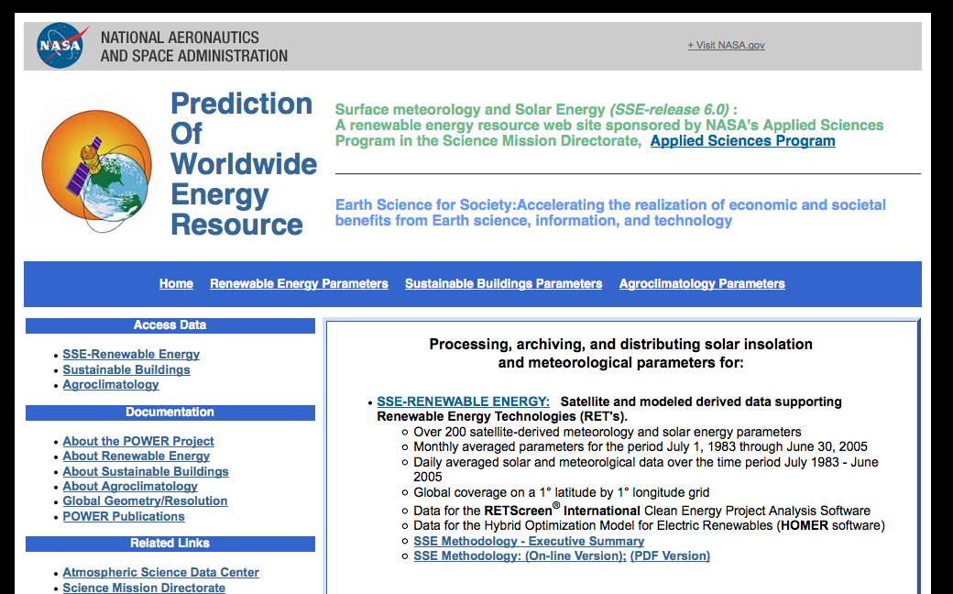
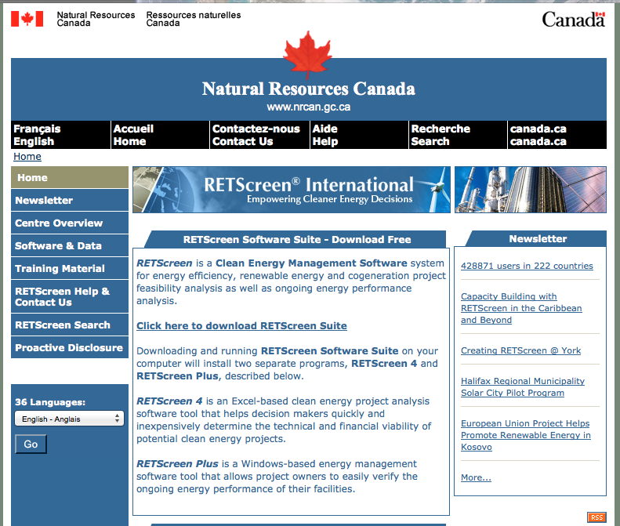
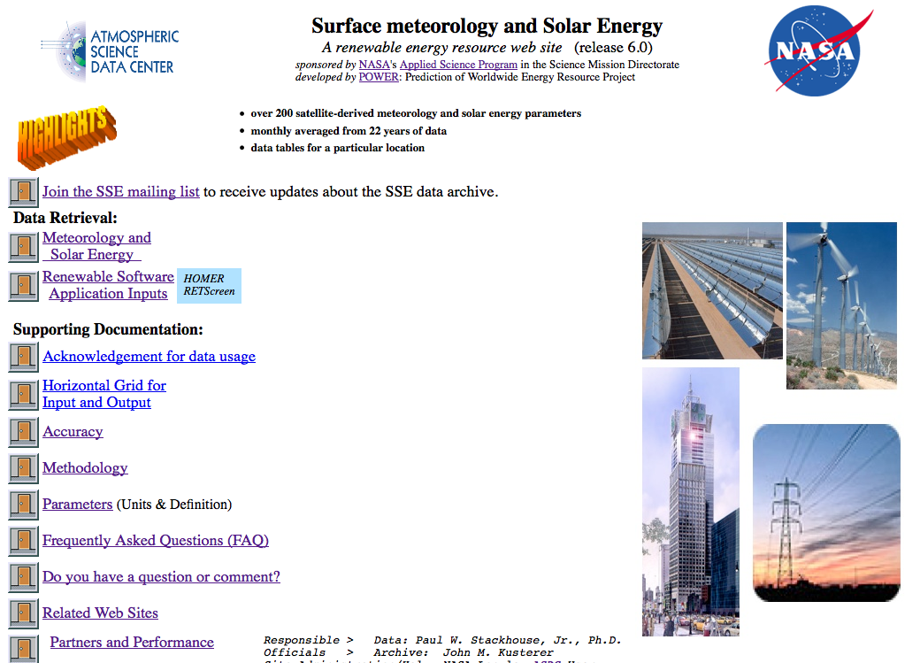
GEWEX SRB: Research to Decisions
NASA Earth-Sun Satellite Analysis
and Modeling Projects:
(ISCCP, GEWEX SRB, CERES FLASHFlux,
GMAO GEOS)
POWER/SSE Project
Solar and meteorological parameters in specialized units
Satellite
observations,
analysis and
modeling
Adaptation and
validation of
parameters
Surface Solar Irradiance (W m⁻²)
RETScreen® International
POWER/SSE Datasets and Web interface
Decision Support
System design and
planning tool
Data Accessibility
through
Web Interface
200+ Parameters (most on-the-fly)
(~15,000 unique users, ~ 1,200,000 hits and 230,000 data downloads per month)
~ 450,000 Global Users

Slide 17
GEWEX SRB: Next Steps
  Will re-access assumptions regarding => cloud merging and gridding (1-2 months)
    Compare and homogenize with HGG
  Reprocess 2005-2009 with revised calibration tables and cloud properties
    Will be assessing changes to cloud properties
    Compare to CERES, BSRN and assess
    Production time required for 1x1: 10 years per month
  Redeliver at 1x1 time periods needed; considering not reprocessing 30 years at 1x1 => 2000 - 2009
  Progress of conversion to ½º x ½º nearly completed
    Using full equal area sampling and data production grid
    Will provide data provides at the ½º x ½º equal angle
    Testing aspects on Cloud based system

Slide 18
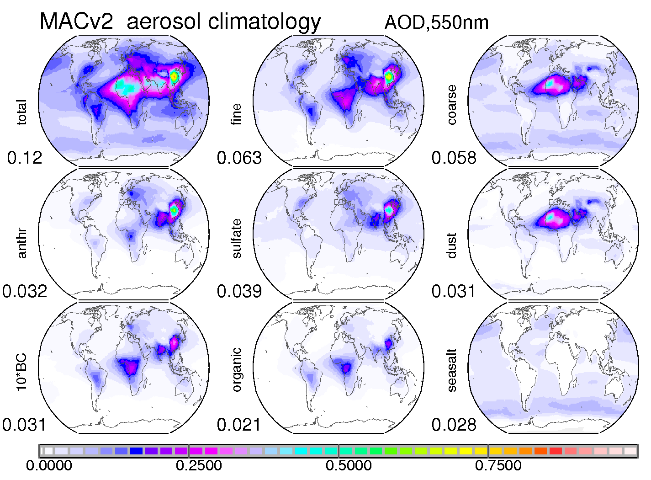
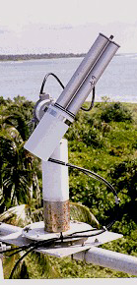
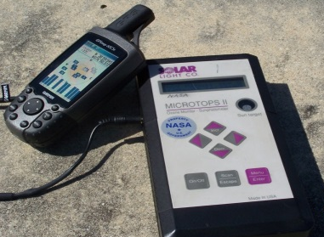
Aerosols
(Stephan Kinne)
spatial
context
by global
Modeling:
AeroCom
MACv2 from sunphotometry
to aerosol component distributions

Slide 19
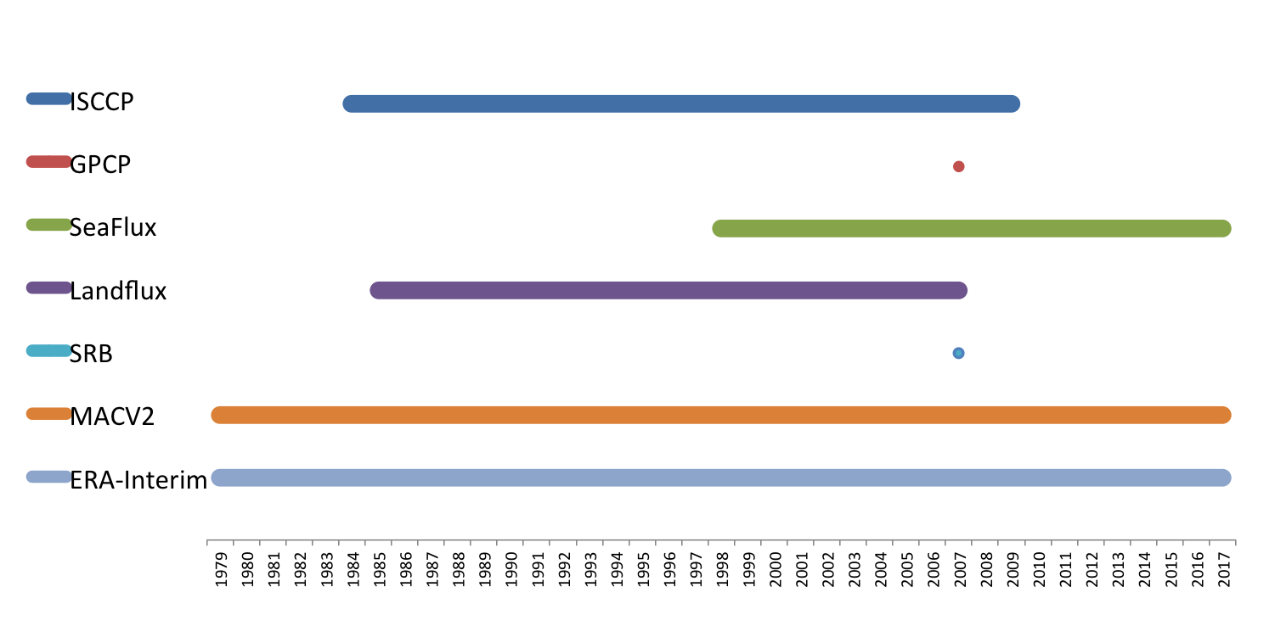
The “Integrated Product”
Test period: 1 Jan 2007 – 31 Dec 2007
1°, 3-hourly equal-area grid
ISCCP Clouds, MAC V2.0 Aerosols, SRB Radiation (TOA & Sfc)
Land/SeaFlux for Sensible and Latent heat flux,
GPCP Precipitation
ERA-Interim for Water Vapor transport, CAPE, dynamical context

Slide 20
ASSESSMENTS
Aerosols
Soil moisture
Clouds (with ICWG)
Water vapor
Precipitation (including the Joint IPWG-GEWEX effort)
Towards a guide for GEWEX assessment

Slide 21
Related Activities
GEWEX Integrated Dataset
GEWEX sponsored or supported datasets on a common 1∘, 3-hourly, equal-area grid
Supports regional water and energy budget closure analyses
User workshop in Spain in 2019
Advance land-ET and surface radiation measurements by explicitly linking to new/proposed land surface temperature, soil moisture, terrestrial water storage, and ground heat storage assessment activities
Grew out of CLIVAR CONCEPT-HEAT and NASA NEWS
Integrated assessment of methods for quantifying fundamental driver of climate and reconciling top-of-atmosphere vs. surface perspectives
Integrated Surface Water and Energy Assessments
Earth’s Energy Imbalance
Notes:
While assessment of individual parameters will continue, some focus is shifting toward integrated assessments of global data projects that apply energy and water cycle closure constraints as an integrated measure of systematic errors in datasets.

Slide 22
Other particular points of interest
More attention to extremes precip (and hence high temp/spat obs)
Strong focus on the human dimension on the water cycle e.g.
  Better incorporate irrigation (effects) in models
  Interface with Socio economics (and their influence on fresh water)
Water for the Food Baskets of the World
  ANDEX
  North America (GWF, Western US)
  Europ (PANNEX)
  Asia (TPE and SE Asia)

Slide 23
Thank You

Slide 24
Our Vision:

Slide 25
Our Mission:

Slide 26
Our Themes:
Water for the Food Baskets
  Supply and demand in a human controlled water cycle
Balancing the Budgets
  Getting the energy and fluxes globally accurate
Dating and Coupling
  Land – Atmosphere interactions processes and benchmarking of models
Science on the Edges
  Extremes in water and energy processes and phenomena

