Slide 1
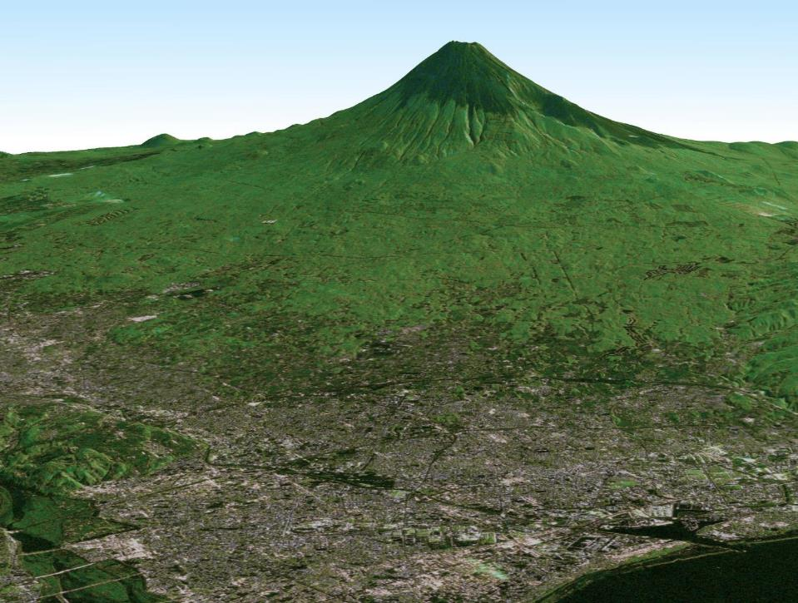
CEOS FDA Workshop
JAXA EO Data Strategy
26 April, 2018
Osamu Ochiai
Satellite Applications and Operation Center (SAOC)
Japan Aerospace Exploration Agency (JAXA)

Slide 2
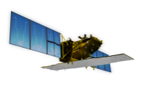



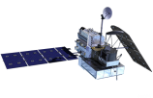


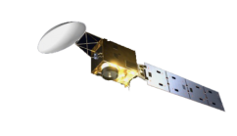


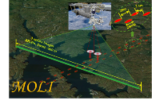
JAXA Satellite Lineup
As of Sep 2017
Targets (JFY) |  | 2014 | 2015 | 2016 | 2017 | 2018 | 2019 | 2020 | 2021 | 2022 | 2023 | 2024
Disasters & Resources
Climate Change & Water Cycle Water Cycle
Climate Change
GHGs
Technology Demonstration
Communications
[Land and disaster monitoring]
ALOS-2 / PALSAR-2
Advanced SAR (ALOS-4)
Advanced Optical (ALOS-3)
[1997〜2015]
TRMM / PR
[Precipitation 3D structure]
GPM / DPR
[2012〜]
[Wind, SST , water vapor, precipitation,]
GCOM-W / AMSR2
AMSR2’s successor sensor
[Vegetation, aerosol, cloud, SST, ocean color]
GCOM-C / SGLI
[Cloud and aerosol 3D structure]
EarthCARE / CPR
[2009〜]
[CO_{2,} CH₄]
[CO_{2,} CH₄, CO]
GOSAT /FTS, CAI
GOSAT-2
GOSAT-3
SLATS
(Super Low Attitude Test Satellite)
MOLI
(Vegetation LiDAR onboard ISS)
[2008〜]
(Wideband InterNetworking engineering test
and Demonstration Satellite)
WINDS
ETS-9 (Engineering Test Satellite No.9)
Japanese Data Relay System (JDRS)
Mission status:
On orbit
Extended Life Period
Development
Study

Slide 3
JAXA’s New EO Data Distribution Plan
Promote Open and Free
Available Spatial resolution
  5 meter resolution or Coarser
Enhance provision of available products on the internet
  To be open upon processed
ALOS/AVNIR-2 Global → ALOS PALSAR Global
  G-Portal (Standard Products and ARD)
  JJ-FAST, JASMES, JASMIN（for GFOI, GEOGLAM）

Slide 4
JAXA ‘s Open and Free Data
As of April 26, 2018
Satellite/ Sensor |  | Before | NOW
MOS/JERS/ADEOS/ADEOS-2/ AMSR-E/TRMM |  | ○ | ○
GOSAT |  | ○ | ○
GCOM-W and GCOM-C |  | ○ | ○
GPM |  | ○ | ○
ALOS | AVNIR-2 (10m) | ー | ○
 | PALSAR (10m) | ー | ○
 | DSM (30m) | ○ | ○
 | Annual Global Forest map / mosaic (25m) | ○ | ○
ALOS-2 | ScanSAR (100m) | ー | Under Negotiation with PD
 | Fine mode (10m) | ー | Under Negotiation with PD

Slide 5
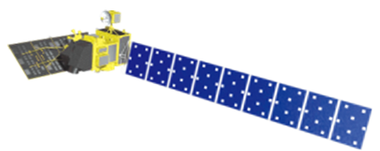
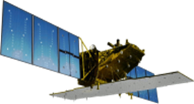
Schedule of Data Processing and O/F Access
 |  | 2018 |  |  |  | 2019
 |  | 1Q Jan Mar | 2Q Apr Jun | 3Q Jul Sept | 4Q Oct Dec | 1Q Jan Mar | 2Q Apr Jun | 3Q Jul Sept | 4Q Oct Dec
ALOS | AVNIR-2 (10m)
 | PALSAR (10m)
ALOS-2 | ScanSAR (100m)
 | Fine Mode (10m)
Japan Area
±60
Degree Area
Global
Data Processing
Japan Area
±60
Degree Area
Global
Data Processing
Under negotiation with PD
Under negotiation with PD

Slide 6
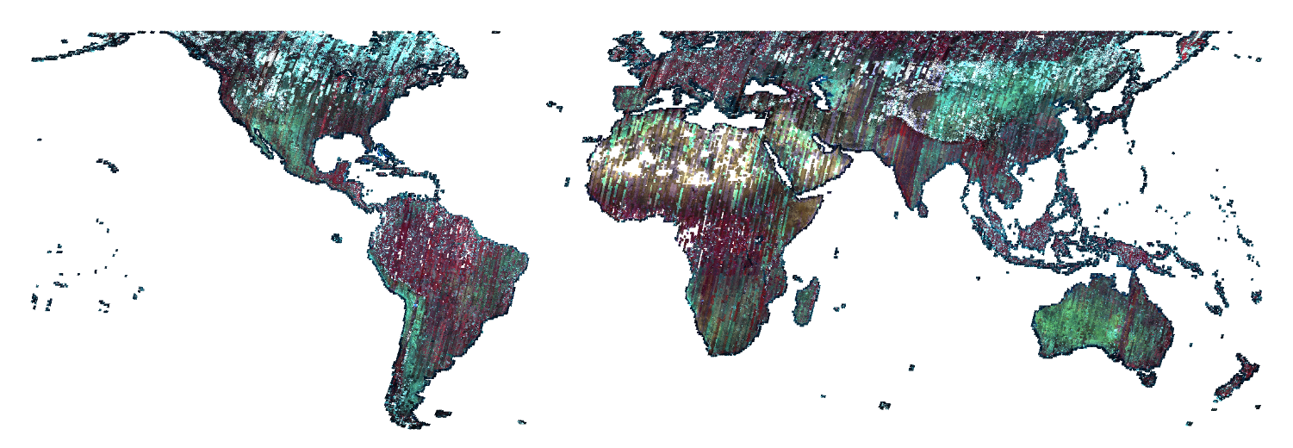
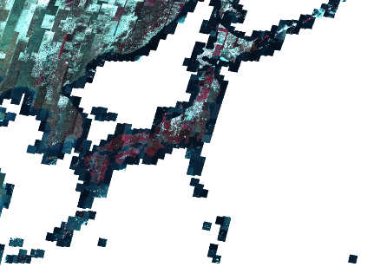
ALOS AVNIR-2 ORI Dataset
AVNIR-2 Ortho Rectified Image (ORI)
- Automatic processing using PRISM DSM and ORI.
- Areas within 60 deg. latitude had priority.
- Global areas will be done in 2019.
- < 30 % clouds / scene is processed.
- Scene-based product in total 0.8 mil. scenes.
- Acquired date: 2006 to 2011.
This will be complemented Landsat-7.
- These does not apply atmospheric correction.
Any suggestions?

Slide 7
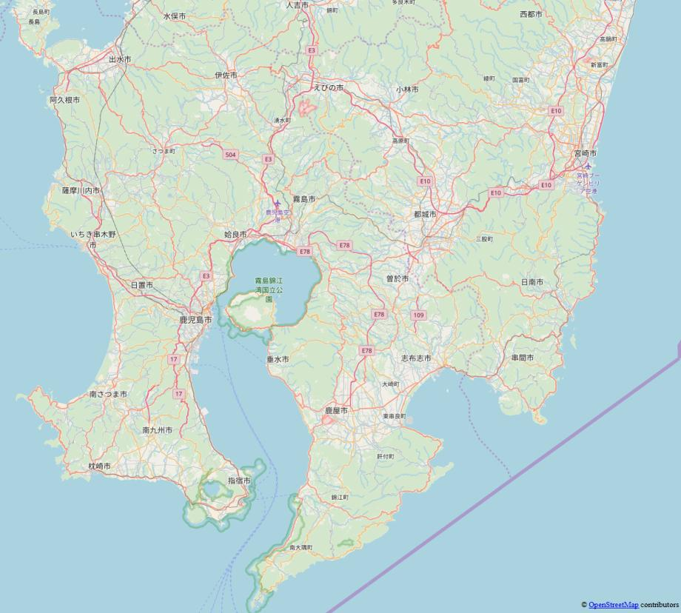
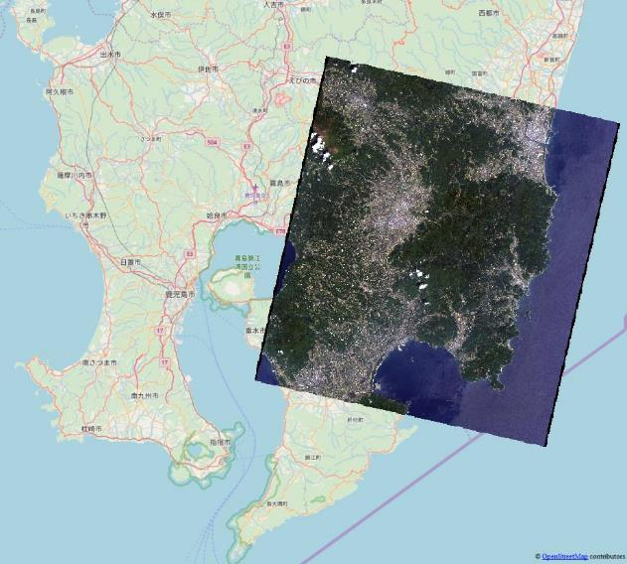
ALOS AVNIR-2 ORI Dataset
Example of utilization
ALOS/AVNIR-2
- 2009/04/29
- 2010/11/02

Slide 8
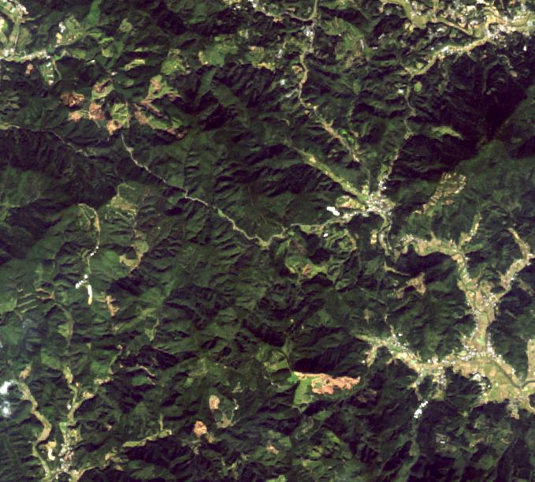
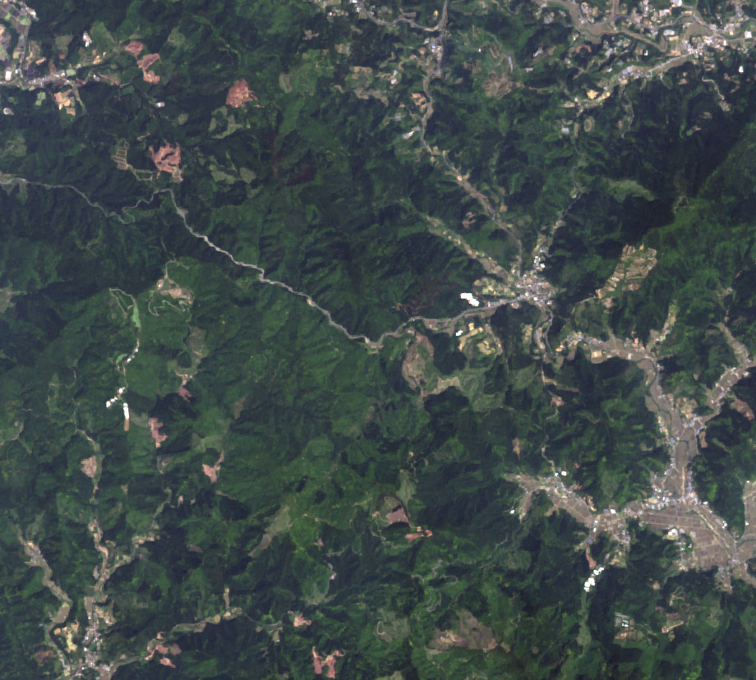
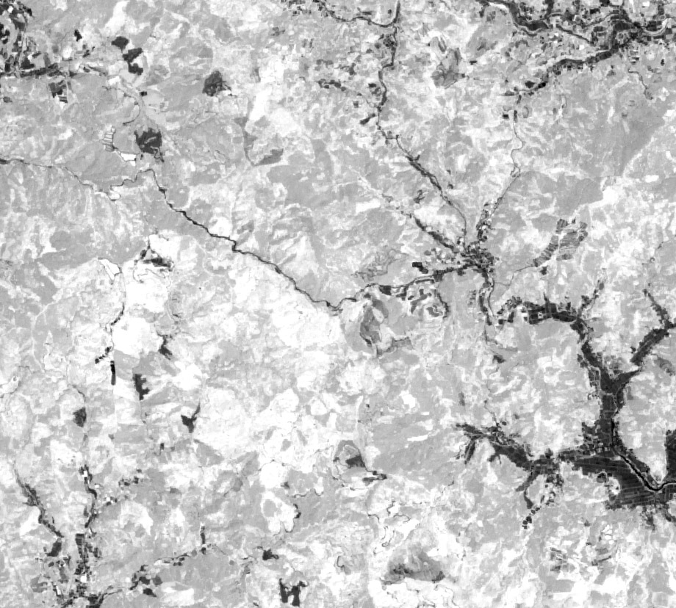
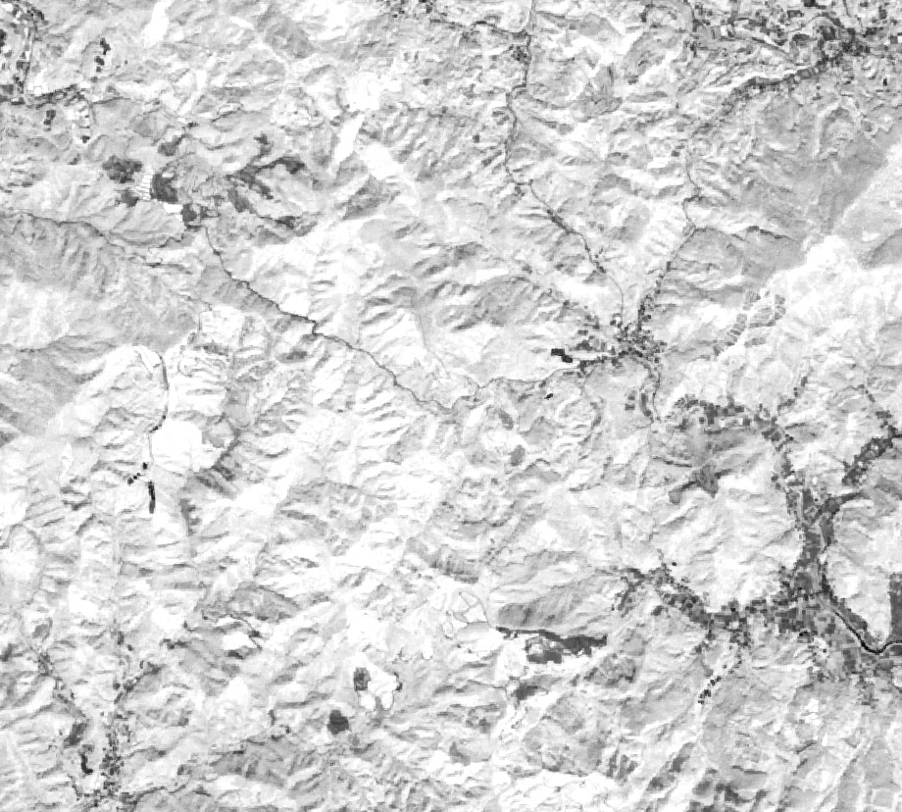
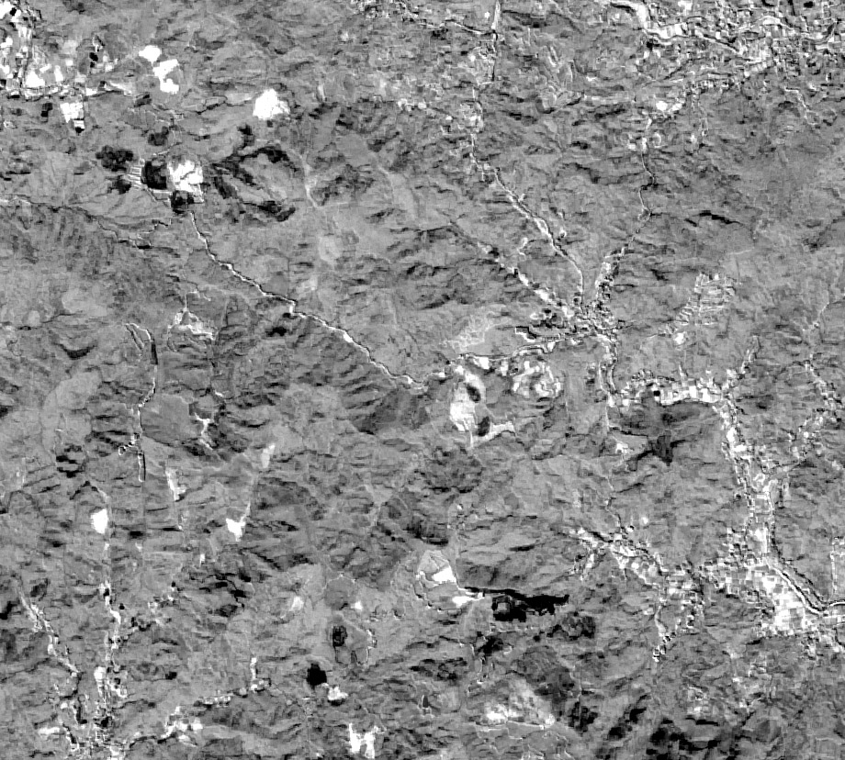
ALOS AVNIR-2 ORI Dataset
2010年観測画像
2009年植生指標画像
2010年植生指標画像
植生指標変化画像
2009年観測画像
2009年観測画像
AVINIR-2画像の変化
森林伐採の検出

Slide 9
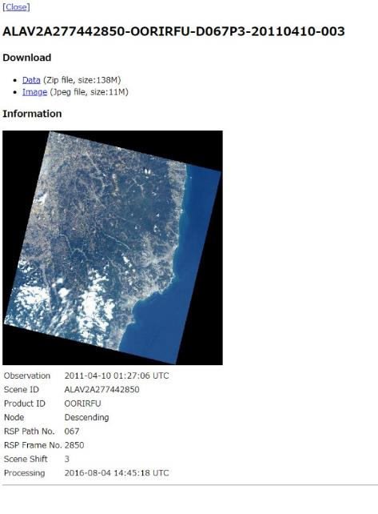
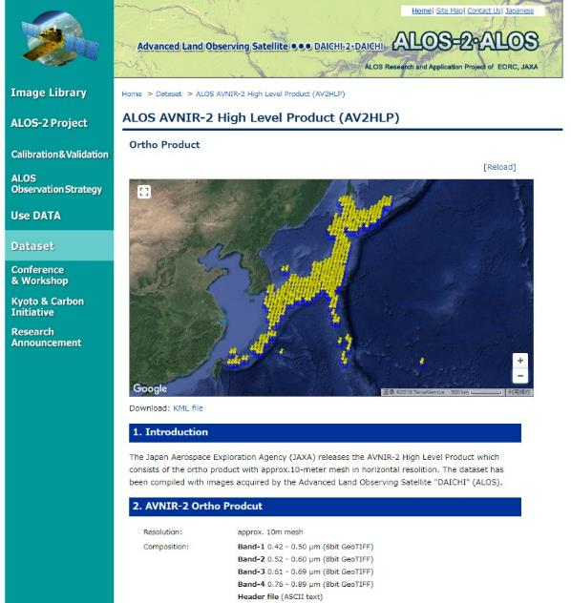
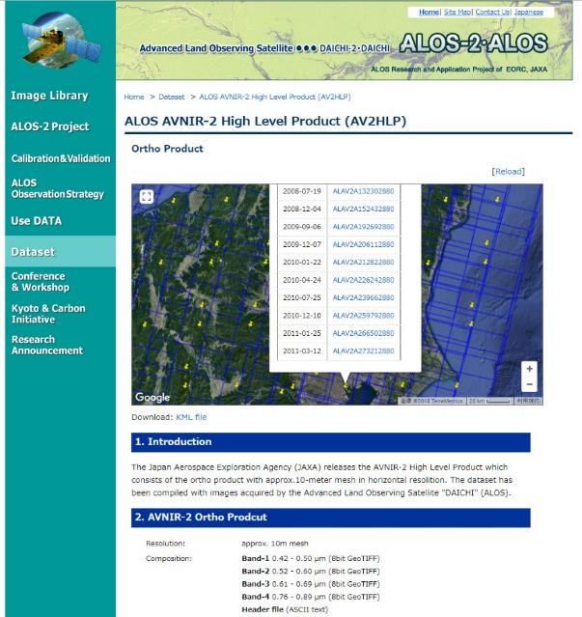
ALOS AVNIR-2 ORI Dataset
Download site on JAXA EORC web http://www.eorc.jaxa.jp/ALOS/en/alos-ori/index.html

Slide 10
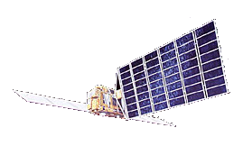
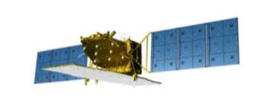
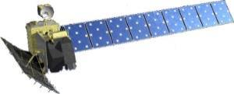
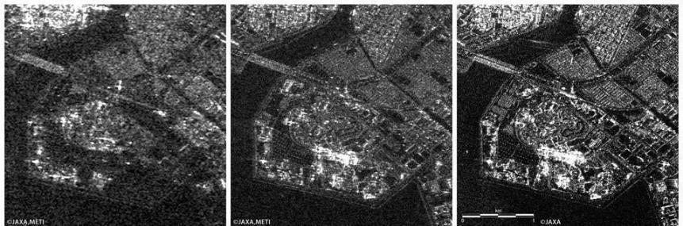
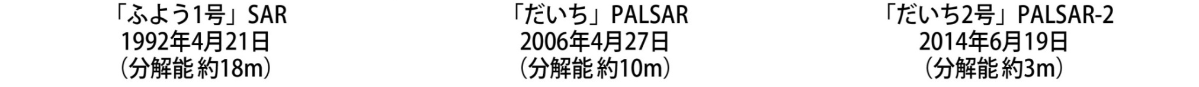
History of Japanese L-band SARs
JERS-1 SAR
1992 - 1998
ALOS PALSAR
2006 - 2011
ALOS-2 PALSAR-2
2014 -
Transmit power:
~1.5 kW
~2 kW
~6.1 kW
Resolution:
18 m
10 m / 100 m
3 m / 100 m
Swath width:
75 km
70 km / 350 km
50 km / 490 km
Polarization:
Single
Single, Dual, Quad
Single, Dual, Quad
Obs. direction:
Right
Right
Right or Left

Slide 11
JAXA’s SAR ARD Productions
Pre-processing (Multiple path processing):
SLC generation, Ortho-rectification+
Slope correction
Multiple raw data
DEM preparation
Multiple ortho generations
Mosaic (processing)
One examples for generating a mosaic image
Flowchart of producing a mosaic product.

Slide 12
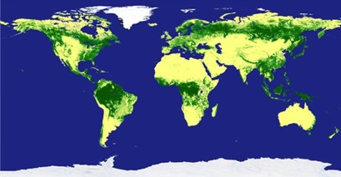
JAXA’s SAR ARD Productions
Download: JAXA’s SAR ARD (analysis ready Data), available from the web site:
http://www.eorc.jaxa.jp/ALOS/en/palsar_fnf/fnf_index.htm
Contents:
  Satellite: JERS-1/SAR (1996), ALOS/PALSAR (2007-2010), and ALOS-2/ PALSAR-2 (2015-)
  Frequency: Annual summer data (June-September)
  Data: gamma-zero image and forest/non-forest (FNF), ancillary data (local incidence, mask, etc.), spaced in 0.8 arcsec (approx. 25 m) and averaged in 100 m, ortho-rectified, and slope corrected
  Geometric accuracy: 10 m
  Expression: 2 byte data (unsigned short integer) for amplitude image
  Area: Global Land
  Download unit: 1 x 1 deg. or 5 x 5
  degrees in lat/long unit
Access:
  Free of charge
  E-mail registered

Slide 13
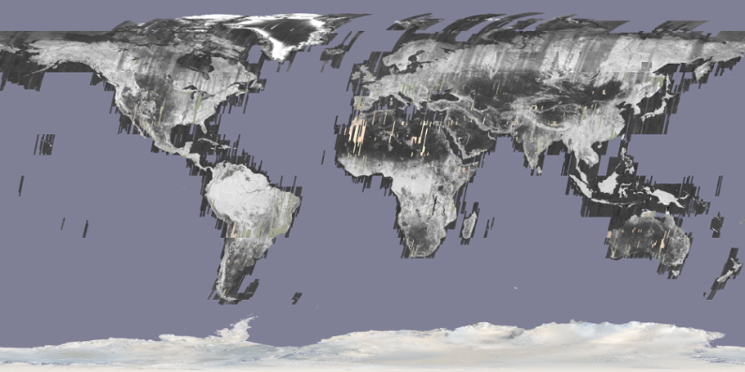
JAXA’s SAR ARD Productions
JERS-1 25 m global mosaic dataset (HH): 1992 - 1998

Slide 14
JAXA’s SAR ARD Productions
ALOS PALSAR 25 m global mosaic dataset (HH, HV): 2007 - 2010
Global 25 m mosaic (Ortho+slope correction)
Global 25m Forest/non-forest map

Slide 15
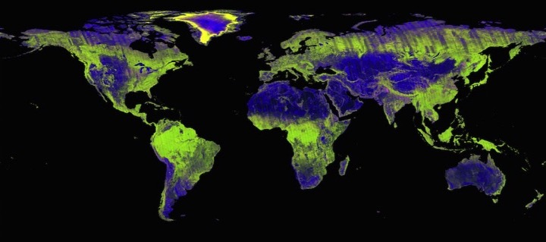
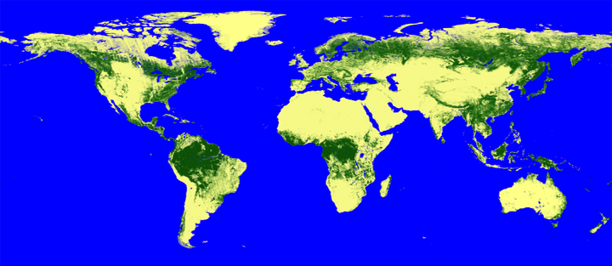
JAXA’s SAR ARD Productions
ALOS-2 PALSAR-2 25 m global mosaic dataset (HH, HV): 2015 -
Global 25 m mosaic (Ortho+slope correction)
Global 25m Forest/non-forest map

Slide 16
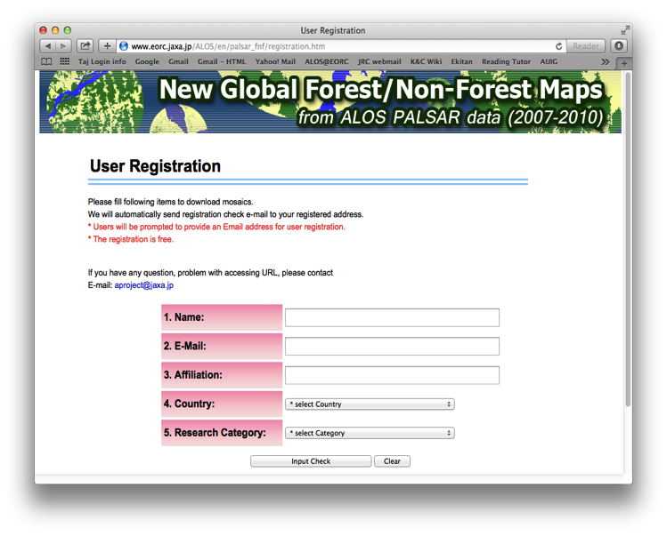
JAXA’s SAR ARD Productions
Online registration for download : JERS-1, ALOS PALSAR, ALOS-2 PALSAR-2 25 m global mosaic datasets open release:
http://www.eorc.jaxa.jp/ALOS/en/palsar_fnf/registration.htm
User ID and Password are sent to registored e-mail address automatically

Slide 17
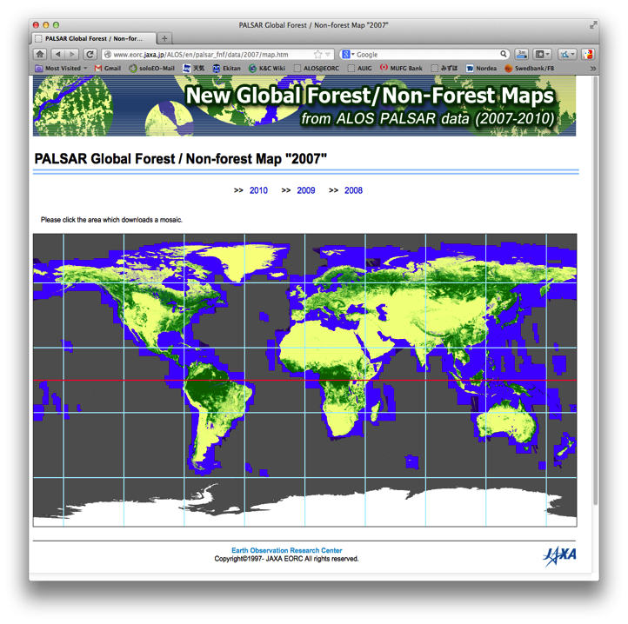
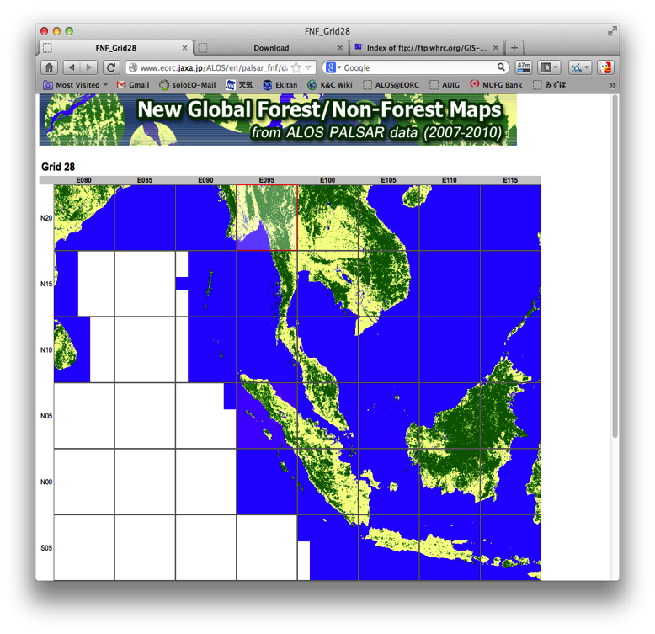
JAXA’s SAR ARD Productions
Browse of FNF can be confirmed after login and select preferred dataset:

Slide 18
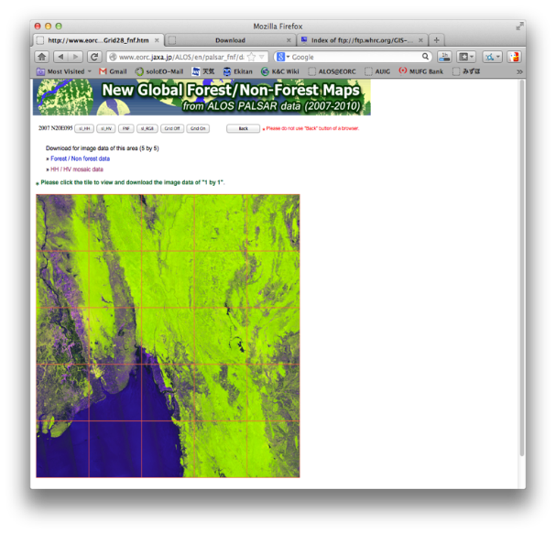
JAXA’s SAR ARD Productions
Download the dataset in 5 x 5 degrees or individual 1 x 1 deg. tile:
Bulk download of data
over 5 x 5 degrees region (25 tiles)
Click on a tile in the grid to download the individual 1 x 1 deg tile

Slide 19
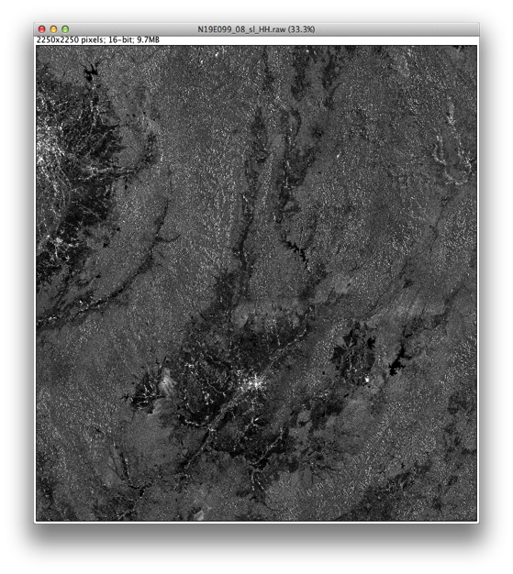
Contents of SAR ARD
PALSAR, PALSAR-2, and JERS-1 25 m global mosaic dataset:
Backscatter image (HH)
Radar backscatter, normalised for incidence angle ( γº = σº/cosθ_{i} )
Radiometric and geometric corrections for topography
16 bits (Unsigned INT)
ENVI header information

Slide 20
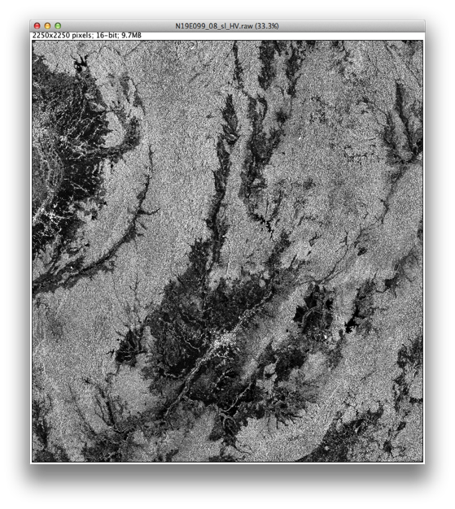
Contents of SAR ARD
PALSAR and PALSAR-2 25 m global mosaic dataset:
Backscatter image (HV)
Radar backscatter, normalised for incidence angle ( γº = σº/cosθ_{i} )
Radiometric and geometric corrections for topography
16 bits (Unsigned INT)
ENVI header information

Slide 21
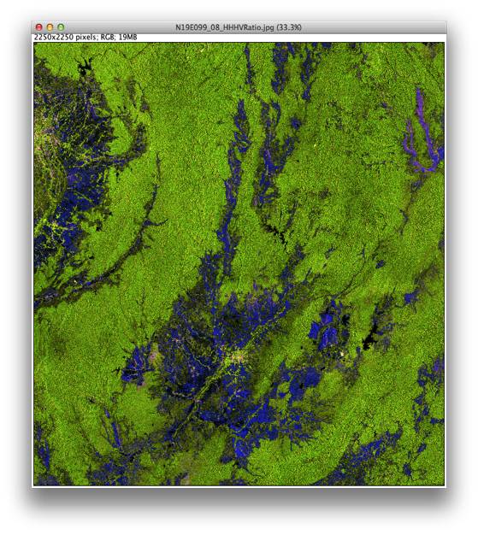
Contents of SAR ARD
PALSAR and PALSAR-2 25 m global mosaic dataset:
Backscatter image
Faulse color composite
R: HH
G: HV
B: HH/HV

Slide 22
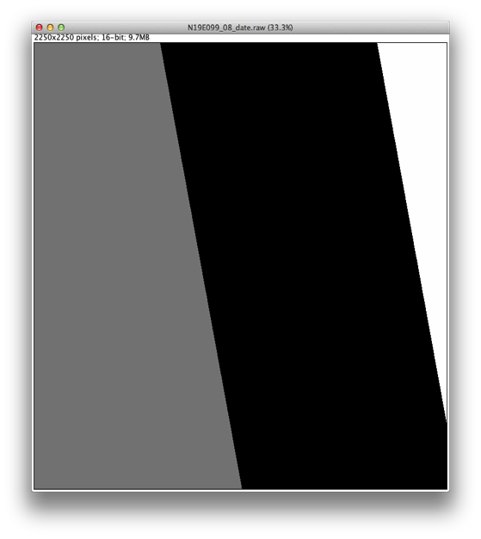
Contents of SAR ARD
PALSAR, PALSAR-2, and JERS-1 25 m global mosaic dataset:
Observation date layer
Data layer showing the acquisition date for each pixel in the image
Date = [Launch date] + DN
11/2/1992 for JERS-1,
24/1/2006 for ALOS, and
24/5/2014 for ALOS-2
16 bits (Unsigned INT)
DN=975
25/09/2008
DN=917
29/07/2008
DN=854
27/05/2008

Slide 23
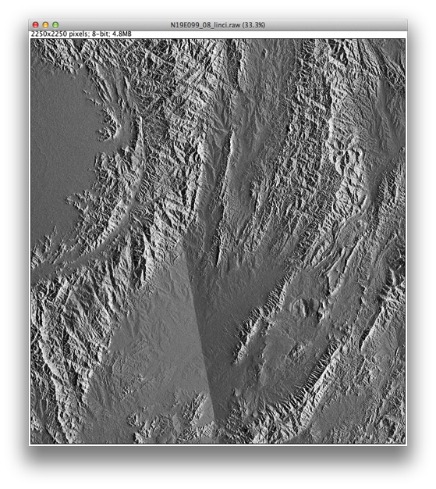
Contents of SAR ARD
PALSAR, PALSAR-2, and JERS-1 25 m global mosaic dataset:
Incidence angle layer
Layer with local incidence angle for each pixel
8 bits

Slide 24

Contents of SAR ARD
PALSAR, PALSAR-2, and JERS-1 25 m global mosaic dataset:
Mask information layer
Ocean and no-data areas: layover and shadow
8 bits

Slide 25
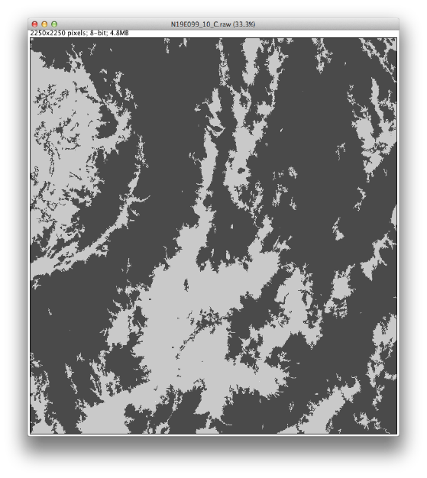
Contents of SAR ARD
PALSAR and PALSAR-2 25 m global mosaic dataset:
Forest and Non-Forest Classification
8 bits

Slide 26
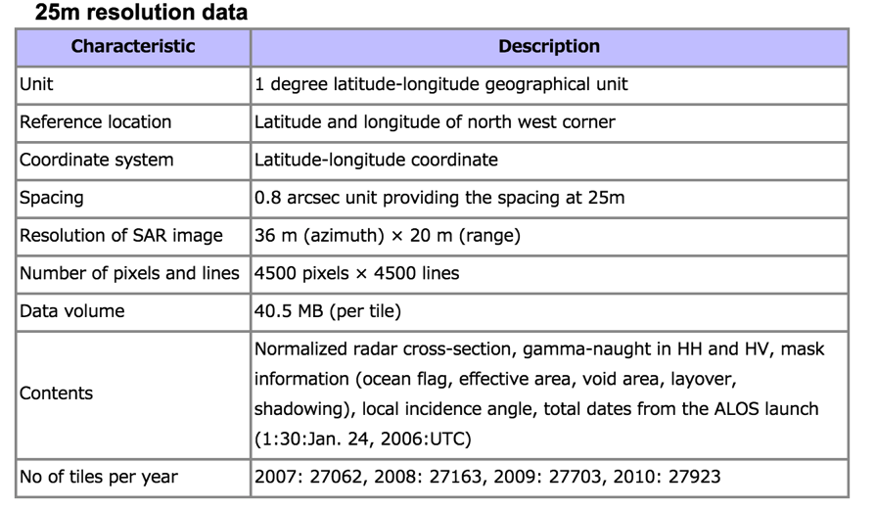
Contents of SAR ARD
PALSAR, PALSAR-2, and JERS-1 25 m global mosaic dataset:
Specifications and ancillary information (for PALSAR)

Slide 27
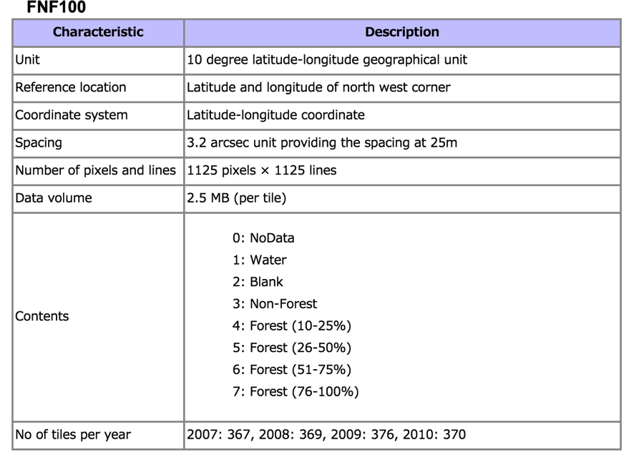
Contents of SAR ARD
PALSAR, PALSAR-2, and JERS-1 25 m global mosaic dataset:
Specifications and ancillary information (for PALSAR)

Slide 28
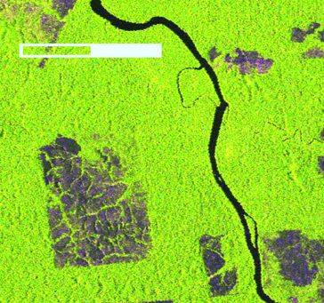
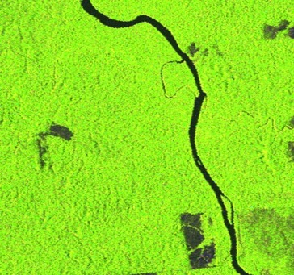
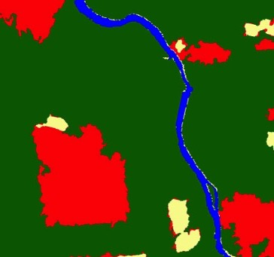
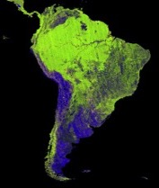
FNF Spatial and Temporal Change
0 5km
●: Forest
●: Non-Forest
●: Deforestation
●: Reforestation
PALSAR-2 2015
PALSAR 2010
South America
(Brazil)
FNF change 2015-2010

Slide 29
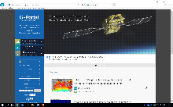
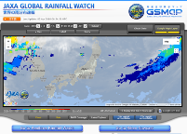
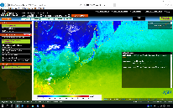
JAXA’s Open and Free EO Data and Services
 | Portal Name and URL
 | G-Portal R (*) Provides products of GPM, GCOM-W, GCOM-C(**), GOSAT, and Past Satellites and Sensors (MOS-1/1b, JERS-1, ADEOS, ADEOS-II, Aqua/AMSR-E, TRMM/PR) https://gportal.jaxa.jp/gpr/ * Will be fully operational in July 2018 ** GCOM-C products will be released publicly in December 2018
 | GSMaP: Global Satellite Mapping of Precipitation Provides hourly Global Rainfall Map in Near-Real-Time (GSMaP_NRT), available four hours after observation. (GPM-Core GMI, TRMM TMI, GCOM-W1 AMSR2, DMSP series SSMIS, NOAA series AMSU, MetOp series AMSU, and Geostationary IR) http://sharaku.eorc.jaxa.jp/GSMaP/index.htm
 | JASMES: JAXA Satellite Monitoring for Environmental Studies Provides users with not only satellite datasets but also information on the current status of the climate variables such as solar radiation reaching the earth's surface (photosynthetically available radiation), cloudiness, snow and sea ice cover, dryness of vegetation (water stress trend), soil moisture, wild fire, precipitation, land and sea surface temperature. http://www.eorc.jaxa.jp/JASMES/index_map.html
Carbon & GHG Initiative
GEOGLOWS

Slide 30




JAXA’s Open and Free EO Data and Services
 | Portal Name and URL
 | JJ-FAST: JICA-JAXA Forest Early Warning System in the Tropics Web-based system using JAXA’s ALOS-2 to monitor tropical forests in 77 countries every 1.5 months and release deforestation data, even in the rainy season. Users can easily access the data for deforested areas from PCs and mobile devices and download the data. http://www.eorc.jaxa.jp/jjfast/
 | JASMIN: JAxa's Satellite based MonItoring Network system for FAO AMIS Market Monitor Provides the latest conditions of precipitation, soil moisture, solar radiation etc. Concerning various agrometeorological information data items, current conditions and the difference from average year conditions can be comprehensively assessed. http://suzaku.eorc.jaxa.jp/JASMIN/index.html
 | GDAS: GOSAT Data Archive Service (Operated by National Institute for Environmental Studies) Provides GOSAT products (Methane and CO2). https://data2.gosat.nies.go.jp/gallery/L4B/concmov/concmov.html
GFOI
GEOGLAM

Slide 31





JAXA’s Open & Free ALOS/ALOS-2 Products
 | Products and URL
 | K&C Mosaic Homepage 1) PALSAR 50m Orthorectified Mosaic Product. 2) PALSAR 500m Browse Mosaic Product. http://www.eorc.jaxa.jp/ALOS/en/kc_mosaic/kc_mosaic.htm
 | Global PALSAR-2/PALSAR/JERS-1 Mosaic and Forest/Non-Forest map Global 25m-resolution mosaic using ALOS-2 PALSAR-2, ALOS PALSAR, and JERS-1 SAR images and global forest/non-forest map. http://www.eorc.jaxa.jp/ALOS/en/palsar_fnf/fnf_index.htm
 | High Resolution Land-Use and Land-Cover Map The High Resolution Land-Use and Land-Cover Map generated using mainly AVNIR-2 in Japan. http://www.eorc.jaxa.jp/ALOS/lulc/lulc_jindex.htm
 | ALOS Global Digital Surface Model "ALOS World 3D - 30m" Global digital surface model (DSM) dataset with a horizontal resolution of approx. 30-meter mesh (1 arcsec) . http://www.eorc.jaxa.jp/ALOS/en/aw3d/index_e.htm
 | ALOS Ortho Rectified Image Product (ALOS-ORI) ALOS/AVNIR-2 ORI products with approx.10-meter mesh in horizontal resolution. The dataset of the Japanese islands is released. http://www.eorc.jaxa.jp/ALOS/en/alos-ori/index.html
* High resolution data is provided by commercial distributors with commercial value. ALOS-2: PASCO (http://en.alos-pasco.com/) ALOS World 3D (5m resolution): NTT DATA and RESTEC (http://aw3d.jp/en/index.html)
GFOI
GFOI
GFOI
Carbon & GHG Initiative

Slide 32
Engaging to data partners
JAXA users
(Pis, Institutes, Agencies)
International
Data Partners
Platforms
JAXA
Next Generation
G-Portal
JAXA One-Stop Access Point to all EO data assets
Domestic
Data Partners
Platforms
IT Giants

Slide 33
Thank you

