Slide 1
Open Data Cubes Cloud Services Experiences and Lessons Learned
Future Data Architectures Big Data Workshop
April 26, 2018
Brian Killough
CEOS Systems Engineering Office
NASA Langley Research Center

Slide 2
Amazon Web Services (AWS)
Since 2016, the SEO has been using annual AWS research credits (~$25,000 per year) to support global Data Cube prototypes and investigate improved approaches for cloud-based analyses.
The SEO uses a combination of S3 storage and EC2 processing instances to support our online Data Cube user interface tool (tinyurl.com/datacubeui), prepare datasets (ingestion) and run application analyses. The performance has been excellent!
The Data Cube initiative is interacting with over 40 countries. Many of those countries (~10) desire to use cloud-based storage and computing, to reduce operational costs and enhance analysis performance.
Lessons Learned ... Storage is cheap (~$270/TB/year), egress (in/out) can be costly for large volumes and frequent moves ... processing and analysis is the primary cost.

Slide 3
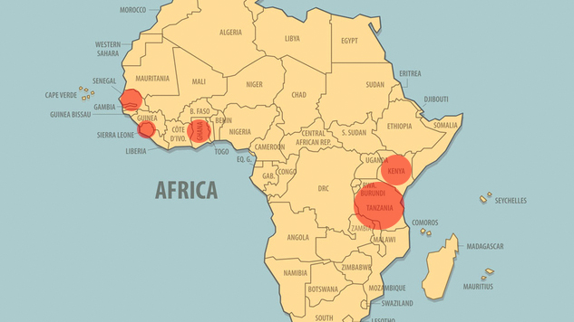
Africa Regional Data Cube
Ghana, Kenya, Senegal, Sierra Leone, Tanzania

Slide 4
Africa Regional Data Cube Operational Model
Strathmore
University (Nairobi, Kenya)
Amazon Web Services (AWS) Cloud
S3 Data Storage
(13 to 23 TB)
EC2 Computing
* Data Cube management, new data ingestion, web-based user interface
* Managed by Strathmore
Landsat 7/8
Sentinel-1
Sentinel-2 (year 2)
Kenya
Sierra Leone
Senegal
Ghana
Tanzania
Each country has its own EC2 Computing “instance” for analysis purposes (User Interface and Jupyter Notebooks), but S3 data storage is shared among countries in the AWS cloud

Slide 5
AWS Plans for 2018
Develop a "data cube on demand" function using hosted AWS datasets
Test the use of on-demand "spot" processing and analysis
Test the use of Lambda functions for finding new datasets to ingest into data cubes and running rapid queries
Test how EC2 instance performance scales with multiple data cube users
Test elastic load balancing for horizontal scaling of EC2 instances
Test AWS "Workspaces" to host QGIS and Jupyter Notebooks
Test the use of "docker containers" for on-demand computing instances
Explore the use of QGIS to read data cube content directly from S3

Slide 6
Google Earth Engine (GEE)
The Google Earth Engine system is similar to a Data Cube and allows users to interact with satellite data without data downloads
The Data Cube team has been working with the GEE team to investigate approaches to use their satellite datasets and take advantage of the large community of user algorithms
Google sees the Open Data Cube as the “ground based” implementation of their cloud-based solution since there is no good method to supply GEE data to users that desire local deployments.
One example ... We have developed a process to generate a Sentinel-1 data cube “on demand” using the GEE level-2 intensity data (gamma nought) for any location in the world. GEE is the only known source of level-2 global pre-processed S1 data. Data Cubes can be created at a country size scale within 1 day. This has been demonstrated for Colombia, Switzerland, and Samoa Island.

Slide 7
Why not use GEE versus the Open Data Cube?
PROS
Free, open, global datasets (e.g. Landsat, MODIS, Sentinel-1, Sentinel-2)
Powerful analysis tools using Javascript and Python
CONS
Commercial dependency ... Will it be sustained for the future?
Limited time and spatial scales for analyses
Cloud-based computing only ... No options for local computing solutions. Users go to the data for analyses and downloads are not encouraged.
Google “owns” all of the data. Some users prefer control and ownership or source data and results.
Missing datasets .. You get what Google offers. Datasets such as ALOS, CBERS, and SPOT are not included.
Difficulty using multiple interoperable datasets (space or ground), as they may not be available or not prepared in common grid formats.
Does not allow commericial or private use

Slide 8
Conclusions and thoughts ...
There is a significant global trend toward the use of cloud-based storage and processing. Due to large data volumes, we need to find ways to avoid downloads and perform analyses near the data.
Cloud-based solutions can be significantly cheaper and demonstrate better performance over local computing systems (but not always).
We are currently using AWS and GEE for our cloud service testing, but we are open to other options, such as DIAS. The Open Data Cube can be deployed on any cloud platform. We DO NOT want to be “locked in” to specific cloud system vendors.
We need to find solutions that produce ARD in the cloud and produce data cubes in the cloud. Egress of large data volumes is costly and inefficient.
We are all comfortable with cloud computing, but much of the world still wants the data locally.

