Slide 1



Recent update on EUMETSAT
Alain Ratier, Director-General

Slide 2

MSG-3 Launch
Successful launch of MSG-3 on 5 July (Ariane 5 ECA)
Following nominal LEOP, EUMETSAT took control of MSG-3 from ESA/ESOC on 16 July and moved the satellite to its commissioning longitude at 3.4 W
MSG-3 commissioning is ongoing l
    First SEVIRI and GERB images on 7 & 10 August, respectively
    Trial dissemination started end September 2012
    Commissioning Results Review in December
  MSG-3 will then be renamed Meteosat 10 and be moved to 0°

Slide 3
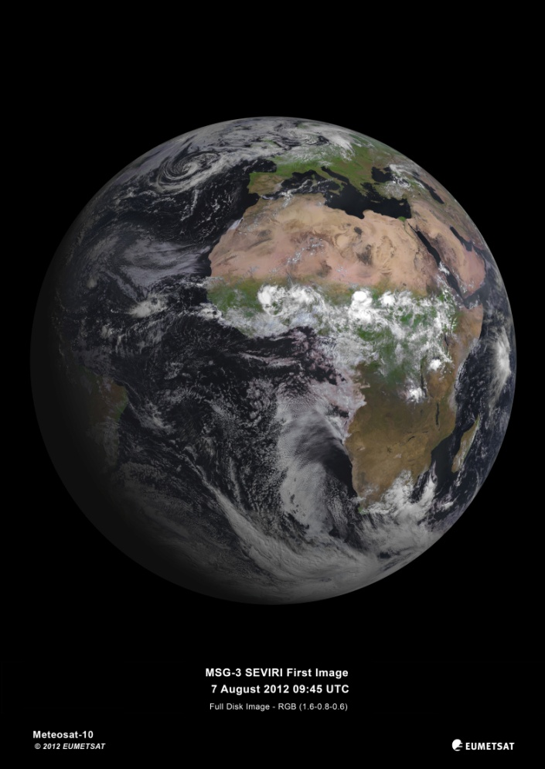
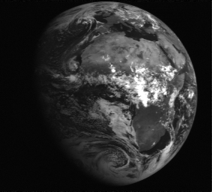
MSG-3 first images (SEVIRI & GERB)
OLD – STG/AFG
07 August 2012: First SEVIRI Image
10 August 2012: First GERB Image

Slide 4
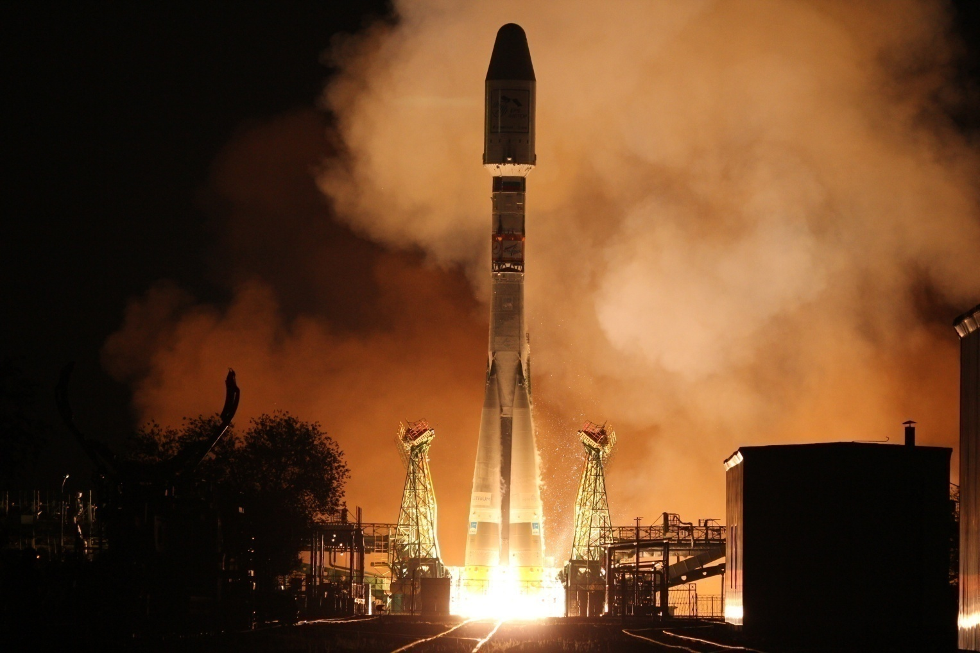
Metop-B Launch
OLD – STG/AFG

Slide 5
Metop-B Launch
Successful launch of Metop-B on 17 September (Soyuz 2.1 a)
Following nominal LEOP, EUMETSAT took control of Metop-B from ESA/ESOC on 20 September and started commissioning
Satellite In Orbit Verification (SIOV) status:
  All instruments switched on, first data acquired for all (IASI on 23 October)
  Trial dissemination of Level 1 products started
  Investigation on antenna shared by ARGOS-DCS & Search & Rescue
  SIOV expected to be completed in November
Commissioning will continue until February 2013, with staggered release of products

Slide 6
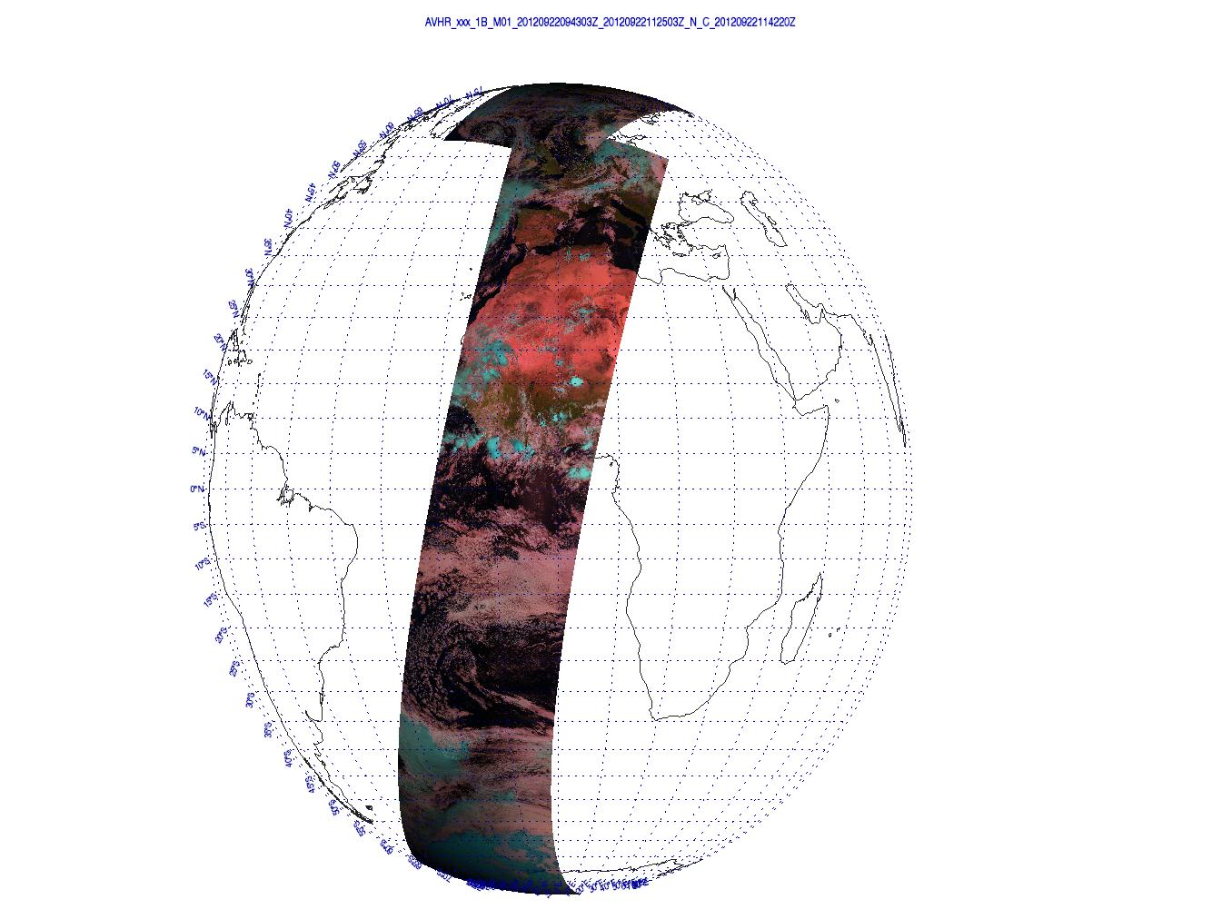
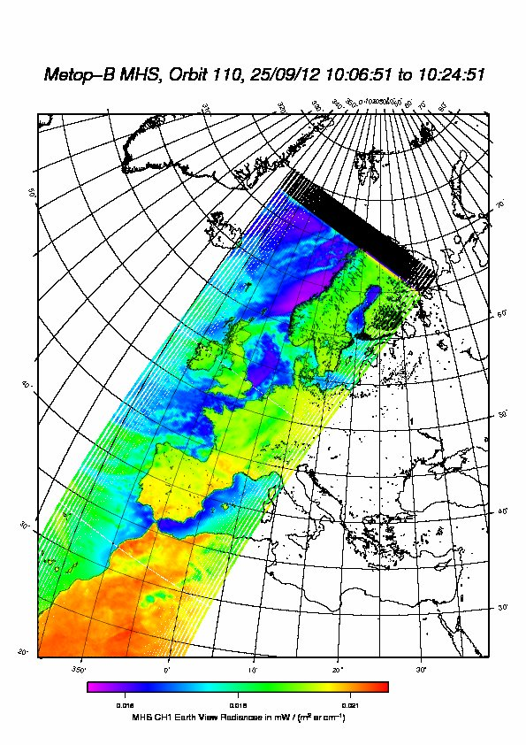
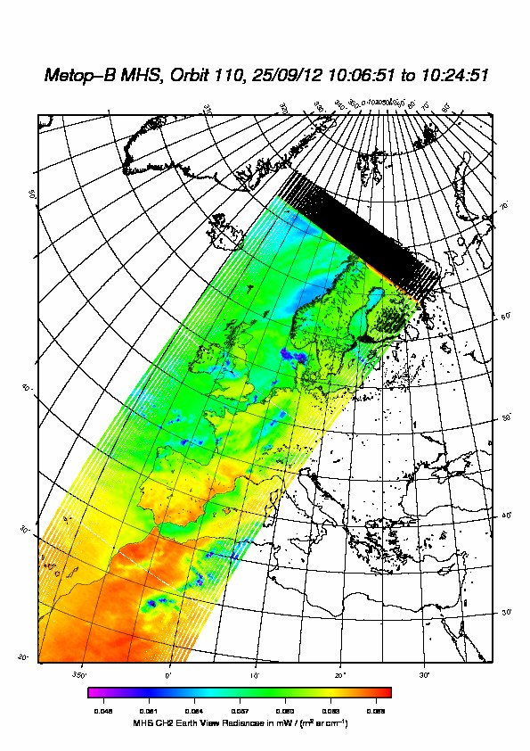
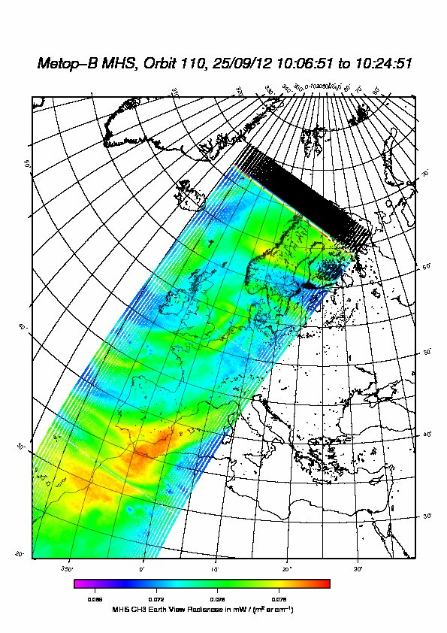
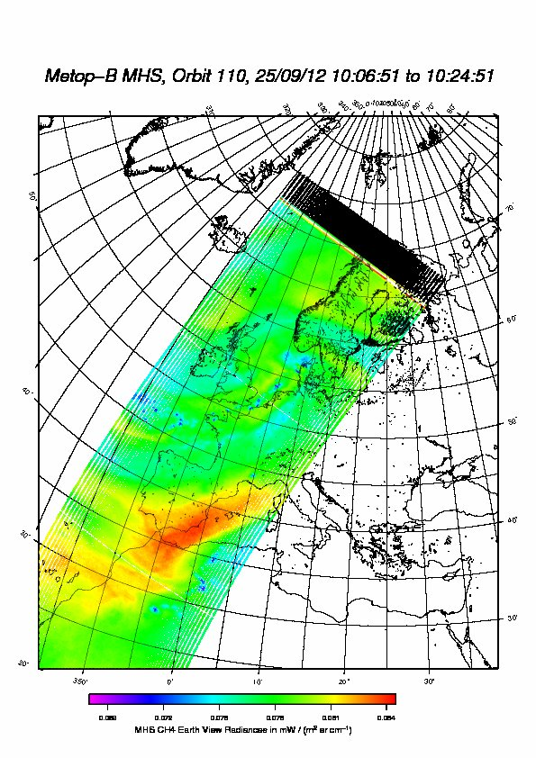
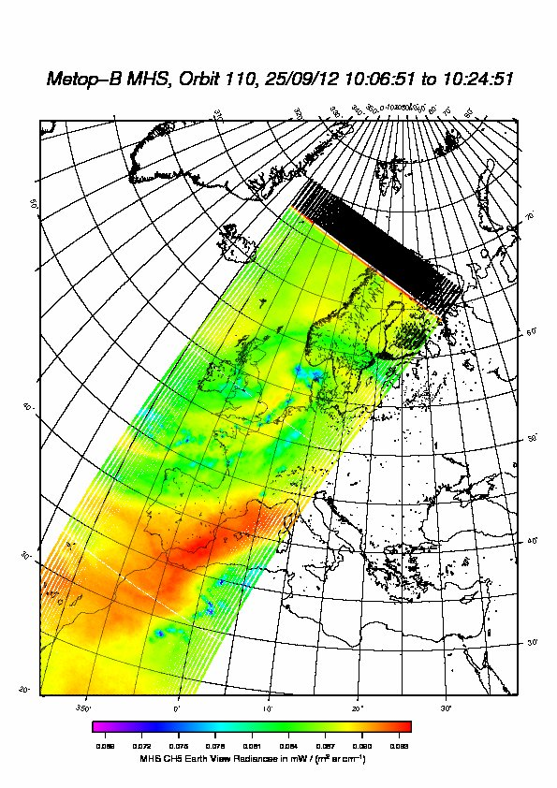
Metop-B first images
22 September : First full orbit AVHRR
MHS Channels 1 to 5

Slide 7
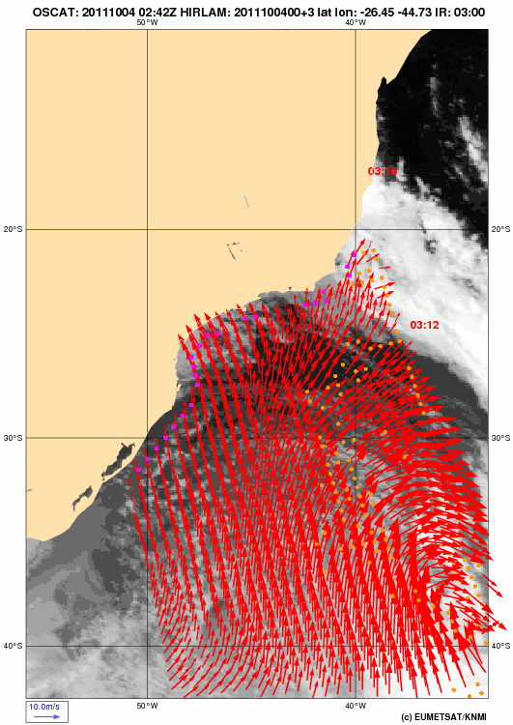
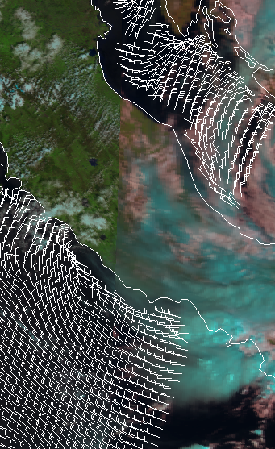
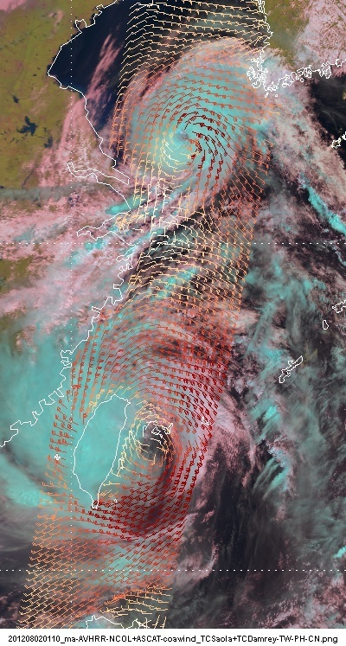


Scatterometer winds: Metop and Oceansat-2
ASCAT Coastal
ASCAT
OSCAT
Service declared fully operational on 25 October 2012

Slide 8
Scatterometer winds: Metop and Oceansat-2
ASCAT Coastal
ASCAT
OSCAT

Slide 9

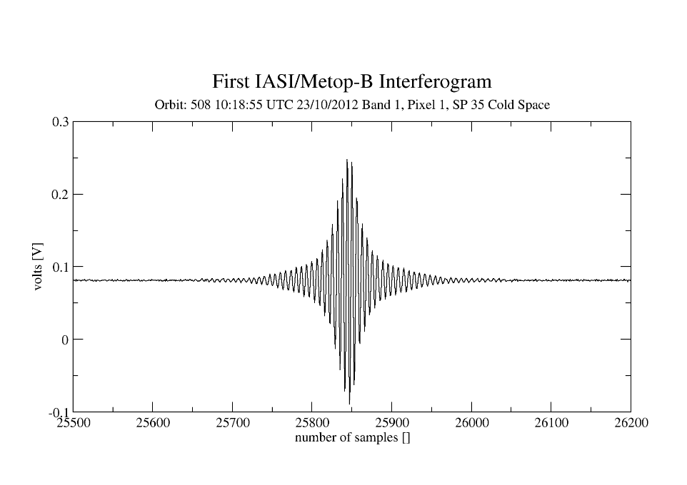
Metop-B first IASI Interferogram
23 October 2012

Slide 10

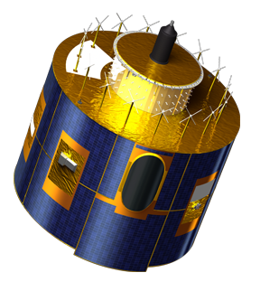
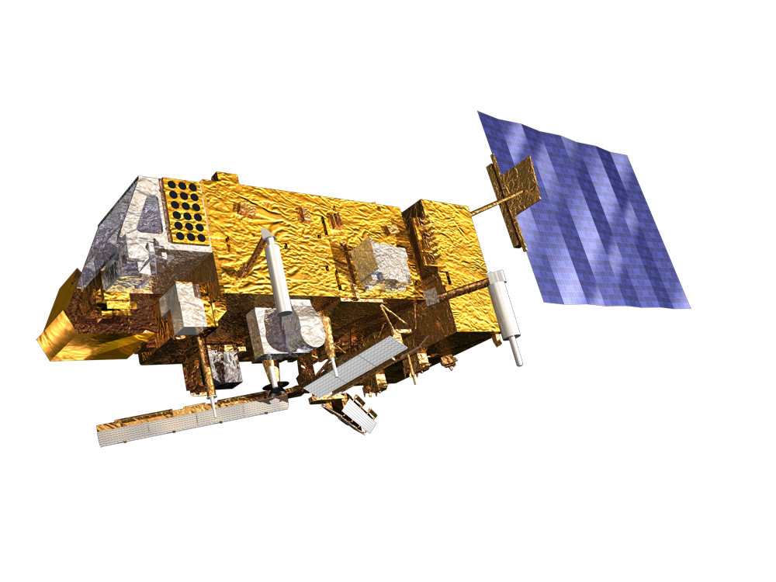
Near Future
Jason-3 launch (with CNES, NOAA and NASA) end 2014
EUMETSAT will operate GMES Sentinel-3 (Marine Mission) after commissioning by ESA, end 2014
MSG-4 launch early 2015 (for in orbit storage)
  Metop-C launch planned in Feb 2018 (TBC)
Sentinel-3

Slide 11
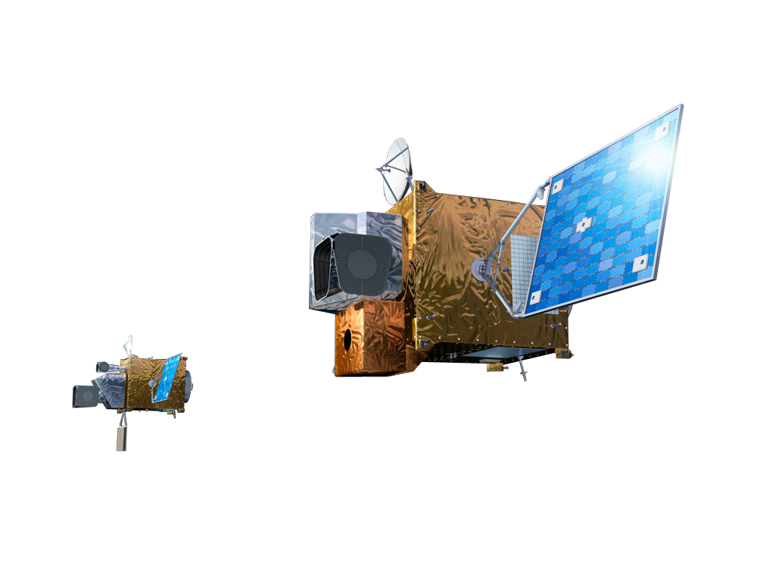
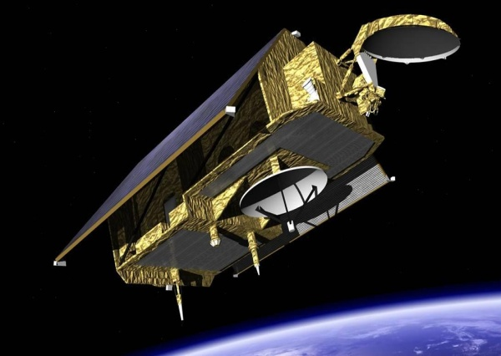
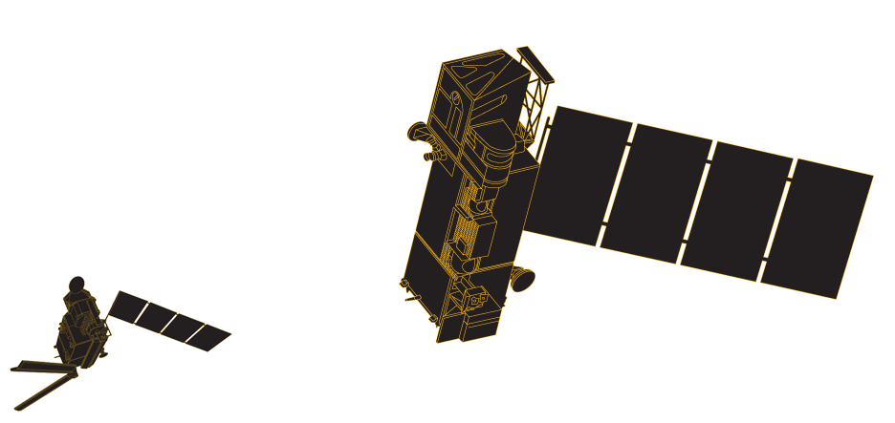
Future : 2018 - 2040
MTG: Approved
Jason-CS : Planned
EPS-SG : planned

Slide 12

IOCCG, NASA and EUMETSAT will host the first meeting of the International Ocean Colour Science group in 2013 ...
Register on ... http://iocs.ioccg.org
(as of 1 November 2012)
6-8 May 2013
Darmstadt, Germany

