Slide 1


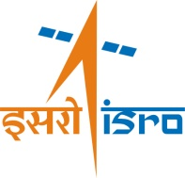
ISRO’s Earth Observation System
PG Diwakar

Slide 2

Earth Observation System: Components
EO Applications
EO Data Acquisition
Data Processing & Dissemination
Products & Services
Applications
Ground Segments
Natural Resources
Cartography
Disaster Management support
Environmental monitoring
Ocean & Atmos. studies
Spacecraft Control
Payload Programming
Data Acquisition & processing
Satellites, Sensors, Techniques
Users
Cent./ State Govts
Researcher/ Academia
Private/ Industry
International
Institutionalization
MoES MoEF
MoA MoWR
MRD DST
DIP, GIS, GPS, DSS, Photogrammetry,
Value Added Services
Modelling/ Simulations
Multi-sensor Products
Visualisation
Standard Products
Value added products
Data Archival
Free data downoad
Satellite Data Products
…in sync with country’s priorities…
Enabling Techniques

Slide 3
India EO Satellites - Scenario by 2017

Slide 4
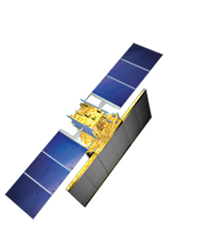
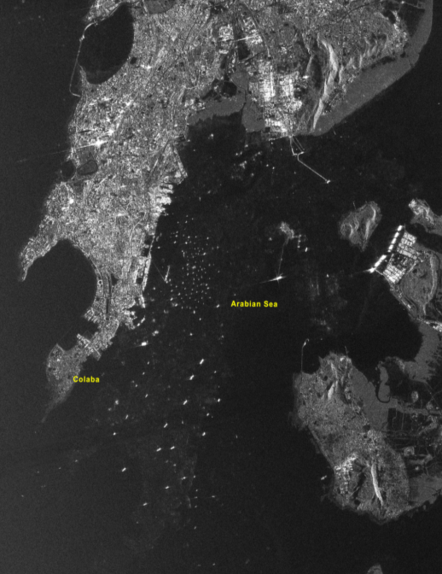
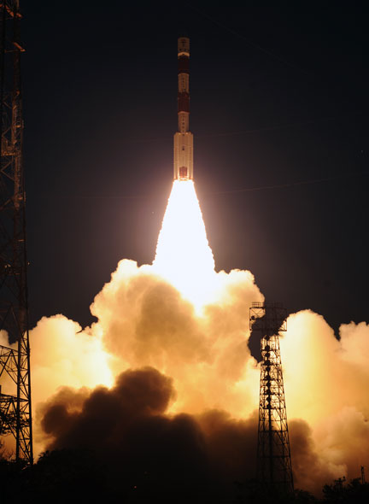
ISRO EO Satellite since last Plenary
RISAT-1
C band SAR 5.35 GHz frequency;
5 imaging modes
Single, dual & quad polarisation modes
For applications in agriculture, soil moisture, flood & water spread, geology, snow & glaciers, forest, topography & oceanography.
Imaging modes * | FRS-1 | FRS-2 | FRS-2 | MRS | CRS
Slant Range Resolution | 3m | 6m | 9m | 25m | 50m
Swath/Spot (km) | 25 | 25 | 25 | 115 | 223
Polarisation | Linear/ Dual/ Polarimetry | Polarimetry | Quad | Linear/ Dual/ Polarimetry | Linear/ Dual/ Polarimetry
April 26, 2012

Slide 5
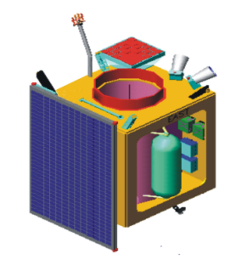
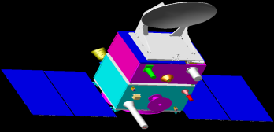
EO – Future Satellites
SARAL
Satellite with ARgos and ALtika
- Joint ISRO-CNES Mission
GISAT
Multiple acquisition capability from a Geosynchronous Orbit
Payloads
High resolution multi-spectral VNIR (HRMX-VNIR): 50m Res.
Hyper spectral VNIR & SWIR: 320m and 192m Res.
High resolution Multi-spectral (HRMX-TIR): 1.5km Res.
Payloads
Ka-band Altimeter (~35.5GHz)
Dual freq Radiometer (23.8/36.8 GHz
Status
Launch by PSLV in December 2012
Status
Launch by PSLV during 2016-17
Resourcesat-2A
INSAT - 3D
For improved understanding of weather systems
Land and Water Resources Applications – Continuity Mission
Payloads
19 channel Sounder
6 Channel Imager
Payloads
LISS IV Mx, LISS III and AWiFS
Status
Launch by 2013
Status
Launch by PSLV during 2015-16

Slide 6
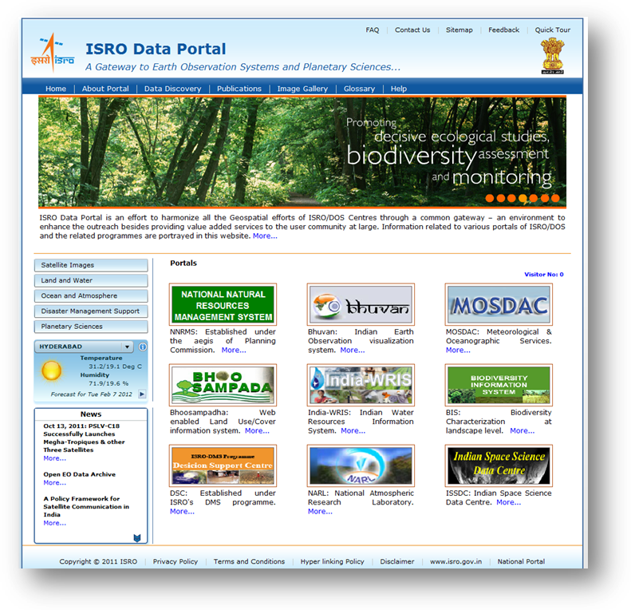
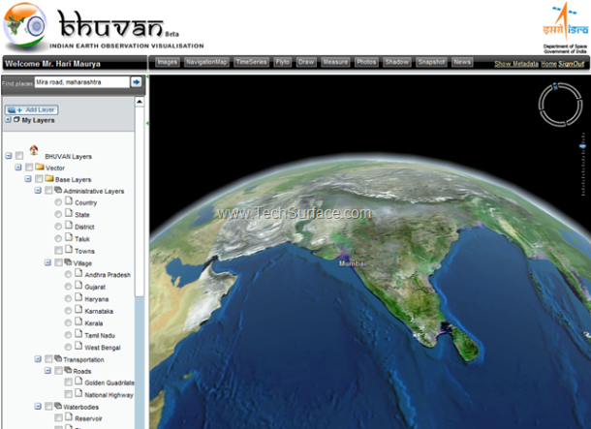
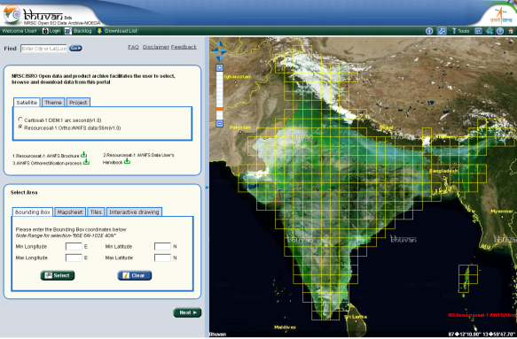
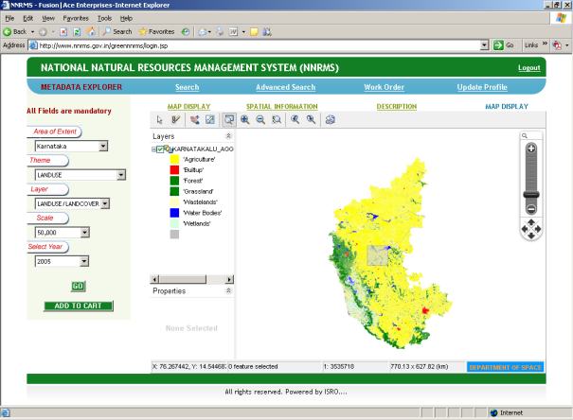
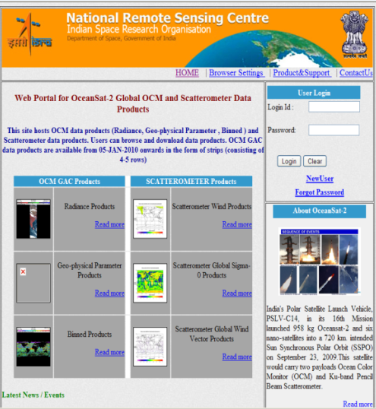
EO - Information Services
Bhuvan
NRSC EO Open Data Archive
www.dataportal.isro.gov.in
Natural Resources Database
Water Resource Information
www.nrsc.gov.in

Slide 7
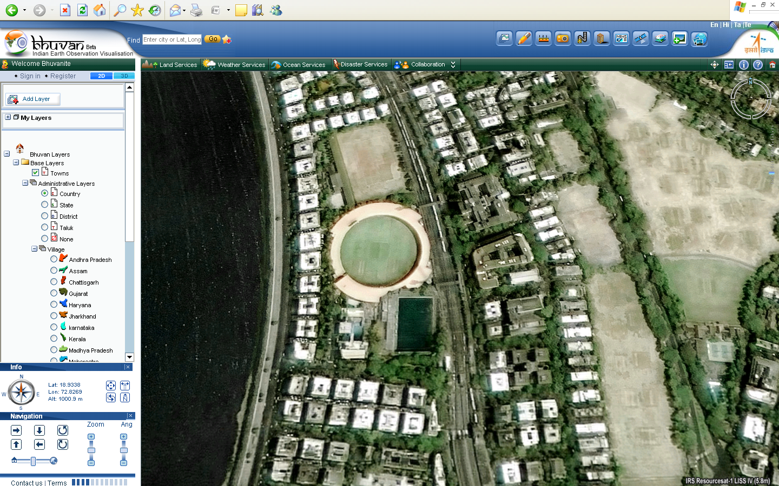
Bhuvan Portal Service – Medium for Outreach
ThankYou

