Slide 1
GEO Blue Planet
Agenda item: 16
Espen Volden, GEO Secretariat
Kerry Ann Sawyer, CEOS Executive Officer

Slide 2
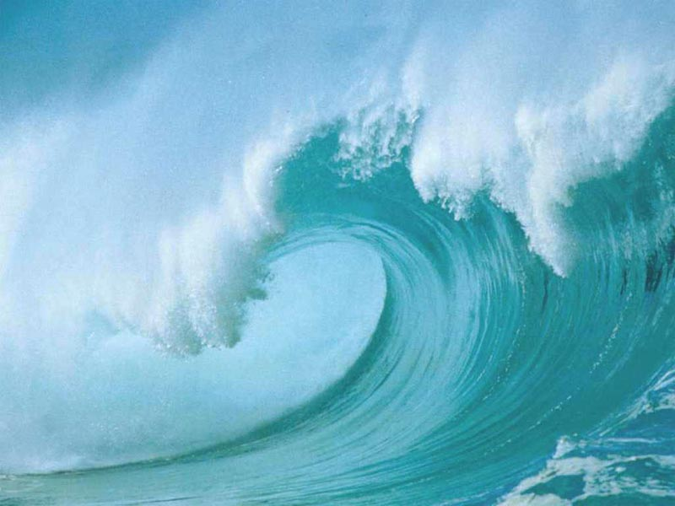
Notes:
There is no Ocean SBA, although oceans play a role in all nine SBAs (ex., ocean observations are critical for monitoring climate variability and change (Climate); ocean observations help improve predictions of longer-range weather forecasts (Weather); ocean observations are important in managing fisheries (Agriculture).

Slide 3
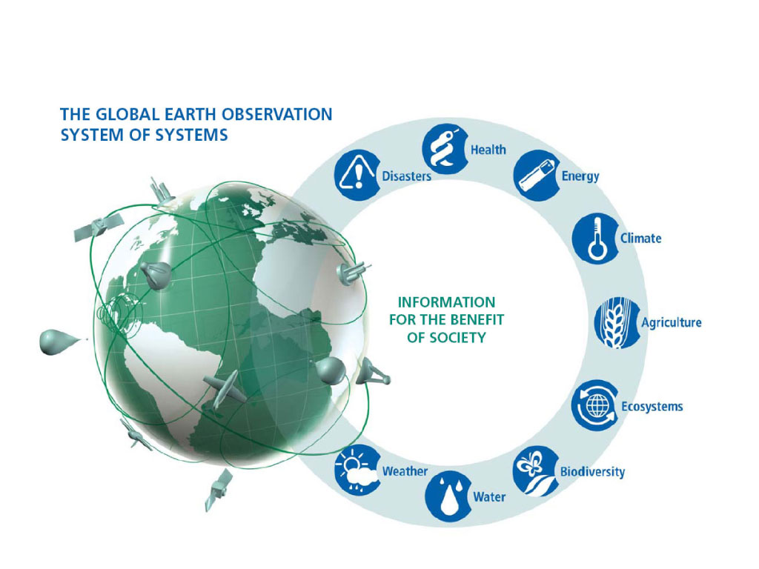
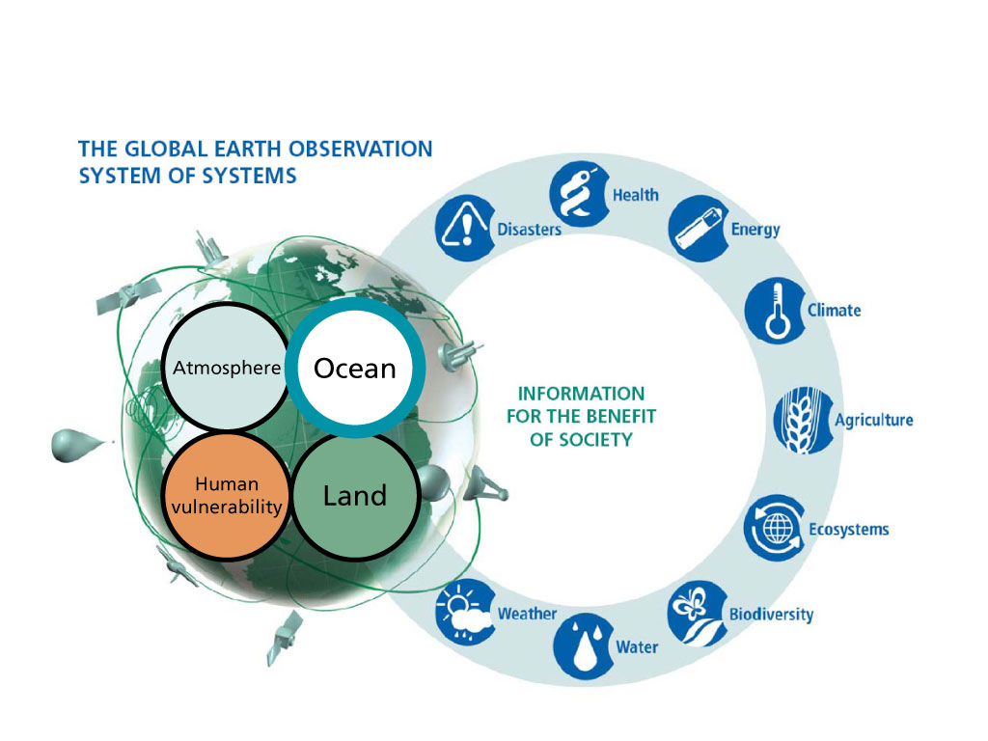
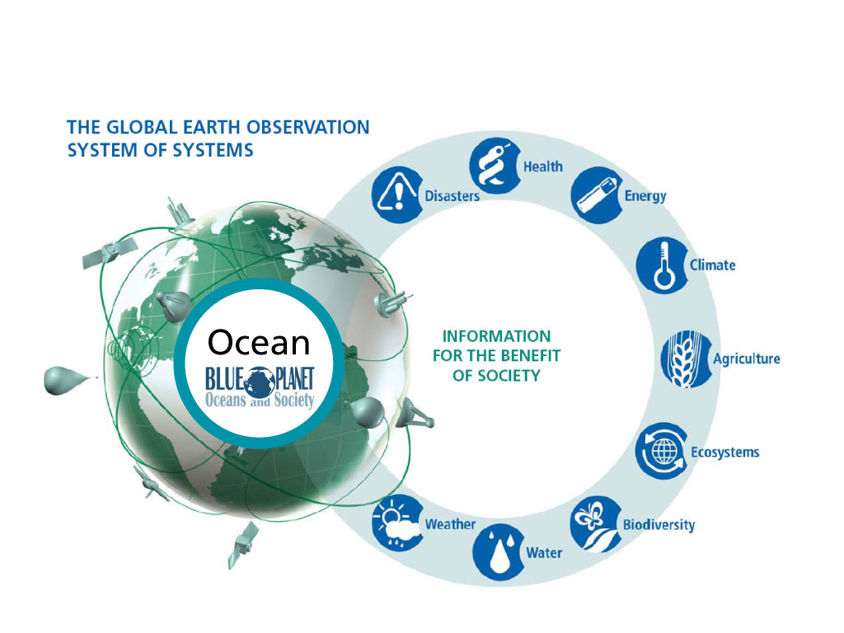
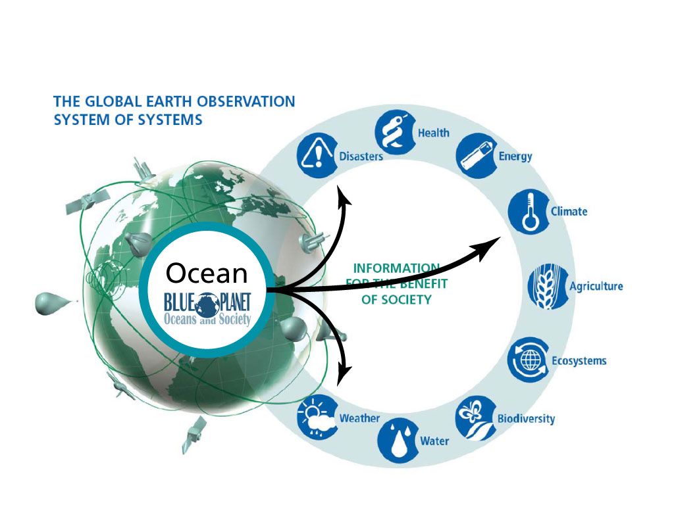
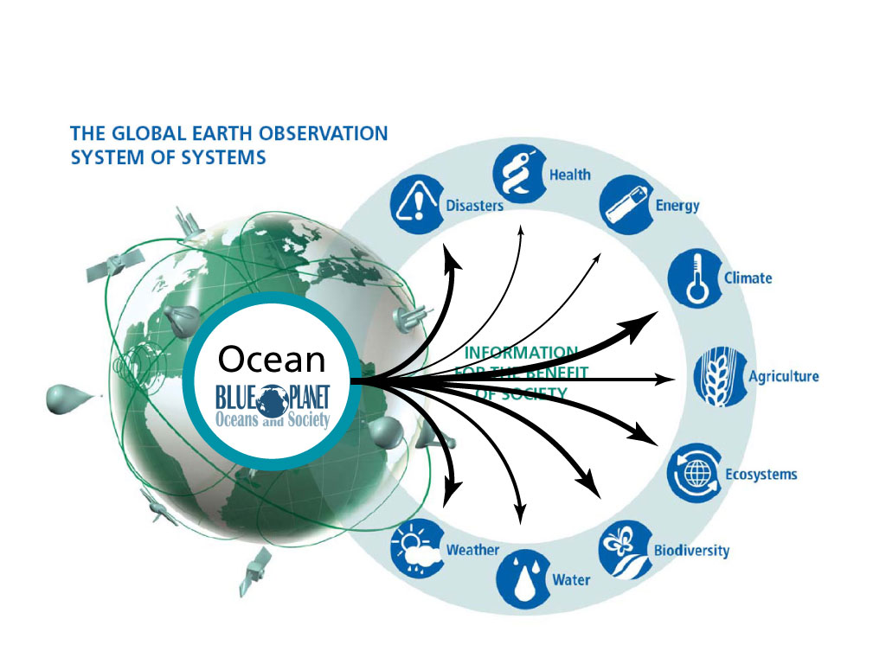
Notes:
The basic concept of GEOSS – to provide earth observations, space and in situ, and create information for societal benefit.
There are many ways to conceptualize the areas of earth observation, but one way is to divide these by domain: earth observations of the atmosphere, the ocean, land surface; and in order to create societal benefit, observations and information about human vulnerability.
The Blue Planet task focuses on the ocean domain, which is crucial in all of the cycles of life on earth. Much of it is an area beyond national jurisdiction, and the common heritage of all humankind.
Observations of the ocean domain contribute in different ways to all of the 9 GEO Societal Benefit Areas.
Physical observations of the ocean are critical to monitoring climate variability and change, and to generating forecasts and projections of climate that can be used in climate services. Ocean observations help improve predictions of longer-range weather forecasts, and ocean-related hazards such as tsunamis, storm surges, and extreme waves require ocean observations for early warning systems.
Because of their role in climate, ocean observations also provide important information for the forecasts of precipitation and drought, and of climate events that can lead to public health events or changes in energy demand.
Ocean biological observations are critical in monitoring the health of ocean ecosystems and biodiversity, and the way ecosystem services are being impacted by a changing environment. They are also important in managing fisheries, which fall into the Agriculture SBA.
So ocean observations in some way contribute to each of the 9 GEO Societal Benefit Areas.

Slide 4
SB-01 – Oceans and Society or
“the Blue Planet Task”
Task in the GEO 2012-2015 Work Plan – 17 Dec 2012
Related GEOSS Strategic Targets
Climate, Ecosystems, Agriculture, Biodiversity
Components:
C1 – Global Ocean Information Coordination and Access
Lead (CEOS) – P. DiGiacomo (NOAA)
C2 – Operational Systems for Monitoring of Marine and Coastal Ecosystems
Lead (CEOS) – P. DiGiacomo (NOAA)
C3 – A Global Operational Ocean Forecasting Network
C4 – Applications of Earth Observations and Information to Sustainable Fishery and Aquaculture Management
Notes:
Task “seeks to coordinate the marine work under GEO and develop synergies between its various components. A related goal is to raise awareness of the societal importance of observing the ocean, both in situ as well by remote sensing.
Added Value of Blue Planet:
Provides new platforms to demonstrate importance of sustained in situ and satellite observations of marine and freshwater environments, and the value of integrating these with models
Brings together a wide and diverse community of governmental and academic researchers and provides new platforms for integration of multiple streams of data into products that provide the real value to users
Includes a dynamic, focused program in capacity building, complemented by a vigorous, global network of former scholars from developing countries.

Slide 5
WGClimate
Carbon Task Force
GHRSST
GlobalHAB
IOCCG
IOC/UNESCO
Virtual Constellations
Committee on Earth
Observation Satellites
JCOMM
GCOS
IODE
GCZIS
OBIS
DBCP
CLRCoP
SOT
Group on Earth Observations:
Coastal Zone Community of Practice
Global Ocean
Observing System
GLOSS
Argo
OceanSITES
IOCCP
GACS
GEOWOW
Antares
GEO Integrated Water
Information Task
Partnership for
Observation of the Global Oceans
ChloroGIN
IV-TT
IQOE
OSE-TT
Capacity Building
COSS-TT
SAFARI
MEP-TT
Notes:
Blue Planet links strongly together the activities of POGO, GOOS, CEOS, GODAE Oceanview, and the GEO Coastal Zone Community of Practice.

Slide 6
CEOS 2013 Work Plan
Expected Outcomes for 2013 – CEOS Support to Key Stakeholder Initiatives
6.5 – Determination of the level and scope of engagement of the four ocean-related Virtual Constellations in the GEO Blue Planet Task
Ocean VCs and WGClimate “will participate in a CEOS Oceans Summit to address key activities where CEOS entities can make significant contributions to the newly developed Blue Planet Task.”
“Additionally, CEOS will consider how best to capitalize on the existence of the four ocean-related Virtual Constellations by reviewing and investigating the feasibility of creating an overarching entity for operational oceanography.”

Slide 7
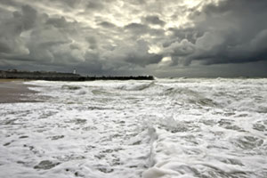
But Change is Coming…

Slide 8
Sustained Ocean Observations
C1
Ocean Forecasting
C3
Sustained Ecosystems & Food Security
C2
Ocean Climate & Carbon
C5
Services for the Coastal Zone
C4
Developing Capacity & Societal Awareness
C6
Blue Planet “Maltese Cross”
Courtesy M. Dowell

Slide 9
Future Challenges and Way Forward
C1 – Sustained Ocean Observations: “to deliver a sustained ocean observing system meeting societal and scientific needs for data and information.”
Promote cooperation of space agencies in measuring EOVs and ECVs through CEOS Virtual Constellations
Stakeholders include CEOS Space Agencies
C5 – Ocean Climate and Carbon: “to advance the development and Implementation of the marine component of the observation systems for both Climate and Carbon.”
WGClimate, CEOS Carbon Strategy Report and Virtual Constellation contributions
CEOS welcomes the opportunity to review the revised Task and Components to ensure that CEOS contributions are accurately reflected.

Slide 10
Blue Planet Steering Committee
Members
Trevor Platt, POGO
Mike Bell, UK Met Office
Michael Berger, EC
Douglas Cripe, GEO Secretariat
Paul DiGiacomo, NOAA
Samuel Djavidnia
Mark Dowell, EC-JRC
Albert Fischer, GOOS
Pierre-Philippe Mathieu, ESA
Shubha Sathyendranath, PML, UK
Kerry Sawyer, CEOS
Andy Steven, CSIRO
ToR
Oversee and guide the evolution of the Blue Planet Task.
Promote the Blue Planet in appropriate international scientific fora.
Constitute the pro tem governance structure for the Task.
Promote the societal applications of ocean observations.
Facilitate the interconnections between elements of Blue Planet.
Aid deliver of benefits to society from Blue Planet.
Assist in securing a resource base for execution of the Blue Planet Task.
Notes:
Address the “Oceans and Society: Blue Planet” book – result of the November 2012 Symposium
Provided a section on “International Coordination of Satellite Observations of the Ocean”

Slide 11
Decision Makers ● Scientists ● Public Sector ● Partner Orgs (NGOs, intergov) ● Stakeholders / users ● Public awareness ●
CEOS
BLUE
PLANET
POGO
GOOS
CZCP
GODAE

Slide 12
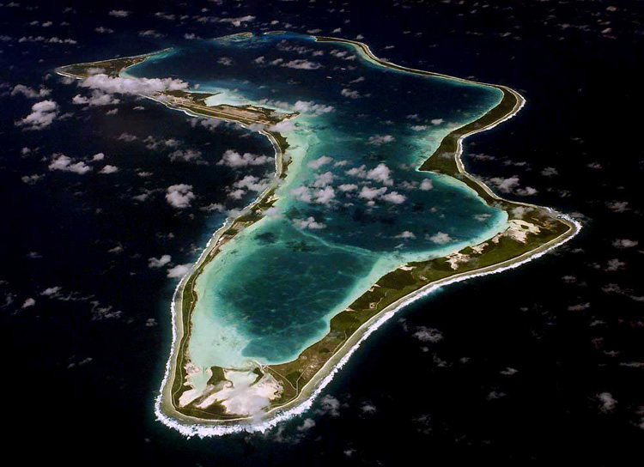
And Calm is to be Restored…
And Calm is to be Restored…

Slide 13
BACK UP SLIDES

Slide 14
Oceans and Society
Blue Planet Symposium 2013
19-21 November 2012 – Ilhabella, Brazil
Main Outcomes/Actions:
Continue developing the SB-01 Task and establish further synergies between the various Task Components
Develop a White Paper to elaborate contributions of various programs and elements of Blue Planet
CEOS Presentation to Symposium highlighted:
Initiatives at the international level to coordinate satellite observations of the ocean that are relevant to the Blue Planet Task of GEO
Examples (not meant to be exhaustive) include:
CEOS Working Group on Climate – ocean Essential Climate Variables
CEOS Virtual Constellations – all main ocean observations!
CEOS Carbon Task Force – ocean aspects covered in Strategy report

Slide 15
CEOS Intervention in Support of Blue Planet Task
CEOS is very pleased with the development of the Blue Planet Task in the 2012-2015 Work Plan. We are well-positioned to support the identified priority actions. CEOS leads two of the four Components in the Task. In 2013, CEOS will consider how best to engage the four ocean-related Virtual Constellations: Ocean Colour Radiometry, Ocean Surface Topography, Ocean Surface Vector Wind, and Sea Surface Temperature, to seek if this Task can receive further support. CEOS is engaged in the analysis of contributions to outputs for monitoring the marine ECVs and the role of the oceans in the carbon cycle and how best to define a strategy for the next generation of CEOS Agency satellite missions to monitor that process. The CEOS Carbon Task Force is also assessing the three major domains, including oceans, and their interrelationships, and this was addressed earlier this week at the Oceans and Society Blue Planet Symposium, in which I was pleased to participate.

Slide 16
C1 Sustained ocean observations
GOOS
C2 Sustained ecosystems and food security
ChloroGIN
C3 Ocean forecasting
GODAE OceanView MEP-TT
GODAE OceanView COSS-TT
Argo
OceanSITES
CEOS Virtual Constellations
HF Radar
Antares
SAFARI
GEOHAB
GACS
IQOE
GEOWOW
GODAE OceanView OSE-TT
GODAE OceanView IV-TT
C4 Services for the coastal zone
Coastal Zone Community of Practice
Panel for Integrated Coastal Observations
C5 Ocean climate and carbon
GCOS Essential Climate Variables
IOCCP
Ocean acidification
CEOS Carbon Strategy
C6 Developing capacity and societal awareness
Visiting professorship programmes
Fellowship programmes
Centres of excellence
Summer/winter schools
Shipboard training
Data management training
Distance learning
Outreach activities
Mangrove monitoring
Coral reef monitoring (GCRMN, I-CREOS)
Estuary monitoring (Our Global Estuary)
Global Coastal Zone Information System
[Figure 4]

