Slide 1
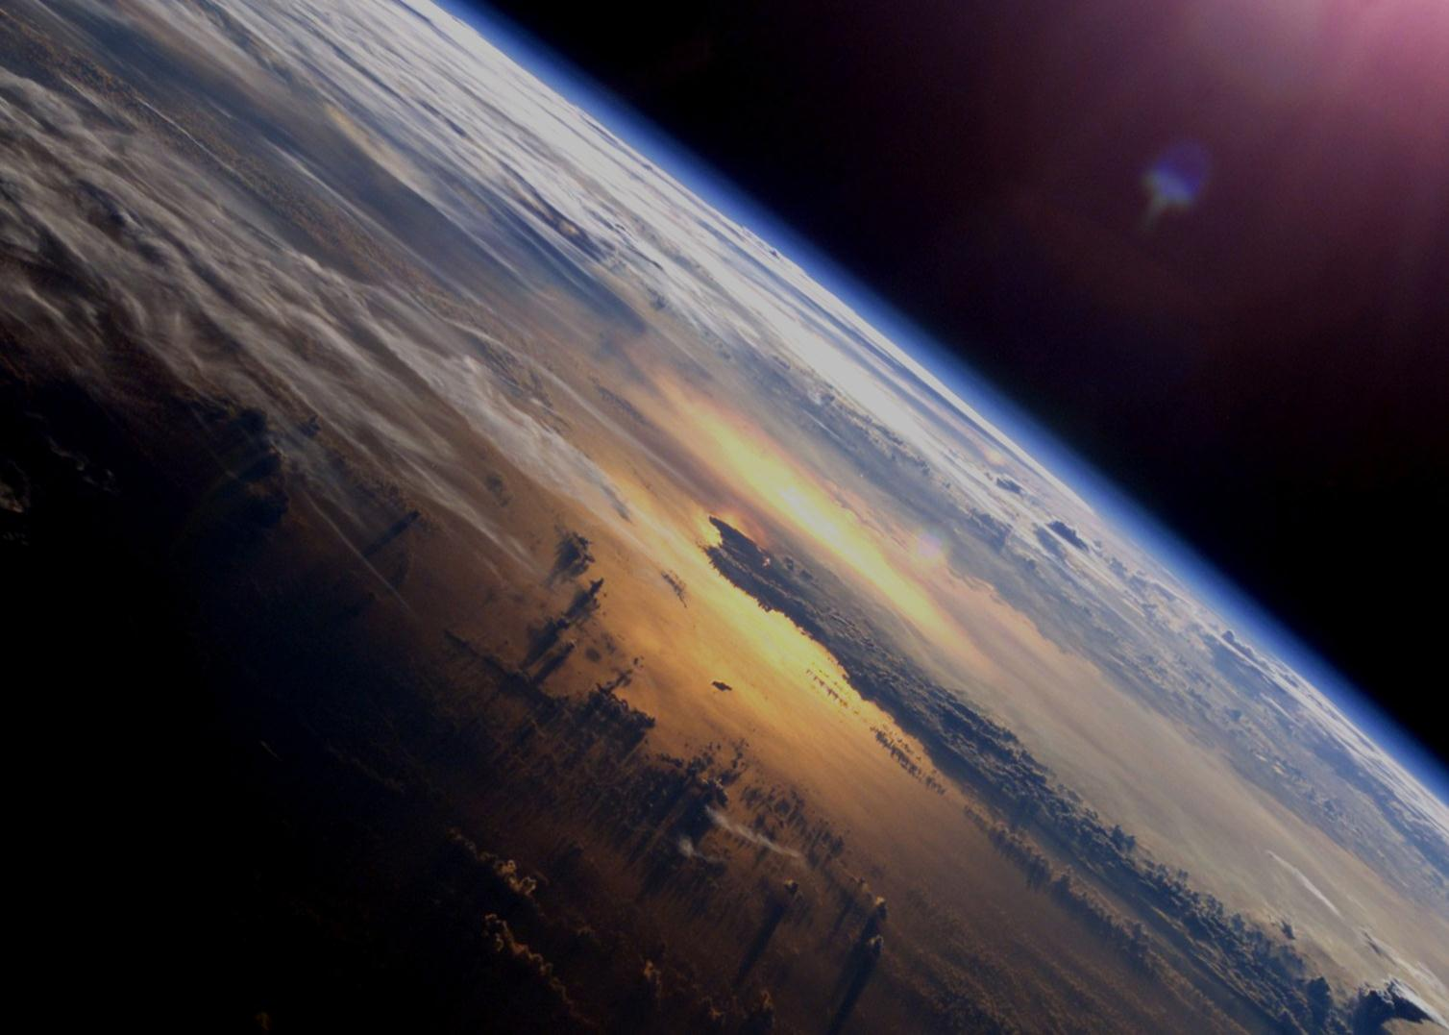
ESA’s Earth Observation Programme – Selected Elements
CEOS Plenary Session
Montreal, 4 November 2013
Stephen Briggs, ESA
Head, Programme Planning and Coordination Service

Slide 2
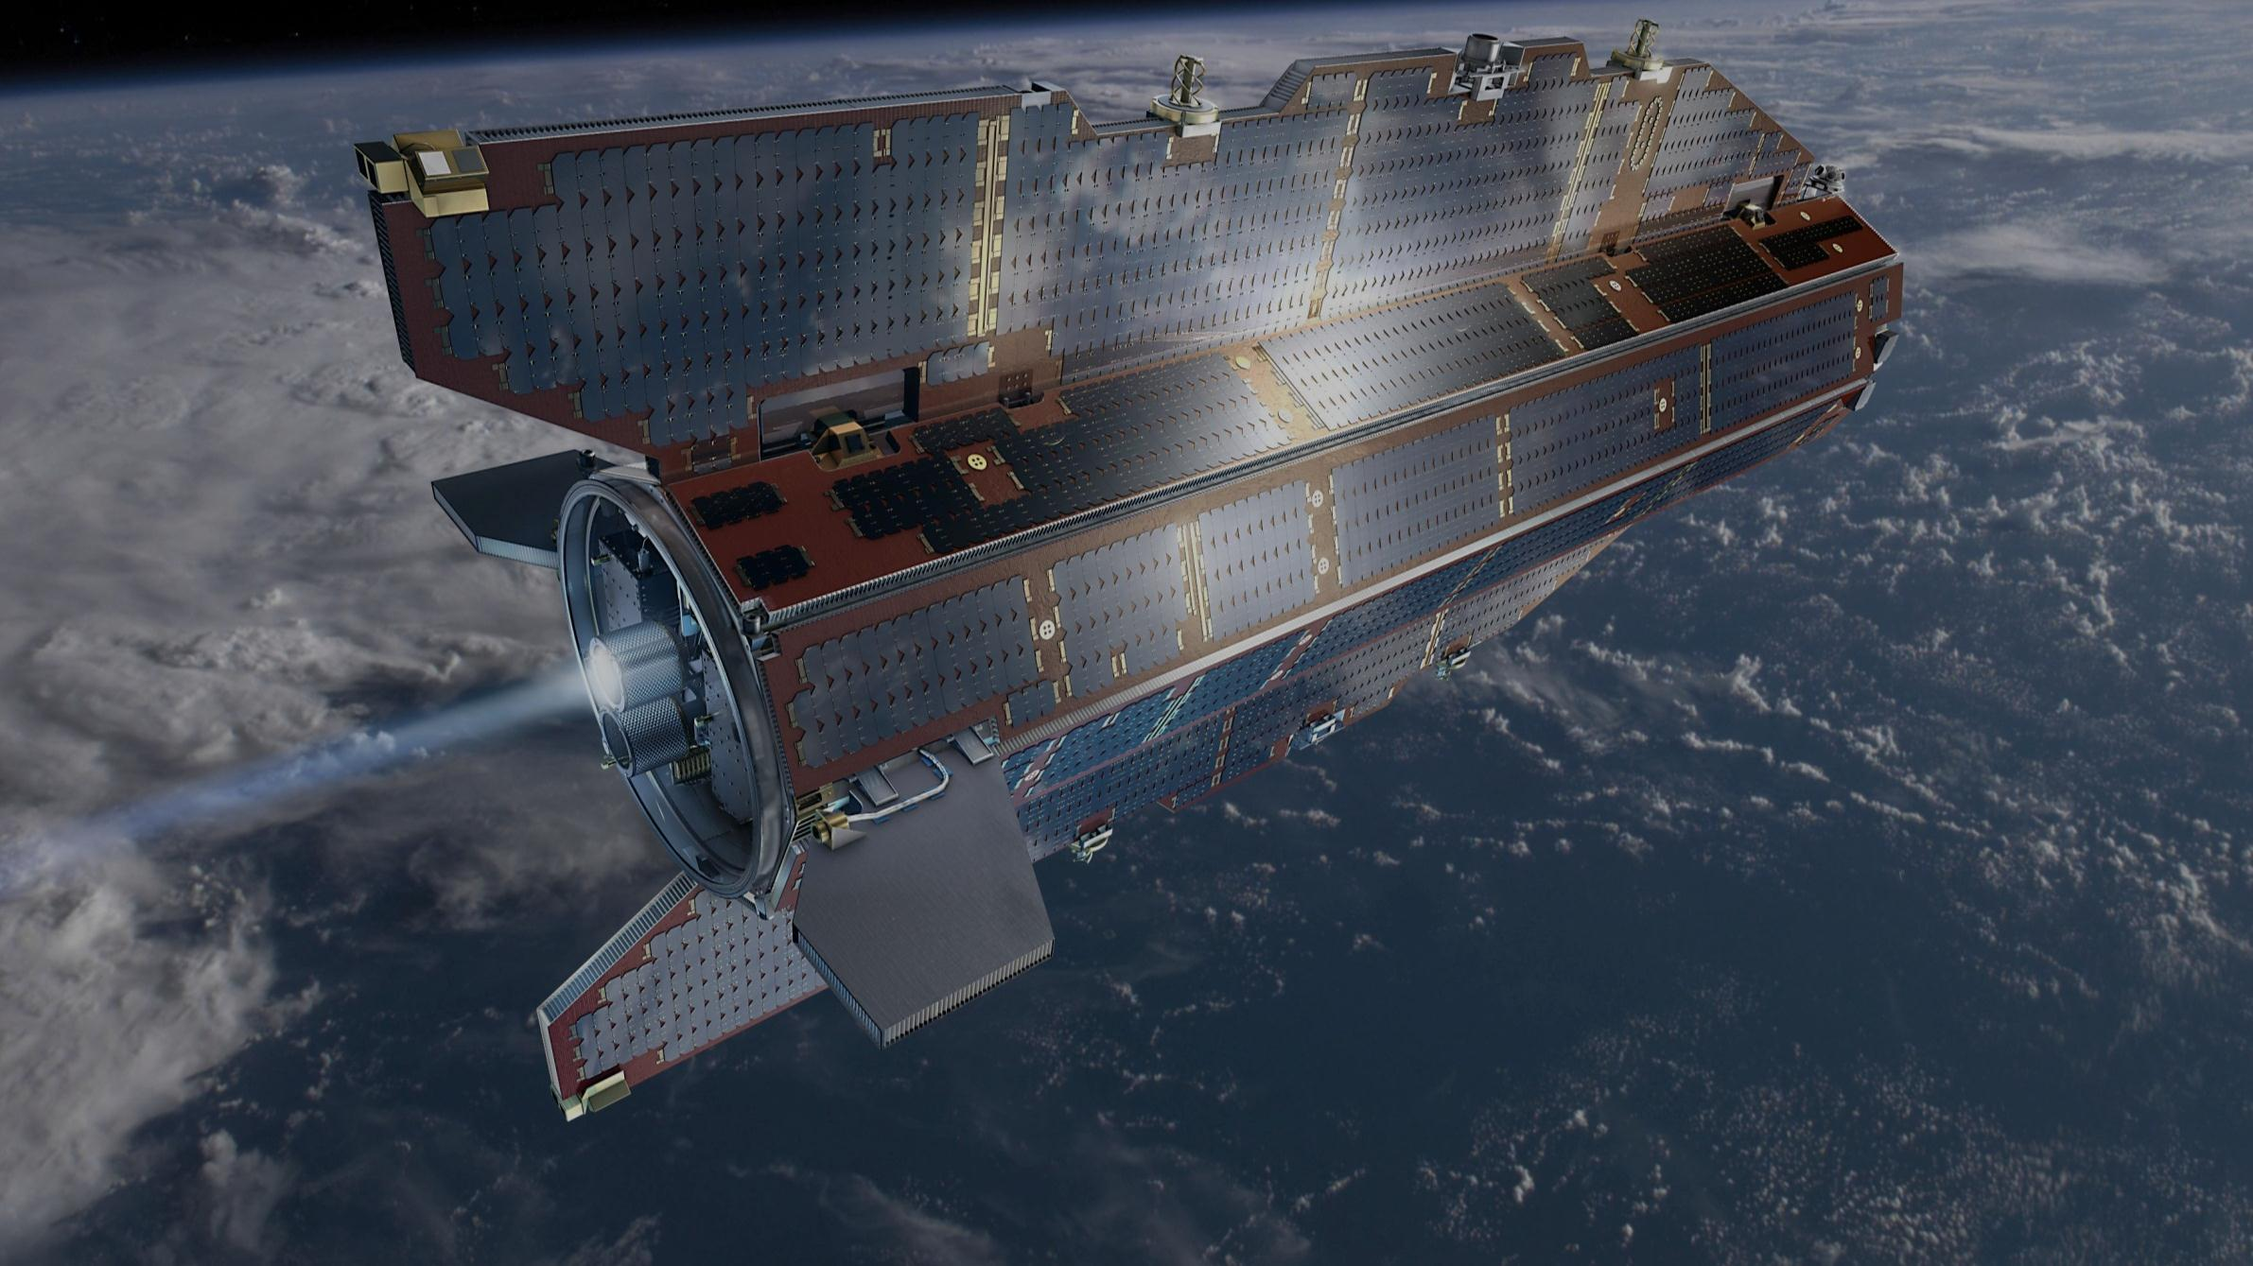
GOCE
Measured the Earth’s gravity field
First gradiometer in space
Active air drag control (ion engine)
Very low operational orbit, (225 km ultimately)
Best geoid ever produced <2cm
Mean dynamic ocean topography
5th version of geoid foreseen in mid 2014, including all GOCE measurements (<80km)
End of mission 21 October 2013
Imminent re-entry

Slide 3
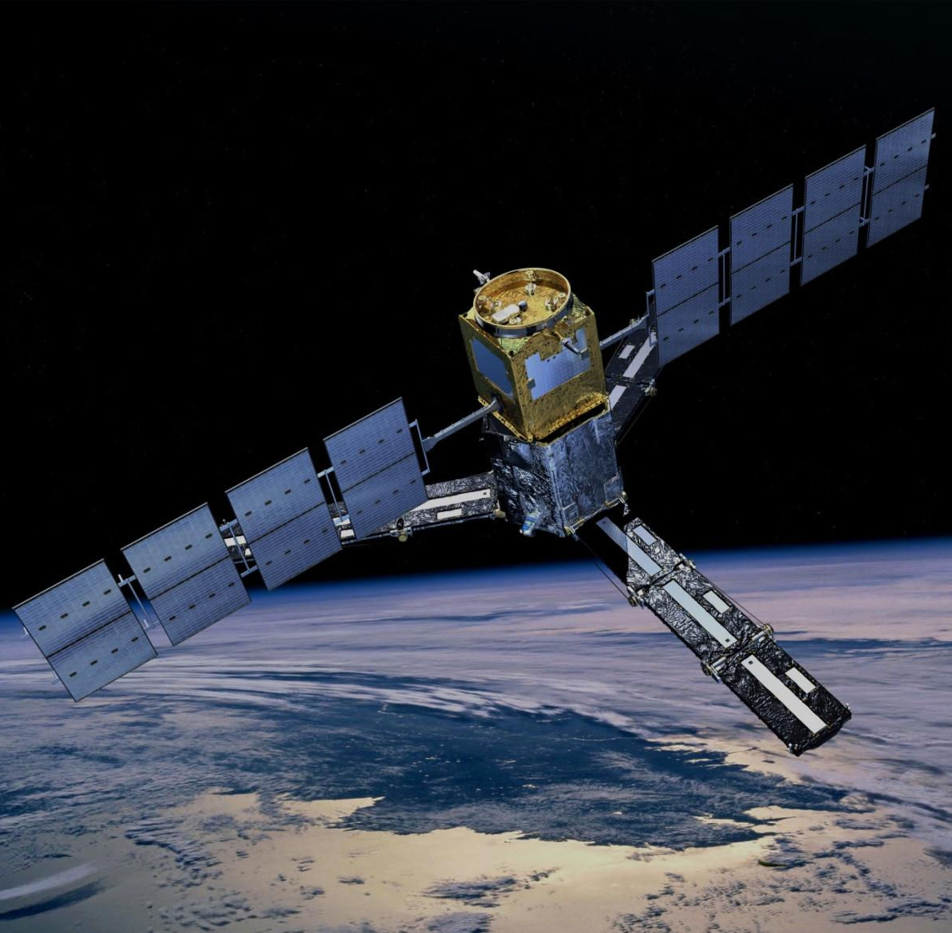
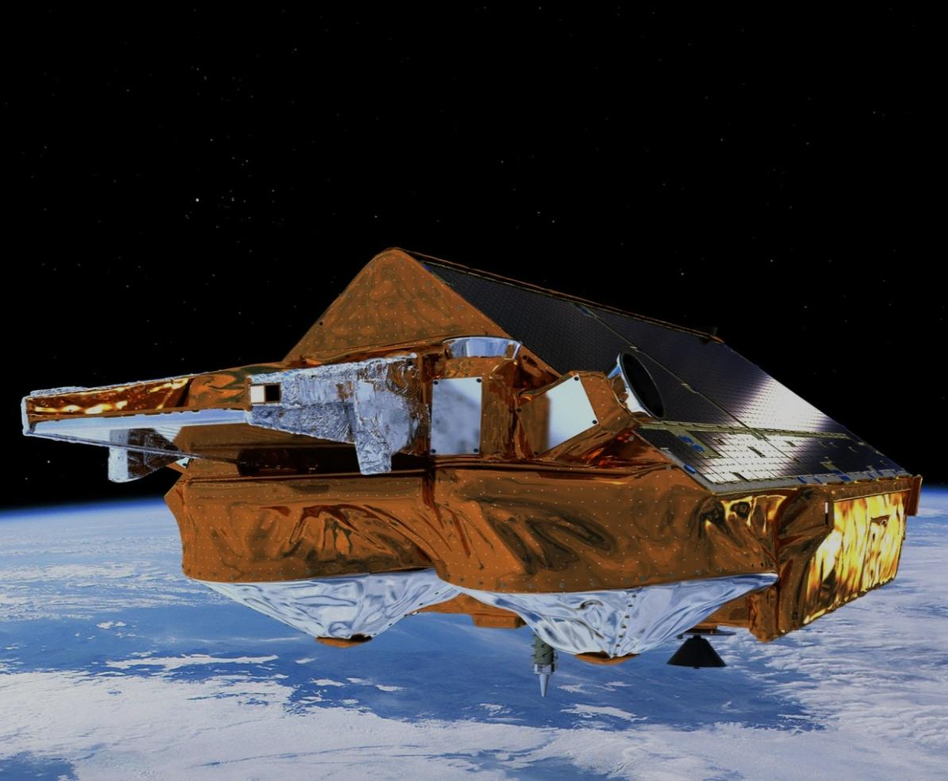
Other Earth Explorers on orbit
SMOS
Measures Soil Moisture and Ocean Salinity
Radio Frequency Interference (RFI) mitigation continues
Mission extension until 2017 likely
Cryosat
Global sea ice thickness measurements
Used for ice research, but also for oceanography
Mission extension until 2017 likely
Notes:
SMOS
Collaboration with CNES, CDTI, NASA missions Aquarius and SMAP (the latter will be launched in 2014)
Cryosat:
First interferometric altimeter in space
According to our present knowledge the onboard resources would allow us to fly (with current mission profile) till mid 2020.

Slide 4
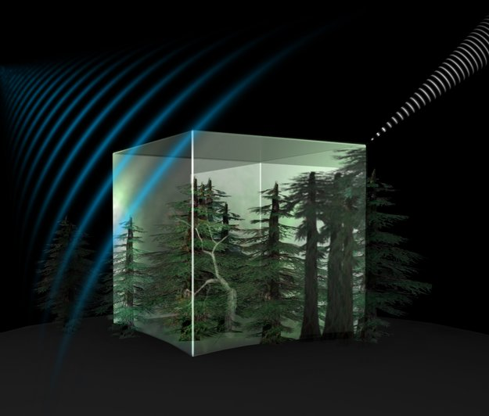
Upcoming Earth Explorers
Swarm
Best-ever survey of the Earth’s geomagnetic field and its variation in time
New insights into the Earth’s interior and climate
Launch 21 November 2013
Biomass
Biomass based on global interferometric and polarimetric P-Band Radar observations
Essential to understand the Earth’s carbon cycle
Notes:
Swarm: Satellites ready and fuelled at Plesetsk
Biomass: Selected as 7th Earth Explorer

Slide 5
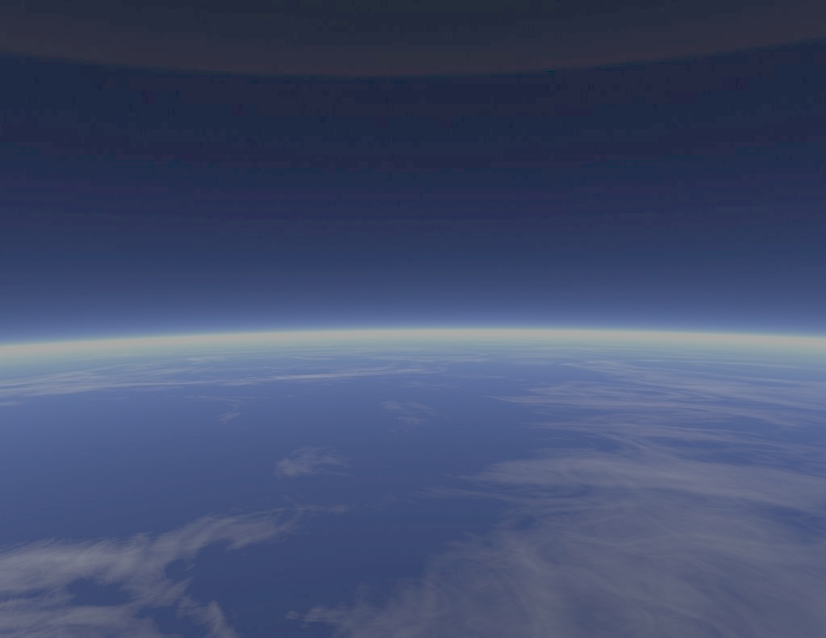
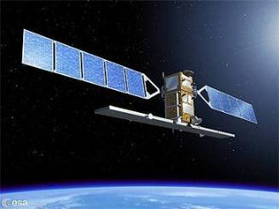
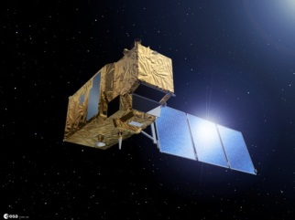
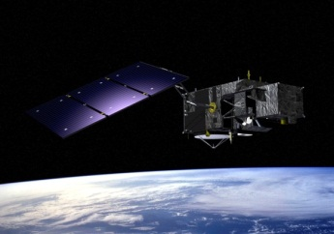
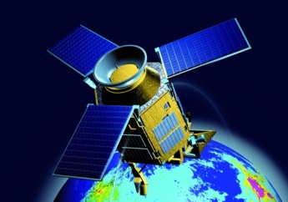
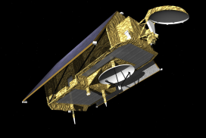
Copernicus: A New Generation of Data Sources
Sent-1A/B
Sent-2A/B
Sent-3A/B
Sent-4A/B
Sent-5/5P
Jason-CS
Copernicus is a European space flagship programme led by the European Union
ESA coordinates the space component
Copernicus provides the necessary data for operational monitoring of the environment and for civil security
Sentinel-1 A launch in 2014
Notes:
Europe is more than the EU

Slide 6
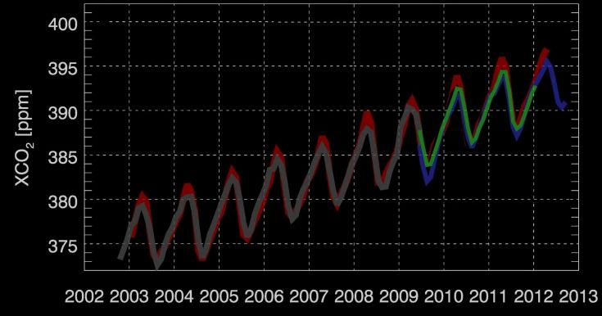
The ESA Climate Change Initiative (CCI)
EO satellites deliver global, consistent and long-term data for Essential Climate Variables, supporting climate research & applications
Copernicus Sentinels will provide long-term continuity for monitoring our planet
Gaps in time series would cause irreversible damage to climate research

