Slide 1



Update on EUMETSAT
Alain Ratier, Director-General

Slide 2


EUMETSAT Membership: situation expected in 2014
Member States
Cooperating State
AUSTRIA
BELGIUM
BULGARIA
CROATIA
CZECH REPUBLIC
SERBIA
DENMARK
ESTONIA
FINLAND
FRANCE
GERMANY
GREECE
HUNGARY
ICELAND
IRELAND
ITALY
LATVIA
LITHUANIA
LUXEMBOURG
NETHERLANDS
NORWAY
POLAND
PORTUGAL
ROMANIA
SLOVAK REPUBLIC
SLOVENIA
SPAIN
SWEDEN
SWITZERLAND
TURKEY
UNITED KINGDOM

Slide 3
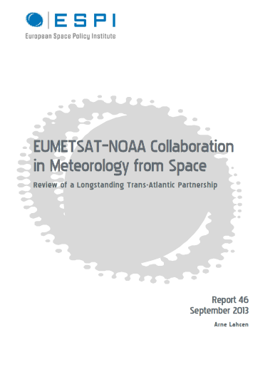
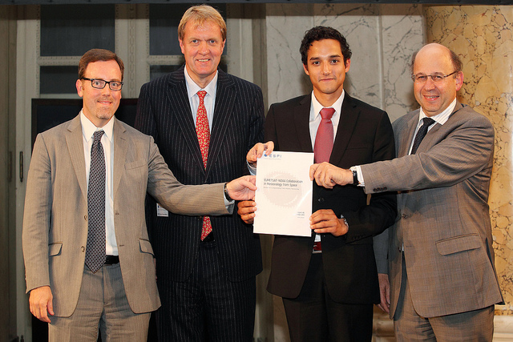
Value of international Cooperation
NOAA-EUMETSAT
New cooperation agreements signed or to be signed with:
  NOAA, NASA, CMA, ISRO
Report can be downloaded from :
http://www.espi.or.at/images/stories/dokumente/studies/ESPI_Report_46.pdf

Slide 4
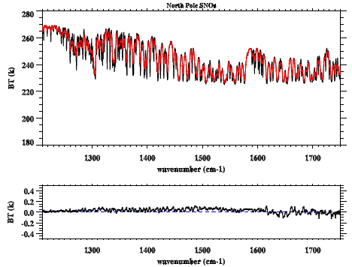
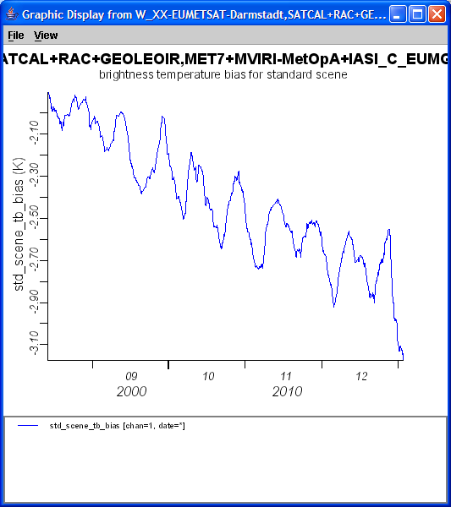
Enhancing climate data records through cross calibration
Reference IR Instrument: IASI on Metop
Meteosat-7 against IASI

Slide 5






CURRENT EUMETSAT SATELLITES
METOP-A/B (98.7° incl.)
JASON-2 (63° incl.)
EUMETSAT POLAR SYSTEM/
Initial Joint Polar System
OCEAN SURFACE TOPOGRAPHY
Non-synchronous low Earth orbit at 1,336km altitude
Mid-morning, sun synchronous orbit at 817km altitude
Partnership with NASA/NOAA/CNES
METEOSAT-7 (57.5° EAST)
1st generation
METEOSAT-10 (0° LONGITUDE)
2nd generation
METEOSAT-9 (9.5E° LONGITUDE)
2nd generation
INDIAN OCEAN DATA COVERAGE
METEOSAT FULL DISC IMAGERY
METEOSAT-8 (3.5° EAST)
2nd generation
Operated in support of the Indian Ocean Data Coverage (IODC) mission, bridging an observational gap in this region until end 2016
Prime Meteosat full disc imagery service over the European continent, Africa and parts of the Atlantic and Indian oceans every 15 minutes
RAPID SCAN SERVICE
Rapid scan service over Europe every 5 minutes
BACKUP SERVICE

Slide 6
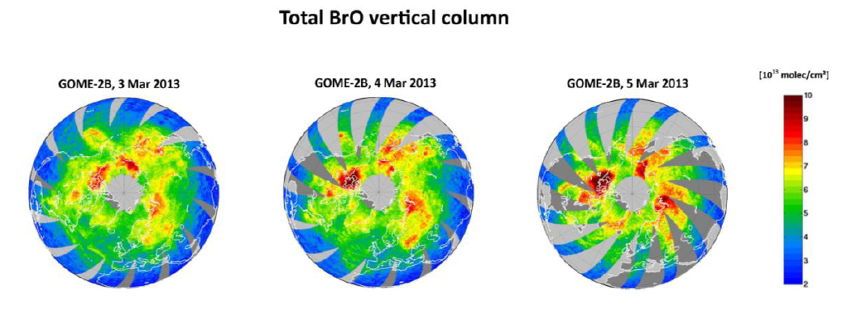
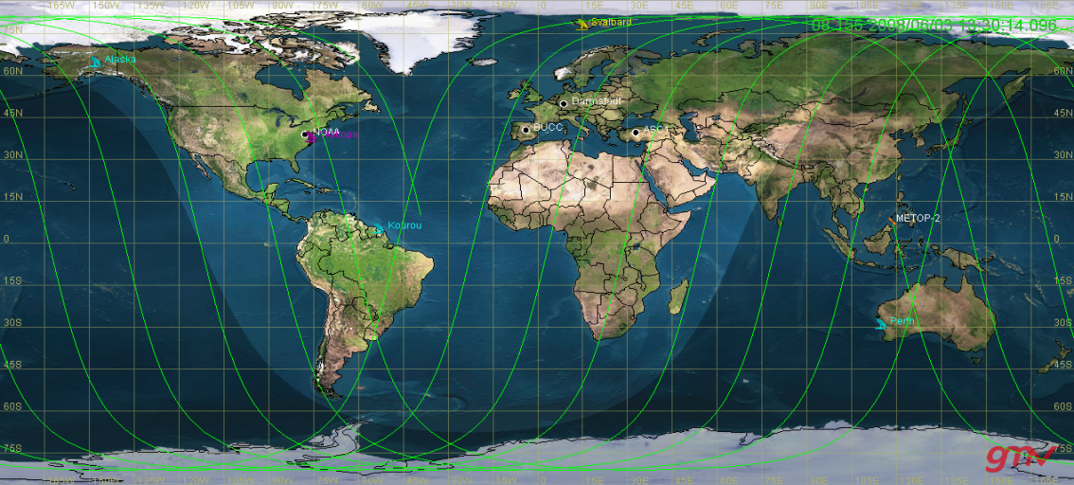
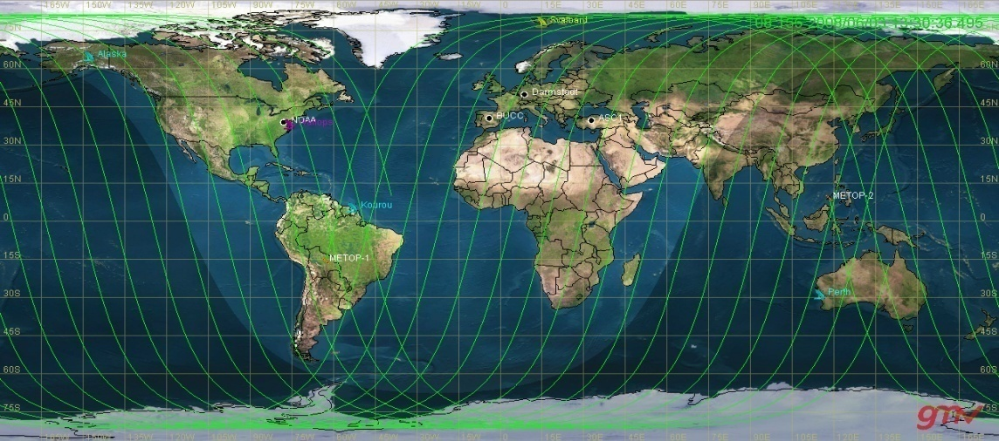
From single to dual Metop operations
METOP-B
METOP-A
Single Metop ground track over 9 orbits
Dual-Metop ground track over 9 orbits
1920 km swath
960 km swath

Slide 7
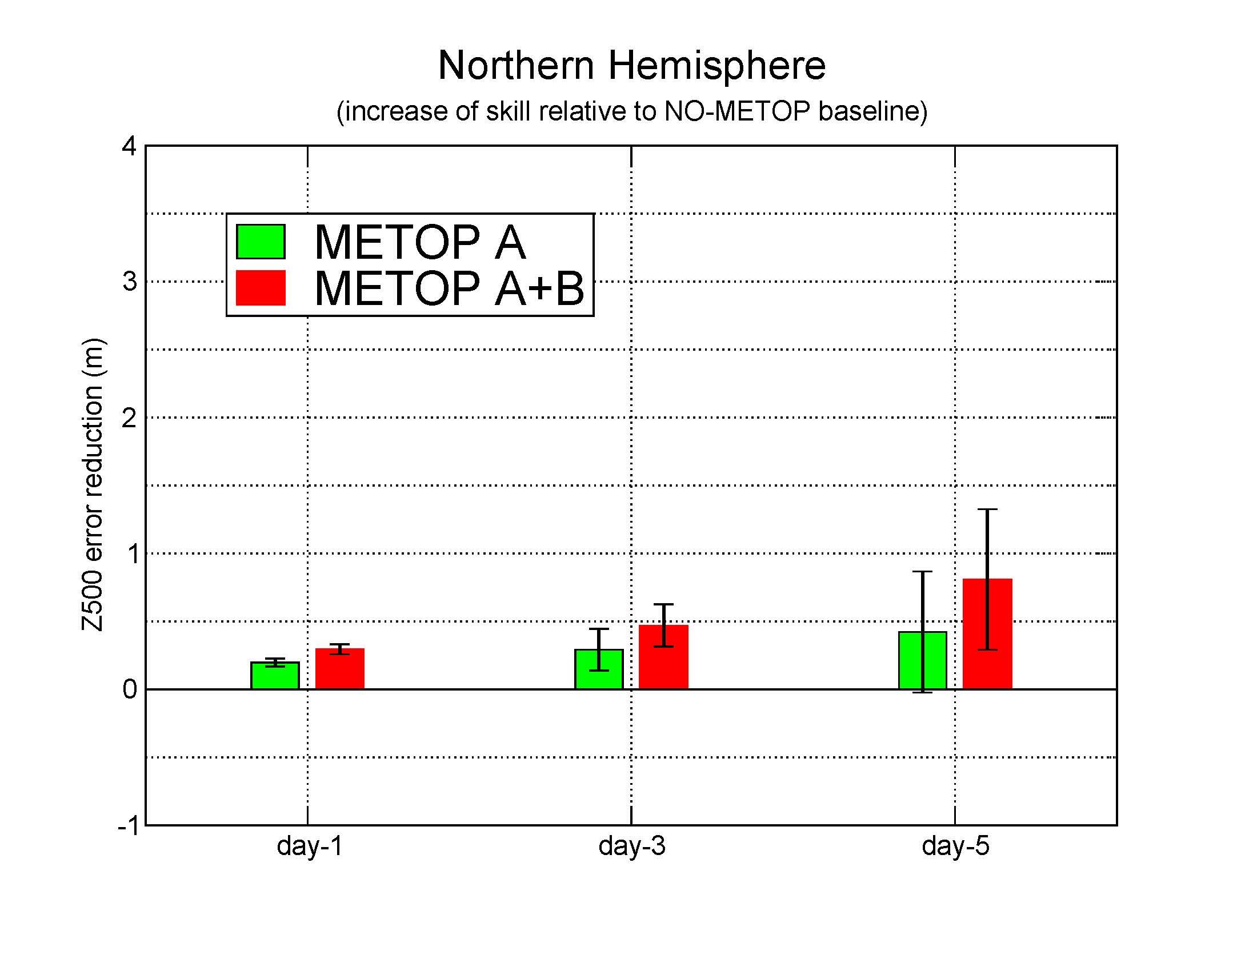
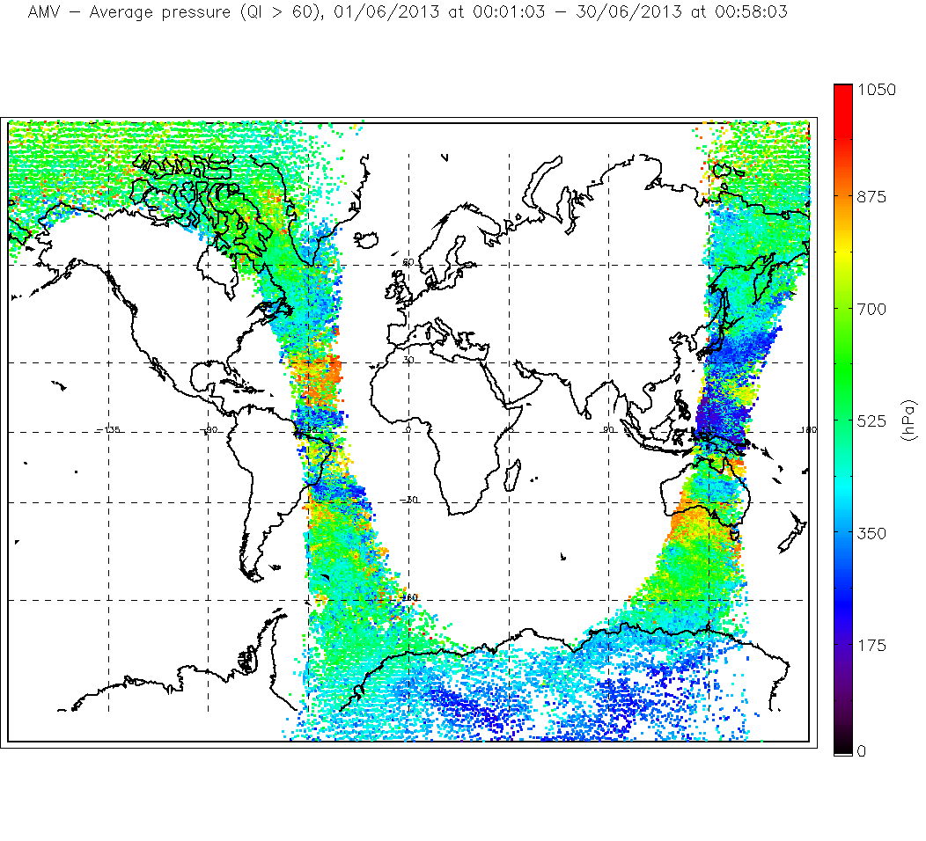
Dual Metop operations: Impact on NWP & wind product

Slide 8
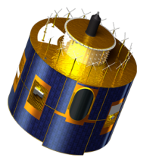
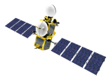
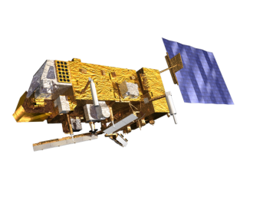
Future launches: 10 satellites in orbit in 2015
ASCAT Coastal
MSG-4 launch mid 2015 (for in orbit storage)
Jason-3 launch (with CNES, NOAA, NASA) in March 2015
From mid 2015, EUMETSAT will operate Copernicus Sentinel-3 with ESA on behalf of the EU, focusing on the Marine Mission
  Metop-C launch planned in Q1 2018
ASCAT
OSCAT

Slide 9
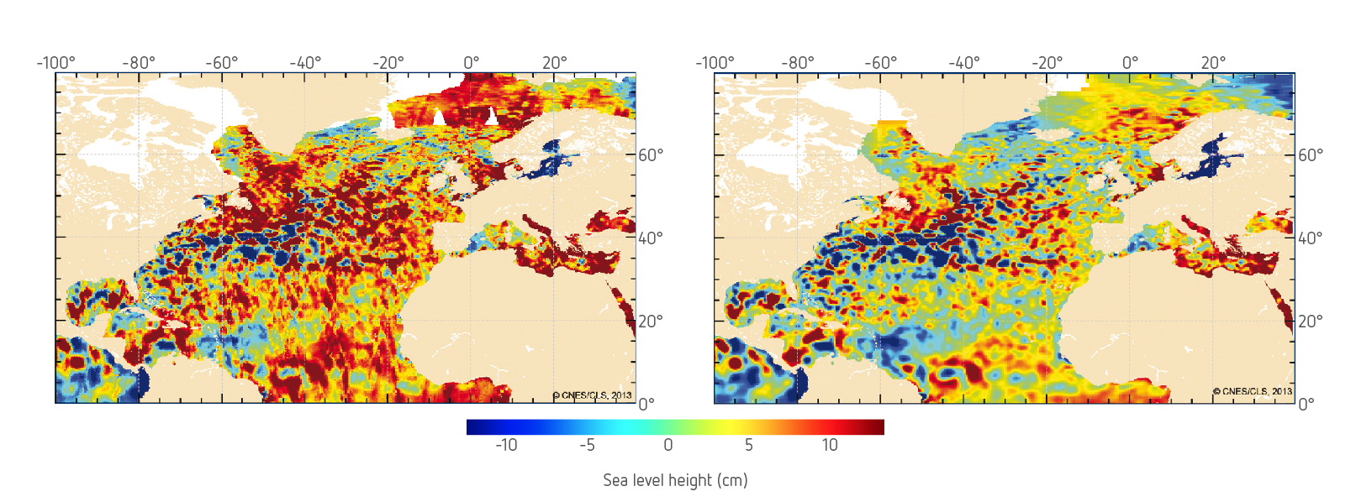
Preparing for Jason-3 & Sentinel-3: enhancing the OST virtual constellation
Sea surface anomalies using Cryosat and Jason-2 data, without (left) and with cross calibration (right)
(Source: CLS)

Slide 10
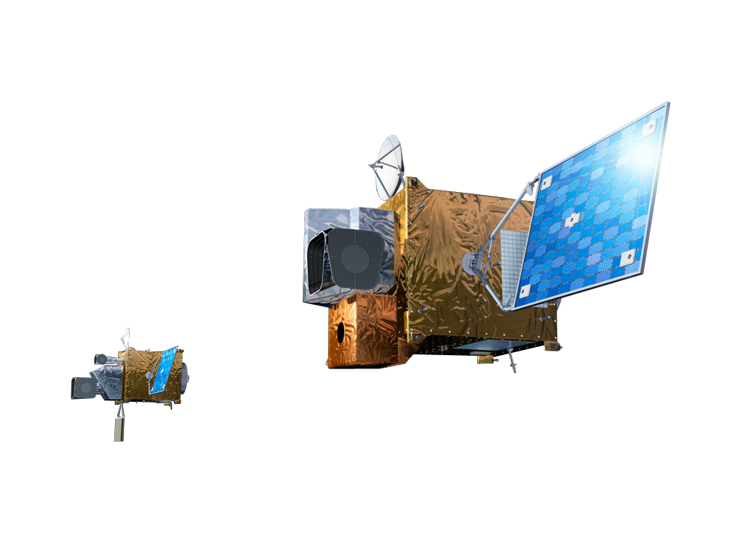
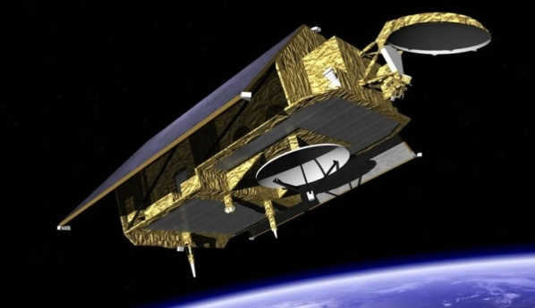
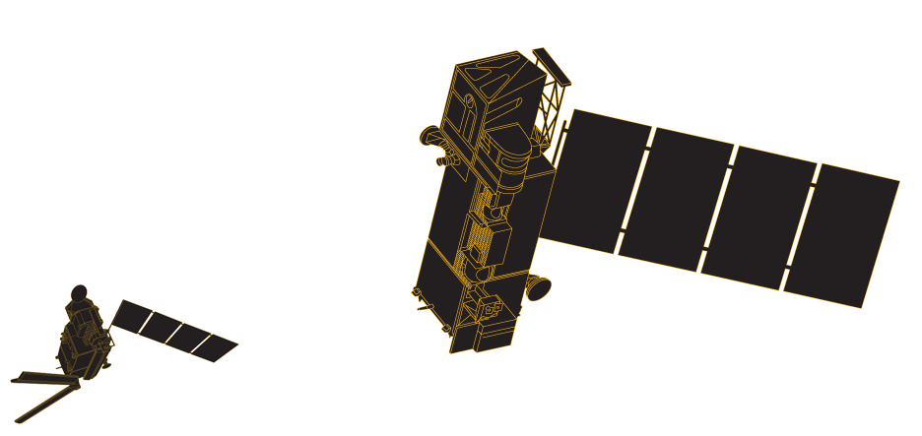
Future programmes: Observations in 2018 – 2040
MTG: Approved, under development
Sentinel-4 approved
Jason-CS : Proposed, to be approved in 2015
Phase B2 approved at ESA CMIN12
EPS-SG : to be approved in 2014
Metop-SG programme approved at CMIN12
Sentinel-5 Phase B2 approved at ESA CMIN 12

Slide 11
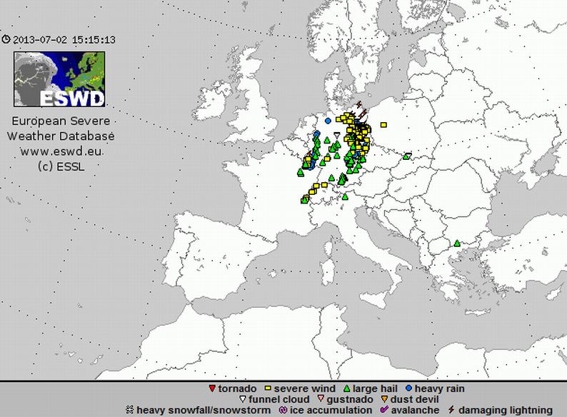
Preparing Meteosat Third Generation
“super rapid scan” experiments with Meteosat-8
  Meteorological situations selected by CWG: 17 May, 17 and 20 June, 29 July
  Support to research on convection and preparation of MTG
2.5 Minutes
5 Minutes
15 Minutes
Notes:
Prime Service
18 Dec 12 - Start of Met-9/Met-10 parallel dissemination
21 Jan 13 - Met-10 became prime
19 Feb 13 – Stop of Met-9 parallel dissemination
Rapid Scan Service
31 Jan 13 - Start of the Met-8 RSS 1-month yearly pause
5 Mar 13 - Start of Met-8/Met-9 RSS parallel dissemination
9 Apr 13 - Met-9 became RSS prime
7 May 13 – Stop of Met-8 RSS parallel dissemination

