Slide 1
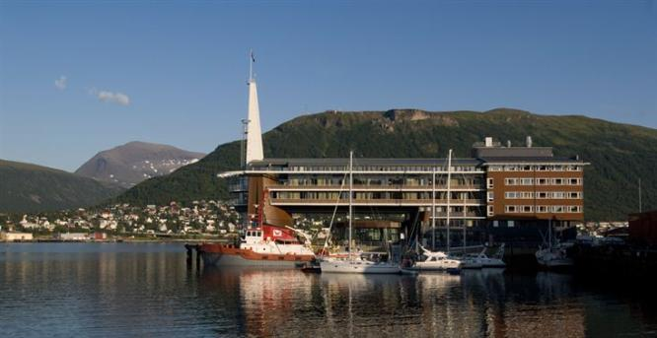
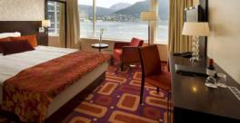
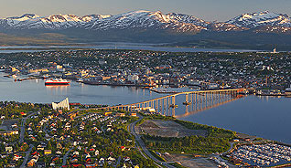
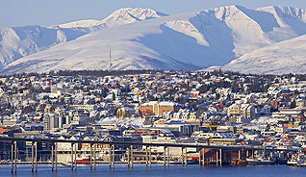
28th CEOS Plenary Session CEOS Preparation for COP 21
Pascale Ultré-Guérard
CNES, SIT chair
CEOS Plenary, Agenda Item 29
Tromsø, Norway 28-30 October 2014

Slide 2
COP 21
2 main actions in which CEOS can be associated :
1. Scientific Conference “Our Common Future under Climate Change”
To be held in July (7-10) at Unesco, Paris, France
The timeline is as follows:
7 October 2014: Opening of the Call for Parallel Sessions
30 November 2014: Deadline for the submission phase of the Call for Parallel Sessions
Mid-November 2014: Opening of Conference registration
Mid-November 2014: Opening fo the hotel booking system
Mid-December 2014: Call for Contributions
15 December 2014: Call for Side Events
Mid-February 2015: Deadline for the Call for Contributions
More information available on the Conference website:
http://www.commonfuture-paris2015.org/
Cnes is partner of the conference and is in the organisation committee
Cnes with Fr scientists intends to submit one or several sessions dedicated to observations from space
CEOS members (agencies, WG Climate) will be invited to contribute to this(these) session(s)

Slide 3
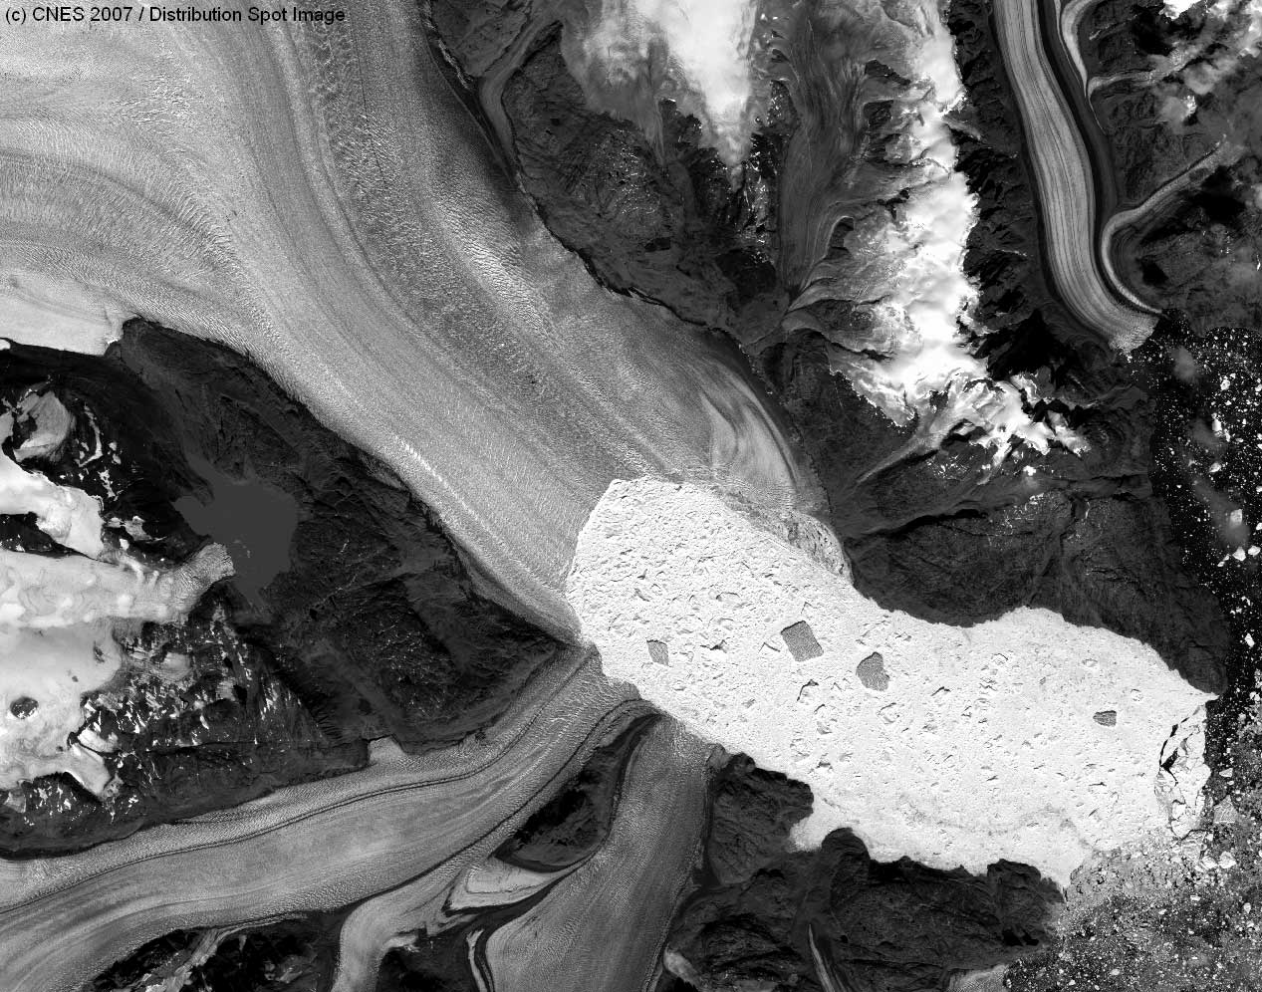
COP 21
2 main actions in which CEOS can be associated (cont’d)
2. Side events during the COP 21 itself from 30/11 to 11/12 (Le Bourget, France)
Cnes intends to propose a booth (re-using material from the 51st Paris Air Show booth of Cnes), exact location TBD
CEOS (WG Climate) invited to provide content to the booth
Possibility to organise conferences and invite CEOS members
repr., TBD

