Slide 1
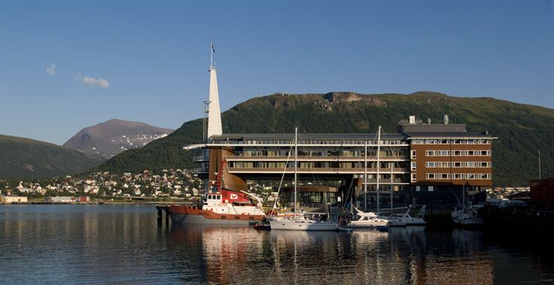
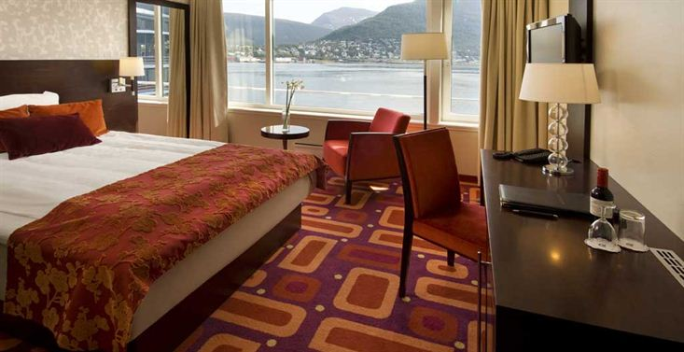
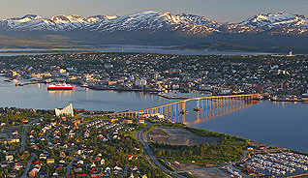
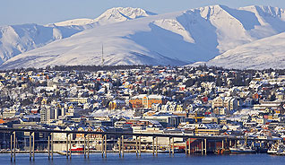
28th CEOS Plenary Session
Paul Counet
EUMETSAT
CEOS Plenary, Agenda Item 34
Tromsø, Norway 28-30 October 2014

Slide 2
CEO/DCEO Transition Arrangements
Following extensive discussions during the last year the CEOS Chair distributed a proposal to CEOS SEC on 21st June.
This proposed arrangement not only addresses the impending vacancy for CEO but also the long-standing vacancy for the DCEO
The proposal has been agreed with all contributing agencies

Slide 3
CEO/DCEO Transition Arrangements
The main features of the proposal are:
On 1 December 2014:
Mrs Marie-Josée Bourassa (CSA) will take over the position CEO
Mr Jonathon Ross (GA) will become DCEO for GA
Ms Kerry Ann Sawyer (NOAA) will act as “assistant to the CEO and DCEO” to ensure a smooth transition until the end of the SIT-30 Meeting in April 2015.
At CEOS Plenary 2015, when JAXA will finish its CEOS Chair term and CSIRO take over the CEOS chairmanship:
Mr Jonathon Ross (GA) will become CEO
Mrs Marie-Josée Bourassa (CSA) will become DCEO
This arrangement will last until CEOS Plenary 2016.

Slide 4
CEO/DCEO Transition Arrangements
For the post-Plenary 2016 timeframe, GA has indicated the possibility to continue to support the position of CEO until Plenary 2017, but this will have to be confirmed in due time.
The detailed modalities of the transition arrangements were agreed during the SIT workshop in September

