Slide 1
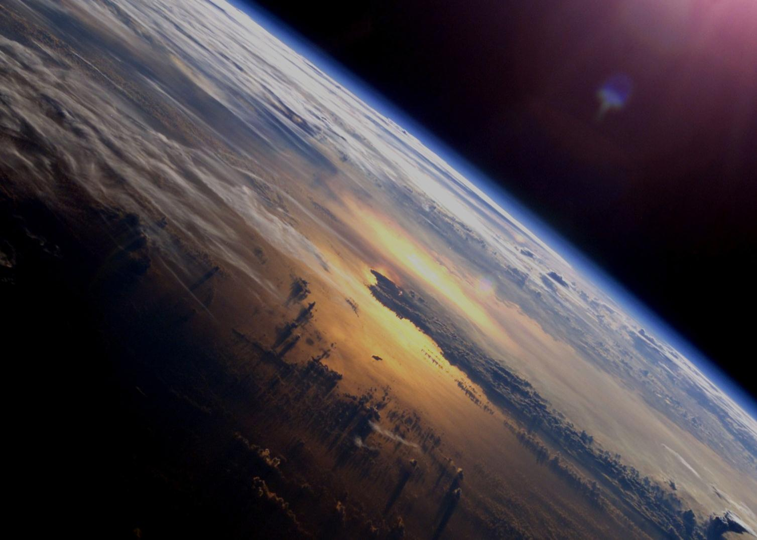
Update on ESA’s Earth Observation Programmes
CEOS-28 Plenary
TromsØ, 30 October 2014
Prof. Volker Liebig, ESA
Director of Earth Observation Programmes

Slide 2
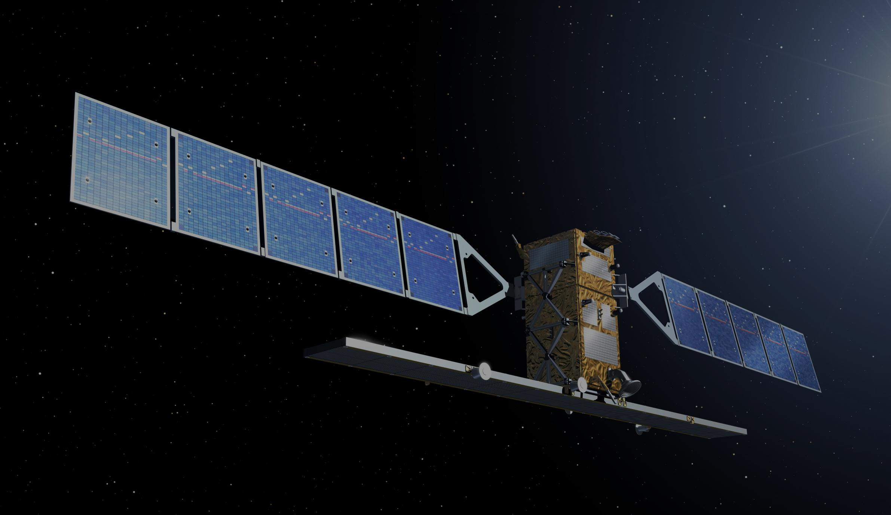
Copernicus – Current Status
Operations secured until 2021
Infrastructure secured until 2028-2030
Fully geared towards contributing to GEOSS
EU-ESA Agreement being signed
Sentinel-1 A launch on 3 April 2014
IOCR concluded 23 September 2014
Data freely available since 3 October 2014
Notes:
4.3 billion Euro MFF: c.e.c.
Adoption of Regulation by EP Plenary on 12 March 2014; Council end of April
Delegation Decision to be taken by EU Copernicus Committee, formal mandate for COM to negotiate EU-ESA Copernicus Agreement
Delegated Act on Data Policy incorporates Sentinel Data Policy Principles
S1A reached target orbit on 7 August 2014

Slide 3
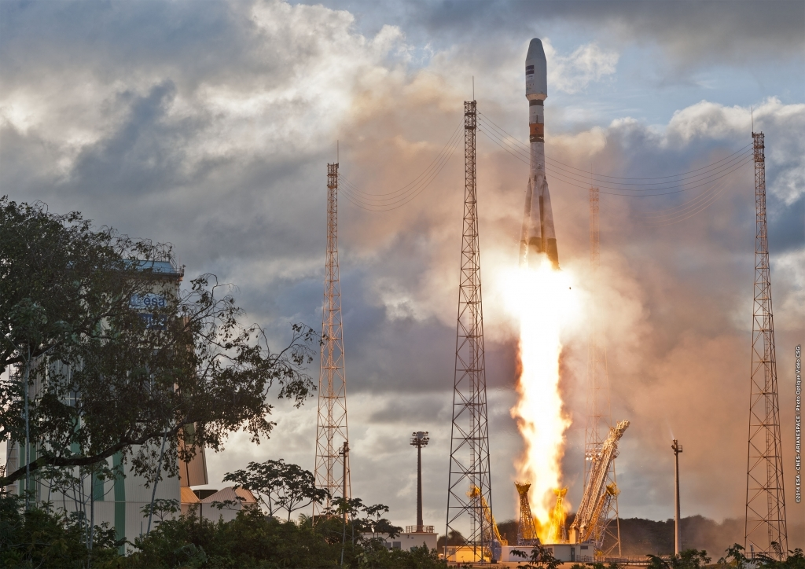
Launch Sentinel-1A
3 April 2014
Kourou spaceport
Soyuz-2 rocket

Slide 4
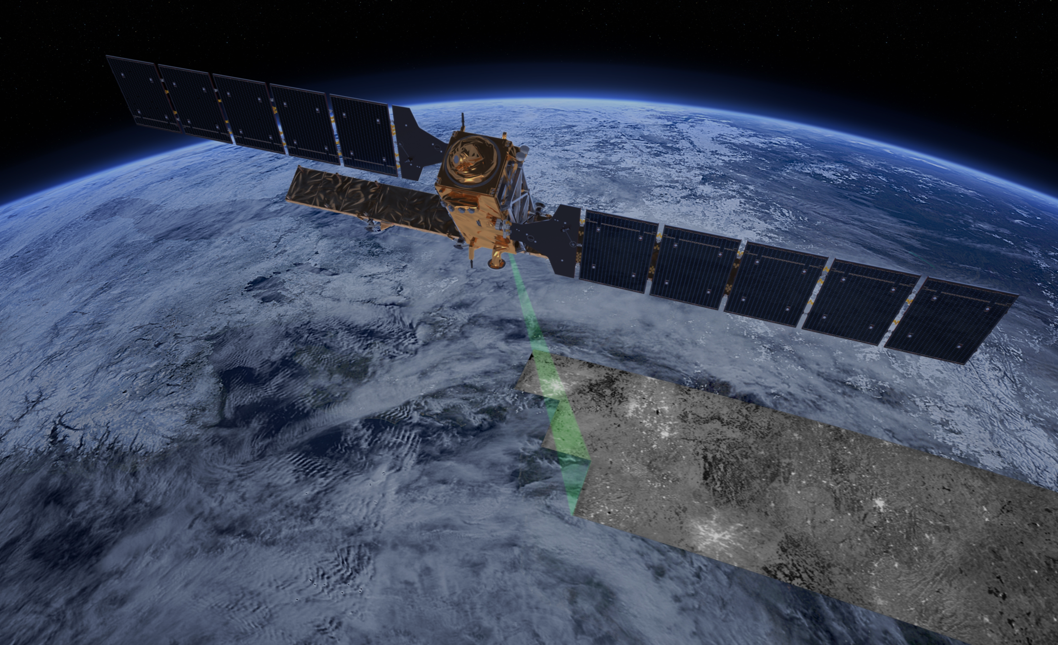
Sentinel-1: Mission Profile
Sun-synchronous orbit at 693 km altitude
Inclination: 98.18˚
7 years lifetime
Consumables for 12 years
Mean LST: 18:00h at ascending node
12-day repeat cycle at Equator (with 1 satellite)
175 orbits/cycle
96h operative autonomy

Slide 5
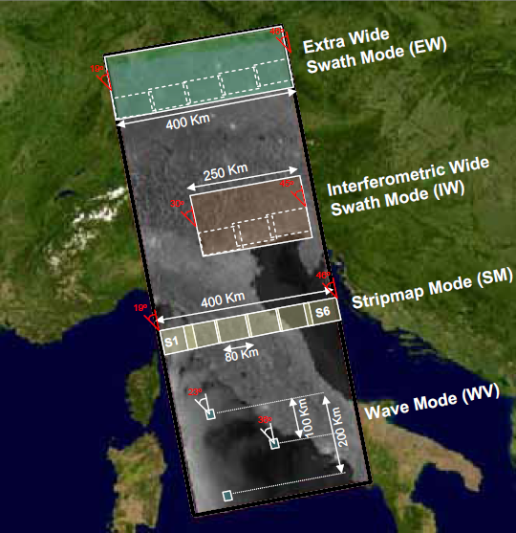
Sentinel-1 Operational Modes
Operational Modes
Resolution | Swath Width | Polarisation
20 x 40 m² | > 400 km | HH+HV or VV+VH
5 x 20 m² | > 250 km | HH+HV or VV+VH
5 x 5 m² | > 80 km | HH+HV or VV+VH
5 x 5 m² | 20 x 20 km² at 100 km spacing | HH or VV
Frequent coverage of high priority areas, e.g. Europe, Canada, shipping routes

Slide 6
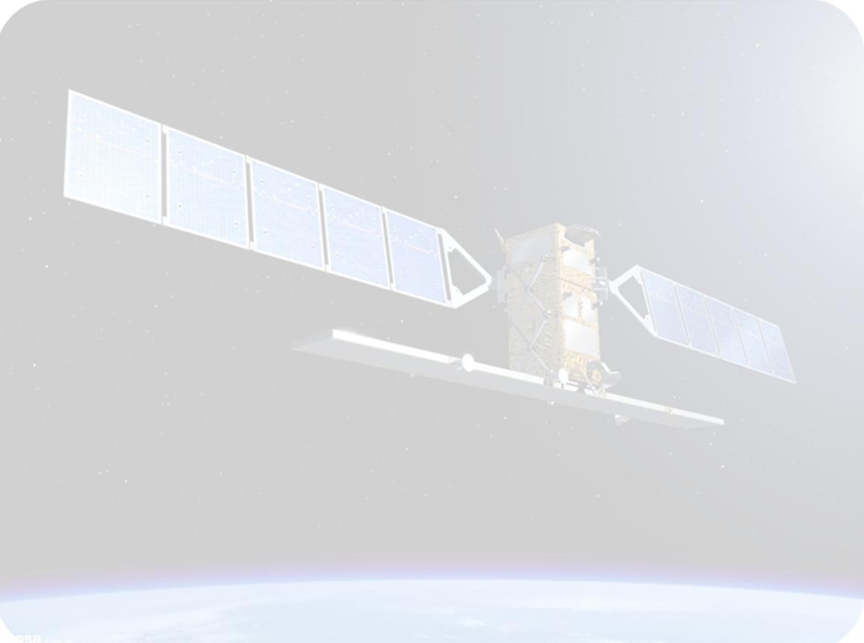
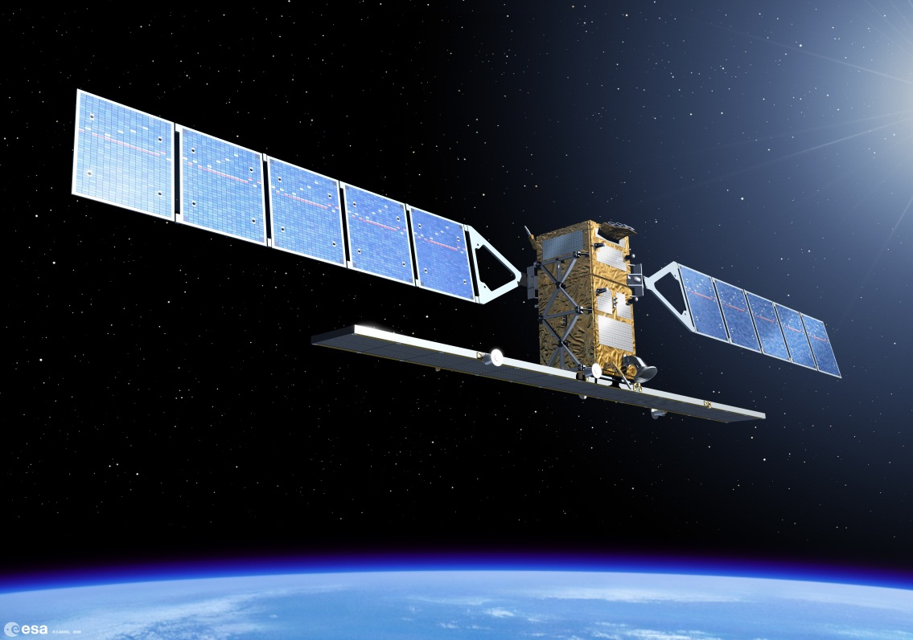
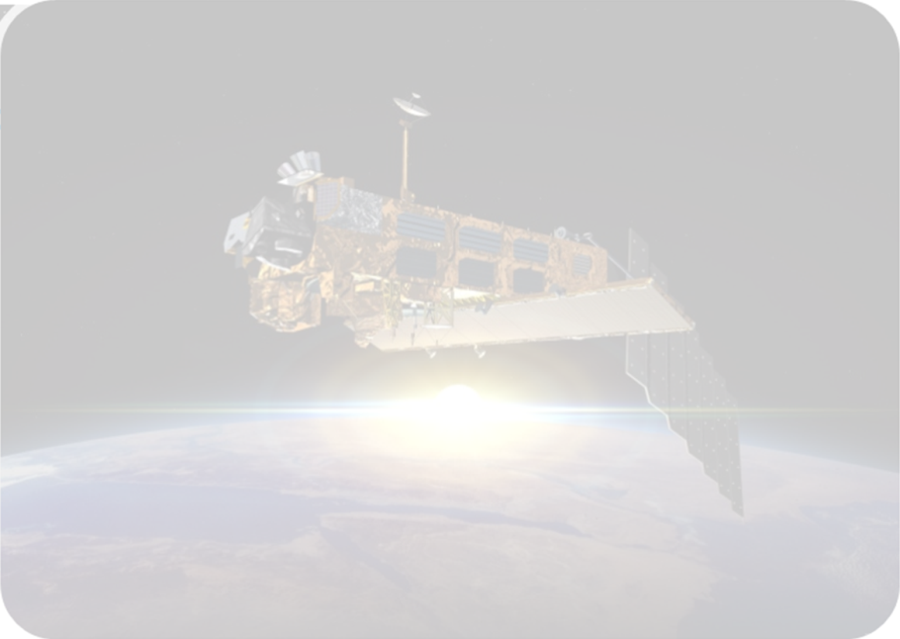
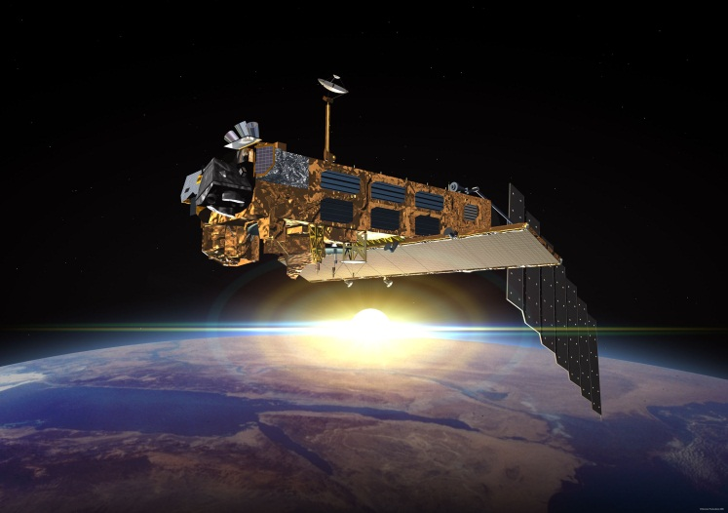
Sentinel-1 Quantum Leap
Sentinel-1
10 m ground range resolution (stripmap mode)
250 km swath width (Interferometric wide swath mode)
6 days repeat cycle (with 2 satellites)
2 x 260 Mb/s downlink data rate
7 years design lifetime (consumables for 12 years)
Optical link to downlink the data to EDRS.
Envisat
20 m ground range resolution
100 km swath width (Imaging mode)
35 days repeat cycle
Up to 100 Mb/s space to ground data rate
5 years design lifetime
Sentinel-1: Twice the sensitivity and thrice the accuracy in Radar imaging quality

Slide 7
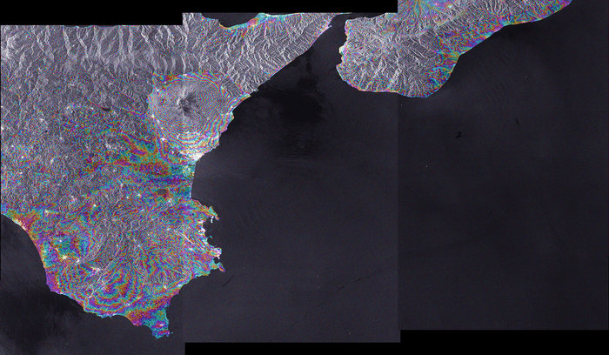
Sentinel-1A Interferogram
Etna slopes
Notes:
Sentinel-1A’s radar acquired the two images that make up this interferogram in its 'Interferometric wide Swath' mode on 9 and 21 August 2014 over Sicily, Italy. The rainbow-coloured fringes mainly denote differences in topography – hence the steep slopes of Mount Etna can be seen clearly. The second image was acquired after the first cycle of the Sentinel-1 satellite in its reference orbit. The interferogram shows a very good quality, demonstrating the sensor’s excellent capability for interferometric applications.

Slide 8
Tentative Sentinel Schedule
Etna slopes

Slide 9
Copernicus Services Component
Services Component
Atmosphere
Emergency Management
Land
Marine
Climate Change
Security
Notes:
Copernicus processes data and provides users with reliable and up-to-date information through a set of services related to environmental and security issues. The services address six thematic areas: land, marine, atmosphere, climate change, emergency management and security. They support a wide range of applications, including environment protection, management of urban areas, regional and local planning, agriculture, forestry, fisheries, health, transport, climate change, sustainable development, civil protection and tourism. Marine environmental monitoring: maritime safety, the marine environment and coastal regions, marine resources as well as seasonal meteorological forecasting and climate monitoring
Land monitoring: focused on a Periodic Land Cover mapping service at European, regional and national level, and on dynamic Land monitoring activities
Atmospheric monitoring: air quality, ultraviolet radiation forecasting, effect of greenhouse gases and aerosols on climate change
Emergency management response: help mitigating the effects of natural and manmade disasters, flood, forest fire, earthquakes and humanitarian aid
Security: maritime surveillance, border control and support to EU external actions
Climate change monitoring: it will use data from land, marine and atmosphere services to allow for the adaptation and mitigation of its effects
Based on the Copernicus services, many other value-added services can be tailored to more specific public or commercial needs. This will create new business opportunities. In fact, several economic studies so far have demonstrated a huge potential for job creation, innovation and growth.

Slide 10
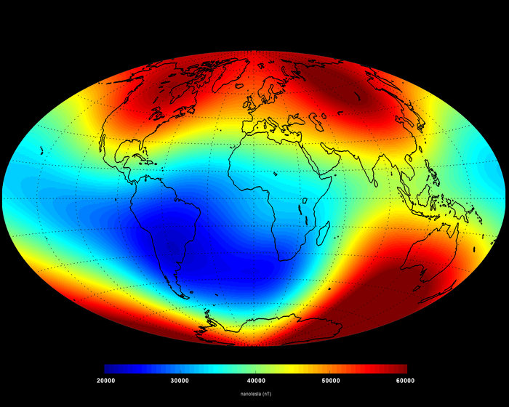
Earth’s Magnetic Field from Swarm Data
© ESA/DTU
Notes:
‘Snapshot’ of the main magnetic field at Earth’s surface as of June 2014 based on Swarm data. The measurements are dominated by the magnetic contribution from Earth’s core (about 95%) while the contributions from other sources (the mantle, crust, oceans, ionosphere and magnetosphere) make up the rest. Red represents areas where the magnetic field is stronger, while blues show areas where it is weaker.

Slide 11
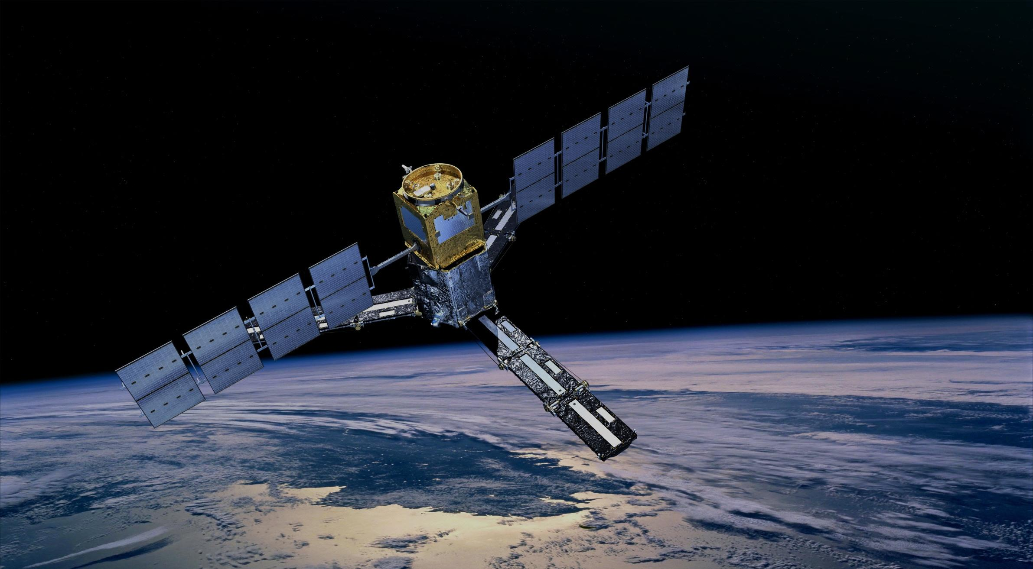
SMOS – Soil Moisture and Ocean Salinity
Mission extension until 2017
Data delivery since February 2010
Complete Earth coverage within three days
Outstanding international cooperation
Notes:
Sea surface salinity measured in psu (practical salinity units)
Soil moisture measured in cubic metre of water per cubic metre of soil
Collaboration with CNES, CDTI, NASA missions Aquarius and SMAP (the latter will be launched in 2014)

Slide 12
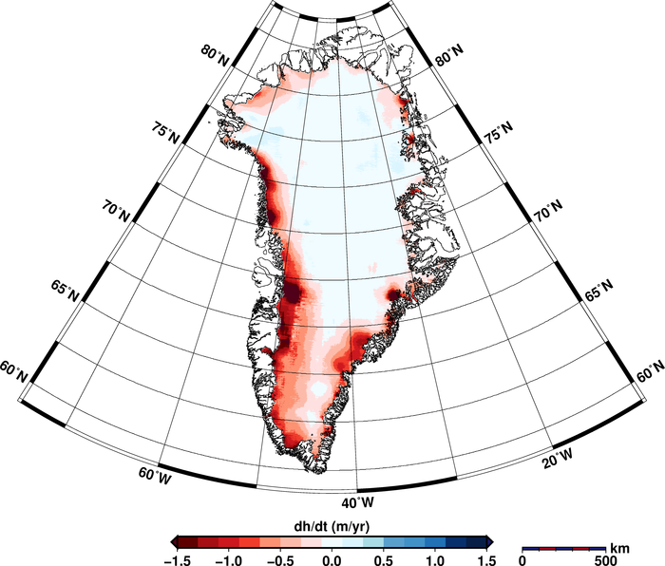
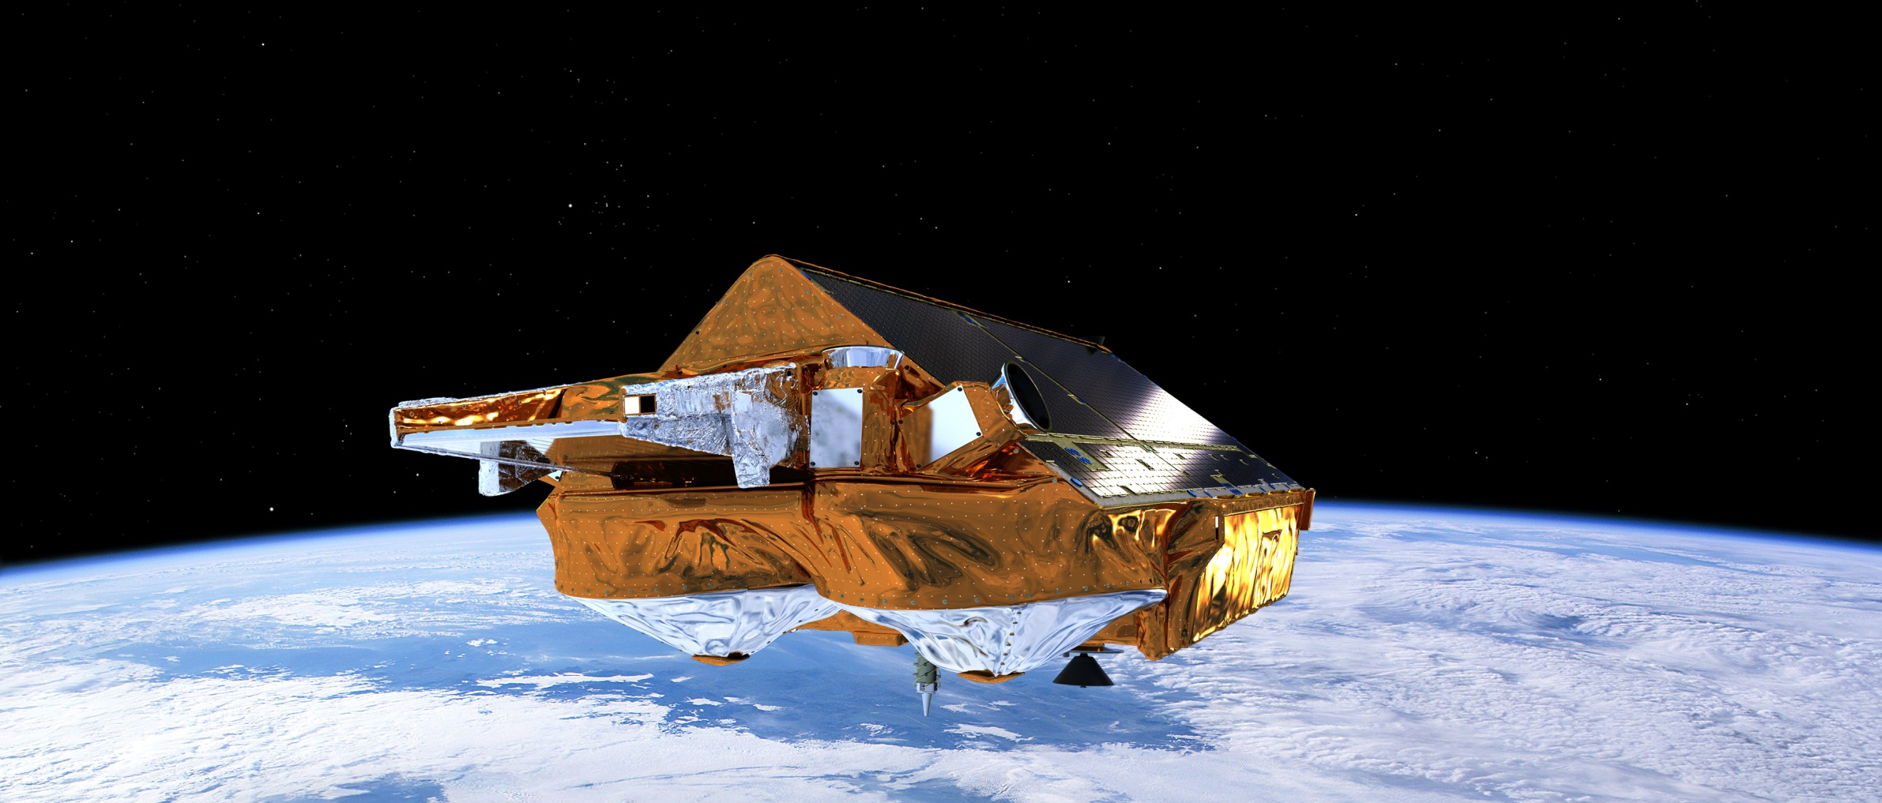
CryoSat: The Ice Mission
Mission extension until 2017
First interferometric altimeter in space
Global sea ice thickness measurements
Data used for ice research, but increasingly also for oceanography
© Helm et al.
(Alfred Wegener Institut)
The Cryosphere,
2014
Notes:
Using 14.3 million measurements collected by ESA’s CryoSat mission between January 2011 and January 2014, researchers from the Alfred Wegener Institute in Germany have discovered that the Greenland ice sheet is shrinking in volume by 375 cubic kilometres a year. The study, which was published in a paper published on 20 August 2014 in the European Geosciences Union’s Cryosphere journal, also showed that Antarctica is losing about 125 cubic kilometres a year.

Slide 13
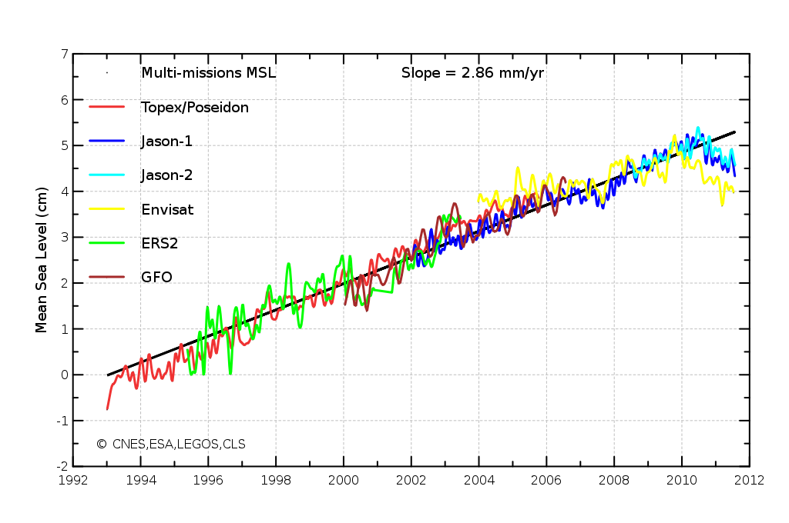
The ESA Climate Change Initiative (CCI)
Phase I successfully completed (14 projects, more than 170 peer reviewed papers)
Phase II started for 10 projects, 4 more to follow
© Getty Images
Notes:
To respond to the need for climate-quality satellite data, ESA has set up the ESA Climate Change Initiative. A €75m programme, it will run from 2009 - 2016 and consist of three stages: requirement analysis, algorithm development and prototype ECV building; ECV production and system development; and user analysis and feedback.
The aim of the programme is:
To realise the full potential of the long-term global Earth Observation archives that ESA, together with its member states, has established over the last thirty years, as a significant and timely contribution to the ECV databases required by United Nations Framework Convention on Climate Change (UNFCCC).
The goal is to provide stable, long-term, satellite-based ECV data products for climate modellers and researchers. The ECVs will be derived from multiple satellite data sets (not just ESA but all sources via international collaboration) and include specific information on the errors and uncertainties of the data set. Comprehensive information will also be provided on calibration and validation, long term algorithm maintenance, data curation and reprocessing. The Climate Change Initiative will bring together European expertise covering the full range of scientific, technical and development specialisations available within the European Earth Observation community, and will establish lasting and transparent access for global climate scientific and operational communities to its results.
An updated curve from CCI including data until 2013 will be available roughly mid-2014. There are updated versions of the curve to be found on the net, but they do not feature the same data quality. (Jerome Benveniste)

