Slide 1
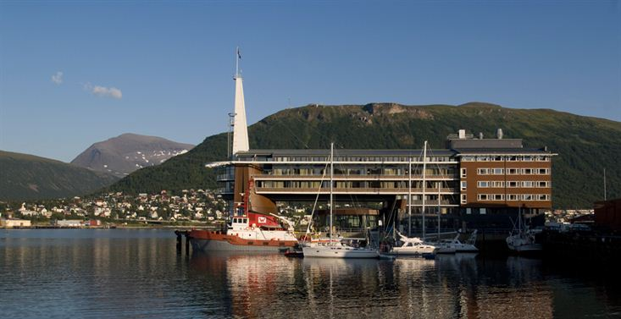
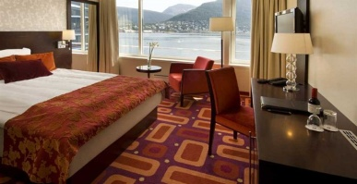
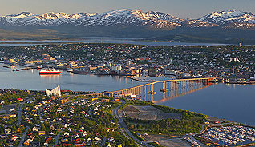
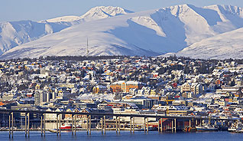
Progress on EUMETSAT Satellite Programmes
Alain Ratier, Director-General
CEOS Plenary, Agency Reporting Session
Tromsø, Norway
28-30 October 2014

Slide 2
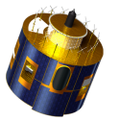
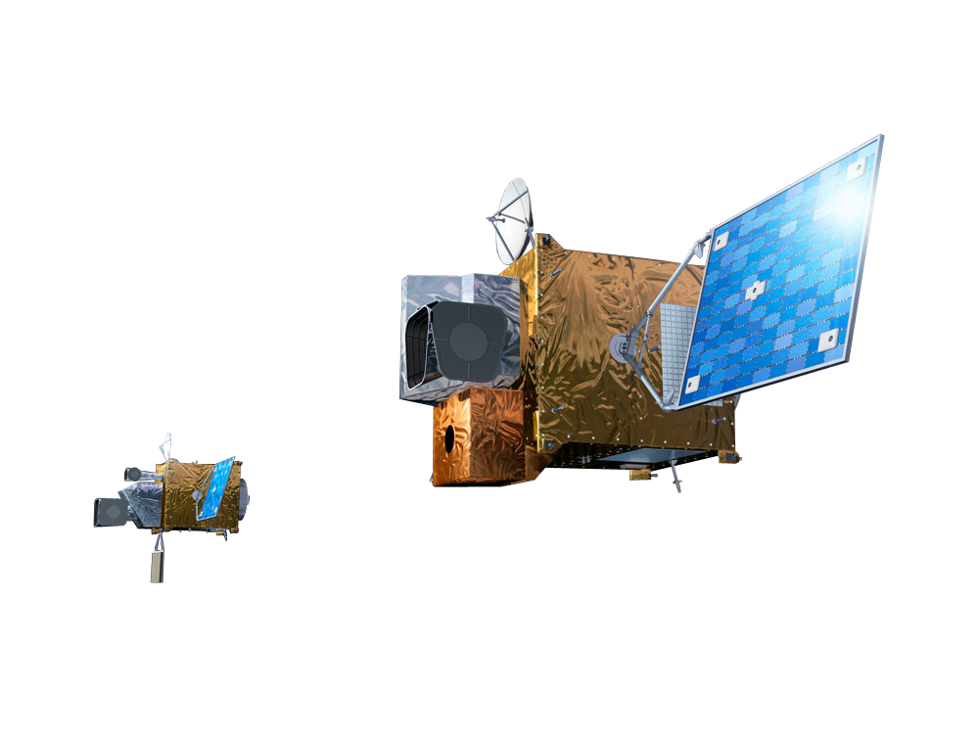
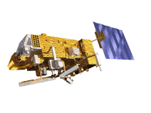
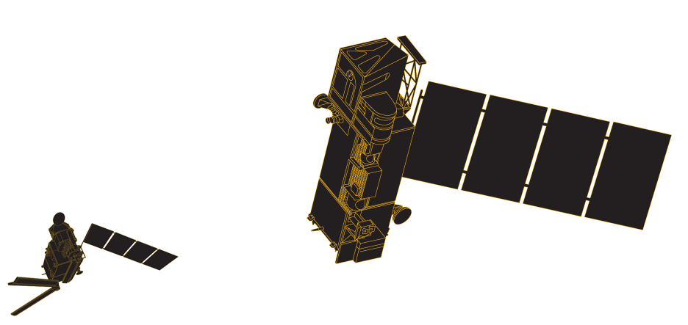
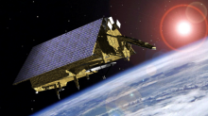
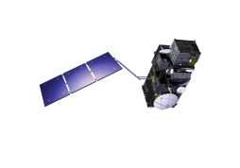
EUMETSAT satellite programmes – Long term planning
YEAR...
03
04
05
06
07
08
09
10
11
12
13
14
15
16
17
18
19
20
21
22
23
24
25
26
27
28
29
30
31
32
33
34
35
36
37
38
39
40
METEOSAT SECOND GENERATION
METEOSAT-8
METEOSAT-9
MSG-3/METEOSAT-10
MSG-4/METEOSAT-11*
METEOSAT THIRD GENERATION
MTG-I-1 : IMAGERY
Mandatory Programmes
MTG-S-1: SOUNDING
MTG-I-2: IMAGERY
MTG-I-3: IMAGERY
EUMETSAT POLAR SYSTEM (EPS)
MTG-S-2: SOUNDING
METOP-A
MTG-I-4: IMAGERY
METOP-B
METOP-C
EPS-SECOND GENERATION (EPS-SG)
METOP-SG: SOUNDING AND IMAGERY
METOP-SG: MICROWAVE IMAGERY
Optional Programmes
JASON
JASON-2
JASON-3
SENTINEL 6 (JASON-CS)
Third Party Programmes
COPERNICUS
SENTINEL-3
SENTINEL-4 ON MTG-S
SENTINEL-5 ON EPS-SG
YEAR...
03
04
05
06
07
08
09
10
11
12
13
14
15
16
17
18
19
20
21
22
23
24
25
26
27
28
29
30
31
32
33
34
35
36
37
38
39
40

Slide 3
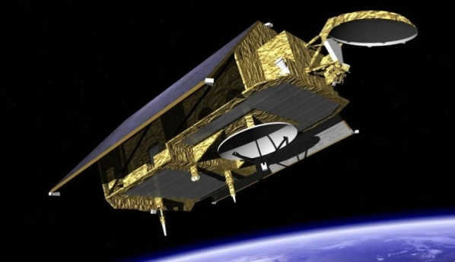
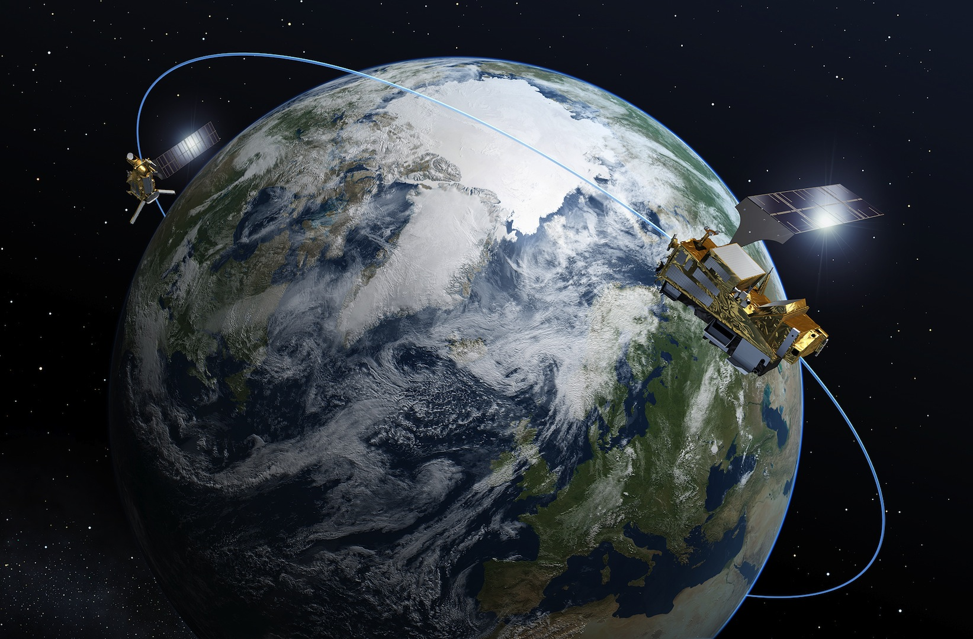
Future programmes shape the 2018 – 2040 timeframe
MTG: Approved, under development
Sentinel-4 approved (2 instruments funded by ESA)
Jason-CS / Sentinel-6 : Proposed,
to be approved in 2015
Phase B2 approved at ESA CMIN12
EPS-SG : approval process started in July 2014
Metop-SG programme approved at ESA CMIN12
Sentinel-5 development started/approved at ESA PBEO

Slide 4

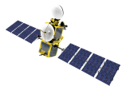

Future launches: 10 satellites in orbit in 2015
ASCAT Coastal
MSG-4 launch mid 2015 (for in orbit storage)
Jason-3 launch (with CNES, NOAA, NASA) in March 2015
From mid 2015, EUMETSAT will operate Copernicus Sentinel-3 with ESA on behalf of the EU, focusing on the Marine Mission
  Metop-C launch planned in Q3 2018
ASCAT
OSCAT

