Slide 1
Committee on Earth Observation Satellites
Virtual Constellations – Status and issues
SIT Chair
Plenary Agenda Item #
29th CEOS Plenary
Kyoto International Conference Center
Kyoto, Japan
5 – 6 November 2015

Slide 2
VC Status and issues
Content
The SIT Chair Team has maintained closed interaction with the VCs and WGs over the past year, as was done in the first year of my term
This interaction used regular teleconferences, held twice a year, and aiming at identifying potential issues requiring SIT decision or action, and at preparing the SIT and Technical workshop meetings
This interaction also used a new event, the “VC/WG Day”, aimed at enabling a better understanding between VCs & WGs and promoting collaboration among the various groups (value added of CEOS ).
VC/WG Days took place on 16 September 2014 and 2015, inaugurating what promises to be a very fruitful series of 16 Septembers 20xx.
The present report presents the status and issues of the six active VCs, and introduces the new Terms of Reference and proposed Implementation Plan of a revived Land Surface Imaging Constellation, submitted for endorsement by Plenary.

Slide 3
ACC-VC Air Quality Constellation
Air Quality Missions
3 geostationary missions to be launched in the timeframe 2020 in Europe (Sentinel-4), Korea (GEMS) and in the USA (TEMPO)
1 polar-orbiting mission to be launched in Europe next year (S-5P)
Ongoing Activities
Data harmonization activities are underway: Mission leads have been sharing specifications
An Air Quality Constellation Geophysical Validation Document is being prepared based on mission specific requirements being developed by the respective agencies
Next: identify goals/approaches for common constellation products and their validation;
Past and upcoming airborne field campaigns offer potential for ongoing collaborative GEO mission preparation and possibly early S-5P cal/val;
AROMAT Romania 2015, 2016 (ESA)
KORUS-AQ Korea 2016 (Korea NIER, US NASA)

Slide 4
ACC-VC – GHG Constellation
The ACC Response to the CEOS Strategy for Carbon Observations
Huge efforts ongoing in Europe (CCI), Japan and the US to exploit SCIAMACHY, GOSAT, IASI and OCO data
A series of GHG missions are proposed/under preparation (Japan: GOSAT-2, China: TanSat, Europe - MERLIN, MicroCarb, IASI-NG, G3E)
Ongoing Activities
ACC will support the organization of the annual International Workshop on Greenhouse Gas Measurements from Space (IWGGMS)
Agree on an open data policy for GHG data from space and ground-based/in situ data
Share/agree on mission requirements and support the establishment of a common product format (share specifications, metadata definition, etc.)

Slide 5
ACC-VC – GHG Constellation (cont’d)
Ongoing Activities (cont’d)
Improve interaction/co-operation among space agencies on GHGs
Ensure close interaction between GHG and Air Quality measurements
Support the establishment of common Cal/Val standards (e.g. pre-calibration procedures, perform algorithm intercomparison, provide traceability information, use the same spectroscopy)
Support the continuation/possible extension of the TCCON network
Link into other related activities, including in situ measurement coordination (e.g., an Integrated Global Greenhouse Gas Information System)

Slide 6
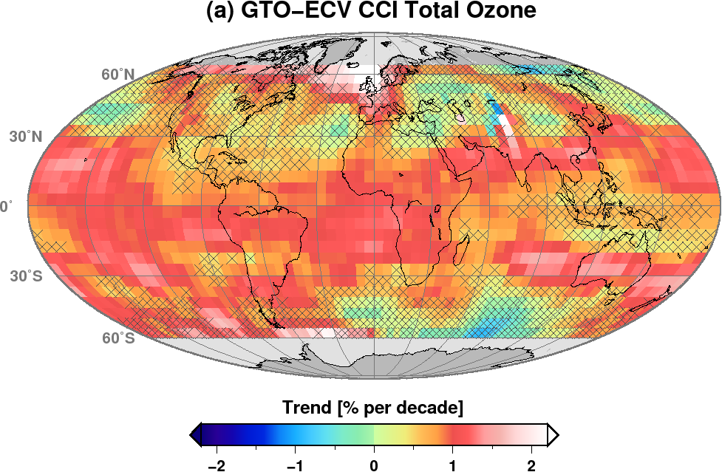
ACC-VC – Long-Term Ozone Data Set Harmonization
Ozone Trend Detection: Global and Regional Monitoring is needed
Combined (USA/Europe) ACC Data Sets
Replace (monthly) zonal mean values by 5 x 5 deg values – need for taking sampling errors into account
Extend ongoing total ozone activities to nadir profiling data
Next ACC meeting planned during summer 2016 in Korea (National Institute for Environment Research)
Future Missions Gap: Limb/occultation measurement gap is imminent!
Linear total ozone trend estimates 1995–2013 from satellite data GTO-ECV CCI

Slide 7
Precipitation P-VC – Results/Status
P-VC Data Portal Phase 2 development completed
VC-16 Closed
Precipitation ECV support – Response to GCOS Action A8 – Ensure continuity of satellite precipitation products
TRMM satellite was decommissioned in mid-April and reentered the Earth’s atmosphere over the Indian Ocean on June 16 UTC.
Its 17+ years of data substantially contributed to the P-VC and it served as the anchor for the ad hoc constellation prior to GPM’s launch in 2014 (Deliverable #1)
Cross-Calibration WG analyzed and recommended the GPM Microwave Imager calibration (<<1K for the 13 channels) based on data from GPM Calibration Attitude Maneuvers (Deliverables #2, #3, #4, and #5).
Precipitation Processing System/Mission Operation System achieved production and distribution of all GPM Standard Data Products to public users. Several NRT multi-satellite precipitation estimates are being produced as well as NRT multi-satellite flood and landslide prediction products (Deliverables #2, #3, #4, and #5).

Slide 8
P-VC – Results/Status (cont’d)
Deployment of GPM phase constellation satellites
GPM Core Observatory completed first year of mission operations
GPM constellation satellites operating nominally
Some early indications of aging – S-NPP/ATMS, GCOM-W1/AMSR2
Upcoming additions to constellation are JPSS-1 (2017), Metop-C (2018)
Advocacy of post-GPM phase Precipitation Virtual Constellation
GPM Future Outlook meeting held on sidelines of 2015 PMM Science Team meeting as well as preparatory meetings
Preparing White Paper for submission in response to 2017 NRC Earth Science Decadal Survey RFI

Slide 9
P-VC – Issues
Concerns regarding Microwave Imager continuity (GCOM-W2, -W3, DMSP FO) and Precipitation Radar measurements following GPM Core
See following Roadmap slide
For Information – no action requested

Slide 10
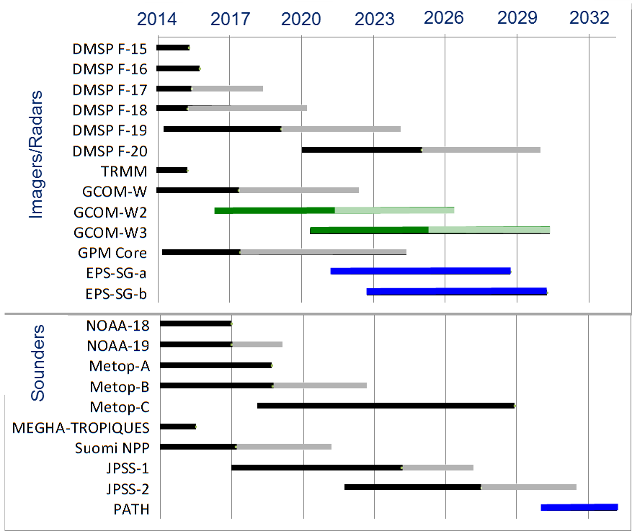
P-VC Roadmap
Other missions of interest are:
Current: Cloudsat (CPR), MSG/Meteosat-9/-10 (SEVIRI), GOES 13/14/15 (Imager), MTSAT-2 (Imager/MTSAT), FY-3B/C (MWRI), Meteor-M N1 (MTVZA).
Future: EarthCARE (CPR), MTG-I1 (FCI), GOES-R/S/T (NOAA), DMSP FO (MWI), FY-3 D/F (MWRI), Meteor M N2-1/-2 and N3 (MTVZA), Meteor M3 series (Advanced MTVZA), PATH, ACE, GPM FO
MW Imager and precipitation Radar continuity gap

Slide 11
P-VC – 2016 Milestones
P-VC will continue to complete its 3-year outcomes (per P-VC ToR v1.0, November 2013)
Includes VC-17 and VC-18
P-VC support to CEOS Strategy for Water Observations from Space response to recommendations
C1 (TBC): FS on Water Constellation
C2, C3 : participation in GEO water vapor and cloud activity
C4, C5 (TBC): participation in the development of precipitation white paper

Slide 12
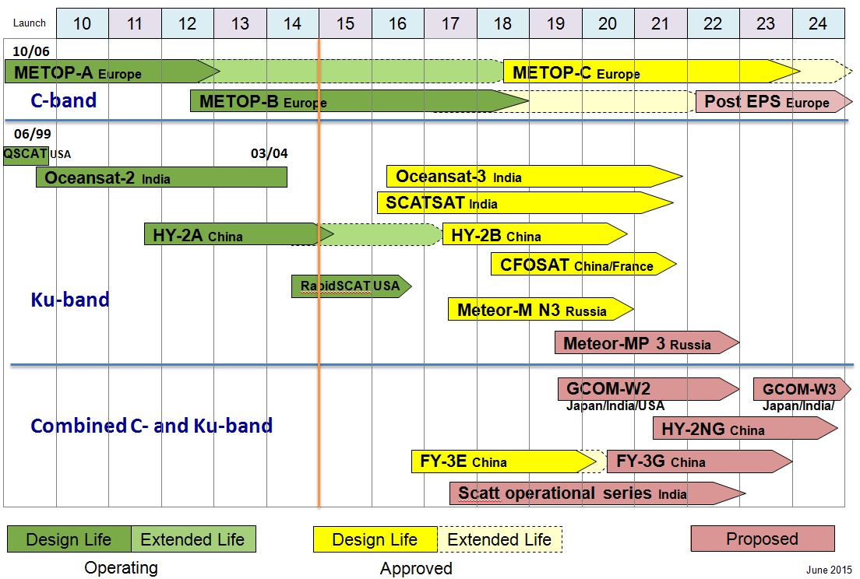
OSVW-VC – Scatterometer constellation status

Slide 13
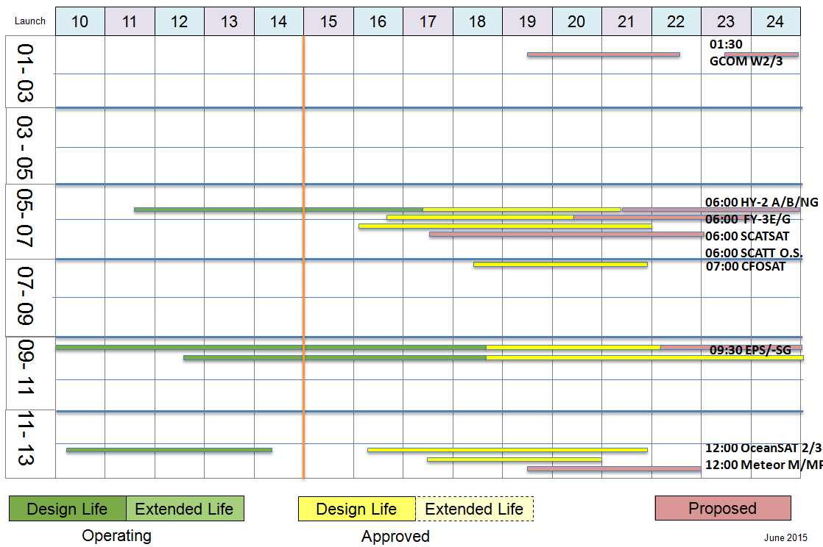
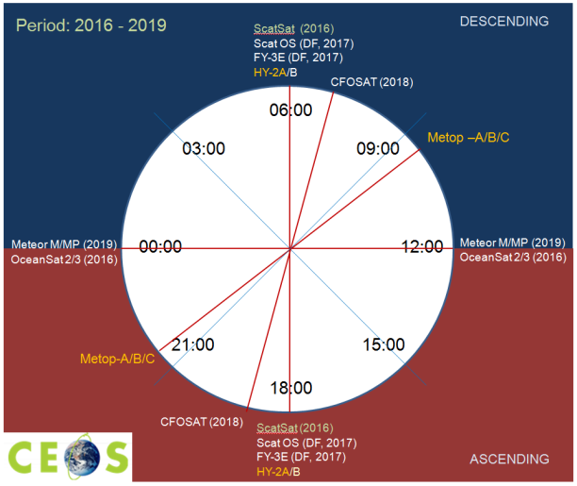
OSVW-VC – Scatterometer constellation status (cont’d)
As a function of local time

Slide 14
OSVW-VC – Status and main topics since last Plenary
Addition of RapidSCAT to the constellation – first opportunity to look into the diurnal cycle, helping to refine the optimum constellation requirement: at least three missions in sun-synchronous orbit (WMO driven), plus one in non sun-synchronous orbit to resolve the diurnal cycle to improve inter-calibration
ScatSAT launch and validation expected early 2016 – work on facilitating data access operationally already ongoing
Updated CEOS web page
Progress on updating the IDN for ASCAT data sets
IOVWST working groups followed up and with VC participation:
On data formats and standards
On climate data sets – main focus being the integration of Ku- and C-band winds
On high winds characterisation and validation - workshop coming up in December 2015

Slide 15
Sea Surface Temperature SST-VC – Current activities
SST-VC meeting #4 took place at ESA-ESTEC on 24 July 2015 (following GHRSST-16)
Supported invitations to NSOAS and CMA China (CMA sent regrets), ROSHYDROMET (Russia, no reply)
New ISRO member welcomed October 2015
Satellite Oceanography User Workshop, Melbourne, 9-11 Nov 2015
https://www.ghrsst.org/ghrsst/Meetings-and-workshops/satellite-oceanography-user-workshop/
Possible SST-VC presentation to IOVWST in Sapporo, May 2016
SST-VC meeting #5 planned for 10 June 2016, at NOAA, USA
VC-1: 81 GHRSST products now in archive.
VC-19: First draft of white paper in progress.

Slide 16
SST-VC – 2016 plans
VC-1: Regional/Global task sharing activities continue
VC-19: First draft of white paper to be completed by the end of 2015, publication early 2016
White Paper will include next generation SST Virtual Constellation, including necessary on-orbit assets, measurement methods (MW and IR, Geo and Polar), climate/NWP applications, fiducial reference measurements, and data management systems.
Dual view IR reference to be solved by Copernicus S3 SLSTR (Dec 15)
Complete geo latitudinal coverage -> ISRO and hopefully CMA

Slide 17
SST-VC – Issues
Remaining issues on SST constellation
Redundant capability of passive microwave radiometers with 6 GHz channel is needed (e.g. continuation of GCOM-W)
More progress needed. Contact with NSOAS (HY-2); ISRO
Considerations by space agencies
Need to ensure continuity of existing capability
How can the coordination of agencies be facilitated to ensure continuity and redundancy of passive microwave radiometers?
More interactions between the VC’s on common issues

Slide 18
Ocean Color Radiometry OCR-VC – Status report
Progress wrt action items in the CEOS 3-year Work Plan
VC-7 – Agency mapping exercise (catalog of Cal/Val infrastructure and activities) complete. IOCCG now has a permanent seat on WGCV.
VC-8 – Implementation plans for Blue Planet being formulated/executed. OCR-VC agencies actively support the GEO Blue Planet Components
VC-9 – INSITU-OCR moving forward with modular implementation. The ultimate goal is to enable communication about the refinement of in situ measurement protocols and to reduce redundancy in efforts, fill in gaps, and better target opportunities and key players
VC-10 – Implementation plans for Water Quality Community of Practice being formulated/executed.

Slide 19
Ocean Surface Topography OST-VC – Status report
OST-VC Aims
Provision of a coordination mechanism to harmonize satellite ocean surface topography payloads, data processing and calibration/validation infrastructures;
Serving as a programmatic point of contact for the global satellite ocean surface topography measurement system as a whole, addressing issues which go beyond the individual mission programmes, such as orbit optimisation;
Establishing and maintaining an international consensus on the structure of the minimum altimetry constellation that fulfils user needs;
Supporting and engaging the active user community, structured through a Science Team for Ocean Surface Topography (as currently implemented by the OSTST whose yearly meetings serve as focal point for international coordination.)

Slide 20
OST-VC – Status report (cont’d)
OST-VC Activities
OST-VC management:
CNES Membership: P. Escudier taking over from J. Lambin
ISRO Membership: R.M. Gairola
No dedicated VC meeting planned in 2015.
Missions:
Jason-3 launch postponed : 16 Dec 2015 (TBC)
Sentinel-3A launch postponed : 27 Dec 2015 (TBC)
Sentinel-6/Jason-CS: Program approved by ESA and EUMETSAT.
Altimetry SAR mode: (Cryosat-2/sentinel-3/Jason-CS)
Development/alignment of Level 1 products
Development of training
Update Constellation User Requirements Document:
To be re-defined from on-going studies

Slide 21
OST-VC – Past Roadmap
Launch
Date
01
02
03
04
05
06
07
08
09
10
11
12
13
14
15
Reference Nadir Missions (Non Sun-Synchronous)
Jason-1 FR/EU/USA
08/92
TOPEX/POSEIDON FR/USA
Jason-2 FR/EU/USA
Complementary Nadir Missions
ENVISAT EU
04/95
ERS-2 EU
Saral/AltiKa FR/Ind
02/98
GEOSAT FO USA
CRYOSAT-2 EU
HY-2A CN
Past
Operating
HB: Oct 2015

Slide 22
OST-VC – Future Roadmap
Launch
Date
13
14
15
16
17
18
19
20
21
22
23
24
25
26
27
Reference Nadir Missions (Non Sun-Synchronous)
20/08
Jason-2 FR/EU/USA
Jason-CS-A/Sentine-6-A EU/USA
Jason-3 FR/EU/USA
JCS-B EU/USA
Complementary Nadir Missions
02/13
Saral/AltiKa FR/Ind
Sentinel-3A EU
Sentinel-3B EU
Sentinel-3C EU
Sentinel-3D EU
04/10
CRYOSAT-2 EU
08/11
HY-2A CN
HY-2C CN
HY-2B CN
HY-2D CN
Broad-Coverage Mission
SWOT USA/FR
Compira JP
Operating
Development
Proposed
HB:Oct 2015

Slide 23
Land Surface Imaging LSI-VC – Proposed ToRs
LSI-VC Terms of Reference – Mission Statement
The Land Surface Imaging Virtual Constellation exists to maximize the value derived from CEOS agency land surface imaging assets and activities by providing an overarching coordination role.
The responsibility of the LSI-VC is to facilitate coordinated and optimized land surface imaging contributions from CEOS agencies to enable access to fundamental measurement products in support of confirmed/validated requirements linked to adopted CEOS priorities. These priorities are typically derived from key stakeholders, such as UN agencies/programs and GEO.
Since SIT-30
June 30, 2015 – final draft of the LSI-VC implementation plan and revised Terms of Reference to the SIT Chair team for consideration.

Slide 24
LSI-VC – Implementation horizon revised
 | 3-Year Horizon | 5-Year Horizon
Space Segment | Aggregate and analyze multiple sets of validated, domain-specific requirements to identify gaps and opportunities for optimization and improve interoperability and complementarity Optimize and harmonize CEOS Agency global data collections, as much as possible. | Harmonize acquisition plans across major international land surface imaging programs to support validated domain-specific requirements
Ground Segment and Information Systems | Explore architectures for future distribution that would potentially enable the analysis of very large land surface imaging datasets, trialed across at least three nations/regions Stimulate an environment conducive to the creation of analysis-ready data to enhance usage and exploitation of the CEOS data portfolio for land surface imaging | Establish the framework for an architecture network for analysis of very large land surface imaging data sets
Products and Services | Produce 1-2 compatible, non-domain-specific measurement products derived from one sensor and produced by multiple agency systems | Produce 4-5 compatible, non-domain-specific measurement products derived from 3-4 sensors and produced by multiple agency systems

Slide 25
LSI-VC – Proposed Implementation plan
Framework Considerations
The desire to address ‘pressing issues’ of strategic concern to CEOS and CEOS Agencies.
The need to work with the resources that agencies can realistically provide.
The need to re-build momentum by implementing solutions that work, thereby encouraging additional CEOS agencies to buy-in and contribute.
The desire, and need, to ensure strong linkages with other CEOS Entities. This builds on the linkages identified in the Terms of Reference.
The Land Surface Imaging Virtual Constellation
Draft Implementation Plan, v.1
June 29, 2015

Slide 26
LSI-VC – Proposed Implementation plan (cont’d)
Proposed Focus Themes
Optimizing and harmonizing where feasible global data collections (with an ever increasing volume expected).
Promoting analysis-ready data (with the goal to minimize the need for the end user to understand satellite/pass/sensor-specific processing).
Exploring how new approaches to management/analysis of large data structures (e.g. Data Cubes) can be implemented and sustained.
Addressing the actions identified for LSI-VC by the CSIST, as a pathfinder to broader approaches to analyzing land surface imaging requirements.

Slide 27
LSI-VC – Proposed Implementation plan (cont’d)
Phased Approach
Three phases (over a 3 year period) where the outcome of each phase will lay the groundwork for each subsequent phase
Phase 1 – 2015-2016 (assessing, identifying, scoping and defining)
Identify gaps/opportunities in acquisition planning in support of CEOS Carbon Strategy
Develop agreed definitions of intercomparable Analysis Ready Data (ARD) products in the context of land surface imaging
Engage with implementation of trial ‘data cubes’
Assimilate and incorporate lessons learned from an SDCG for GFOI scoping study for global data flows for long time series land surface imaging data
Phase 2 – 2016-2017; involves pilot approaches and development of road maps (e.g. building toward an integrated set of ARD)
Phase 3 – 2017-2018; involves working toward implementation to meet or exceed the goals established in the 3 year horizon in the ToRs

Slide 28
LSI-VC – Proposed Endorsement by Plenary
The CEOS Strategic Implementation Team accepted the revised Terms of Reference and Implementation Plan at its Technical Workshop in Darmstadt on 17-18 September 2015.
Therefore the SIT recommends the 29th CEOS Plenary
To endorse the submitted update to the LSI-VC Terms of Reference
To endorse the submitted LSI-VC Implementation Plan.

