Slide 1
CEOS Chair Priorities for 2017
Committee on Earth Observation Satellites
Frank Kelly, USGS
CEOS Plenary 2016
Agenda Item # 10.6
Brisbane, Australia
1st – 2nd November 2016

Slide 2
2017 CEOS Chair Objectives
Ensure continuity and coherence of current CEOS activities
Ensure that the priorities and themes identified by the outgoing Chair (CSIRO) and the current SIT Chair (ESA) are supported and further developed through 2017
Chair (CSIRO)
Future Data Access & Analysis Architectures
Non-meteorological Applications for Next Generation Geostationary Satellites
SIT Chair (ESA)
Consideration of future partnerships and priorities for CEOS, notably with GEO, the UN system, development banks, and the big data players
Expediting existing CEOS thematic acquisition strategies – in relation to forests, agriculture, disasters, climate, carbon and water
Pursue 2017 Chair Initiatives

Slide 3
2017 Chair Initiatives
2017 Chair Initiatives
Future Data Architectures Continuation
Moderate Resolution Sensor Interoperability

Slide 4
Future Data Architectures
Continuation
Approval for the Ad-hoc Team on Future Data Access and Analysis Architectures to continue for a further year to complete the mandate and to pursue confirmation of the Co-Chairs.
Agreement for the proposed pilot project(s) to be progressed in parallel with the ongoing report work, with oversight by the FDA team and contributions from LSI-VC, SEO, and SDCG.
Invitation for further proposals for practical demonstrations in the area of FDA for ‘lessons learnt’ evaluation by CEOS Principals at CEOS-31.
Action for CEOS and SIT Chairs to confer with the FDA Team to ensure necessary CEOS Principal engagement on the strategic issues arising from the 2017 Report, in support of identifying common ground as the basis for a long-term CEOS strategy.

Slide 5
Moderate Resolution
Sensor Interoperability
Priority #1: Generally applicable framework for land moderate resolution interoperability
Led by LSI-VC (with SEO support)
Comprehensive framework that includes characteristics such as radiometry, geometry, data formats, browse, metadata, data access, metrics, and reporting
Priority #2: Case Studies. Document, publish, and communicate clearly to the community the objectives and intended uses of the interoperable products
Led by WGCV & WGISS (with LSI-VC and SEO support)
Case Study #1: Landsat-Sentinel-2 Interoperability
Other Case Studies welcomed
Moderate resolution = 10 – 100m

Slide 7
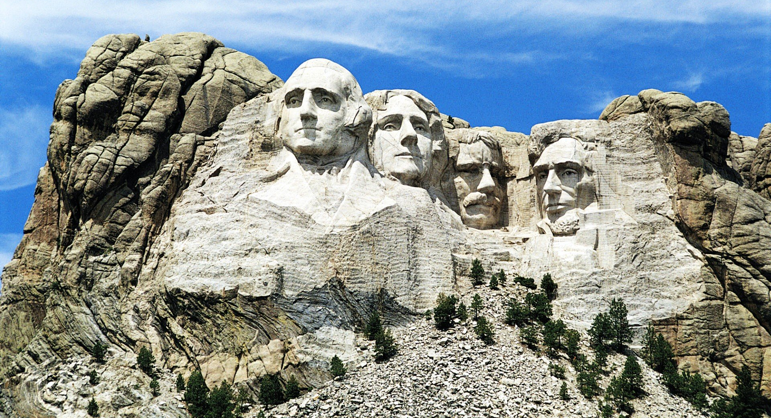
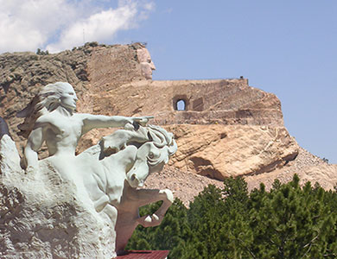
Questions?
We look forward to welcoming you to Rapid City, South Dakota and the Black Hills National Forest – 18th-20th October 2017!

Slide 8
Looking forward to seeing you in the Wild West!
Reach for the SKY!

