Slide 1
Future Data Access and Analysis Architectures
Committee on Earth Observation Satellites
Ad hoc Team
CEOS Plenary 2016
Agenda Item 5.2
Brisbane, Australia
1st – 2nd November 2016

Slide 3
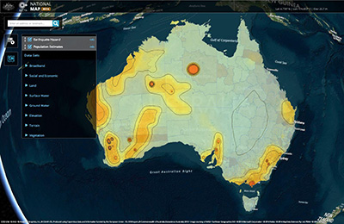
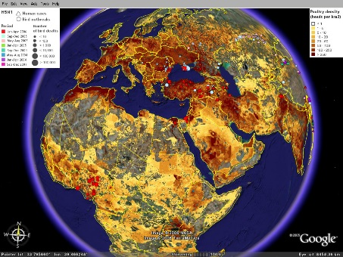
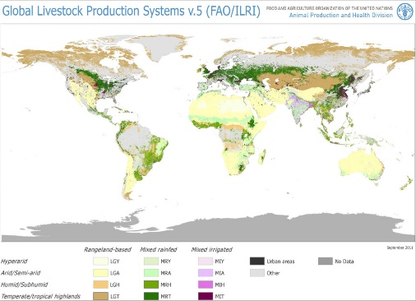
Current development and priorities
Digital Economy
SME direct Cloud hosting
Entrepreneurship
Economic benefit
Growing EO Awareness
Increasing value
Continued investment
Significant activity
Global Services and Partnerships
UN Sust Dev Goals
Development banks
Food, Ag, Climate
CEOS
Open Data, Interoperable data discovery, New missions
Notes:
The FDA AHT surveyed current developments and priorities from a range of agency contributions and confirmed that there are both challenges in the operating environment and opportunities.
Of particular note in the current development and priorities as it relates to CEOS as a community that recognises the need for coordination:
+ Strong investment driven directive to Maximise the value of EO – Industry/economic benefit
+ Contribution to Global initiatives – interoperate and integrate (analysis)
+ Engagement with Developing countries – access to data and analysis
Also noted a Growing EO awareness (thanks to all the mapping apps!) is resulting in continued investment and Significant activity
Finally, the work of CEOS and others in Open data, Interoperable data discovery (thank you WGISS) and new missions and cooperation is having valuable impact.

Slide 4
Significant change Significant opportunity
Substantial expectation of growth in the EO based digital economy across Industry and Government
A step change in EO satellite capability over the next 5 years leading to new applications
Freely available data and Cloud computing combine to create new industries
New applications from new capabilities in EO
Increased awareness leads to more (non-EO expert) users
Higher spatial resolution
Greater diagnostic capability through increased spectral resolution (hyperspectral) and new modalities (active and passive radar)
New capabilities in monitoring through increased acquisition rate
Notes:
The report also shows a number of changes are providing new opportunities and putting pressure on existing architectures and their ability to meet demand and expectations.
Of those two significant ones are (see slide)…
1. The expectation of growth in the EO digital economy by investors in the agency missions is substantial. In addition, the expectation from industry and consumers has also been changed with the growing awareness of value of EO data. The ubiquity of EO mapping type applications, the apparent ease of large and small scale data analysis in the Cloud, the availability of open data that is ready to use, and so on.
In most cases the EO value chain is seen as a platform for entrepreneurship with new applications derived from new satellite and data analysis capabilities.
2. New missions across agencies are creating higher Volume and Varieties of data. And of particular note, higher acquisition rates are creating new application opportunities and increasing demand from users and entrepreneurs. Integration of multiple modalities adds further opportunity.

Slide 5
Significant change Significant challenges
Substantial expectation of growth in the EO based digital economy across Industry and Government
A step change in EO satellite capability over the next 5 years leading to new applications
EO analytics platforms
Data+compute+tools
Cloud hosted
scalable analysis
Third-party application development
Common Dev Interfaces (APIs)
Data Cubes (not just files)
Timely availability
Ready to Analyse, not just access
Multi-sensor integration
Pixel level data discovery and access (refined search)
Notes:
The changing business expectations and the three V’s combine to put pressure on the entire EO value chain.
+ Global initiatives using EO data are reporting issues in bring multiple agency data together for analysis (they can find it thanks to WGISS interoperability, but download preparation and analysis are barriers.
+ Industry innovation has high technical barriers – many are not skilled in data preparation and calibration, but are in downstream analysis and application
(then cover off on the specifics on the slide which has the reported issues and expectations)

Slide 6
Future Data Architectures Principles
“Analysis for the masses”
Interaction | Discovery and Download (files) User provides compute | In-place analysis of ready-to-use data User application, data and compute combine from different parties on-demand
Integration | Single sensor discovery Integration a user problem | Comparable observations Global multi-sensor analysis routine
Interoperability | Discovery of files Emphasis on access | Refined discovery of pixels Emphasis on usability for analysis
Interfaces | Independent application development over data Agency stores and distributes data | APIs, Virtual Labs enabled by standards Use of third parties for storage, distribution and analysis
Notes:
This slide shows the architectural principles that change.
Discussion will be mostly providing an brief explanation of each component – most likely only emphasising a few as there will likely not be time for all.
In some respects the before and after picture is really just a repeat of slides 4 and 5 but it starts to tie into architectural practices – so it leads us from the survey and analysis into the next step – how to make it work in practice. Which the AHT has touched on and is recommending is explored more fully in 2017 with both pilots and more technical work…so leads into next slide.

Slide 7
Recommendations FDA in practice
The team recommends that CEOS adopt a two-stream approach to continue its engagement with this topic:
A further year of work to continue exploration of key areas, and for facilitated strategic discussions;
Parallel efforts to progress CEOS pilot projects to ensure strategic discussions are supported by real-world evidence.
Notes:
The AHT has effectively characterised the issue and key architectural principles that need attention.
Additional informed debate is required to identify the common ground for implementation noting that the future will consist of multiple approaches and implementation (as it should) but coordination is required in some key areas to services the common CEOS demands.
The Team recommends:

Slide 8
Recommendations
Approval for the Ad-hoc Team on Future Data Access and Analysis Architectures to continue for a further year to complete the mandate. And confirmation of the Co-Chairs.
Agreement for a proposed pilot project(s) (TBD) to be progressed in parallel with the ongoing report work, with oversight by the FDA team and contributions from LSI-VC, SEO, and SDCG.
Invitation for further proposals for practical demonstrations in the area of FDA for ‘lessons learnt’ evaluation by CEOS Principals at CEOS-31.
Action for CEOS and SIT Chairs to confer with the FDA Team to ensure necessary CEOS Principal engagement on the strategic issues arising from the 2017 Report, in support of identifying common ground as the basis for a long-term CEOS strategy.
Notes:
The Team recommends:
1. Approval for the Ad-hoc Team on Future Data Access and Analysis Architectures to continue for a further year to complete the mandate. And confirmation of the Co-Chairs. (CSIRO, USGS.. ESA?)
2. Agreement for the proposed pilot project to be progressed in parallel with the ongoing report work, with oversight by the FDA team and contributions from LSI-VC, SEO, and SDCG. (ARD, WGISS, CEOS DC, coordinate and inform FDA) - More on this in next two talks
3. Invitation for further proposals for practical demonstrations in the area of FDA for ‘lessons learnt’ evaluation by CEOS Principals at CEOS-31.
4. Action for CEOS and SIT Chairs to confer with the FDA Team to ensure necessary CEOS Principal engagement on the strategic issues arising from the 2017 Report, in support of identifying common ground as the basis for a long-term CEOS strategy.

