Slide 1

WGCV Report
Committee on Earth Observation Satellites
Albrecht von Bargen (DLR)
Kurt Thome (NASA)
CEOS Plenary 2016
Agenda Item 7.2
Brisbane, Australia
1st – 2nd November 2016

Slide 2
Outline
Key activities from 2016
  CEOS Work Plan Deliverables
  (Some) Highlights (ACIX, RADCALNET, Carbon, CEOS SAR Workshop)
Meetings / Workshops
Interactions with other entities
Conclusion
Endorsement Items

Slide 3
Key activities from 2016
  CEOS Work Plan Deliverables
  (Some) Highlights (ACIX, RADCALNET, Carbon, CEOS SAR Workshop)
Meetings / Workshops
Interactions with other entities
Conclusion
Endorsement Items

Slide 4
CEOS Work Plan Deliverables
# | Short Title | Due date | Comment
CV-01 | CEOS WGCV Cal/Val portal update | Q2 / 2017 | Web Concept consolidation Q4 / 2016
CV-03 | Workshop on pre-flight / on-ground calibration | Q4 / 2017 | In cooperation with GSICS
CV-04 | WGCV self-analysis to serve other VC and WG needs | Q4 / 2016 | Report delivery end of 2016
CV-05 | GSICS cooperation | closed | See below
CV-09 | Establishment of RadCalNet | Q4 / 2016 | Beta-phase opened, see below
CV-12 | Evaluation of validation supersites | closed | https://lpvs.gsfc.nasa.gov/LPV_CS_gen.html
CV-13 | Inter-comparison of atmospheric correction models | Q4 / 2018 | Task team ACIX, see below
CV-14 | Report on application of approaches for cloud masking | Q4 / 2018 | In planning phase
ORG-7 | Working Group Terms of References | [closed] | Today’s endorsement item
CV-01 Overall web concept for WGCV which includes also the appearance on the CEOS web page, presented during WGCV 41 and now under consolidation (inclusion of comments); implementation is planned for 2017.
CV-03 Such a workshop exists for SAR; set-up for optical sensors is planned for implementation together with GSICS at projected and updated due date.

Slide 5
Task team ACIX (I)
Atmospheric Correction Inter-comparison EXercise
(Lead: E. Vermote / NASA, F. Gascon / ESA)
Inter-comparison of Atmospheric correction processors (AC) for high-spatial resolution optical imagers with respect to Bottom-of-Atmosphere products (BOA)
(focus on Sentinel-2 and Landsat-8)
Objectives and Expected Outcome
To elaborate concepts, protocols and guidelines for the inter-comparison and validation of BOA products
To understand, identify and review BOA reflectance uncertainty contributors
Concept, protocols & procedures for inter-comparing & validating products
Assessment of the relative differences among the AC processor results
Definition of key regions and key periods for validation & quality assurance
Description of a coordinated planning for inter-comparison and validation
To propose further improvements for the available AC processor schemes

Slide 6
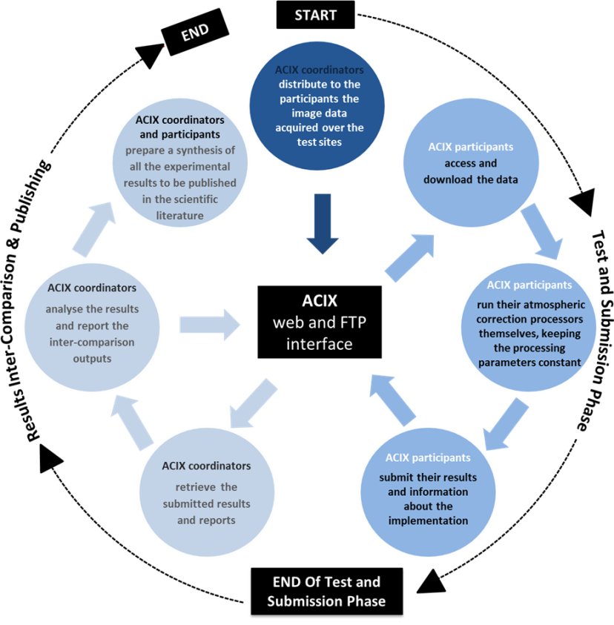
Task team ACIX (II)
Participation
14 groups from 5 countries with
15 Atmospheric Correction processors
Three-phase approach
Definition of inter-comparison protocol
Applications of the AC processors to
agreed test sites
ACIX coordinators analyze the results
Schedule
June 21-22, 2016 1st workshop (inter-comparison protocol, scenes)
October 2016 Result submission
December 2016 Analysis Report
Q1 / 2017 2nd workshop (result discussion, feedback loop)

Slide 7
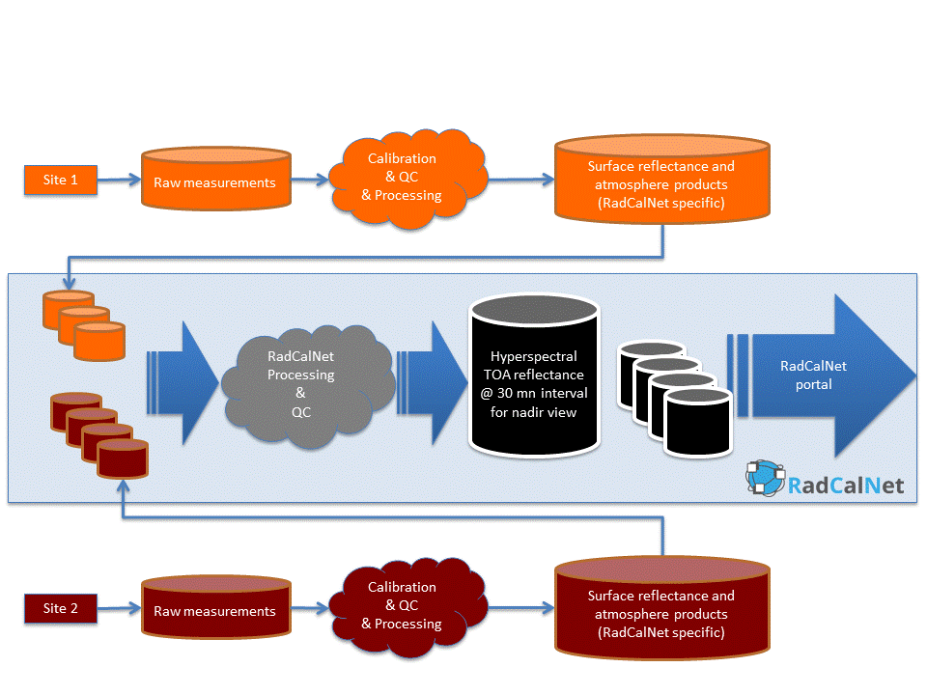
RADCALNET
Network of instrumented sites dedicated to the Radiometric Calibration of EO optical sensors
Developed in a working group
within the IVOS sub-group
(NASA, ESA, CAS, NPL, UoA, CNES)
Automated processing including quality control
Traceability vs. SI standard
Status
Beta test phase until March 2017
Portal to be operational in summer 2017

Slide 8
Carbon Action Items
WGCV Carbon tasks
Carbon action items discussed in
session 4.2
Mapping to WGCV internal tasks
see tabular at right (see “x”)
WGCV tasks grouping
allows “domino” resolution
Near-term resolution of
CA-08 & CA-34
Additional resolution of action items
in 2017
All action items will have been addressed
prior to end of 2017
Note:
Completion of some action
items can be only a snapshot
at time being, but provide
a baseline for evolution.
 | 1 | 2 | 3 | 4 | 5 | 6 | 7 | 8 | 9 | 10 | 11 | 12 | 13 | 14 | 15 | 16 | 17 | 18 | 19 | 20 | 21 | 22 | 23 | 24 | 25 | 26 | 27 | 28 | 29 | 30
1
2
3
4
5 |  |  |  |  |  |  |  |  |  |  |  |  |  |  | x |  |  |  |  | x | x |  |  |  | x
6
7 |  |  |  |  |  |  |  |  |  |  | x | x |  |  |  |  |  |  |  |  | x |  |  |  |  | x
8 |  |  |  |  |  |  |  |  |  |  |  |  |  |  |  |  |  | x |  |  |  | x
9 |  |  |  |  |  |  |  |  |  |  | x |  |  |  |  |  |  | x
10
11
12
13
14 |  |  |  |  |  |  |  |  | x | x |  |  |  |  |  |  |  |  |  |  | x
15
16
17
18
19
20 |  |  |  |  |  |  |  |  |  |  |  |  |  |  | x |  |  |  |  |  |  |  |  |  |  |  | x
21
22 |  |  |  |  |  |  |  | x | x |  |  |  |  |  |  |  |  |  |  |  |  |  |  |  |  |  |  | x
23
24
25
26 |  |  |  |  |  |  |  |  |  |  |  |  |  |  |  |  | x | x |  |  | x |  |  |  |  |  |  |  | x
27 | x | x |  |  |  | x | x |  |  |  |  |  |  |  |  |  | x
28
29 |  |  |  |  |  |  |  |  |  |  |  |  |  |  |  |  | x | x |  |  | x |  |  |  |  |  |  |  | x
30
31 |  |  |  |  | x |  |  |  |  |  |  |  |  |  |  |  |  | x
32 |  | x |  |  |  |  |  |  |  |  |  |  | x | x |  | x |  | x |  |  |  |  | x |  |  |  |  |  |  | x
33 |  |  |  |  |  |  |  |  |  |  |  |  |  |  |  |  |  |  |  |  |  |  |  | x |  |  |  | x
34 |  | x |  |  |  |  |  |  |  |  |  |  |  |  |  |  |  | x |  |  | x | x
35 |  | x
36
37
38 |  |  | x | x |  |  |  |  |  |  |  |  |  |  |  |  |  |  | x
39
40
41
42
WGCV lead
SIT 2017
May 2017
CEOS Carbon Action items

Slide 9

CEOS SAR Workshop
CEOS SAR Workshop at Tokyo Denki University hosted by JAXA
About 90 attendees from agencies, research entities and instrument provides
Abstract book with ~ 60 contributions about
Sentinel-1, RADARSAT, TerraSar/TanDEM-X, NISAR, etc. and its calibration, performance and about future measurement technologies
http://sarcv.ceos.org/site_media/static/symposion/data/ceos-2016.pdf
Plenary Session combined with WGCV plenary #41 at TDU hosted by JAXA
=> Mutual awareness and stimulation

Slide 10
Key activities from 2016
  CEOS Work Plan Deliverables
  (Some) Highlights (ACIX, RADCALNET, Carbon, CEOS SAR Workshop)
Meetings / Workshops
Interactions with other entities
Conclusion
Endorsement Items

Slide 11
Format of WGCV plenary meetings
Attendance
Level of agency participation is growing
Challenge to keep them engaged
Topical session format
Introduction of topical sessions in addition to regular reporting
Good opportunity to discuss topics in more detail
Encourages discussions with other CEOS bodies or other entities
(e.g. climate, carbon, ocean color, metrics, etc…)
Joint meeting format
Joint meeting with a sub-group workshop or another entity
Overlap enriches dedicated discussion and awareness
Both formats are beneficial to promote awareness and new stimulations

Slide 12
Meetings / Workshops
WGCV Meetings
3/2016 hosted by CSIRO/GA in Canberra (AUS) (Topical session format)
9/2016 hosted by JAXA at Tokyo Denki University (Joint meeting format)
5/2017 will be hosted by USGS in Sioux Falls (USA)
Workshops
11/2015 IVOS sub-group meeting & workshops
05/2016 LPV sub-group meeting
07/2016 MWSG sub-group meeting in cooperation with GSICS
07/2016 IVOS sub-group meeting & workshops
09/2016 SAR sub-group: CEOS SAR workshop
01/2017 ACIX Results Workshop
03/2017 IVOS sub-group meeting & workshops
ACSG workshop in cooperation with GSCIS

Slide 13
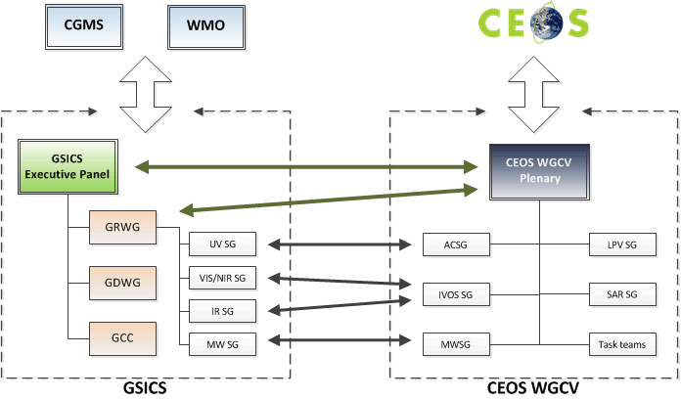
Interaction with other entities
Cooperation with GSICS
Identification of cooperation
priorities and concluded
(cf CV-03)
Cooperation on subgroup level &
working group level which includes
joint meetings of sub-groups
WGCV chair observer @ GSICS-EP
GRWG chair observer @ WGCV
Others
Interaction with IOCCG wrt Cal/Val ocean color
Participation on LSI VC telecons
Combined meeting with WGISS

Slide 14
Conclusion
Increasing trends
  Interaction with other bodies: fruitful & challenging
  Attendance by CEOS member agencies and observers
  Cross-cutting topics, e.g. metrics, etc.
Working formats (subgroups, task teams, ad hoc teams) allow
  Continuous platform for expert discussions / workshops
  Focused addressing of concrete topics with clear deliverable in frame of a consequent (& ensured) implementation plan
  Participation of WGCV members in dedicated tasks
Updated meeting formats are beneficial for WGCV
The cross-mapping of demands of other bodies with WGCV goals allows also to advance WGCV activities
Set-up of clear relationship with GSCIS
Future: Involvement of WGCV members in task responsibilities
Hand-over to incoming Chair after CEOS plenary # 30

Slide 15
Endorsement items
Working Group Terms and References
Vice-Chair Nomination

Slide 16
Endorsement of Terms of References
Working group Terms of References
CEOS Work Plan 2016-2018 Deliverable ORG-7
Rationale: Split of current work plan in
  (General) Terms of references
  Rolling work plan which includes the action items of WGCV and of its sub-bodies
Terms of References agreed in WGCV
Rolling Work plan is currently under draft (end of 2016)
(structure described in ToRs)
Request for approval of Terms of References

Slide 17
Endorsement Vice Chair Nomination
Working Group Vice Chair Nomination
Current Chair term terminates with CEOS plenary 30
Need of Vice Chair nomination
Only Candidate: Dr Cindy Chin Hui Ong
Principal Research Scientist @ CSIRO
Expertise in ground-based and airborne-based
remote sensing (imagers & optical sensors)
Current research focus with Greenhouse Gas detection including sensor development
CEOS WGCV recommends the nomination of Dr Ong
Request for endorsement of Dr Ong as incoming Vice-Chair 2016

