Slide 1
Updates on CMA Meteorological Satellite Programs
Committee on Earth Observation Satellites
WEI Caiying
National Satellite Meteorological Center, CMA
CEOS Plenary 2016
Agenda Item #
Brisbane, Australia
1st – 2nd November 2016

Slide 2
Overview
- Planning of CMA satellite systems in 2015-2025
Since 2015, CMA FENGYUN meteorological satellite programs have been included in National Space Infrastructure Plan ( 2015-2025). In NSIP， a number of atmosphere-related satellites are planned in coming decade.
Programs led by CMA
Weather Satellite series: FY-2, & FY-4 GEO
Climate & Environment Satellite series: FY-3 LEO
Programs that CMA engaged in
High Resolution Earth Observation Satellite series: GF series, by CNSA+CMA+MEP+MLR
Atmospheric Environment Monitoring Satellite series : New Series, by MEP+CMA
Joint R&D Programs
Carbon Observation Satellite program: TanSat, by MOST+CMA
Notes:
This is CMA sateliite system plan toward 2020

Slide 3
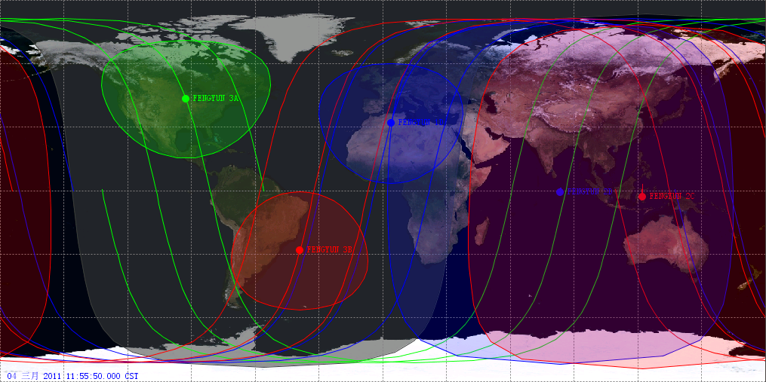
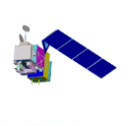
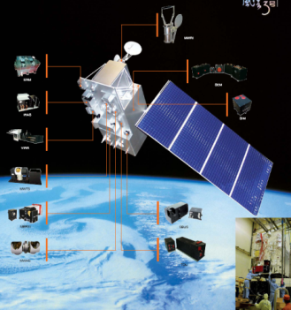
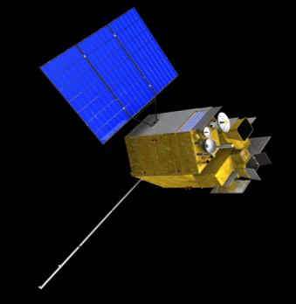
Current CMA satellite programs
LEO Programs
FY-3A/B(R&D)
FY-3C(op.)
FY-3D(op. )
GEO Programs
FY-2E/F/G(op.)
FY-4A(R&D)
Others
GF-4 (R&D，High Spatial Res. Imaging In GEO ）
TANSAT(R&D，Atmosphere Composition)
ok
Notes:
3

Slide 4
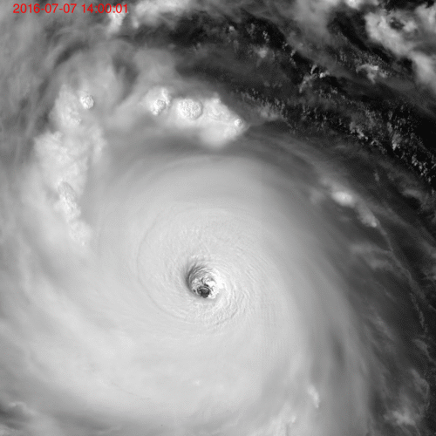
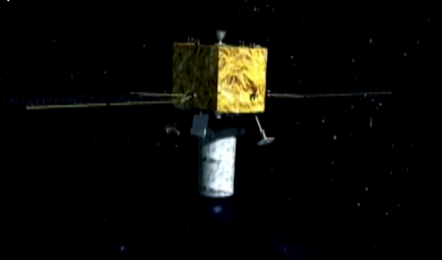
GF-4: New eyesight from GEO orbit Thpoon NEPARTEK，07-07-2016
Detector 10,000X10,000
Spatial res. 50 meters
Temporal res. 10, 20, 60s

Slide 5
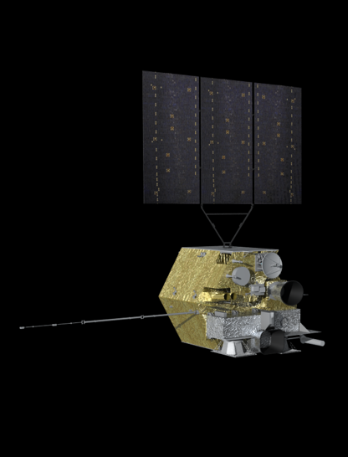
Get ready for FY-4A: -- same timeframe with GOES-R
Spacecraft:
Launch Weight: approx 5300kg
Stabilization: Three-axis
Attitude accuracy: 3″
Bus: 1553B+Spacewire
Raw data transmission : X band
Output power: >= 3200W
Design life: over 7 years
FY-4A Instruments:
AGRI: Advanced Geosynchronous Radiation Imager
GIIRS: Geo. Interferometric Infrared Sounder
LMI: Lightning Mapping Imager
SEP: Space Environment Package

Slide 6
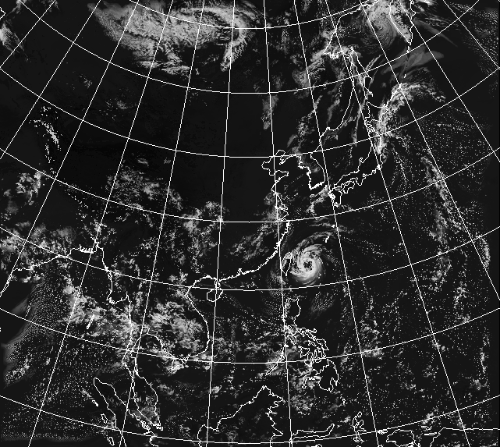
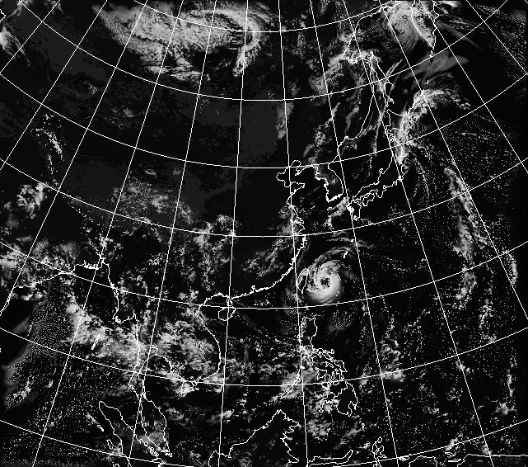
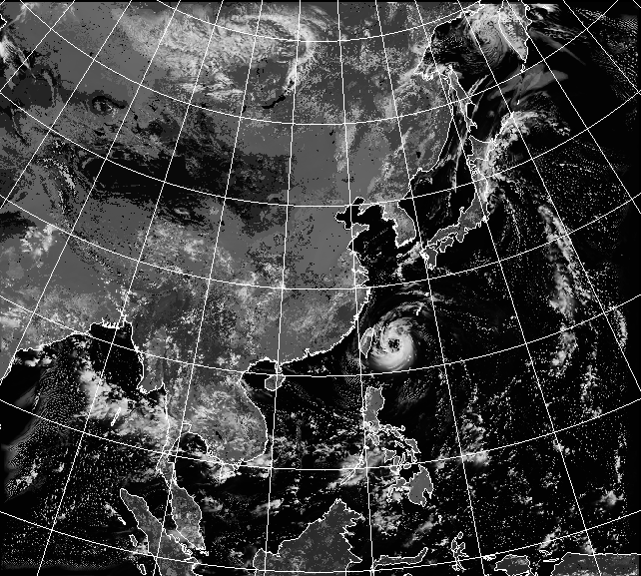
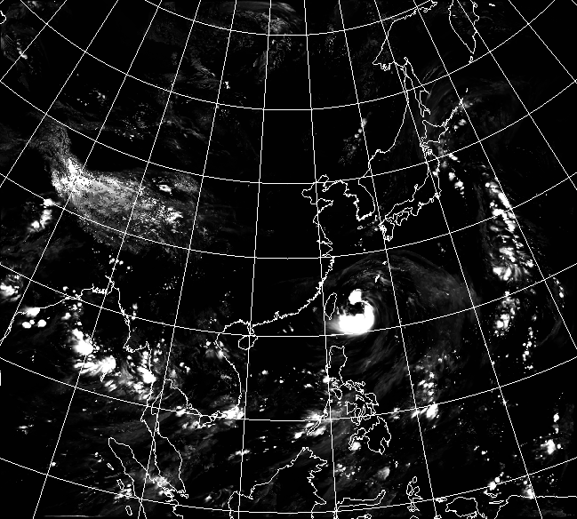
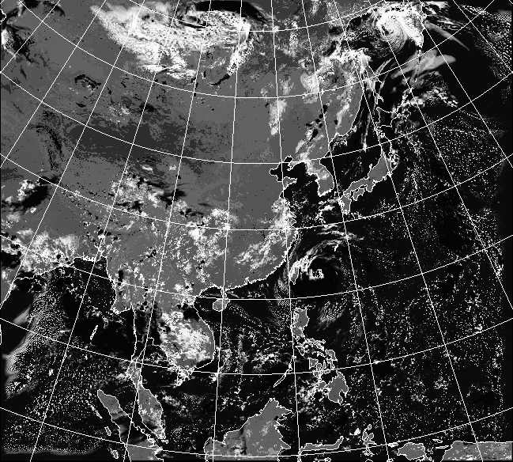
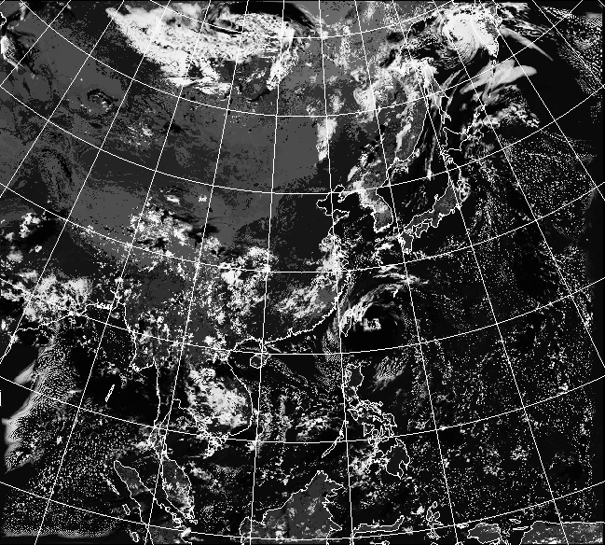
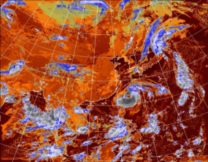
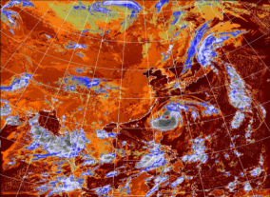
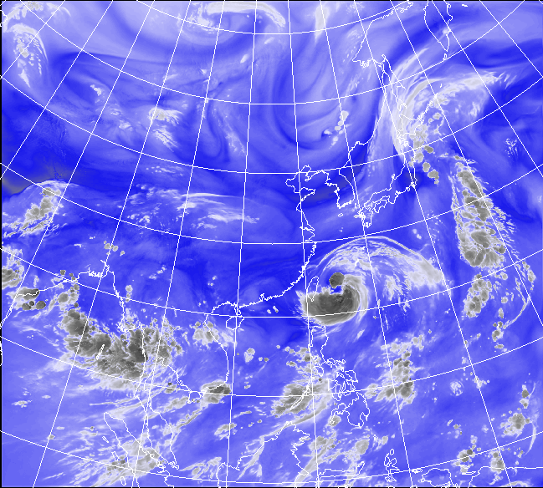
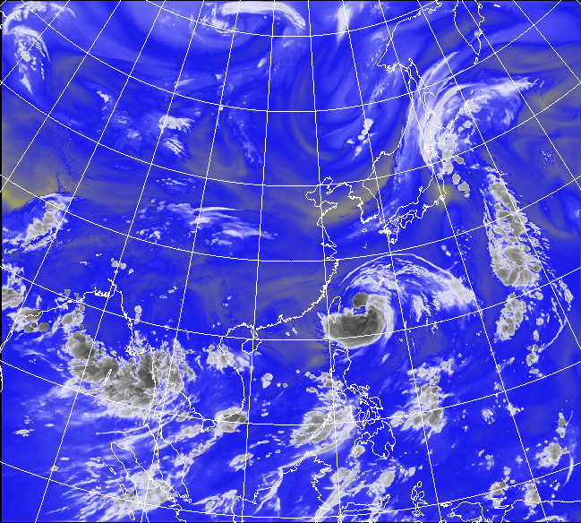
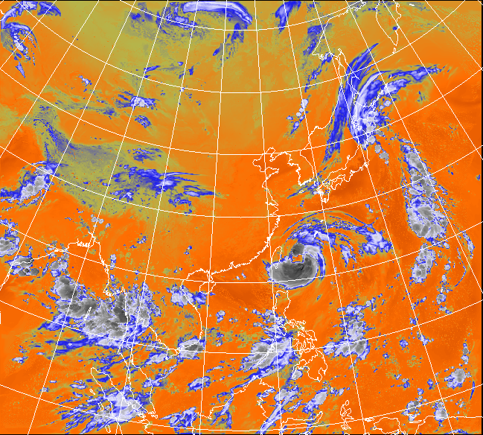
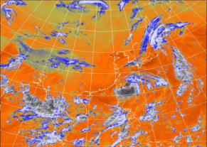
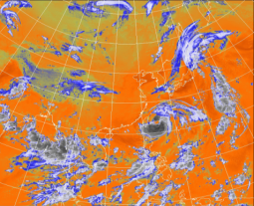
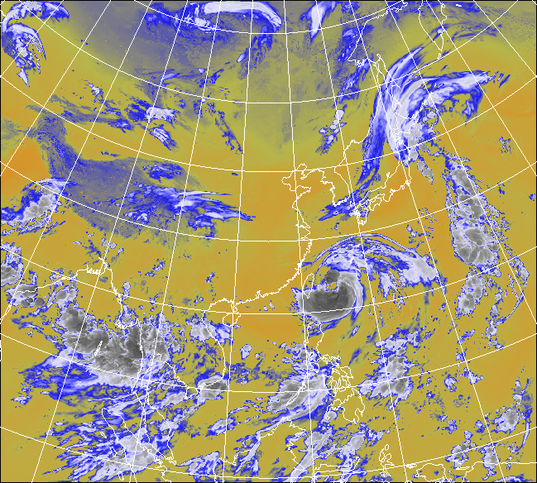
AGRI: Advance Geo. Radiation Imager
CH1 CH2 CH3 CH4 CH5 CH6 CH7
CH8 CH9 CH10 CH11 CH12 CH13 CH14
Compared with FY-2 VISSR:
Higher Spatial Resolution: VIS 1.25km -> 0.5/1km; IR 5km->2/4km
More Spectral Bands: 4 -> 14 (16)
More frequent observation: 30 min. -> 15 min. (Full Disc)/ 10min.
More flexible reginal rapid scan: 6min. -> 2.5/5 min.
More accurate calibration : VIS 5%->3%; IR 1k->0.5K

Slide 7
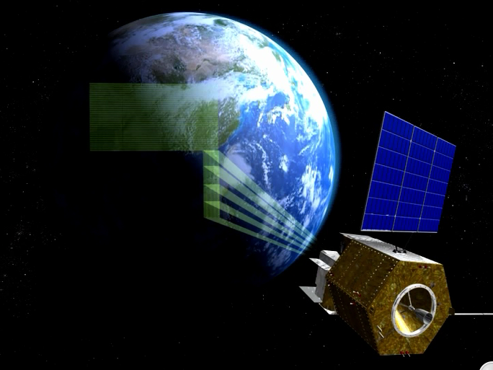
GIIRS:
First Geo. Interferometric Infrared Sounder
 | FY-4A (R&D) | FY-4B (Operational)
Spectral Parameters (Normal mode) | Range Resolution Channels LWIR: 700-1130 Cm -1 0.8 538 S/MIR:1 650-2250Cm -1 1.6 375 VIS : 0.55-0.75 μm 1 | Range Resolution Channels LWIR: 700-1130 0.625 688 S/MIR:1 650-2250 1.2 500 VIS : 0.55-0.75 μm 1
Spatial Resolution | LWIR/S/MIR : 16Km SSP VIS : 2Km SSP | LWIR/S/MIR : 8Km SSP
Operational Mode | China area 5000 × 5000 Km2 Mesoscale area 1000 × 1000 Km2 | China area 5000 × 5000 Km2 Mesoscale area 1000 × 1000 Km2
Temporal Resolution | China area <1 hr Mesoscale area <½ hr | China area <1 hr Mesoscale area <½ hr
Sensitivity (mW/m2sr cm-1) | LWIR: 0.5 -1.1 S/MIR: 0.1-0.14 VIS: S/N>200(ρ=100% ) | LWIR: 0.3 S/MIR: 0.06
Calibration accuracy | 1.5k (3σ) radiation | 1.0k (3σ)
Calibration accuracy | 10 ppm (3σ) spectrum | 5 ppm (3σ)
Quantization Bits | 13 bits | 13 bits

Slide 8
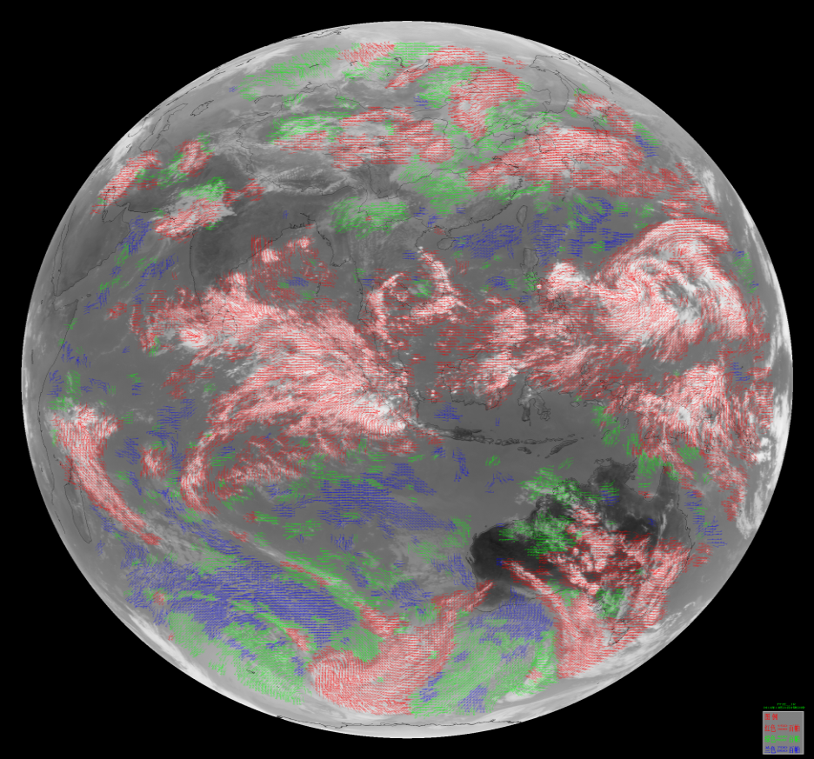
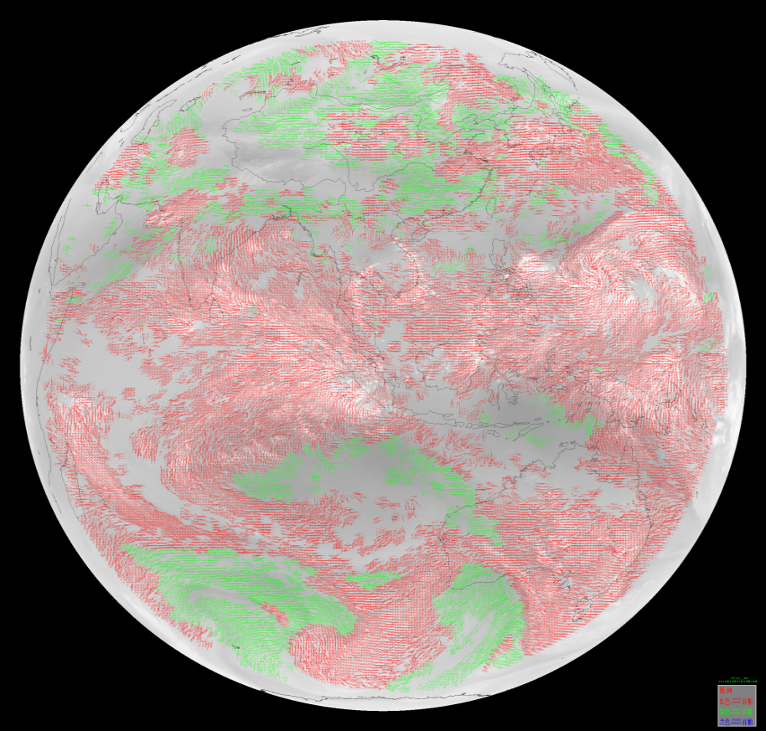
AGRI product example: AMV --to provide better NWP input
CH12 | 10.3～11.3 | 64km
CH10 | 6.9～7.3 | 64km
CH09 | 5.8～6.7 | 64km
CH02 | 0.55～0.75 | 16km
Long-wave IR Cloud-drift Winds
- Day and night; Lower, mid, and upper troposphere
Water Vapor Winds
- Cloud-top and Clear-sky; Mid and Upper troposphere

Slide 9
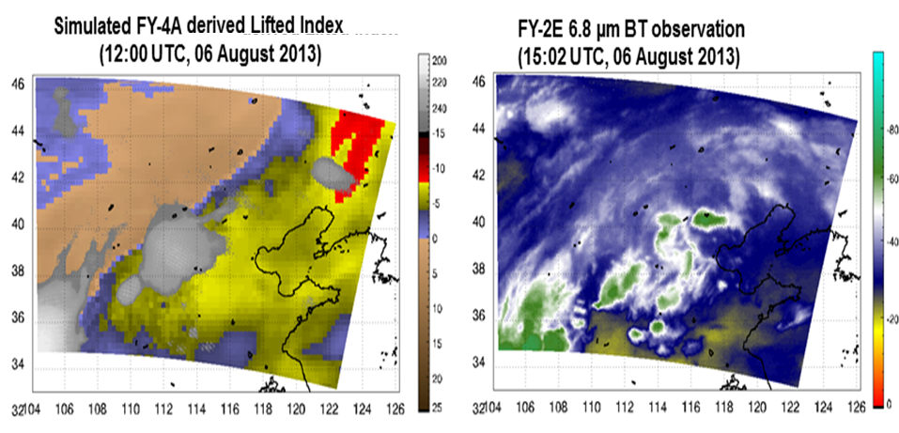
GIIRS product example: Lifted Index
--to support high impact weather monitoring and now-casting
FY-4 GIIRS LIFTED INDEX 12 UTC
FY-2E WV IMAGES 15 UTC

Slide 10
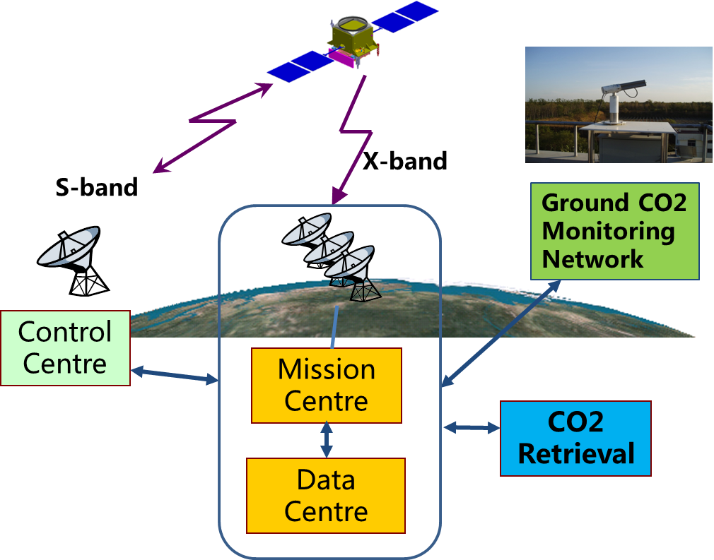
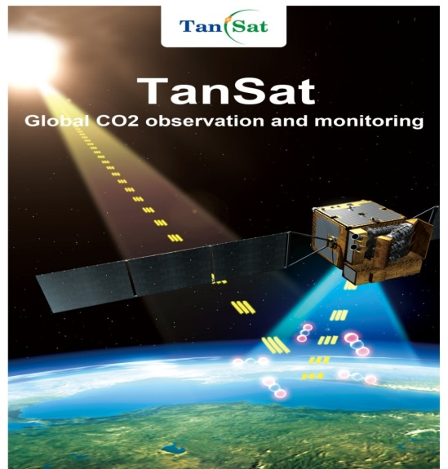
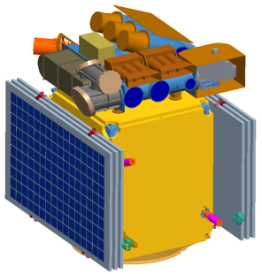
TANSAT: Global CO2 Observation and Monitoring
Mission objectives: to acquire global atmosphere column-averaged CO2 dry air mole fraction
Instruments: 1) CO2 spectrometer; 2) Cloud and Aerosol Polarize Instrument(CAPI)
TANSAT Ground segment by CMA

Slide 11
FengYun LEO Satellites Launch Plan by 2025
2015 | 2016 | 2017 | 2018 | 2019 | 2020 | 2021 | 2022 | 2023 | 2024 | 2025
FY-3D
FY-3E
FY-3F
FY-3G
FY-3H
FY-3 RF

Slide 12
FengYun GEO Satellites Launch Plan by 2025
2015 | 2016 | 2017 | 2018 | 2019 | 2020 | 2021 | 2022 | 2023 | 2024 | 2025
FY-2H
FY-4A
FY-4B
FY-4C
FY-4MW
FY-4D

Slide 13
谢谢！

